Slide 1
Professional Engagement Session Regional Band 5 Recruitment
1st May 2015

Slide 2
Do you agree that it is snowing outside?
5
Strongly Agree
Agree
Neutral
Disagree
Strongly Disagree

Slide 3
Do you agree that Interview only is a reliable method to use for AHP recruitment?
5
Strongly Agree
Agree
Neutral
Disagree
Strongly Disagree

Slide 4
Do you agree that Occupational Assessment only is a reliable method to use for AHP recruitment?
5
Strongly Agree
Agree
Neutral
Disagree
Strongly Disagree

Slide 5
Do you agree that a combination of occupational assessments and interviews are reliable recruitment methods for AHPs?
5
Strongly Agree
Agree
Neutral
Disagree
Strongly Disagree

Slide 6
Do you agree that the information provided to applicants prior to the recruitment process is comprehensive, clear and transparent?
5
Strongly Agree
Agree
Neutral
Disagree
Strongly Disagree

Slide 7
Do you agree that the management of the recruitment waiting lists is clear and transparent?
5
Strongly Agree
Agree
Neutral
Disagree
Strongly Disagree

Slide 8
Do you agree that the current recruitment assessment methods used for AHPs are fit for purpose?
5
Strongly Agree
Agree
Neutral
Disagree
Strongly Disagree

Slide 9
Who do you think is responsible for deciding the assessment process used for the Regional AHP Recruitment?
5
DHSSPS
Public Health Agency
Professional AHP Heads of Services
Human Resources/
R&S Shared Services
Centre
Health and Social
Care Board

Slide 10
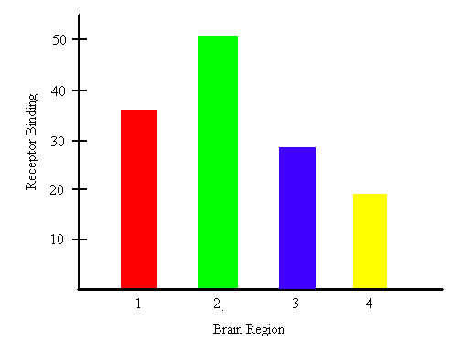
Thank-you for you Contribution

