Slide 1
Regional AHP Band 5 Recruitment Applicant Survey
April 2015
493 Responses

Slide 2
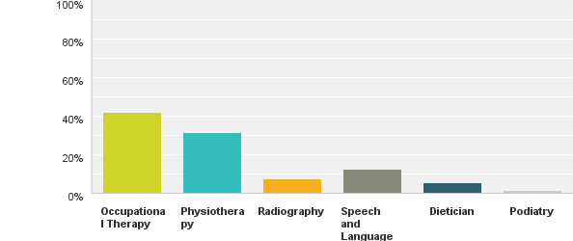
Q1. Range of Professions represented in responses
Answered: 491 Skipped: 2

Slide 3
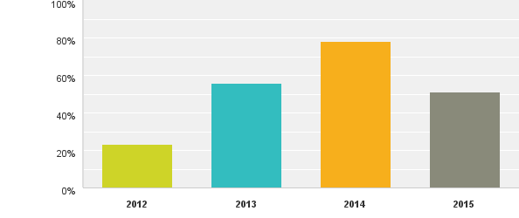
Q2 / 3. What year respondents applied – and if applied more than once how did this feel
Answered: 493 Skipped: 0
Comments Summary of Themes
Easy / Efficient Process
Disappointing – No jobs
Disheartening having to re-apply
A tough process
Stressful
Unfair – questions were not all assessing clinical ability

Slide 4
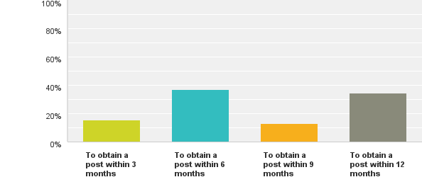
Q4. Expectations of those on the waiting list
Answered: 446 Skipped: 47

Slide 5
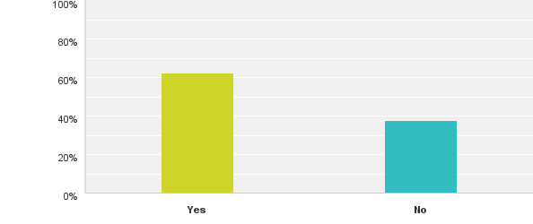
Q5. Split of Respondents by those who were / were not offered a post
Answered: 481 Skipped: 12

Slide 6
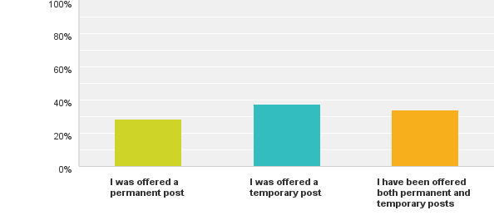
Q6. Status of the post respondents were offered:
Answered: 306 Skipped: 187

Slide 7
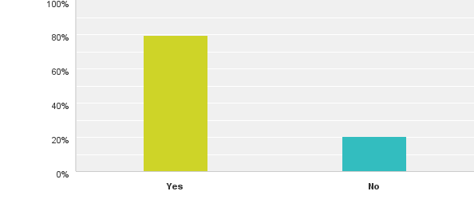
Q7: Did you accept the post you were offered?
Answered: 305 Skipped: 188
Comments Summary of Themes
Change in personal circumstances
Less hours than I was working elsewhere
Decided to relocate to another country

Slide 8
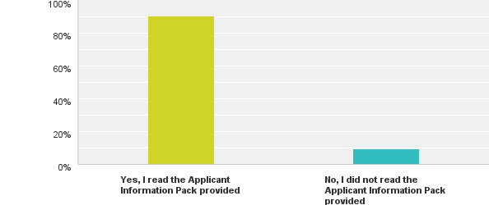
Q8: Applicant Information Packs were provided online for candidates to refer to when applying for the regional waiting list. Please confirm whether you read the information provided during your application process:
Answered: 487 Skipped: 6

Slide 9
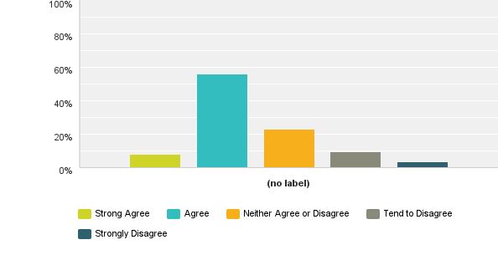
Q9: Of those who indicated 'Yes' - The quality of the information within the applicant information pack was satisfactory and relevant to the regional waiting list you were interested in?
Answered: 444 Skipped: 49
Comments Summary of Themes;
No information on Preparing for ‘Exam’
Understanding the rules of the waiting list

Slide 10
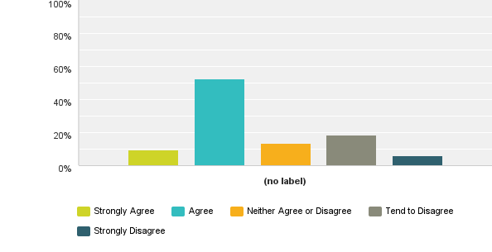
Q10: There was sufficient notice for the Selection Process?
Answered: 486 Skipped: 7
Comments Summary of Themes
If living away need more time for flights etc
Exam needs preparation – need more time to prepare.
Only found out date by word of mouth

Slide 11
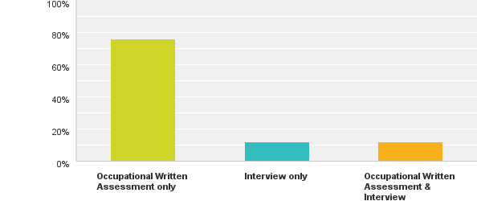
Q11: Please confirm the format of the Selection Process you undertook?
Answered: 484 Skipped: 9

Slide 12
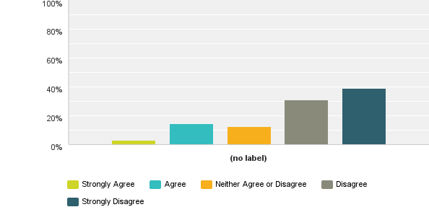
Q12: The Selection process activity you undertook allowed you to demonstrate your skills, knowledge and experience for the regional waiting list you applied for?
Answered: 487 Skipped: 6
Comments Summary of Themes;
Could not elaborate
Asked about areas no knowledge of
Didn’t take account of experience
Didn’t allow ‘showcase’ of interpersonal skills
Didn’t take account of clinical reasoning
Questions could have had more than one answer

Slide 13
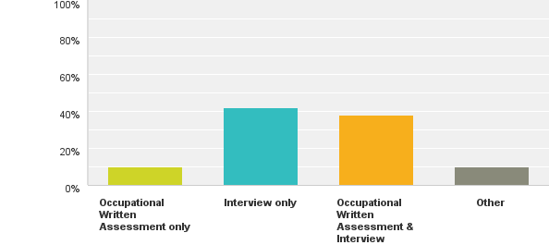
Q13 / 14: Please indicate what Selection format you think should be used to assess candidates?
Answered: 490 Skipped: 3
Comments Summary of Themes;
Practical Assessments
Case Scenario / Role Play
Group Interviews
Interview for EACH job
Interviews but not regional
Any form okay but flawed for those who don’t get jobs
Either way – no-one likes selection

Slide 14
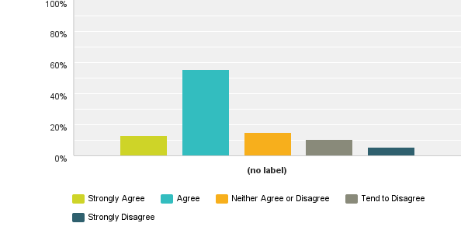
Q15: Do you believe the Selection Process activity was managed well on the day you attended and that the location was a suitable venue?
Answered: 488 Skipped: 5
Comments Summary of Themes;
Not central
Too far to travel
Room cold
Late starting

Slide 15
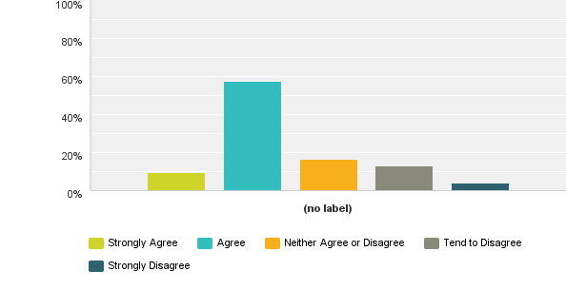
Q16: You received confirmation of your Selection Process outcome within a timely manner and were satisfied with how the communication was issued?
Answered: 484 Skipped: 9
Comments Summary of Themes;
Email impersonal
Would like a phone call
Took too long to complete process
Feedback would be helpful

Slide 16
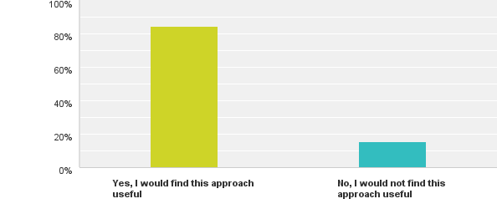
Q17: Due to the volumes of applicants, providing individual feedback to candidates is not possible. What can be offered is key themes for those who did not make it onto the regional waiting list regarding how they could improve for future applications. How useful would you find this type of feedback?
Answered: 486 Skipped: 7

