Slide 1
HIV surveillance in Northern Ireland 2018
An analysis of data for the calendar year 2017 Data taken from the 2018 report and was provided by GUM clinics
Public Health England
Regional Virology Laboratory
Antenatal Screening Programme

Slide 2
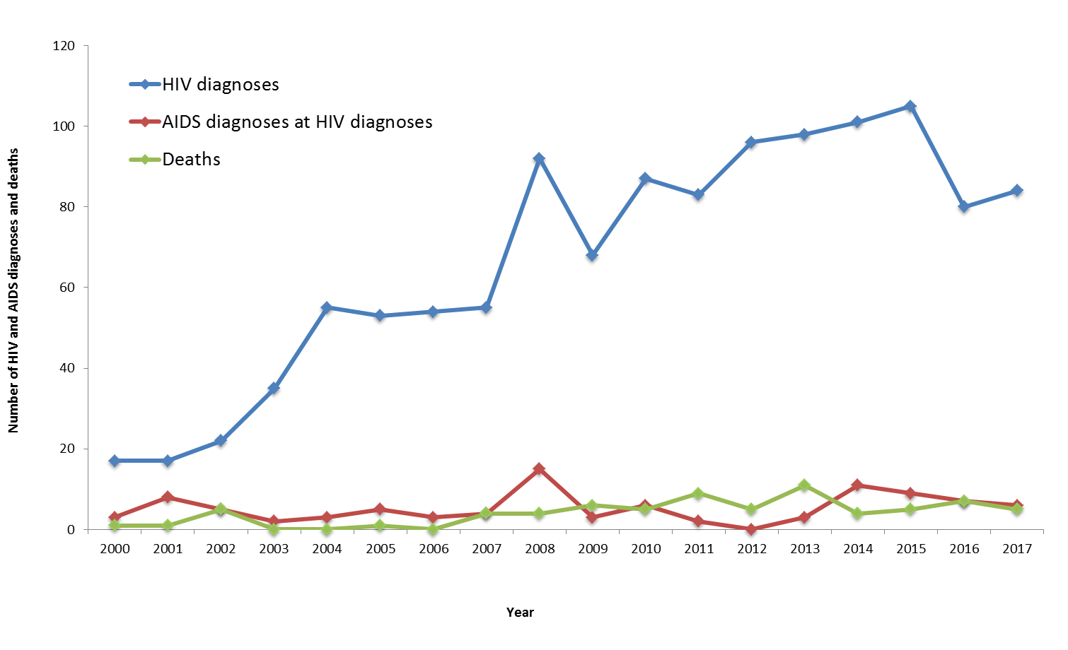
Figure 1: New HIV and AIDS diagnoses and deaths among HIV-infected persons, by year of diagnosis or death, 2000 – 2017, Northern Ireland

Slide 3
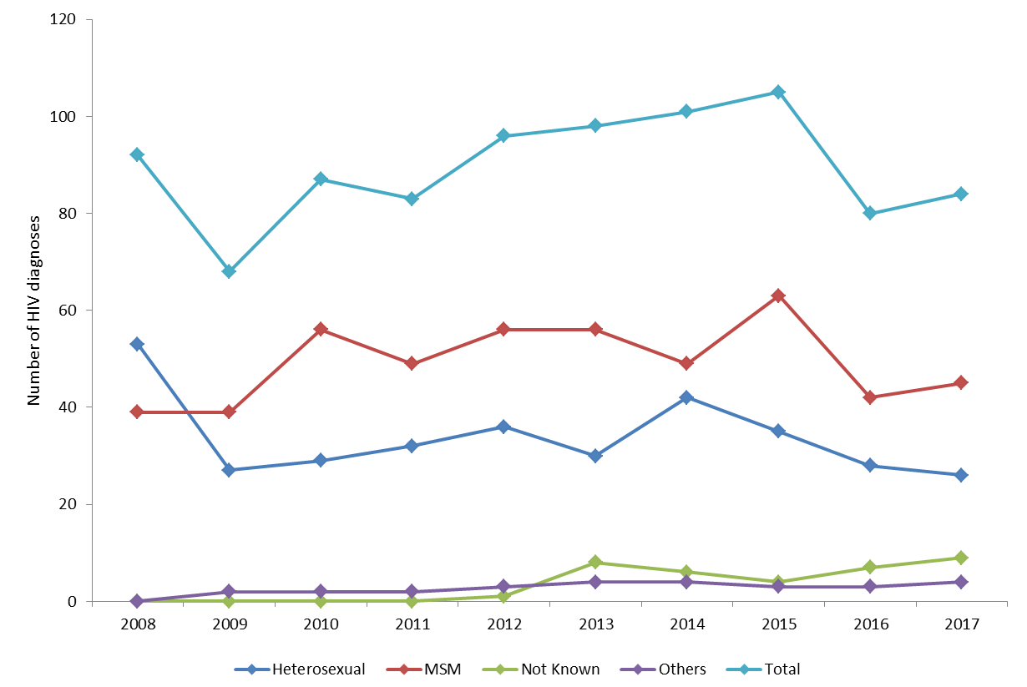
Figure 2: Annual new diagnoses of HIV by route of exposure, 2008 – 2017, Northern Ireland

Slide 4
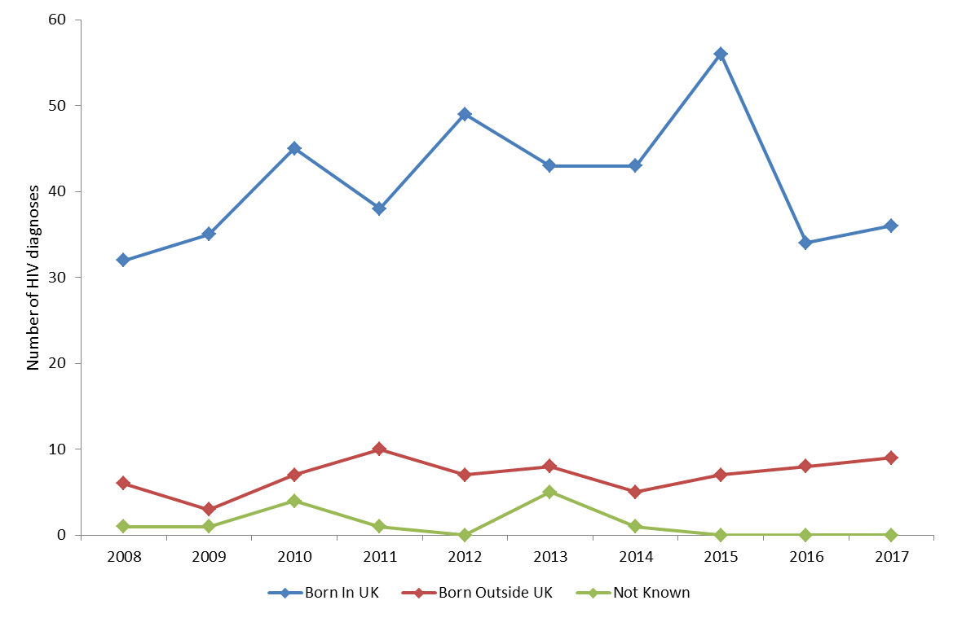
Figure 3: Annual new HIV diagnoses in MSM exposure, by region of birth, 2008 – 2017, Northern Ireland

Slide 5
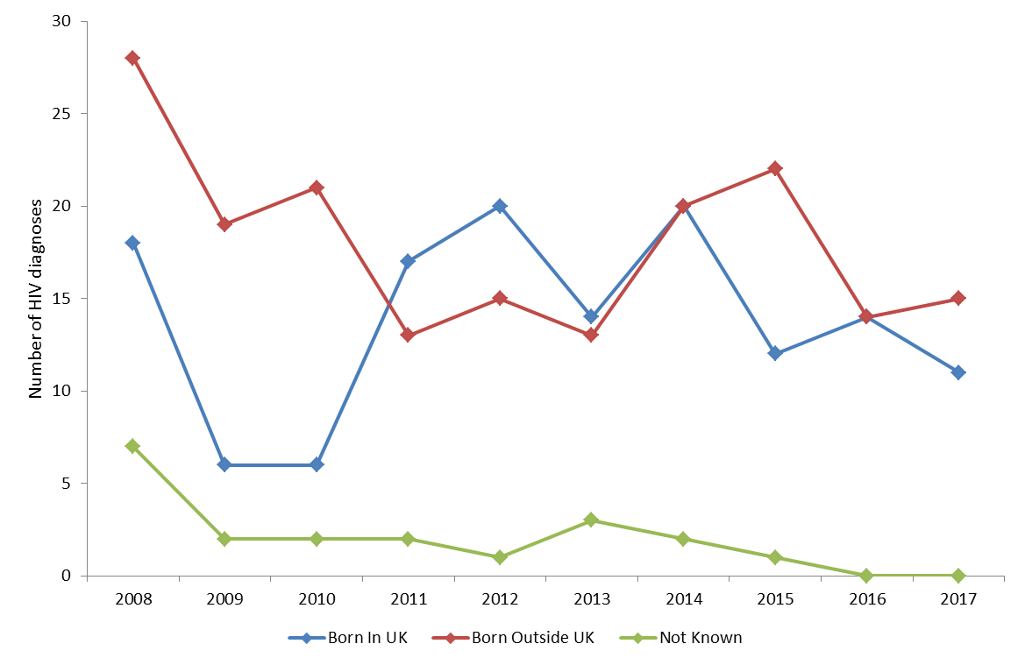
Figure 4: Annual new HIV diagnoses, in Heterosexual exposure, by region of birth, 2008 – 2017, Northern Ireland

Slide 6
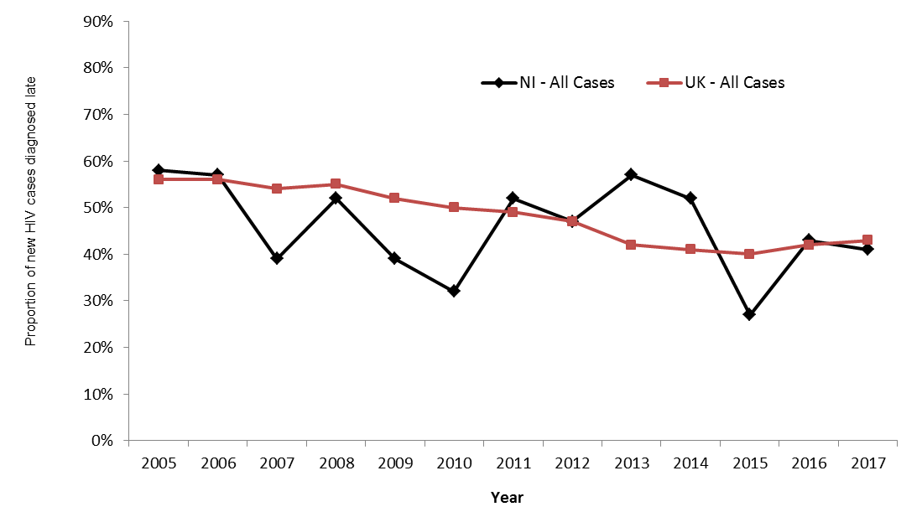
Figure 3: New HIV diagnoses by year of diagnosis, by country where infection was acquired, Northern Ireland, 2000–2016
Figure 5: Proportion of new HIV diagnoses in adults diagnosed with a CD4 count <350 cells/mm³ within 91 days of diagnosis, 2005 – 2017, Northern Ireland and UK

Slide 7
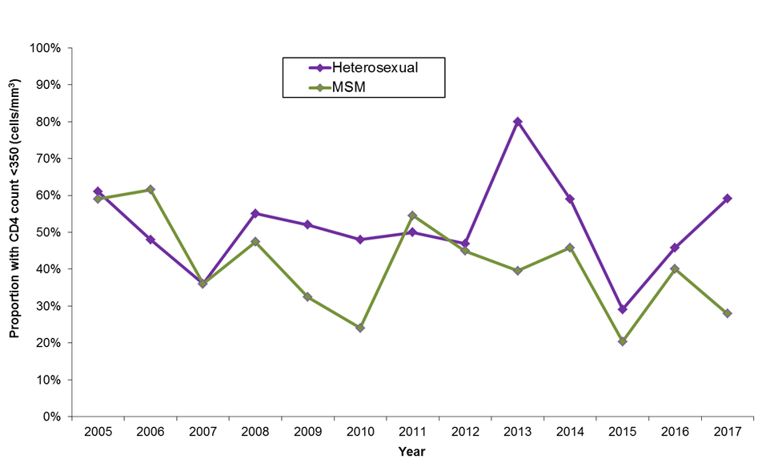
Figure 6: Proportion of new HIV diagnoses in adults with a CD4 count <350 cells/mm3 within 91 days of diagnosis, by probable route of infection, 2005 – 2017, Northern Ireland

Slide 8
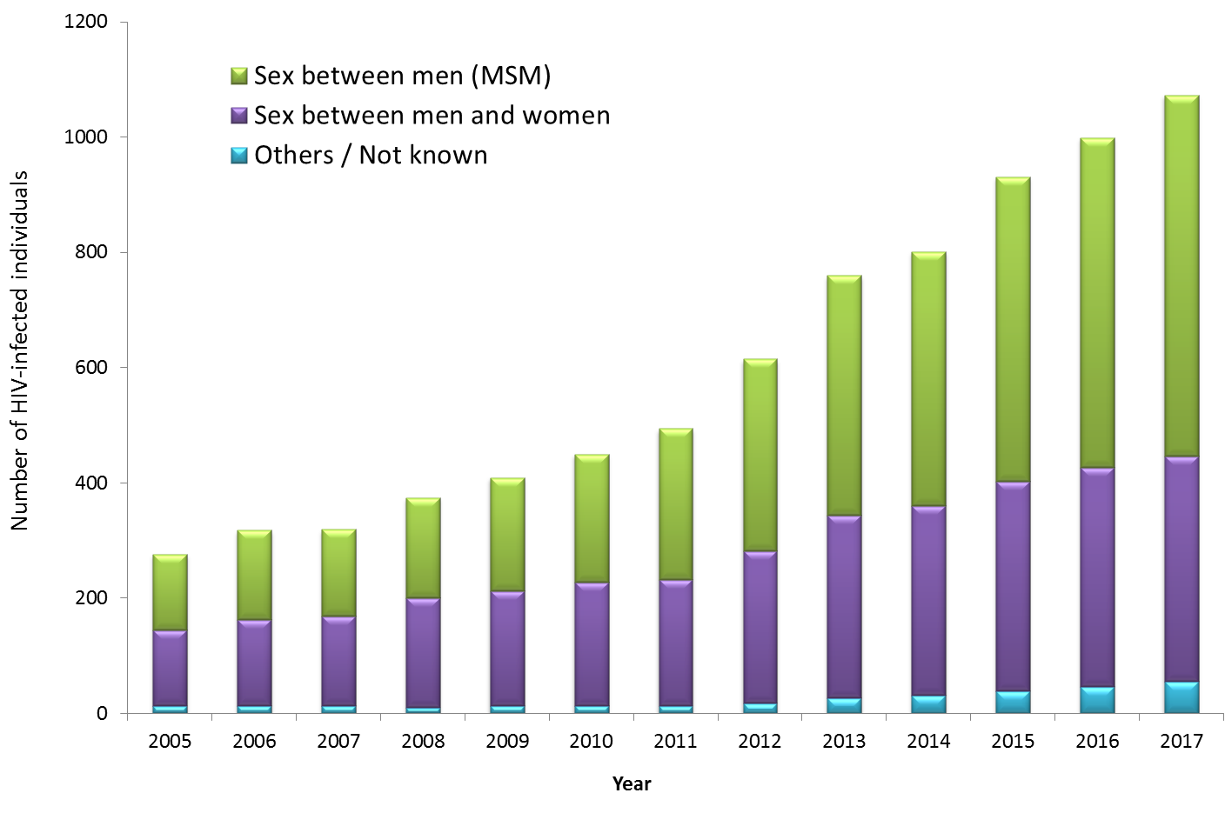
Figure 7: Annual number of HIV infected individuals resident in Northern Ireland accessing HIV-related care, by probable route of infection, 2005 – 2017

Slide 9
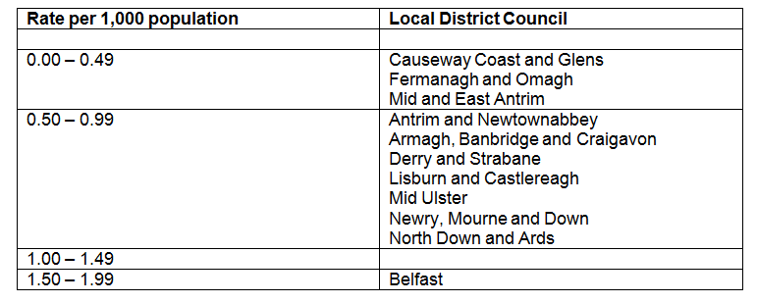
Table 1: Diagnosed HIV prevalence per 1,000 population aged 15-59 years, by Local Government District, 2017, Northern Ireland

Slide 10
Table 2: Number of HIV tests performed by healthcare setting, 2010 – 2017, Northern Ireland (excludes antenatal screening programme)

Slide 11
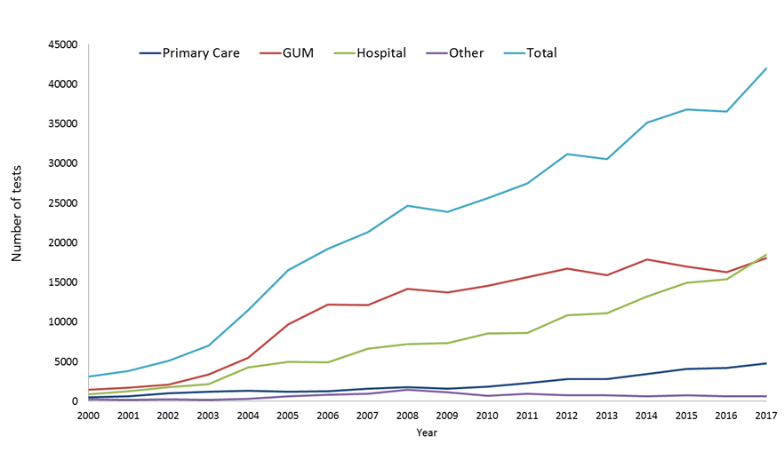
Figure 8: Annual number of HIV tests performed, by healthcare setting, Northern Ireland, 2000–2017 (excludes antenatal screening programme)

Slide 12
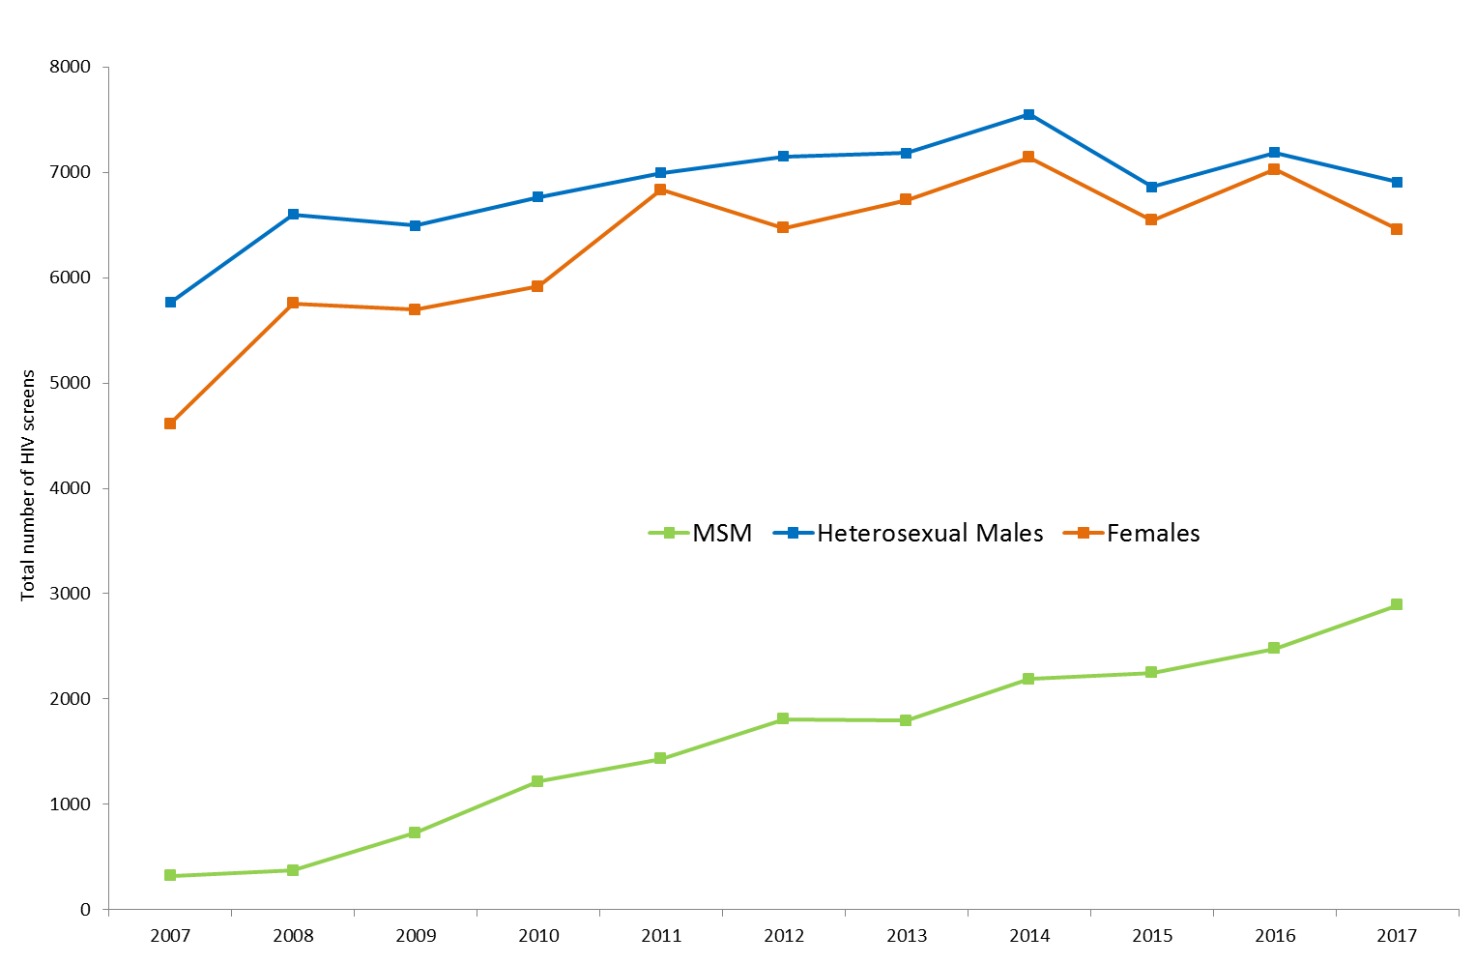
Figure 9: Annual number of HIV screens carried out in GUM clinics, 2007 – 2017, Northern Ireland Screening codes - P1A,T4, T7

