Slide 1
Changes to the infant pneumococcal conjugate vaccine schedule (PCV 13)
Training for healthcare practitioners
The Health Protection Team (PHA) would like to thanks PHE and in particular Laura Craig for permission to adapt their slides for use in Northern Ireland.
28/11/19 Alison Quinn (Health Protection Nurse, PHA)

Slide 2
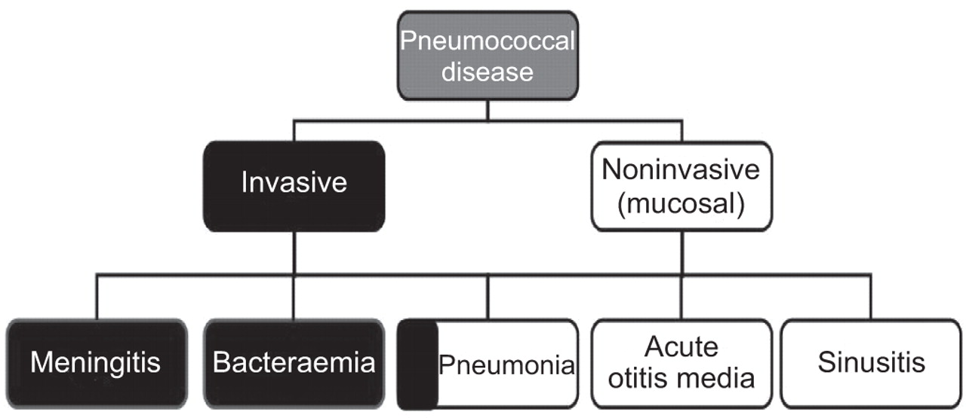
Introduction
Streptococcus pneumoniae (the pneumococcus) commonly colonises the nasopharynx of young children without causing any symptoms
Occasionally, the pneumococcus may invade locally to cause otitis media, sinusitis and pneumonia
Invasive pneumococcal disease (IPD) is rare and includes meningitis, septicaemia and bacteraemic pneumonia, which are associated with significant morbidity & mortality

Slide 3
Notes:
The objective of the immunisation programme is to protect all of those for whom pneumococcal infection is likely to be more common and / serious and this includes infants as part of the routine childhood immunisation programme.

Slide 4
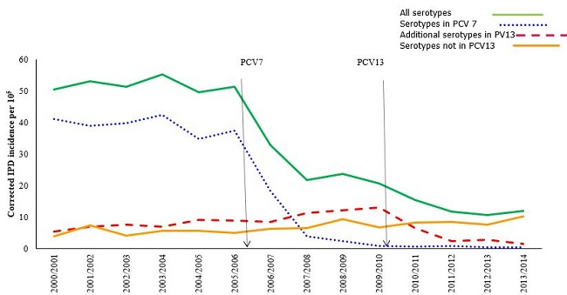
Key Points
The Routine infant PCV programme was introduced in 2006, initially using a 7-valent vaccine (PCV7)
Notes:
The routine infant PCV programme was introduced in 2006, initially using a 7-valent vaccine (PCV7).

Slide 5

Key Points
PCV-7 was replaced with a 13-valent vaccine in 2010 (PCV13)
The UK pneumococcal conjugate vaccine (PCV) immunisation programme has successfully achieved high levels of population (herd) protection for all age groups
Uptake > 90%
Notes:
This was then replaced with a 13-valent vaccine (PCV13) in 2010.
The introduction of both PCV7 and PCV13 has been associated with a large and sustained decline in pneumococcal disease due to the respective vaccine serotypes.
A small increase in pneumococcal disease due to non-vaccine serotypes (serotype replacement disease) has occurred, mainly in older adults

Slide 6
Key Points
Currently circulation of the 13 serotypes contained in the vaccine is low, and therefore, the risk of disease due to these serotypes, is very low in the UK
Multiple doses no longer required
Notes:
Because of the fact that there is very little carriage / disease due to PCV13 serotypes, multiple doses of PCV13 is no longer considered necessary in the childhood immunisation programme.
JCVI have recommended that the 2+1 schedule (8 weeks, 16 weeks and 1 year) is replaced with a 1+1 schedule (12 weeks and one year).

Slide 7
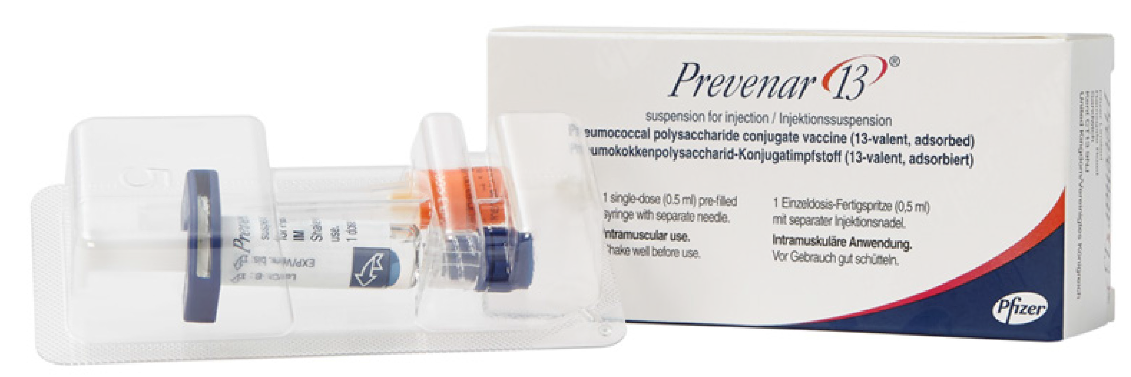
Old Schedule
Infants born on/before 31 December 2019 should continue to receive two doses of PCV 13 vaccine alongside their routine immunisations at 8 and 16 weeks of age, followed by a PCV 13 booster on / after their first birthday
2+1 PCV13 Schedule
Notes:
All infants born on / before 31 December 2019 will remain on the 2 + 1
schedule. The impact to the schedule will come into effect in late February 2020; when babies in the first cohort will no longer require an 8-week PCV dose.

Slide 8
New Schedule
Infants born on/after 1 January 2020 should be offered a single dose of PCV13 alongside routine immunisations at 12 weeks of age, followed by a PCV13 booster on / after their first birthday
1+1 PCV 13 Schedule
The 1+1 schedule should continue to provide individual protection against pneumococcal disease
Notes:
In line with the advice of the Joint Committee of Vaccination and Immunisation (JCVI) all infants born on or after 1 January 2020 will be offered the updated schedule, (referred to as a 1 + 1 PCV schedule).
This will be a single dose of PCV13 alongside the routine DTaP/IPV/Hib/HepB and rotavirus immunisations at 12 weeks of age, followed by the PCV13 booster on or after the first birthday. This 1 + 1 schedule will replace the previous schedule of 2 + 1 (at 8 and 16 weeks, and the booster dose given on or after the first birthday).
The first vaccines to be given on the new 1 + 1 schedule will start in late March 2020 when infants born on or after 1 January 2020 attain 12 weeks of age.

Slide 9

Changes to PCV13 Schedule
12 week dose will provide some protection against pneumococcal infection & prime infant’s immune system for booster dose (1 Year)
Booster dose important for individual protection, preventing carriage
Change in recommendations is supported by several studies
Move to 1+1 schedule:
Reduces number of vaccines administered at immunisation appointments
Leaves space in vaccine schedule in case there is a need to introduce new vaccines
Notes:
The 12 week dose will provide infants with some protection against pneumococcal infection and will prime their immune system so that they can make a good response to the booster dose given at 12 months of age.
The booster dose is not only important for individual protection but also in preventing carriage of pneumococcal bacteria in the nasopharynx and passing the bacteria on to others. The interruption to transmission is vital to sustaining high levels of herd protection for unvaccinated susceptible individuals achieved to date in the U.K.
The change in recommendations is supported by several studies, including a clinical trial comparing the immunogenicity of the 2+1 and 1+1 schedules.
The move to the 1+1 schedule for babies born from 1 January onwards provides an opportunity to reduce the number of vaccines administered at immunisation appointments and leaves space for any new vaccines that may need to be introduced in the future.

Slide 10

The same PCV13 vaccine will be used
Change to schedule only
Currently used Prevenar13® will be used for 1+1 schedule

Slide 11
Information for Healthcare Practitioners
Provides specific information re schedule:
that child should have depending on date of birth
including details on what to do when infants are given the incorrect schedule / infants previously vaccinated in another country using a different schedule
for infants in clinical risk groups
Link to document on PHA web-site

Slide 12
CHS 7 (Unscheduled Vaccination)
Notes:
The CHS7 unscheduled attendance form has been updated to reflect the changes to the PCV13 schedule. Instead of referring to the vaccine as the pneumococcal vaccine it is now referred to as pneumococcal conjugate vaccine (PCV).

Slide 13
CHS 7 (Unscheduled Vaccination)
Notes:
Children born on/before 31 December 2019 will require 2 PCV vaccines under the age of 12 months and they should marked in here. If however the child is born on/after the 01 January 2020 they will only receive one vaccine if given at the appropriate time and it should be marked in here too.

Slide 14
CHS 7 (Unscheduled Vaccination)
Notes:
The dose of PCV that is given when the child is 12 months / over is referred to as the PCV booster and should be marked in here.

Slide 15
Appointment card
Children born on / before 31 December 2019
Children born on / after 01 January 2020
1st PCV
2nd PCV
PCV-B (Booster)
1st PCV
PCV-B (Booster
Notes:
Instead of saying 1st,2nd and 3rd pneumococcal vaccine on the appointment card the following changes will be made:

Slide 16
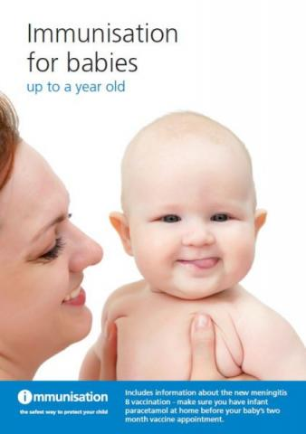

Resources
CMO letter detailing change to PCV Schedule
Green Book Chapter 25 Pneumococcal Chapter
Information for Healthcare Professionals about the changes to the PCV Programme
Immunisation for babies up to one year old
Immunisation Guidance Notes for Professionals
PHA Routine Immunisation Poster
PCV PGD

