Slide 1
STI surveillance in Northern Ireland 2019
An analysis of data for the calendar year 2018

Slide 2
STI surveillance in Northern Ireland
An analysis of data for the calendar year 2018
http://www.publichealthagency.org/directorate-public-health/health-protection/sexually-transmitted-infections

Slide 3
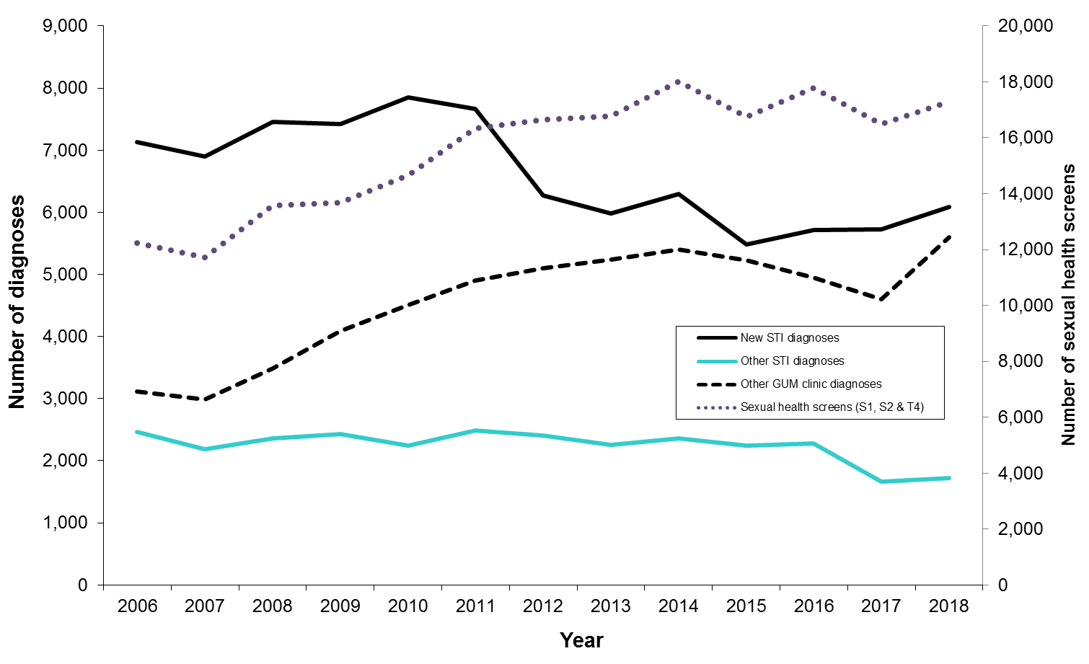
Trends in diagnoses and sexual health screens made in Northern Ireland GUM Clinics, 2006-2018

Slide 4
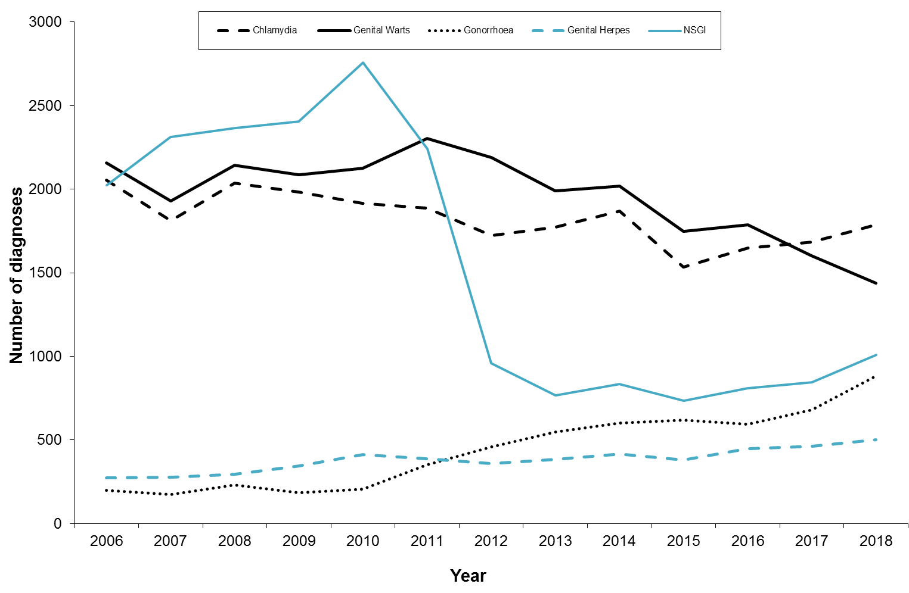
Trends in new diagnoses of STIs in Northern Ireland GUM clinics, 2006-2018

Slide 5
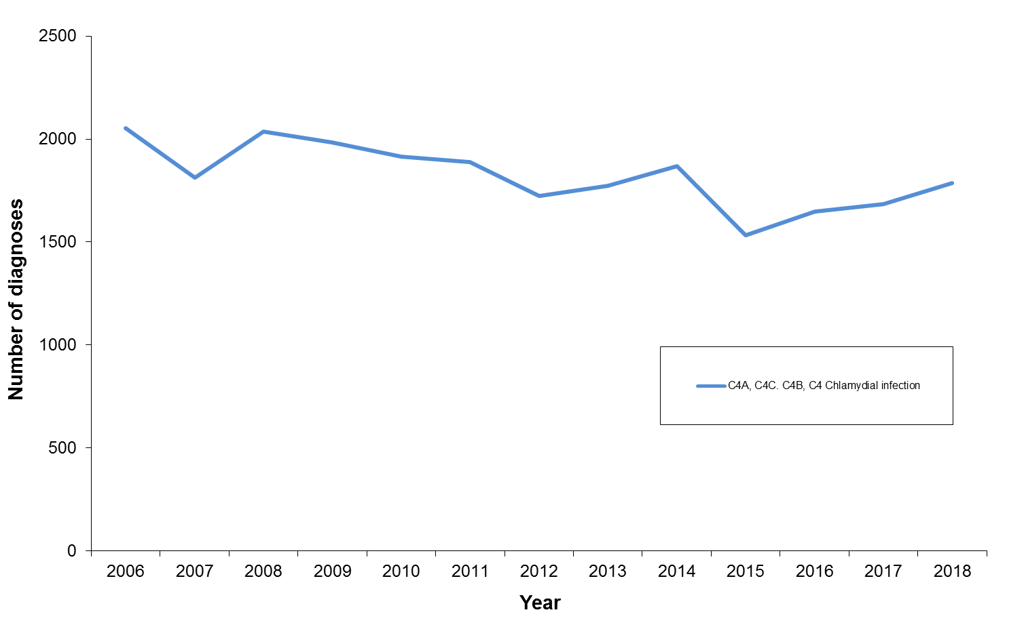
Diagnoses of chlamydial infection in Northern Ireland, 2006-2018

Slide 6
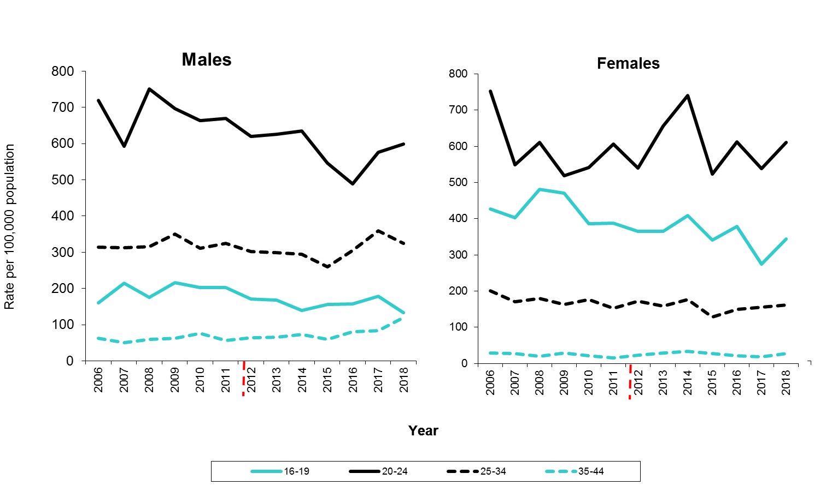
Rates of diagnosis of chlamydial infection in Northern Ireland
by gender and age group, 2006-2018
Rates have been recalculated from 2012 as a result of new coding within GUMC clinic

Slide 7
Referral source of genital Chlamydia trachomatis specimens, 2006–2018

Slide 8
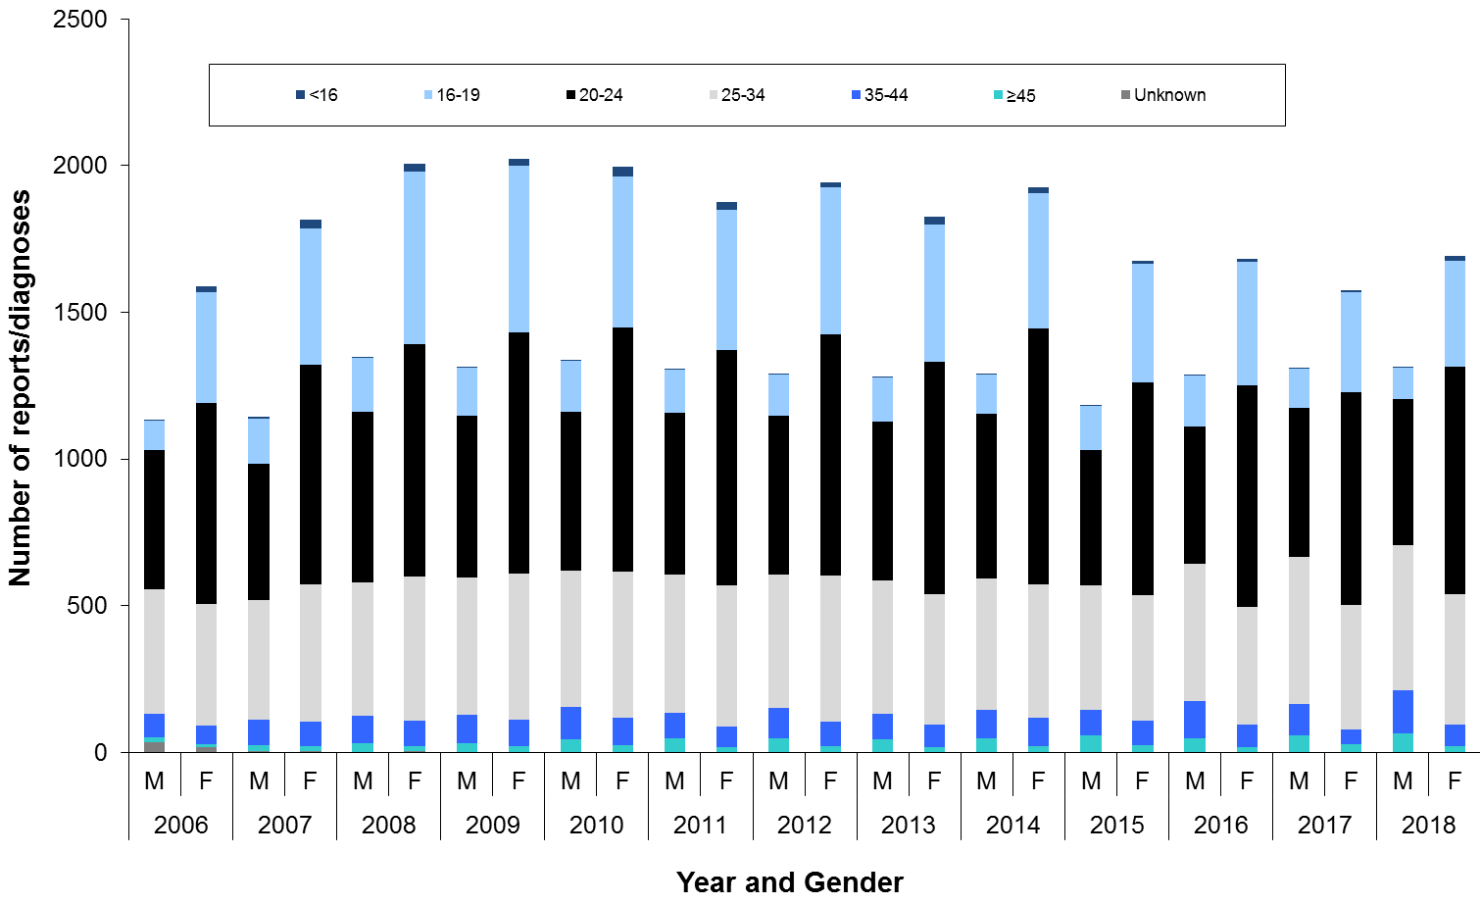
Laboratory reports of genital Chlamydia trachomatis, by age and gender, 2006–2018

Slide 9
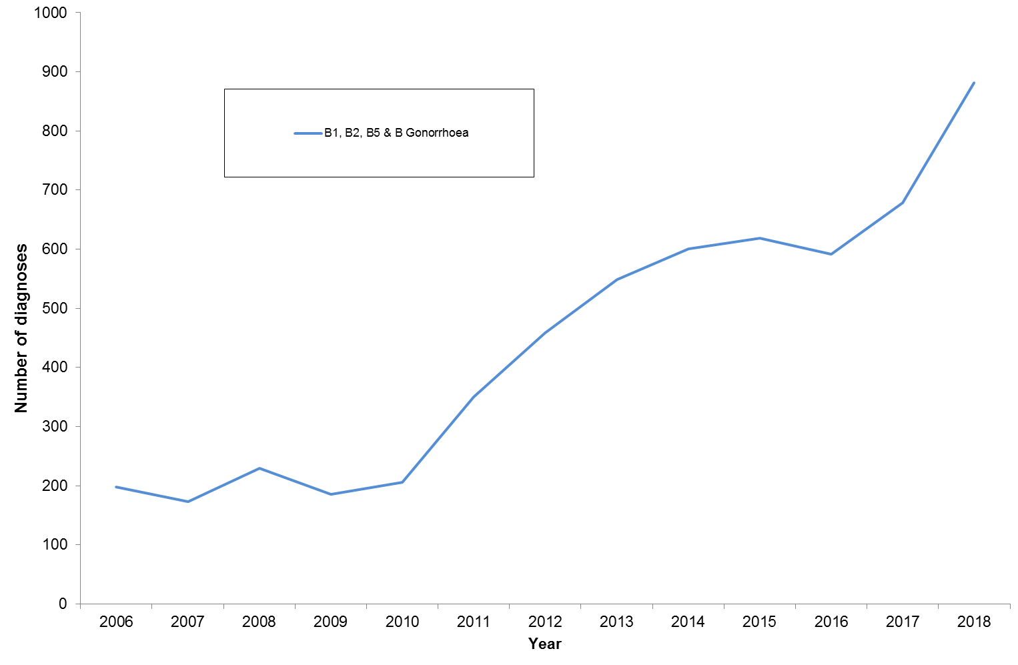
Diagnoses of gonorrhoea in Northern Ireland, 2006–2018

Slide 10
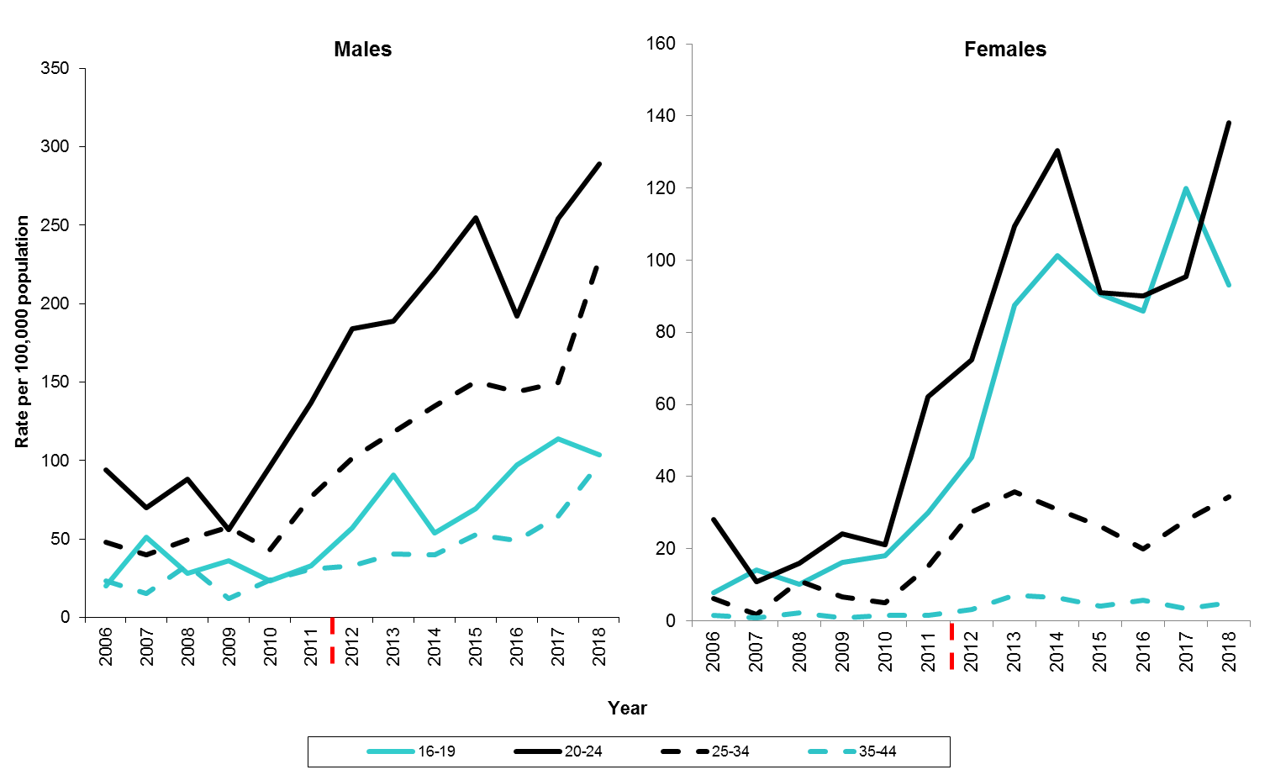
Rates of diagnosis of gonorrhoea in Northern Ireland,
by gender and age group, 2006–2018
Rates have been recalculated from 2012 t as a result of new coding within GUMC clinic

Slide 11
Number of diagnoses of gonorrhoea by sexual orientation in
Northern Ireland, 2006-2018

Slide 12
Neisseria gonorrhoeae antibiotic susceptibility reported activity for antibiotics, 2018
Source: Regional Cosurv

Slide 13
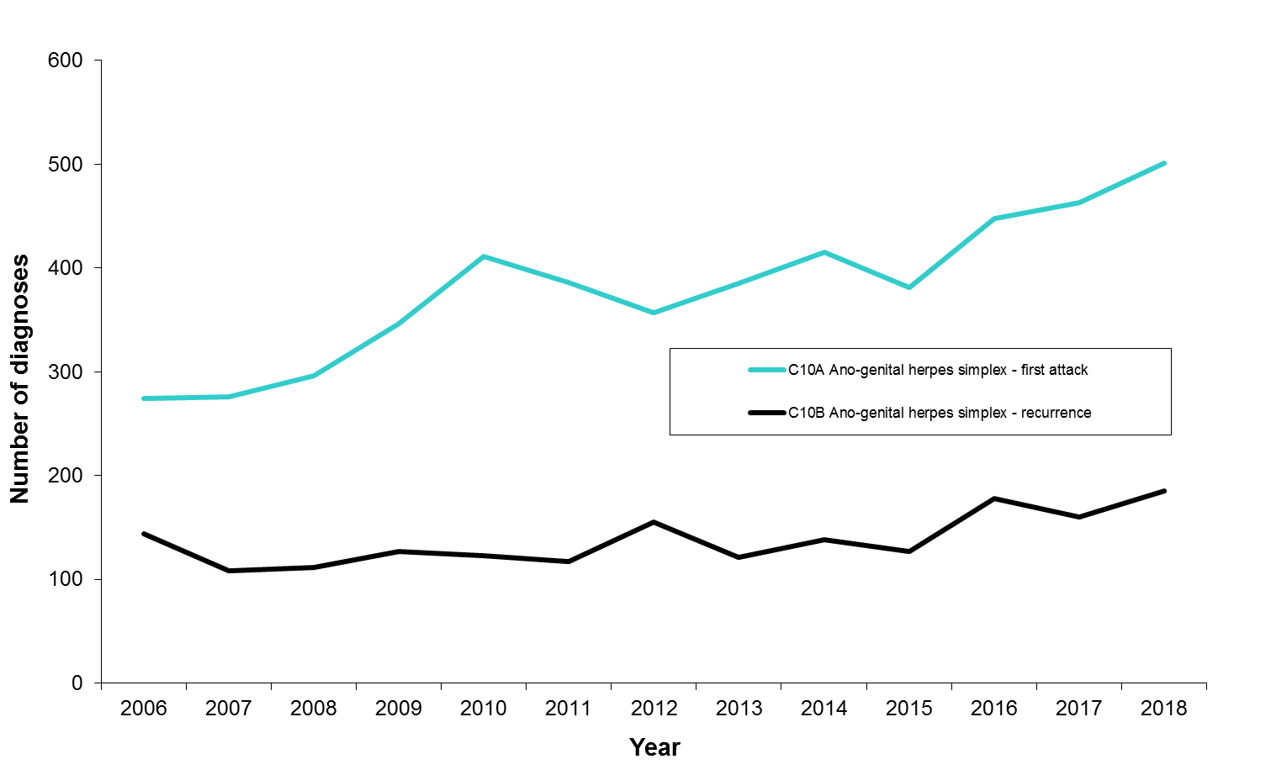
Diagnoses of genital herpes in Northern Ireland, 2006–2018

Slide 14
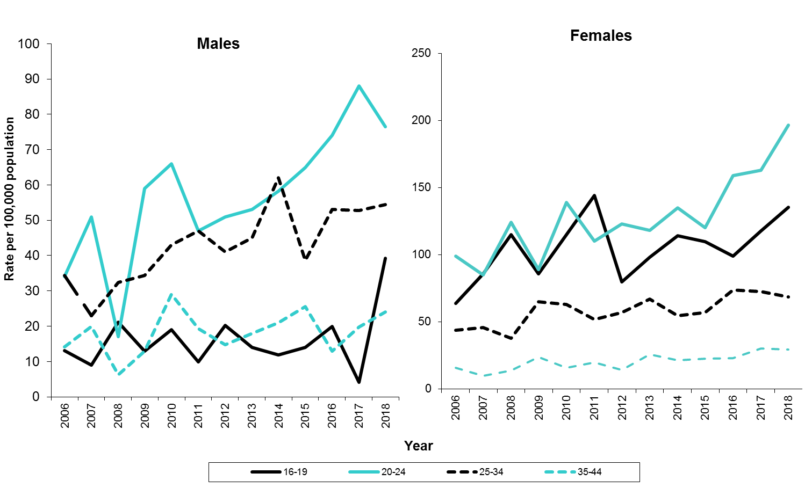
Rates of diagnosis of genital herpes (first episode) in Northern Ireland,
by age and gender, 2006–2018

Slide 15
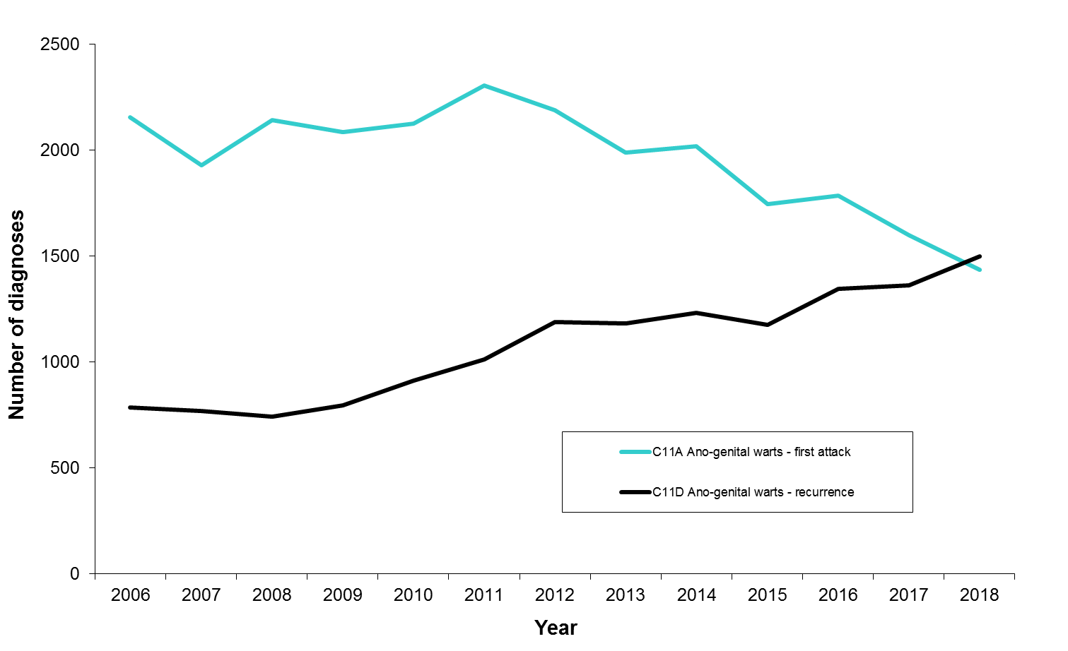
Diagnoses of genital warts in Northern Ireland, 2006–2018

Slide 16
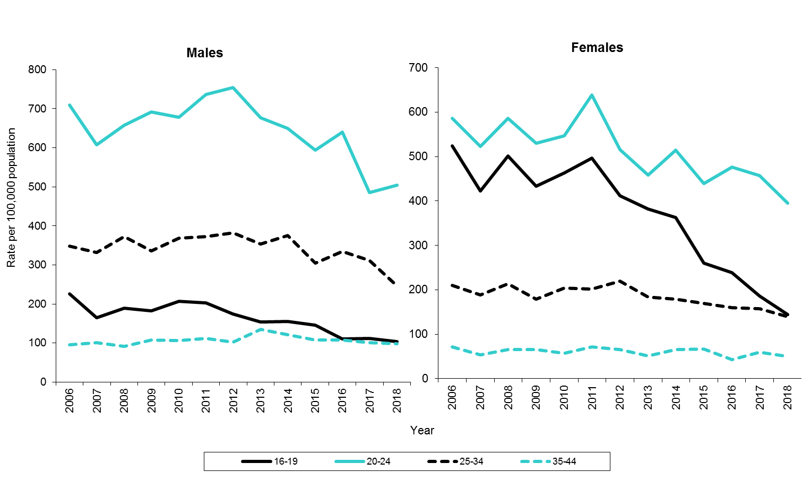
Rates of diagnosis of genital warts (first episode) in Northern Ireland,
by age and gender, 2006–2018

Slide 17
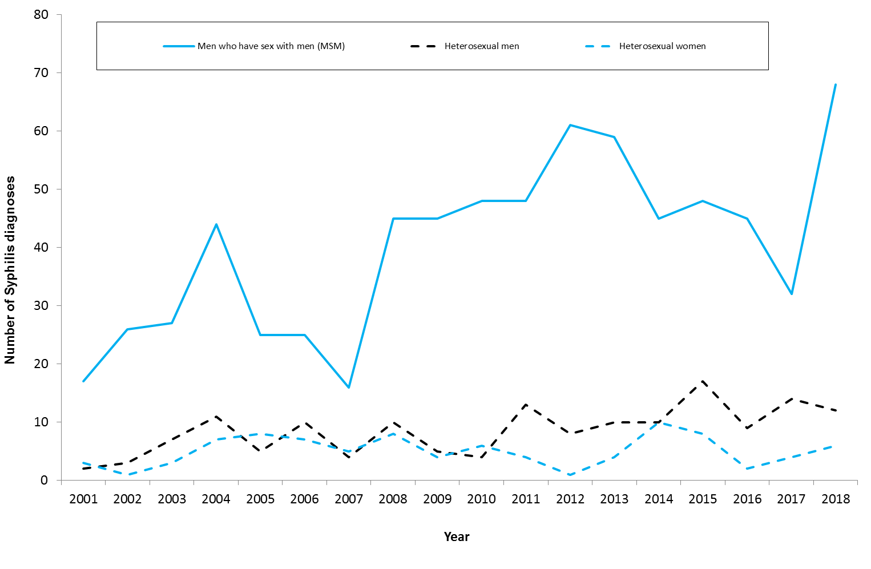
Number of syphilis* diagnoses in Northern Ireland, by gender and sexual orientation, 2001-2018
*Primary, secondary & early latent syphilis

Slide 18
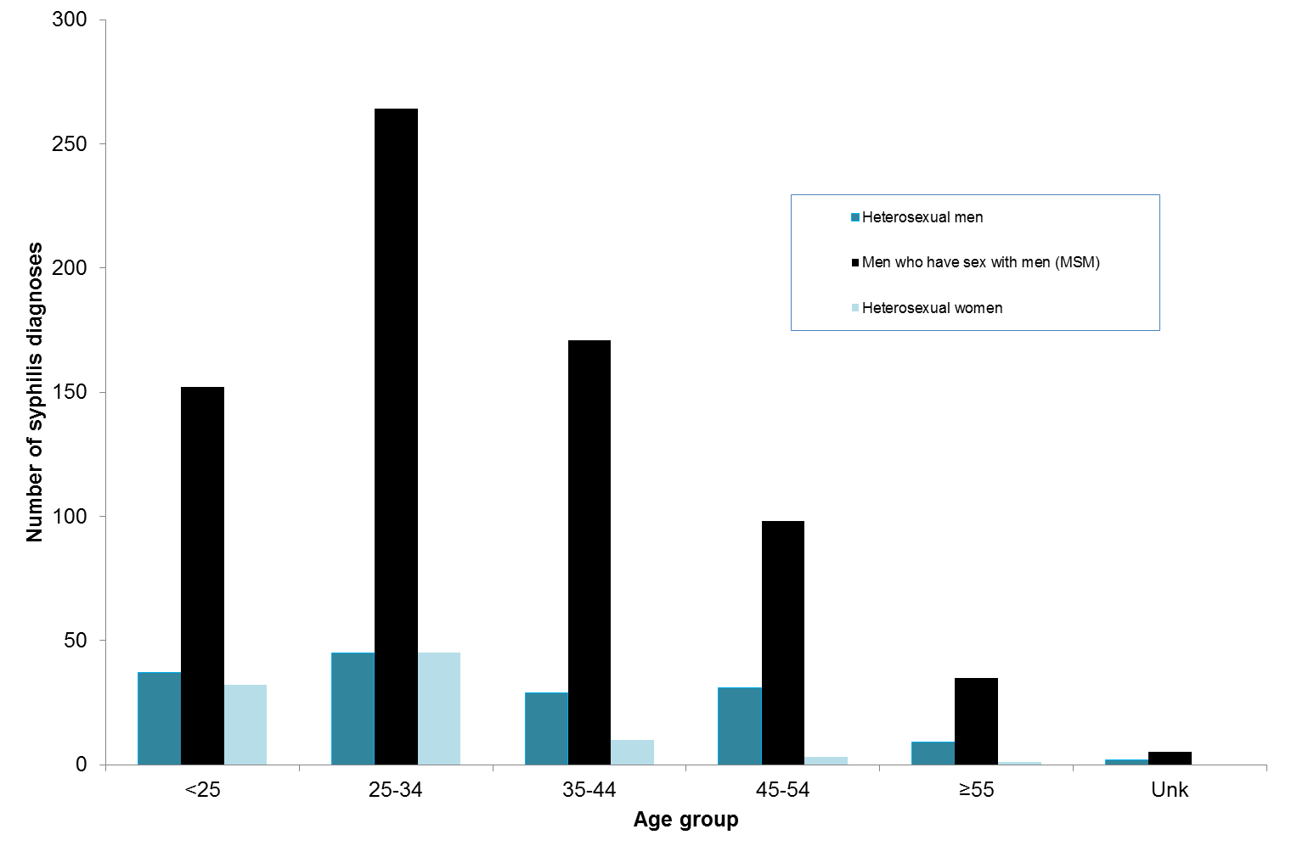
Age distribution of syphilis* diagnoses in Northern Ireland, by gender and sexual orientation, 2001–2018
*Primary, secondary & early latent syphilis

Slide 19
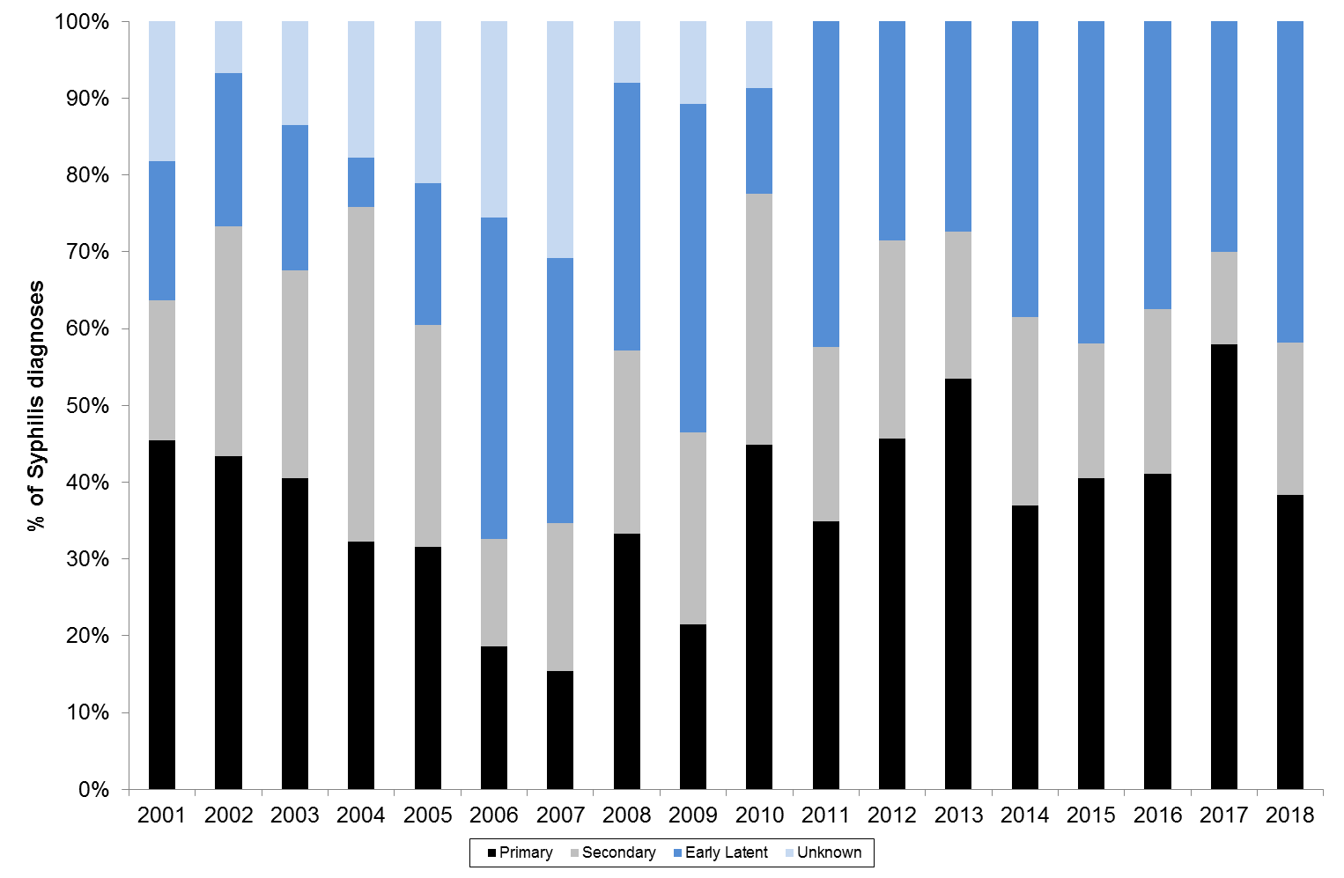
Stage of disease, by year of diagnosis, 2001-2018

