Slide 1

Flu Immunisation Programme for
Northern Ireland (2021/22)
Notes:
This training resource has been designed to educate healthcare practitioners involved in delivering the flu immunisation programme for the 2021/22 flu season. This resource does not cover the actual administration techniques involved in vaccination. If staff are required to deliver vaccinations they should refer to their line manager for additional training that may be required.

Slide 2
Key Messages
flu immunisation is one of the most effective interventions we can provide to reduce harm from flu and pressures on health and social care services during the winter
it is important to increase flu vaccine uptake in clinical risk groups because of increased risk of death and serious illness if people in these groups catch flu
In previous year only around half of patients under 65 years in clinical risk groups have been vaccinated, last year this rose to around 68%.
Influenza during pregnancy may be associated with perinatal mortality, prematurity, smaller neonatal size, lower birth weight and increased risk of complications for mother
vaccination of health and social care workers protects them and reduces risk of spreading flu to their patients, service users, colleagues and family members
by preventing flu infection through vaccination, secondary bacterial infections such as pneumonia are prevented. This reduces the need for antibiotics and helps prevent antibiotic resistance

Slide 3
Impact of COVID pandemic on 2021-22 flu vaccine programme
This year high uptake of flu vaccine is even more crucial this ever
Those most at risk from flu are also the most vulnerable to COVID-19 related morbidity and mortality. There is evidence that co-infection of COVID and flu can increase mortality.
This year, the Department of Health has obtained extra flu vaccine to maintain uptake targets for all groups and to expand eligibility to new groups
New eligible groups include: all children up to School Year 12 and household contacts of individuals that received a shielding letter during COVID
Flu vaccine will be extended to all 50 to 64 year olds this year
Delivery of the programme will be more challenging because of the likelihood of increased demand from the public and the need to achieve higher uptake whilst continuing to adhere to social distancing and Infection Control Guidance

Slide 4

Flu Overview
Influenza (or flu) is a viral infection affecting the respiratory tract
Is highly infectious and spreads rapidly in closed communities
Can be spread by people with mild / no symptoms
Usually occurs most often in an 8-10 week period during the winter
Notes:
Influenza virus causes an acute viral infection of the respiratory tract commonly referred to as flu.
Flu is highly infectious and spreads rapidly in closed communities. It is possible to have been infected with flu and to have mild / no symptoms.
Serological studies in healthcare professionals have shown that approximately
30-50% of influenza infections can be asymptomatic (Wilde et al 1999). Asymptomatic people can still transmit flu to other people.
Most cases of flu occur during an 8-10 week period during the winter months but sometimes the flu season can start earlier. It is important that people are vaccinated by the end of December to prevent infection.
4

Slide 5
Type of Influenza viruses
There are three types of flu vaccines:
Type
A viruses | Causes the majority of seasonal flu cases Always the cause of pandemics Animal reservoir – birds, wildfowl, also carried by other mammals
B viruses | Associated with low-level sporadic disease Burden of disease mostly in children Predominantly found in humans
C viruses | Minor respiratory illness only
Notes:
There are three types of influenza virus that can cause disease in humans: A,B & C. Influenza A & B are responsible for most clinical illness.
Influenza A causes the majority of seasonal flu cases and is the cause of pandemics. The virus is found in many different animals and may spread between them. Birds, particularly wildfowl, are the main animal reservoir for influenza A.
The burden of Influenza B disease is mostly in children when the severity of illness can be similar to that associated with influenza A.

Slide 6

Flu A virus
Genetic material (RNA) in the centre
Two Surface Antigens
Two surface antigens:
Haemagglutinin (H)
Neuraminidase (N)
There are 18 different types of H and 11 different types of N
e.g. H3N2 or H1N1
Notes:
This slide shows a schematic model of an influenza A virus. Influenza A is an RNA Virus and there are two antigens on the surface of the virus as illustrated.
The role of the Hemagglutinin (H) antigen is to bind to the cells of the host.
There are currently 18 known different types of H surface antigen.
The role of the Neuraminidase (N) antigen is to release the virus from the host cell surface. There are currently 11 known different types of N surface antigen.
The different types of H and N antigens are identified by numbers that when combined provide the name of the influenza A virus e.g. H3N2 / H1N1.

Slide 7
Antigenic Drift
Minor changes (natural mutations) in the genes of flu viruses that occur gradually over time
Antigenic Drift
Notes:
Influenza A viruses are prone to antigenic variation / changes in the principal surface antigens.
Minor changes described as antigenic drift occur progressively from season to season.
The slide describes antigenic drift. These are minor changes that occur gradually over time and are occur progressively from season to season. This means that the circulating strain will differ every year and is the reason why the flu vaccine if given every year as the content may change.

Slide 8
Antigenic Shift
Two or more different strains combine. This abrupt major change results in a new subtype. Immunity from previous flu infections/vaccinations may not protect against the new subtype, potentially leading to a widespread epidemic or pandemic
Antigenic Shift
Notes:
Influenza A virus can also change abruptly when 2 or more different strains of influenza A combine, resulting in antigenic shift and a new subtype of influenza A, to which little / no immunity exists within the general population.
This potentially leads to a widespread epidemic / pandemic.
The World Health Organization (WHO) convenes a group that reviews the global influenza situation (once each year for the northern hemisphere and once for the southern hemisphere) and recommends which flu strains should go in the seasonal vaccine to be produced by manufacturers for the following season six to eight months later. This recommendation is based on information about the circulating viruses and epidemiological data from around the world at that time.
Trivalent vaccines e.g. aTIV contain two subtypes of influenza A and one B virus.
Quadrivalent vaccines for example Fluenz tetra intranasal vaccine (LAIV)/ the Sanofi Pasteur Quadrivalent Influenza vaccine (QIVe) / Flucelvax Tetra (QIVc)) offer additional protection against a second strain of influenza B.
The use of quadrivalent flu vaccines is expected to improve the matching of the vaccine to the circulating B strain(s).

Slide 9
Features of flu
  Easily transmitted by droplets, small-particle aerosols and by hand to mouth/eye contamination from a contaminated surface or respiratory secretions of infected person
  People with mild or no symptoms can still infect others
  Incubation period 1-5 days (average 2-3 days) though may be longer especially in people with immune deficiency
  Common symptoms include:
    Sudden onset of fever, chills, headache, muscle and joint pain and extreme fatigue
    Dry cough, sore throat and stuffy nose
    In young children, gastrointestinal symptoms such as vomiting and diarrhoea, may be seen
Notes:
Flu is easily transmitted by droplets, small particle aerosols and by hand to mouth/eye contamination from a contaminated surface or respiratory secretions of an infected person.
Serological studies in healthcare professionals have shown that approximately 30 to 50% of influenza infections can be asymptomatic¹ but the proportion of influenza infections that are asymptomatic may vary depending on the characteristics of the influenza strain.
In healthy individuals, flu is usually unpleasant but self-limiting with recovery within 2-7 days⁶. Common symptoms include fever, chills, muscle and joint pain and extreme fatigue. Symptoms may also include dry cough, sore throat and stuffy nose. Young children may also experience gastrointestinal symptoms such as vomiting and diarrhoea.

Slide 10
Possible complications of flu
Common:
  Bronchitis
  otitis media (children), sinusitis
  secondary bacterial pneumonia
Less common:
  meningitis, encephalitis, meningoencephalitis
  primary influenza pneumonia
Risk of most serious illness is higher in
      children under six months
      older people
      those with underlying health conditions such as respiratory disease, cardiac disease, long-term neurological conditions or immunosuppression
      pregnant women (flu during pregnancy may be associated with perinatal mortality, prematurity, smaller neonatal size and lower birth weight)
Notes:
Common complications of flu include bronchitis, otitis media in children, sinusitis and secondary bacterial pneumonia. Less commonly flu causes meningitis, encephalitis, meningoencephalitis and primary influenza pneumonia.
The risk of serious illness from flu is higher among children under six months of age, older people and those with underlying health conditions such as respiratory disease, cardiac disease or immunosuppression, as well as pregnant women. Flu in pregnancy is associated with perinatal mortality, prematurity, smaller neonatal size and lower birth weight.

Slide 11
Flu vaccine effectiveness (VE)
The UK has a well-established system to monitor influenza VE each season using data from primary care schemes in England, Scotland, Wales and Northern Ireland
VE varies from one season to the next
Growing flu viruses in eggs results in egg-adapted changes that cause differences between the viruses in the vaccine and the ones that circulate and thus reduce their effectiveness
Over the years, efficacy of the standard egg grown flu vaccines has been calculated around 50-60% for adults aged 18 to 65 years
Efficacy in elderly has always been lower for the non-adjuvanted egg grown inactivated vaccines
Adjuvented vaccines are used in this group because they have been shown to be more effective in reducing incidence of severe disease including bronchopneumonia, hospital admissions and mortality.

Slide 12
Flu vaccine effectiveness for last year - 2020/21
Flu levels last year were exceptionally low, as were other common respiratory viruses such as RSV.
The majority of cases of respiratory viral infection were for COVID-19
While vaccination will have contributed – COVID-19 prevention measures were also significant factors in the low levels of influenza.

Slide 13
Flu epidemiology

Slide 14
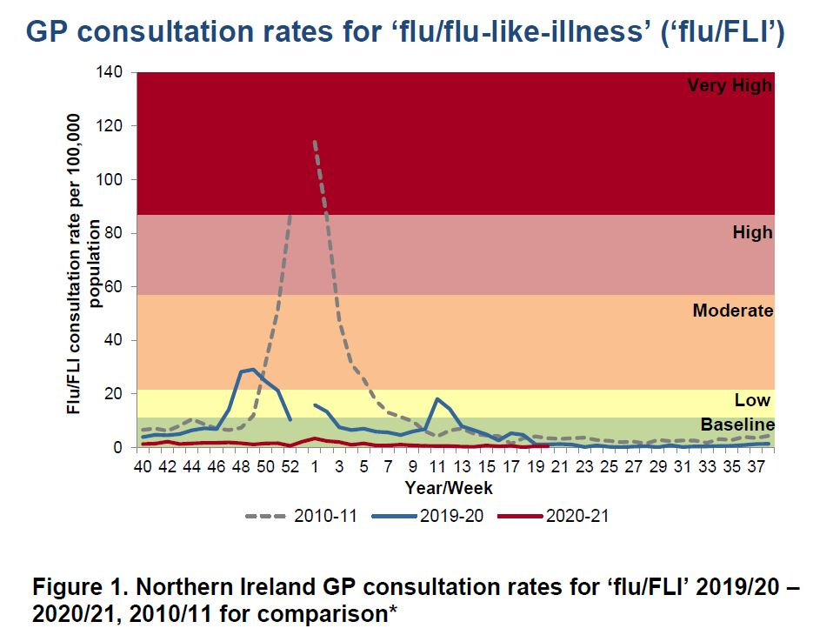
GP flu/FLI consultation rates
The baseline MEM threshold for Northern Ireland is 11.3 per 100,000 population for 2020-21. Low activity is 11.3 to <21.8, moderate activity 21.8 to <57.0, high activity 57.0 to <87.1 and very high activity is >87.1
Notes:
This graph shows the rate of influenza/influenza-like illness episodes in Northern Ireland per 100,000 consultations in primary care for the 2010/11 flu season, 2019/20 season, and 2020/2021. The data show that although flu viruses circulate each winter season, the degree of activity varies substantially.
Last year (2019/20), lower levels of flu activity were seen in 2019/20, and 2020/21 in comparison with 2010/11.

Slide 15
Weekly number of flu laboratory reports with weekly
GP consultation rates for ‘flu/FLI’ and proportion positivity
Note: there was no epidemiological week 53 in the 2019-20 seasonal influenza season
Notes:
Slide 15 – The weekly GP consultation rate for ‘flu/FLI’ remained below the baseline threshold for the duration of the 2020/2021 flu season. The rates observed were at a lower intensity level than observed in previous seasons. Low influenza activity.

Slide 16
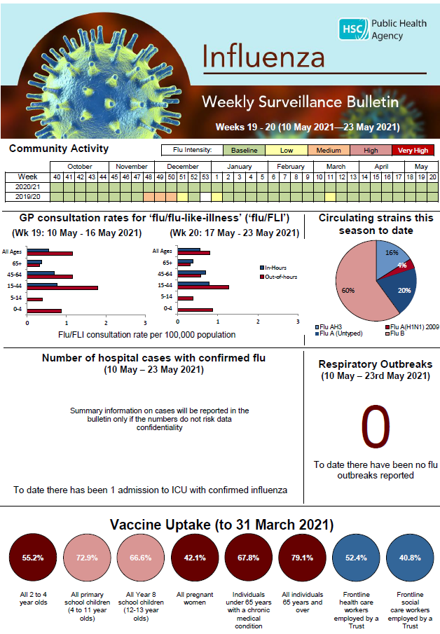
Influenza Weekly Surveillance Bulletin,
Northern Ireland, 2020/21
Public Health Agency weekly Flu Surveillance Bulletin
Notes:
Slide 16: updated image of bulletin to 2020/21 final bulletin
The PHA Health Protection Flu team monitors flu activity throughout the year. This includes information on primary care consultations, laboratory testing and positivity, strain types, indicators of severity including hospitalisations, intensive care admissions, respiratory deaths and excess all-cause mortality.
During the flu season (1st October to end of March) the flu bulletin is available every 2 weeks, and then weekly and can be accessed by PHA website.

Slide 17
National Flu Vaccination Programme
Late 1960s: recommended to directly protect those in clinical risk groups at higher risk of influenza associated morbidity and mortality
2000: extended to include all people aged 65 years or over
2010: pregnancy added as a clinical risk category for routine flu vaccine
2013: All pre-school children from 2 years and primary school children
2020: COVID Pandemic with increased flu vaccine target groups.
2021: Extension to 50-64 year olds, school age children to Year 12 HSCWs & household contacts of immunocompromised individuals (for this year only)
Notes:
The flu vaccination programme was introduced into NI in the late 1960s and was recommended for those in clinical risk groups that have a higher risk of
associated morbidity and mortality. In 2000 the programme was extended to include everyone > 65 years of age. In 2010 pregnancy was added as a clinical risk category for routine flu immunisation. In 2013 the programme was extended to include pre-school children from 2 years and older and all primary school children
Last year the programme is being further extended to include Year 8 school children and household contacts of anyone who has received a shielding letter during the COVID-19 pandemic.
This year, , the vaccination programme has been extended to additional cohorts, such as all healthy 50 to 64 year olds, year 9-12 school children and household contacts of immunocompromised individuals

Slide 18
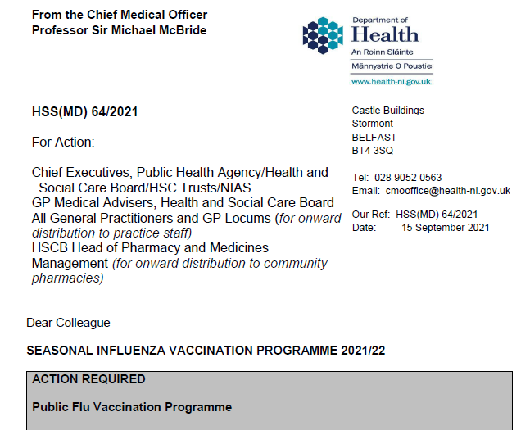
Northern Ireland Flu Vaccine Programme policy: outlined in annual CMO letter 2021/22
Published 15.09.21
  Department of Health (NI) CMO Letter
Notes:
Every year the Department of Health published the annual CMO season flu letter. This letter provides information on the policy for the seasonal flu programme. Eligible groups, types of vaccine and other relevant information is included within the letter.
As mentioned previously, the letter also states that based on vaccine availability and the uptake rates being achieved, the vaccination programme has been to additional cohorts, such as all healthy 50 to 64 year olds, Year 9-12 secondary school children and household contacts of immunocompromised individuals.

Slide 19
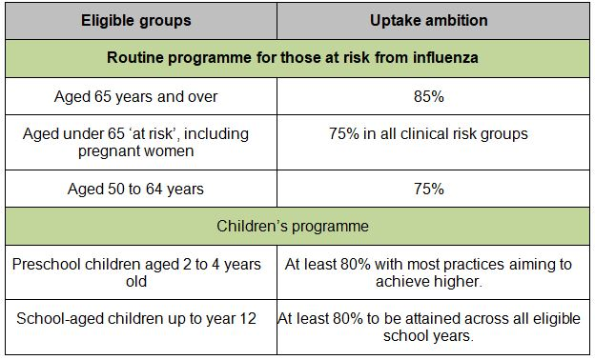
2021/22 Uptake Targets to be confirmed in the annual CMO letter
Notes:
Every year the CMO seasonal flu vaccination programme letter 2021/22 outlines the uptake targets for groups eligible for vaccination. In light of the Covid-19 pandemic it is essential that every effort is made to maximise uptake rates and help reduce the risk of concomitant circulation of Influenza and Covid-19 and for this reason the Department of Health has increased the targets for all eligible groups considerably for 2021/22.
The uptake ambition for those age 65 years and over is 85%.
The uptake ambition for pre-school children age 2 and over and children from primary one to year eight is %.

Slide 20
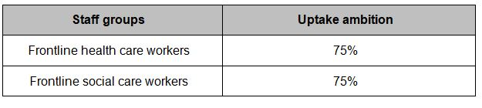
2021/22 HSCW uptake Targets to be confirmed in the annual CMO letter
Vaccine uptake rates (as per previous years) only apply to Trust frontline health and social care workers

Slide 21
Eligibility for 2021/22 season (TBC CMO letter)
All individuals aged 50 years or over
Individuals aged 18 to 64 years in a clinical risk group
Children aged 6m to 2y and 12 to 17 years in a clinical risk group or who a household contacts of very severely immunocompromised
All children aged 2 – 16 years (pre-school, primary school & secondary school to Year 12)
Individuals living in long-stay residential care homes or facilities
Main carers of an elderly / disabled person
Household contacts of immunocompromised individuals
Health & social care staff in direct contact with patients / clients
Notes:
The above list outlines eligible groups outlines in the Green Book and CMO letter. Those highlighted in red bold are new for 2021-22
Individuals living in long-stay residential care homes or facilities where rapid spread is likely to follow introduction of infection and cause high morbidity and mortality. Note: This does not include prisons, young offenders institutions, university halls of residence etc. Separate arrangements are being put in place for adult prison populations.
Consideration should also be given to vaccinating household contacts or carers of immunocompromised individuals, i.e. individuals who expect to share living accommodation on most days over the winter and for whom close contact is unavoidable.

Slide 22
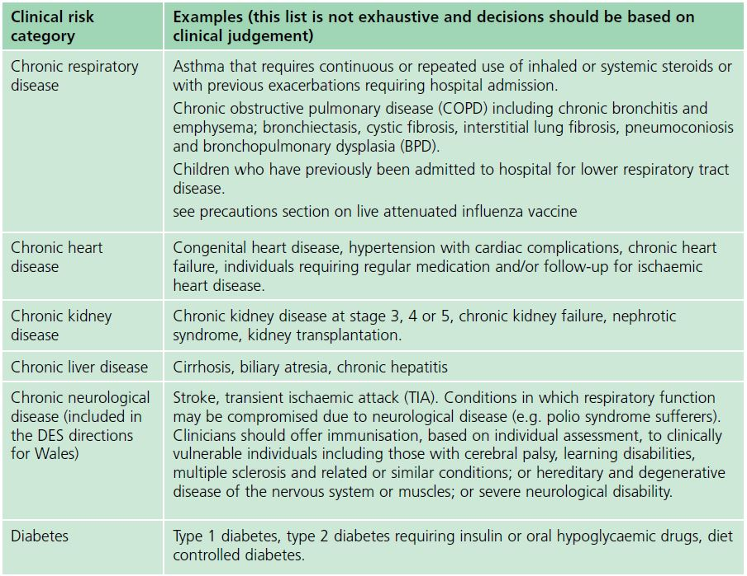
Clinical risk groups
The national flu immunisation programme 2017/18
Notes:
Clinical risk categories also include:
Chronic Respiratory Disease
Chronic Heart Disease
Chronic Kidney Disease
Chronic Liver Disease
Chronic Neurological Disease &
Diabetes
Increasing uptake of flu vaccine is important in clinical risk groups because of the increased risk of death and serious illness if people who are in these groups develop flu. In particular uptake rates in people with chronic liver and neurological disease need to be improved. Some of the highest mortality groups are associated with patients with liver and chronic Neurological disease.

Slide 23
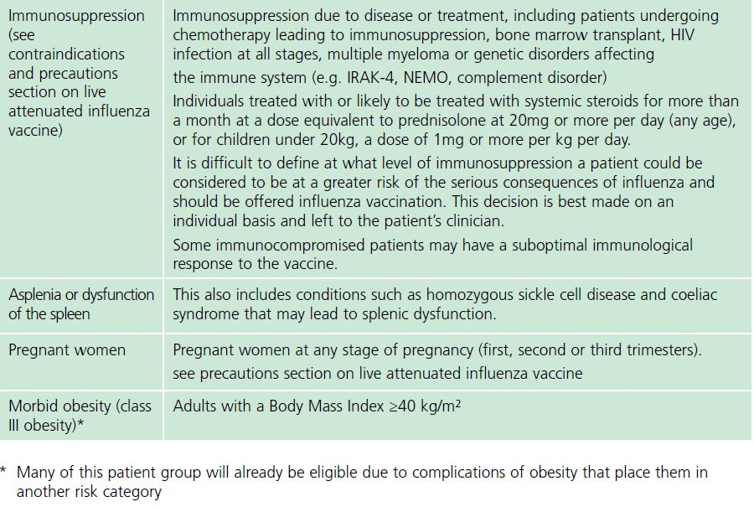
Clinical risk groups
Notes:
Clinical Risk categories also include:
Immunosuppression due to a disease / treatment
Asplenia / dysfunction of the spleen
Pregnant woman at any stage of pregnancy and
Morbid Obesity-many of the patients in this group will already be eligible for the flu vaccine due to complications of obesity that place them in a clinical risk category.

Slide 24
Other groups that should be vaccinated
The list of eligible groups is not exhaustive
Clinical judgement should be applied to take account the risk of exacerbating any underlying disease with flu, as well as the risk of serious illness from flu itself
The flu chapter of The Green Book has been updated this year and those involved in delivering flu vaccine programmes should be familiar with the updated chapter and the CMO Seasonal flu letter
Notes:
The list of eligible clinical risk groups is not exhaustive, and the healthcare practitioner should apply clinical judgement to take into account the risk of influenza exacerbating any underlying disease that a patient may have, as well as the risk of serious illness from flu itself. Flu vaccine should be offered in such cases even if the individual is not in one of the specified clinical risk groups.
The flu chapter of The Green Book has been updated this year and those involved in delivering flu vaccine programmes should be familiar with the updated chapter and the CMO Seasonal flu letter

Slide 25
Pregnant women
All pregnant women should be offered the inactivated flu vaccine by their G.P. irrespective of the stage of pregnancy
pregnant women are at increased risk of complications from flu
flu during pregnancy is associated with premature birth, and smaller birth weight
flu vaccination during pregnancy provides passive immunity against flu to infants in the first few months of life
studies on flu vaccine safety in pregnancy show that the inactivated flu vaccine can be safely and effectively administered during any trimester of pregnancy
no study to date has demonstrated an increased risk of either maternal complications or adverse fetal outcomes associated with inactivated flu vaccine
Notes:
All pregnant women are recommended to receive the inactivated flu vaccine
irrespective of their stage of pregnancy.
There is good evidence that pregnant women are at increased risk from
complications if they contract flu .In addition, there is evidence that
having flu during pregnancy may be associated with premature birth and
smaller birth size and weight and that flu vaccination may reduce the
likelihood of prematurity and smaller infant size at birth associated with an
influenza infection during pregnancy. Furthermore, a number of studies
show that flu vaccination during pregnancy provides passive immunity against
flu to infants in the first few months of life. A review of studies on the
safety of flu vaccine in pregnancy concluded that inactivated flu vaccine can
be safely and effectively administered during any trimester of pregnancy and
that no study to date has demonstrated an increased risk of either maternal
complications or adverse fetal outcomes associated with inactivated influenza
vaccine.
The ideal time to offer flu vaccination to pregnant women is before flu starts
circulating. However, even after flu is in circulation, vaccine should continue
to be offered to those at risk and newly pregnant women. If a woman becomes pregnant after the usual vaccinating period of October to January, it is still worth considering offering the vaccine if flu is still circulating in the community.

Slide 26
Rationale for vaccinating children against flu
Extension of the seasonal flu vaccination programme to children aims to appreciably lower the public health impact of flu by:
Providing direct protection thus preventing a large number of cases of flu infection in children
Providing indirect protection by lowering flu transmission from children:
      to other children
      to adults
      to those in the clinical risk groups of any age
Notes:
In July 2012, the JCVI recommended extending the annual flu programme to include healthy children aged 2 to their seventeenth birthday in order both
to lower the potentially serious impact of flu in vaccinated children and also to have a more profound effect on flu transmission. Children are the main
source of transmission in the population, and extending the flu programme to include healthy children should therefore reduce the spread of infection
from children to other children, to adults and to those in clinical risk groups of any age. In Northern Ireland the programme was started in pre-school
children > 2 years and all primary school children. From 2020/21, the programme has been extended to include Year 8 children in Northern Ireland.
From 2021/2022, the programme has been further extended to included Year 9-12 secondary children.
Reducing flu transmission in the community will avert many cases of severe flu and flu-related deaths in older adults and people with clinical risk factors.
Since the programme was introduced to pre-school and primary school children in Northern Ireland the levels of GP consultation rates has been lower compared to other parts of the UK and ROI where there was a more limited vaccination programme for healthy children.

Slide 27
Health and social care workers
Duty of care to protect patients and service users from infection
Flu vaccine reduces transmission of flu to:
  HSCW;
  Vulnerable patients, who may have impaired immunity and not respond well to immunisation;
  Colleagues and family members.
Significantly lowers rates of flu-like illness, hospitalisation and mortality in elderly in long-term healthcare settings
Reduces sickness absences and contributes to delivery of Health and Social Care services during winter pressures.
Notes:
Frontline health and social care workers have a duty of care to protect their patients and service users from infection. This includes getting vaccinated
against flu.
Flu outbreaks can occur in health and social care settings with both staff and their patients/service users being affected when flu is circulating in the
community. It is important that health and social care workers protect themselves by having the flu vaccine, and, in doing so, they reduce the risk of spreading flu to their patients, service users, colleagues and family members.
Vaccination of healthcare workers against flu has been shown to significantly lower rates of flu-like illness, hospitalisation and mortality in the elderly in
long-term healthcare settings. Vaccination of staff in acute care settings may provide similar benefits. Flu immunisation of frontline health and social
staff care staff may reduce the transmission of infection to vulnerable patients, some of whom may have impaired immunity, increasing their risks of flu. These people may not respond well to immunisation. Achieving a good uptake of flu vaccine in HCWs is even more important this year because of the increased risk of morbidity and mortality from co-infection with flu and COVID-19.
Vaccination of health and social care workers also helps to reduce the level of sickness absenteeism that can jeopardise health and social care services.

Slide 28
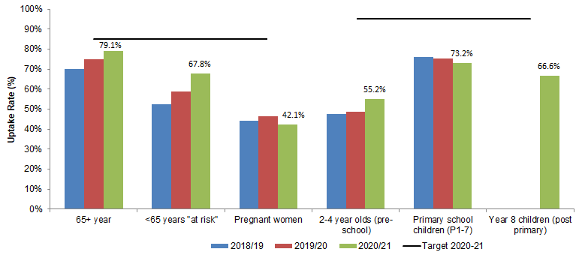
Uptake rates in population target groups,
2018/19 - 2020/21
Note: Year 8 children introduced as new data collection group in 2020-21.
Notes:
Slide 28
Year 8 new group introduced 2020/21
Uptake % not available for 50-64 years – also new group for 2020/21 (no population denominator available), 21,931 vaccinated between 1 January and 31 March 2021.
Note: Proportion of primary school children offered and vaccinated is 73.2%. Proportion of year 8 offered and vaccinated is 66.6%
Vaccine uptake figures as per final DoH vaccine uptake report (internal) – October 2020 to March 2021.

Slide 29
Primary School children influenza vaccine uptake,
2018/19 – 2020/21
Notes:
Cumulative number of vaccinations
Overall 72.9% of primary school children received the vaccine in 2020/21 compared to 72.1% in 2019/20.
99.6% (182,908 children) offered it in 2020/21 compared to 95.7% (172,751 children) in 2019/20.
When you just look at the number offered; 73.2% took up the offer in 2020/21 and 75.4% in 2019/20.
97.2% (130,186) of those vaccinated received their vaccination in schools in 2020/21. Compared to 95.1% (123,816) in 2019/20.
2.8% (3,684) of those vaccinated were vaccinated by their GP in 2020/21. Compared to 4.9% (6,419) in 2019/20.
Vaccine uptake figures as per final DoH vaccine uptake report (internal) – October 2020 to March 2021.

Slide 30
Year 8 children influenza vaccine uptake,
2018/19 – 2020/21
Note: Year 8 children introduced as new data collection group in 2020-21.
Notes:
Vaccine uptake figures as per final DoH vaccine uptake report (internal) – October 2020 to March 2021.

Slide 31
Pre-school children influenza vaccine uptake,
2018/19 – 2020/21
Notes:
Cumulative vaccinations
Vaccine uptake figures as per final DoH vaccine uptake report (internal) – October 2020 to March 2021.

Slide 32
Children influenza vaccine uptake rates by Trust and NI,
2020/21
 | Delivered by | BHSCT | SEHSCT | NHSCT | SHSCT | WHSCT | NI
All 2 to 4 year olds | GP | - | - | - | - | - | 55.2%
% of primary school children offered the vaccine and vaccinated | Trust School Nurse Service | 70.3% | 78.9% | 70.4% | 71.3% | 65.3% | 71.2%
% of primary school children offered the vaccine and vaccinated | Trust School Nurse Service & GP | - | - | - | - | - | 73.2%
% of all primary school children vaccinated (based on total population 183,670) | Trust School Nurse Service & GP | - | - | - | - | - | 72.9%
% of year 8 children offered the vaccine and vaccinated | Trust School Nurse Service | 66.7% | 71.1% | 69.0% | 65.9% | 60.6% | 66.6%
% of all year 8 children vaccinated (based on total population 25,463) | Trust School Nurse Service |  |  |  |  |  | 66.6%
Notes:
Slide 31 – ****GP vaccinations by Trust not reported, NI level for presentations, internal reports and publication.
****School nurse vaccinations by Trust for presentations and internal reports. Not published at this level.

Slide 33
Which flu vaccine?

Slide 34
Types of flu vaccine
Over the years different flu vaccines have been developed to improve effectiveness overall, especially the elderly, and to avoid egg adaption changes
There are now the following types of vaccine available:
  Inactivated vaccines – by injection
    Egg Grown
    Cell Grown
    Adjuvanted
  Live attenuated – by nasal application
This year all vaccines used will be Quadrivalent vaccines contain two subtypes of Influenza A and both B virus types*
None of the flu vaccines can cause clinical influenza in those that can be vaccinated

Slide 35
Vaccine Composition: Antigens
Northern Hemisphere 2021/22*
Vaccine composition in 2021-22 Quadrivalent vaccines
Egg-based Vaccines
• an A/Victoria/2570/2019 (H1N1)pdm09-like virus;
• an A/Cambodia/e0826360/2020 (H3N2)-like virus;
• a B/Washington/02/2019 (B/Victoria lineage)-like virus; and
• a B/Phuket/3073/2013 (B/Yamagata lineage)-like virus.
Cell- or recombinant-based Vaccines
• an A/Wisconsin/588/2019 (H1N1)pdm09-like virus;
• an A/Cambodia/e0826360/2020 (H3N2)-like virus;
• a B/Washington/02/2019 (B/Victoria lineage)-like virus; and
• a B/Phuket/3073/2013 (B/Yamagata lineage)-like virus.
Source: WHO
*https://www.who.int/influenza/vaccines/virus/recommendations/2020-21_north/en/
Notes:
The World Health Organization (WHO) convenes a group that reviews the global influenza situation (once each year for the northern hemisphere and once for the southern hemisphere) and recommends which flu strains should go in the seasonal vaccine to be produced by manufacturers for the following season six to eight months later. This recommendation is based on information about the circulating viruses and epidemiological data from around the world at that time.
Trivalent vaccines e.g. aTIV contain two subtypes of influenza A and one B virus.
Quadrivalent vaccines for example Fluenz tetra intranasal vaccine (LAIV)/ the Sanofi Pasteur Quadrivalent Influenza vaccine (QIVe) / Flucelvax Tetra (QIVc)) offer additional protection against a second strain of influenza B.
The use of quadrivalent flu vaccines is expected to improve the matching of the vaccine to the circulating B strain(s).

Slide 36
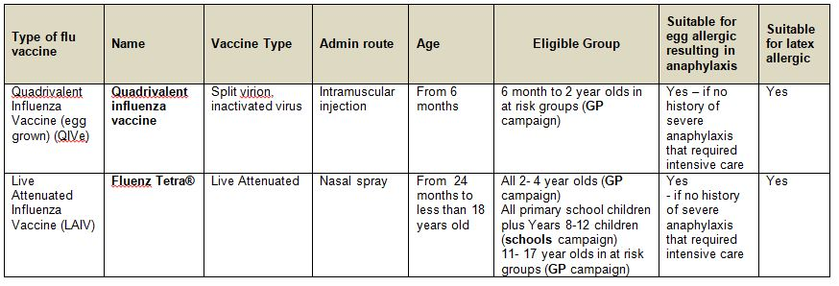
Vaccines for 2021-22 (1)

Slide 37
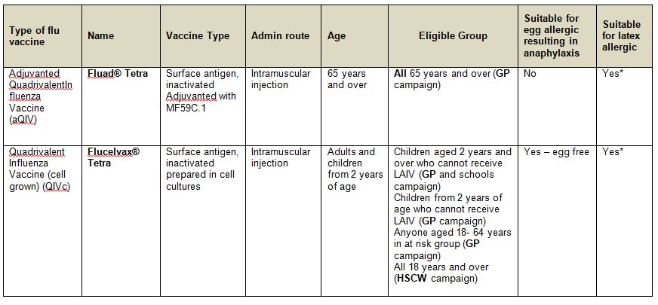
Vaccines for 2021-22 (2)

Slide 38
Vaccines for 2021-22 (3)
*Fluad Tetra and Flucelvax Tetra are supplied in single-dose prefilled syringes, with a plunger stopper (bromobutyl rubber), with attached needles. None of the components of this staked needle prefilled syringe presentation that are in direct contact with the vaccine (syringe barrel, plunger and rubber stopper) are made with natural rubber latex. The needle shield for Fluad Tetra and Flucelvax Tetra contains natural rubber latex. The risk of allergy is extremely small and is considered to be safe in those patients that have latex allergy / latex anaphylaxis.
Please refer to the Green Book Chapter 6: Contraindications and special considerations for further information pages 2&3. https://www.gov.uk/government/publications/contraindications-and-special-considerations-the-green-book-chapter-6

Slide 39
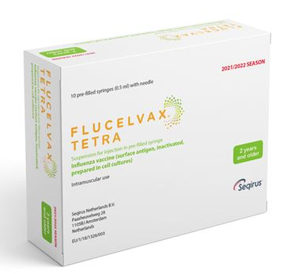
1. Flucelvax Tetra: cell-based Quadrivalent
Inactivated Flu vaccine (QIVc)
First line for all adults 18 to < 65 years who are eligible for the flu vaccine
Second line for adults 65 years and older with egg allergy
Second line for children over 2 years with contraindication to Fluenz Tetra®
Single i.m. injection
  One dose schedule required unless:
    Child is in a clinical risk group and under 9 years old and has not previously received a flu vaccine
  If second dose required leave at least 4 weeks between dose
Needle attached
Notes:
It is recommended for adults age 18 to < 65 years who are eligible. Second line for children over 2 years with contraindication to Fluenz Tetra®
It should be considered for use in Adults 65years+ who have an allergy to eggs .
One dose schedule unless:
Child is in a clinical risk group and
< 9 years old and
Has not previously received a flu vaccine
If second dose required leave at least 4 weeks between doses

Slide 40
Quadrivalent cell culture vaccine
(QIVc)
QIVc (Flucelvax TETRA) was first licenced in the US in 2016 and was licensed in the UK in December 2018 for adults and children from 9 years of age
Flucelvax TETRA is a quadrivalent vaccine containing two subtypes of Influenza A (H3N2 and H1N1pdm00) and both B virus lineages. As the vaccine contains both lineages of B viruses it may provide better protection against circulating flu B strain(s) than trivalent flu vaccines
QIVc has a similar safety profile to other flu vaccines (similar rate and type of adverse reactions reported). More than 36 million doses of cell-based vaccine have been administered with no serious safety concerns
the cell-based vaccine manufacturing process uses an animal cell line (Madin-Darby Canine Kidney, or MDCK) to grow the influenza virus rather than the traditional egg based manufacturing methods
this manufacturing process eliminates the risk of egg-adaptation and may result in the vaccine containing virus that is a closer match to wild-type circulating flu viruses

Slide 41
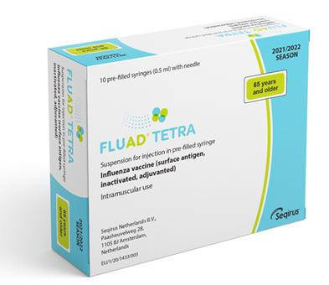
2. adjuvanted Quadrivalent flu vaccine (aQIV)
First line for adults 65 years and over
Only licensed for ≥ 65 years at the time of vaccination
Not suitable for those with egg allergies
Single i.m. injection
One dose schedule
Notes:
The vaccine is not suitable for anyone with any type of egg allergy regardless of the severity.
Should only be administered I.M.

Slide 42
Adjuvanted Quadrivalent
Influenza Vaccine (aQIV)
Adjuvanted trivalent influenza vaccine (aTIV) was used in the UK in the 2018 to 2019 and 2019 to 2020 flu seasons in 65y and over age group and was used widely elsewhere. It has been used for 20 years and over 93 million doses have been distributed worldwide and it has an excellent safety record
Adjuvanted vaccines have higher immunogenicity and effectiveness than non-adjuvanted, normal dose vaccines in older people
An adjuvanted quadrivalent vaccine (aQIV) has replaced aTIV for 2021 to 2022. This vaccine contains two subtypes of Influenza A (H3N2 and H1N1pdm09) and two type B virus
an adjuvant (MF59) has been added to the vaccine to enhance the immune response to counter the effect of immunosenescence (age related reduction in immune response)
MF59 adjuvant is an oil-in-water emulsion of squalene oil which is a naturally occurring substance found in humans, animals and plants. In humans, it is made in the liver and circulates in the bloodstream
aQIV is made using an egg-based manufacturing process
Notes:
An adjuvanted quadrivalent vaccine (aQIV) has replaced aTIV for 2021 to 2022. This vaccine contains two subtypes of Influenza A (H3N2 and H1N1pdm09) and two type B virus

Slide 43
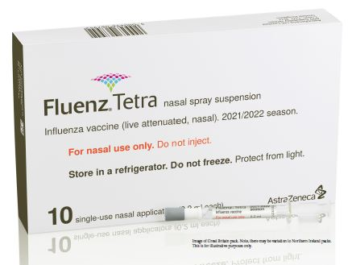
3. Fluenz tetra live attenuated influenza Vaccine (LAIV)
Recommended for children from age 2 years to < 18 years
Also, remains the vaccine of choice for at risk children aged 2 to <18 years – except where contraindicated.
Notes:
Fluenz Tetra is a live attenuated intranasal influenza vaccine.
As well as being the vaccine of choice for healthy children preschool (from age 2 upwards) and children p1-7 and this year, Year 8-12 (the programme delivered by the school nursing team), Fluenz Tetra is also the vaccine of choice for at-risk children age 2-17 years inclusive.
This has been shown to be more effective in children compared with inactivated influenza vaccines (administered by injection)
May offer some protection against strains not contained in the vaccine in addition to those that are, and has potential to offer better protection against virus strains that have undergone antigenic drift
Since this vaccine is comprised of weakened whole live virus, it also replicates natural infection which induces better immune memory (thereby offering better long-term protection to children than from the inactivated vaccines)
LAIV has a good safety profile in children aged two years and older
It is important to note that some Fluenz Tetra stocks may expire (18 week shelf life after released from manufacturer) before the end of December so expiry dates should be checked before use and an effort should be made to try and complete the programme by the end of December.

Slide 44

3. Fluenz Tetra® (LAIV)
  Ready to use nasal spray (suspension)
  Applicator contains 0.2ml (administered as 0.1ml per nostril)
  LAIV can be administered at the same time as, or at any interval from other vaccines including live vaccines
  Patient should breathe normally – no need to actively inhale
  The vaccine is rapidly absorbed so no need to repeat the dose if patient sneezes, blows their nose or their nose drips following
  One dose required unless:
    Child is in a clinical risk group and under 9 years old and has not previously received a flu vaccine
  If second dose required leave at least 4 weeks between doses
Notes:
Fluenz Tetra® is supplied as a single use prefilled nasal applicator.
It is a live attenuated nasal vaccine and must not be injected
The nasal applicator is ready to use. No reconstitution or dilution is required.
The nasal suspension is colourless to pale yellow, clear to opalescent. Small white particles may be present¹⁹.
Each applicator of Fluenz Tetra (LAIV) contains 0.2ml (that’s 0.1ml administered/ nostril).
One dose is required unless the child is in a clinical risk group and is < 9 years old and has not previously received a flu vaccine. If a second dose is required at least 4 weeks intervals should be left between doses. If the child attends primary school they will be offered the first vaccine in school but there is no mop up and at-risk children should attend their G.P. for vaccination if they have missed the first dose and / require a second dose of vaccine. If Fluenz tetra is not available for use when a child attends for their second vaccine because stocks have expired, the second dose can be replaced with an inactivated vaccine..

Slide 45
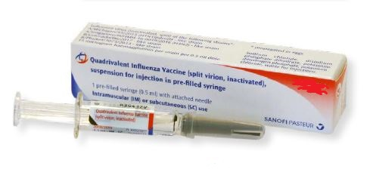
4. Egg-based Quadrivalent Influenza
Vaccine (QIVe)
First line for children 6m to < 2 years in risk groups
Second line if QVIc unavailable
One dose schedule OR
Two doses 4 weeks apart for < 9 years old in clinical risk group and no previous history of flu vaccine
Notes:
Sanofi Pasteur inactivated Quadrivalent flu vaccine is supplied in a pre-filled Syringe containing 0.5 ml dose.
One dose of the vaccine is required unless the patient is a child in a clinical at-risk group and they are < 9 years old and they have not previously received a flu vaccine. If a second vaccine is required an interval of at least 4 weeks should be left between the two vaccines.

Slide 46
Administration of flu vaccines given by injection
Patients taking anticoagulants / with bleeding disorder
Individuals on stable anticoagulation therapy (including individuals on warfarin who are up-to-date with their scheduled INR testing and whose latest INR was below the upper threshold of their therapeutic range) can receive intramuscular vaccination
if in any doubt, consult with the clinician responsible for prescribing or monitoring the individual’s anticoagulant therapy
Please see the relevant section in the Green Book Chapter 19
Notes:
Individuals on stable anticoagulation therapy (including individuals on warfarin who are up-to-date with their scheduled INR testing and whose latest INR was below the upper threshold of their therapeutic range) can receive intramuscular vaccination
if in any doubt, consult with the clinician responsible for prescribing or monitoring the individual’s anticoagulant therapy

Slide 47
Storage of all flu vaccine
  Efficacy, safety and quality may be adversely affected if vaccines are not stored at the temperatures specified in the licence
Must be stored in accordance with manufacturer’s instructions:
  store between +2⁰C and +8⁰C
  do not freeze
  store in original packaging
  protect from light
Check expiry dates regularly:
  the LAIV has an expiry date 18 weeks after manufacture – this is much shorter than inactivated flu vaccines
  it is important that the expiry date on the nasal spray applicator is checked before use
Notes:
Vaccines should be stored in the original packaging at +2°C to +8°C and protected from light. All vaccines are sensitive to some extent to heat and cold. Heat speeds up the decline in potency of most vaccines, thus reducing their shelf life. Efficacy, safety and quality may be adversely affected if vaccines are not stored at the temperatures specified in the licence. Freezing may cause increased reactogenicity and loss of potency for some vaccines and can also cause hairline cracks in the container, leading to contamination of the contents.
Vaccines are expensive and it is important to minimise wastage through inappropriate storage. We have had a few cold-chain failures recently where practices did not place vaccines in the Vaccine fridge on arrival to the practice, resulting in large vaccine losses and it is important to ensure that all staff responsible for handling / storing vaccines have received cold-chain training.
It is also important to check the expiry dates of flu vaccines and to rotate stock to prevent Vaccine loss. LAIV has a shelf life of 18 weeks that starts at the point of release from the manufacturer. This is a shorter shelf life than other influenza vaccines and some of this time will have passed when the vaccine reaches the place where it is to be administered. It is important that the expiry date on the nasal spray applicator is checked before use. If the expiry date has passed, arrangements should be made to have the vaccine disposed of safely.

Slide 48
Vaccine Intervals
No interval required between live and inactivated flu vaccines
If two / more vaccines are given at the same time give in separate limbs / leave at least 2.5 cms between administration sites
Fluad should be administered in a separate limb if possible
See Chapter 11 The Green Book
Notes:
There is no interval required between inactivated and live vaccines / LAIV
and any other live vaccine. If it is necessary to administer the inactivated flu vaccine at the same time as other vaccines e.g. PPV / Shingles, the vaccines should be administered in separate limbs / leave at least 2.5 cms between vaccination sites.
aTIV should be administered in a separate limb if possible due to the increased risk of localised reaction. The vaccination sites should be recorded.

Slide 49
Contraindications (Inactivated Vaccines & LAIV)
There are very few individuals who cannot receive any flu vaccine
None of the influenza vaccines should be given to those who have had:
confirmed anaphylactic reaction to a previous dose of the vaccine
confirmed anaphylactic reaction to any component of the vaccine (except ovalbumin see precautions)
The aQIV is contra-indicated in anyone with an egg allergy
Note: Always refer to SPC for individual products when deciding which vaccine to give
Notes:
The SPCs for individual products should always be referred to when deciding which vaccine to give. There are very few individuals who cannot receive any flu vaccine.
None of the influenza vaccines should be given to those who have had:
confirmed anaphylactic reaction to a previous dose of the vaccine
confirmed anaphylactic reaction to any component of the vaccine (except ovalbumin see precautions)
It is important to note that the aTIV is contraindicated in anyone with an egg/ latex allergy. Always refer to the SPC for individual vaccines when deciding which vaccine to give.

Slide 50
Contraindications (LAIV)
The live attenuated flu vaccine (Fluenz Tetra) should not be given to children who are:
clinically severely immunodeficient due to conditions or immunosuppressive therapy:
        acute and chronic leukaemias
        lymphoma
        HIV infection not on highly active antiretroviral therapy
        cellular immune deficiencies
        high dose corticosteroids
receiving salicylate therapy
known to be pregnant
See subsequent slide for children with acute and severe asthma
Notes:
The live attenuated influenza vaccine (Fluenz Tetra®) should not be given to children or adolescents who are clinically severely immunodeficient due to conditions or immunosuppressive therapy such as: acute and chronic leukaemias; lymphoma; HIV infection not on highly active antiretroviral therapy (HAART); cellular immune deficiencies; and high dose corticosteroids. It is not contraindicated for use in children or adolescents with stable HIV infection receiving antiretroviral therapy; or who are receiving topical/inhaled corticosteroids or low-dose systemic corticosteroids or those receiving corticosteroids as replacement therapy, e.g. for adrenal insufficiency.
Chapter 6 of the Green Book on contraindications and special precautions gives further advice on the use of live vaccines in individuals who are severely immunosuppressed²². It states that the definition of “systemic high doses steroids” (and until at least three months after treatment has stopped) would include children who receive prednisolone, orally or rectally, at a daily dose (or its equivalent) of 2mg/ kg/day for at least one week, or 1mg/kg/day for one month. Occasionally, individuals on lower doses of steroids may be immunosuppressed and at increased risk from infections. In those cases, live vaccines should be considered with caution, in discussion with a relevant specialist physician”.
The live attenuated vaccine is contraindicated in children and adolescents receiving salicylate therapy (other than for topical treatment of localised conditions) because of the association of Reye's syndrome with salicylates and wild-type flu infection as described in the SPC for Fluenz Tetra®.
Safety data for the live attenuated flu vaccine when given in pregnancy is limited . Whilst there is no evidence of risk with live attenuated flu vaccine, inactivated flu vaccines are preferred for those who are pregnant. There is no need, however, to specifically test eligible girls for pregnancy or to advise avoidance of pregnancy in those who have been recently vaccinated.

Slide 51
Precautions to flu vaccines
Acutely unwell:
  defer until recovered
Heavy nasal congestion:
  defer live intranasal vaccine until resolved or, if the child is in a risk group, consider inactivated flu vaccine to provide protection without delay
Use with antiviral agents against flu:
live flu vaccine (LAIV) should not be administered at the same time or within 48 hours of cessation of treatment with flu antiviral agents
administration of flu antiviral agents within two weeks of administration of LAIV may adversely affect the effectiveness of the vaccine
Notes:
Minor illnesses without fever of systemic upset are not valid reasons to postpone vaccination. If the individual is acutely unwell, immunisation may be postponed until they have recovered. This is to avoid confusing the differential diagnosis of acute illness by wrongly attributing any signs or symptoms to the adverse effects of the vaccine.
There is no data on the effectiveness of LAIV when given to children with a heavily blocked or runny nose attributable to infection or an allergy. However as heavy nasal congestion might impede delivery of the vaccine to the nasopharyngeal mucosa, deferral of administration until nasal congestion has resolved should be considered or an appropriate alternative influenza vaccine that is administered by injection should be considered.
There is a potential for influenza antiviral agents to lower the effectiveness of the live attenuated influenza vaccine. Administration of influenza antiviral agents within two weeks of administration of LAIV may adversely affect the effectiveness of the vaccine.

Slide 52
Acute and severe asthma
New guidance last year from JCVI based on recent data (2019)
Children with asthma on inhaled corticosteroids may safely be given LAIV irrespective of the dose prescribed
LAIV is not recommended for children and adolescents currently experiencing an acute exacerbation of symptoms including - those who have had increased wheezing and/or - needed additional bronchodilator treatment in previous 72 hours
Such children should be offered a suitable inactivated influenza vaccine to avoid a delay in protection
Children who require regular oral steroids for maintenance of asthma control, or have previously required intensive care for asthma exacerbation should only be given LAIV on the advice of their specialist
As these children may be at higher risk from influenza infection, those who cannot receive LAIV should receive a suitable inactivated influenza vaccine
Children with significant asthma and aged under nine years who have not been previously vaccinated against influenza will require a second dose (of either LAIV or inactivated vaccine as appropriate).
Notes:
JCVI have advised (2019) that, on the basis of recent data, children with asthma on inhaled corticosteroids may safely be given LAIV, irrespective of the dose prescribed. LAIV is not recommended for children and adolescents currently experiencing an acute exacerbation of symptoms including those who have had increased wheezing and/or needed additional bronchodilator treatment in the previous 72 hours. Such children should be offered a suitable inactivated influenza vaccine to avoid a delay in protection (Sanofi Pasteur Quadrivalent Inactivated Vaccine).
There are limited safety data in children who require regular oral steroids for maintenance of asthma control, or have previously required intensive care for asthma exacerbation – such children should only be given LAIV on the advice of their specialist. As these children may be at higher risk from influenza infection, those who cannot receive LAIV should receive a suitable inactivated influenza vaccine. Children with significant asthma and aged under nine years who have not been previously vaccinated against influenza will require a second dose (of either LAIV or inactivated vaccine as appropriate).

Slide 53
Egg allergy – adults
aQIV vaccine is contraindicated in egg allergy & QIVc should be the preferred option for patients aged 65 and over who have an egg allergy (Cell based)
QIVc is also the vaccine recommended in our programme this year for those age 18-64 who are eligible for the flu vaccine. This vaccine can be used in patients with any type of an egg allergy

Slide 54
Egg allergy – children
Children with an egg allergy that did not result in an intensive care admission can be safely vaccinated with LAIV or QIVe (if aged under 2 years) in any setting (including primary care and schools)
Children aged 2 years of age and over with a history of egg allergy that required admission to intensive care for a previous severe anaphylaxis to egg can now be offered QIVc in any setting (including primary care and schools)
There is no licensed egg-free vaccine available for children under 2 years of age who were admitted to intensive care for severe anaphylaxis to egg. Administration of QIVe in a hospital setting should be considered
Notes:
Children
JCVI has advised that, except for those with severe anaphylaxis to egg which has previously required intensive care, children with an egg allergy can be safely vaccinated with Fluenz Tetra (LAIV) in any setting (including primary care and schools).
Children with a history of severe anaphylaxis to egg which has previously required an intensive care admission, can now be offered QIVc if they are age 2 or older in any setting
Egg-allergic children with asthma can receive LAIV if their asthma is well-controlled (see previous slide on severe asthma).
There is no licensed egg-free vaccine available for children under 2 years of age who were admitted to intensive care for severe anaphylaxis to egg. Administration of QIVe in a hospital setting should be considered

Slide 55
Transmission risk from live vaccine
Theoretical potential for transmission of live attenuated virus to immunocompromised contacts - risk is for one to two weeks following vaccination
Extensive use of live attenuated influenza vaccine in US – no reports of illness among immunocompromised patients inadvertently exposed to vaccinated children
However, where close contact with severely immunocompromised patients (e.g. bone marrow transplant patients requiring isolation) is likely/unavoidable (e.g. household members) consider an appropriate inactivated flu vaccine instead
No reports of transmission of vaccine virus in healthcare settings
As a precaution, however, very severely immunosuppressed healthcare workers should not administer LAIV
Notes:
There is a theoretical potential for transmission of live attenuated influenza virus in Fluenz Tetra to immunocompromised contacts for one to two weeks following vaccination.
In the US, where there has been extensive use of the live attenuated influenza vaccine there have been no reported instances of illness or infections from the vaccine virus among immunocompromised patients inadvertently exposed. Where close contact with very severely immunocompromised patients (e.g. bone marrow transplant patients requiring
isolation) is likely or unavoidable (for example, household members), QIVc / QIVe should considered instead depending on the age of the child.
There has not been any reports of the transmission vaccine virus in healthcare settings however as a precaution, very severely immunosuppressed healthcare workers should administer LAIV

Slide 56
Inadvertent administration of LAIV
if an immunocompromised individual receives LAIV, the degree of immunosuppression should be assessed
if patient is severely immunocompromised, antiviral prophylaxis should be considered
otherwise they should be advised to seek medical advice if they develop flu-like symptoms in the four days following administration of the vaccine
if antivirals are used for prophylaxis or treatment, patient should also be offered inactivated flu vaccine in order to maximise their protection in the forthcoming flu season (this can be given straight away)
Notes:
If an immunocompromised individual receives LAIV then the degree of
immunosuppression should be assessed. If the patient is severely immunocompromised, antiviral prophylaxis should be considered, otherwise they should be advised to seek medical advice if they develop flu-like symptoms in the four days (the usual incubation period) following administration of the vaccine. If antivirals are used for prophylaxis or treatment, then in order to maximise their protection in the forthcoming flu season, the patient should also be offered inactivated influenza vaccine. This can be given straight away.

Slide 57
Commonly reported adverse reactions
Following inactivated flu vaccine:
pain, swelling or redness at the injection site, low grade fever, malaise, shivering, sweating, fatigue, headache, myalgia and arthralgia
a small painless nodule may also form at the injection site
these symptoms usually disappear within one to two days without treatment
Following live attenuated flu vaccine:
nasal congestion/rhinorrhoea, reduced appetite, weakness and headache
Rarely, after live or inactivated vaccine, immediate reactions such as urticaria, angio-oedema, bronchospasm and anaphylaxis can occur
Notes:
Pain, swelling or redness at the injection site, low grade fever, malaise, shivering, sweating, fatigue, headache, myalgia and arthralgia are among the commonly reported symptoms after vaccination with inactivated vaccine. A small painless nodule (induration) may also form at the injection site. These symptoms usually disappear within one to two days without treatment.
Due to the adjuvant, a higher incidence of mild post-immunisation reactions has been reported with aTIV, compared to non-adjuvanted influenza vaccines
Nasal congestion/rhinorrhoea, reduced appetite, weakness and headache are common adverse reaction following administration of Fluenz Tetra® (LAIV).
Rarely immediate reactions such as urticaria, angio-oedema, bronchospasm and anaphylaxis can occur following administration of the inactivated / live vaccine.

Slide 58

Reporting suspected adverse reactions
All serious suspected reactions following flu vaccination should be reported to the Medicines and Healthcare products Regulatory Agency using the Yellow Card scheme at http://yellowcard.mhra.gov.uk/
All of the inactivated quadrivalent flu vaccines carry a black triangle symbol (▼) (as do all vaccines during the earlier stages of their introduction)
This is to encourage reporting of all suspected adverse reactions
Notes:
Flucelvax Tetra® and Sanofi Pasteur quadrivalent inactivated vaccine both carry a black triangle symbol (▼). This is a standard symbol added to the product information of a vaccine during the earlier stages of its introduction, to encourage reporting of all suspected adverse reactions.
All serious suspected reactions following flu vaccines should be reported to the Medicines and Healthcare products Regulatory Agency using the Yellow Card scheme at http://yellowcard.mhra.gov.uk/.

Slide 59
Vaccine Ordering
all injectable flu vaccines are purchased regionally for Northern Ireland
LAIV for children is purchased centrally by PHE for the UK
GP practices must order all flu vaccines via the Movianto online website
Trust Pharmacy should order through the normal pharmacy system for school nurses and HSCW programmes
Providers are responsible for ordering sufficient flu vaccine and taking all steps to avoid over ordering and vaccine wastage
PLEASE Don’t Over Order!
Movianto will deliver within 48 hours of an order being placed, will deliver as often as needed
Only order what you need for the next week
  This avoids large losses if fridge breaks down and being left over at end of campaign
Vaccine can’t be taken back once it has been delivered
Notes:
Please only order the amount of vaccines that you require and do not overstock flu Vaccine. Overstocking can result in loss of a large number of vaccines in the event of a cold-chain failure. Movianto will deliver vaccines within your quota on the next working day. Vaccines can not be returned to Movianto once they have been delivered.
It is particularly important this year to prevent avoidable vaccine losses because of the possibility of adding 50-64 year olds to eligible cohorts.

Slide 60
Recording flu vaccine given
As a wide variety of influenza vaccines are on the UK market each year, it is especially important that the following information be recorded:
vaccine name, product name, batch number and expiry date
dose administered
date immunisation given
route/site used
name and signature of vaccinator
This information should be recorded in: VMS (decision pending)
patient's GP record (or other patient record, depending on location)
personal Child Health Record (the ‘Red Book’) if a child
practice computer system
Child Health Information System

Slide 61
Delivery

Slide 62
2021/22 programme
The official launch date will be 1st October 2021
Nasal flu vaccine for children should be available to order by mid-September
All Practices should receive initial deliveries of all flu vaccines before the end of September 2021
Practices can start clinics once they have received the vaccine
Leaflets are expected to be delivered by first week in September
Leaflets can be downloaded from PHA web-site
PGDs available from end of August / start of September
Notes:
The vaccination programme will officially begin on 1 October 2020, however, those administering the vaccine can and should begin offering the vaccine as soon as they have received their first delivery of vaccine. Practices should receive initial delivery of vaccines before the end of September and should check the Movianto web-site regularly for updates.
Leaflets should be arriving in general practices by the last week in August and additional flu leaflets can also be downloaded from the PHA web-site http://www.publichealth.hscni.net/directorate-public-health/health-protection/immunisationvaccine-preventable-diseases.
HCW leaflets and posters should be available from xxxxxxxxxxx.

Slide 63
When to vaccinate
Vaccinate as soon as vaccine available so people are protected when flu begins to circulate in the community;
Try to vaccinate by December before flu circulation peaks;
However, do continue to offer vaccination throughout the season especially if level of flu activity is high;
Remember that immune response following flu vaccination takes about two weeks to develop fully;
Protection offered by the vaccine is thought to last for at least one influenza season;
As antibody levels are likely to reduce in subsequent seasons, and there may be changes to the circulating strains from one season to next, annual revaccination is important.
Notes:
Although influenza activity is not usually significant in the UK before the middle of November, the influenza season can start early and therefore the ideal time for immunisation is between September and early November. After immunisation, protective immune responses may be achieved within 14 days. Protection afforded by the vaccine is thought to last for at least one influenza season. However, as the level of protection provided in subsequent seasons is likely to reduce and there may be changes to the circulating strains from one season to the next, annual revaccination is important⁶.

Slide 64
General Practice Programme
GP Practices are responsible for the operations of delivery of their practice programme
Vaccine sessions will need to be adapted to take into account the potential for increased people from increased public demand, the requirement to achieve high uptake to protect those at risk and the additional social distancing and IPC measures
All eligible groups should be actively called for their flu vaccine
For children this includes:
  Children aged 6 months to 2 years in clinical risk group
  All children aged > 2 years on 1 September 2021 (DOB range: 02/07/2017 – 01/09/2019). Pre-school children who turn 2 between 01/09/2021 and 30/12/2021 can be vaccinated if parents request
  Children who missed vaccine in primary school or who require a second vaccine
Notes:
Pre-school children age 2 years and over on the 1st September should be actively invited by their G.P. for flu vaccination. Children who turn 2 after 1/9/20 will not be actively called for vaccination by their G.P. but can be vaccinated after their 2nd birthday in line with the vaccine license if requested by the child’s parents / guardians.
In addition to this children in clinical at-risk groups who do not attend primary school should be invited by their G.P. for vaccination. Children in Primary School who miss vaccination in school, to be offered it if parents contact surgery requesting it.

Slide 65
School-based Programme
Trust School Health Team will work directly with schools to arrange the vaccination sessions
School Health will arrange their programmes differently to take account of COVID implications. Sessions will be delivered within school premises but there may be > one visit, session outside normal school hours, including weekends, and social distancing / PPE measures will be in place
All Primary School children (P1 – P7) and Secondary School Year 8-12 Children will be offered the flu vaccine in school including children in a clinical risk group (DOB range: 02/07/2005 – 01/07/2017) GPs should NOT invite these children for vaccination even those in risk groups
Primary or secondary (Y8-Y12) children in a clinically extremely vulnerable group who will not receive flu vaccine until later in the school programme (mid Nov or later) should be vaccinated by GP if contacted by a parent / school health team.
Fluenz Tetra® will be offered unless contraindicated, in which case the cell based Quadrivalent Inactivated Flu Vaccine (QIVc) will be used for children aged over 2 years and the egg based Quadrivalent Inactivated Flu Vaccine (QIVe) for under 2’s.
Notes:
All Primary School children and Secondary School children year 8-12 will be offered the vaccine in school including those in risk groups as it is thought that offering it in school will improve uptake. This includes both “at-risk” and healthy children. At-risk children will only be vaccinated by the G.P. if they have missed vaccination at school / they require a second vaccine.
Those children who cannot receive Fluenz tetra in school because of contra-indications, if eligible will be offered the QIVc in school / if they go to GP for vaccination may also be offered QIVc if 2+.

Slide 66
Health and Social Care Programme
All frontline Trust-employed and Independent Sector Health and Social Care Workers are eligible for the flu vaccine
The cell based Quadrivalent Inactivated Flu Vaccine (QIVc) only will be available including for those under 18 years and over 64 years of age, Suitable for egg / latex allergy
The Trust HSCW Programme is lead by Trust Flu Teams and will include a range of models of delivery like previous years
The Independent Sector HSCW Programme will include a range of delivery options including employer schemes, Trust OHD and community pharmacies

Slide 67
Community Pharmacy role
This year community pharmacies across NI will be offering the flu vaccine free of charge to all HSCW (including those working in Trusts, community HSC services or registered independent sector health/social care providers) and any person aged 50 or over
This service will be available from participating community pharmacies across Northern Ireland from late September 2021 until 31st March 2022.
The service is available to patients who:
  Work as a HSCW in direct contact with patient care (these may include administration/support/kitchen staff who work in care homes)
  AND
  are over 16 years of age.

Slide 68
Community Pharmacy role
People aged 50 and above/HSCWs will be entered on VMS to allow GPs to identify which of their patients have been vaccinated
The HSCW should be advised they need to:
  - bring staff photographic ID or proof of their employment in a healthcare setting (so that the pharmacist can confirm the patient is a HSCW).
  - check with their desired pharmacy if they need to book an appointment.

Slide 69
Delivering vaccine sessions during COVID
This year adaptations to the delivery of routine programmes will be required in order to manage potential increased public demand and the need to achieve high uptake
providers need to ensure that measures are in place so that all settings are, where practicable, COVID-secure, using social distancing, optimal hand hygiene, frequent surface decontamination and ventilation
Infection Control Guidance can be found at: COVID-19: Guidance for the remobilisation of services within health and care settings
If collaboration with other practices or larger venues are being considered inform Movianto before 3rd September to ensure that order are delivered correctly
Ensure mechanisms are in place that maintain the cold chain and data records when flu vaccinations are given in other settings.
Cold chain management can be found at: Guidance on vaccine handling and storage in GP practices

Slide 70
COVID-19: Guidance for the remobilisation of services within health and care settings
Infection prevention and control recommendations
https://assets.publishing.service.gov.uk/government/uploads/system/uploads/attachment_data/file/910885/COVID-19_Infection_prevention_and_control_guidance_FINAL_PDF_20082020.pdf (20th August 2020)
Patients/Individuals treatment, care and support managed in 3 COVID-19 pathways
Low risk settings, such as vaccination/injection clinics, where contact with individuals is minimal, the need for single use PPE items for each encounter, for example, gloves and aprons is not necessary.
Staff administering vaccinations/injections must apply hand hygiene, handwashing or use of alcohol gel, between patients and wear a sessional facemask.
Also see: the WHO ‘Framework for decision-making: implementation of mass vaccination campaigns in the context of COVID-19: interim guidance, 22 May 2020’.

Slide 71
Achieving high uptake
The GP practice checklist highlights good practice.
it is based upon the findings from a study examining the factors associated with higher vaccine uptake in general practice
GP practices are encouraged to review their systems in the light of the checklist
most recommendations will also apply to other settings where flu vaccine is given

Slide 72
GP Practice checklist
In order to obtain high vaccine uptake, it is recommended that GP practices:
Identify a named lead individual within the practice who is responsible for the flu vaccination programme
Hold a register that can identify all pregnant women and patients in the under 65 years at risk groups, those aged 65 years and over, and those aged two to four years
Update the patient register throughout the flu season, paying particular attention to the inclusion of women who become pregnant and patients who enter at-risk groups during the flu season
Submit accurate data on the number of its patients eligible to receive flu vaccine and the flu vaccinations given to its patients to HSCB
Order sufficient weekly flu vaccine that takes into account past and planned improved performance, expected demographic increase, and to ensure that everyone at risk is offered the flu vaccine.

Slide 73
GP Practice Checklist (cont.)
Actively invite those eligible to a flu vaccination clinic or to make an appointment (e.g. by letter, email, phone call, text)
Follow-up patients, especially those in at risk groups, who do not respond or fail to attend scheduled clinics or appointments
Start flu vaccination as soon as practicable after receipt of the vaccine
Collaborate with community midwives to offer and provide flu vaccination to pregnant women and to identify, offer and provide to newly pregnant women as the flu season progresses
offer flu vaccination in clinics and opportunistically
collaborate with Trust district nurses to identify and offer flu vaccination to residents in care homes, nursing homes and house-bound patients and to ensure that mechanisms are in place to update the patient record when flu vaccinations are given by other providers

Slide 74
Resources
DH CMO letter seasonal influenza 2021/2022
Flu healthcare worker’s factsheet
PHA flu page
The Green Book: Influenza Chapter
Flu patient information leaflets
Public Health Agency weekly Flu Surveillance Bulletin
COVID-19: Guidance for the remobilisation of services within health and care settings
Guidance on vaccine handling and storage in GP practices
PHA would like to acknowledge PHE for permission to adapt some of their slides and materials for use in Northern Ireland. Slides prepared by the Immunisation and Vaccination Team (PHA, Northern Ireland)
Notes:
Finally the following resources are available and include:
The Green Book’s revised chapter on influenza vaccination, the CMO letter, Flu leaflets and posters and a factsheet on flu vaccination for healthcare workers. This year PHA have added all of the information on flu (including the flu bulletin) to a separate page on the web-site and this can be accessed via the following link:
https://www.publichealth.hscni.net/directorate-public-health/health-protection/influenza

