Slide 1
Storage and Handling of Vaccines
Grainne Mc Keown (Health Protection Nurse)
Acknowledge HPA Core curriculum slides
Dr Smithson and Brian Mc Bride (WHSCT)
December 2017

Slide 2
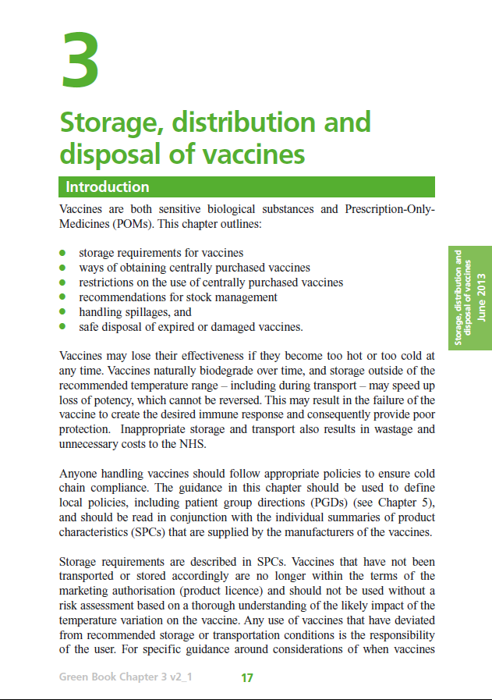
Key Message
Vaccines should be stored between 2-8°C
Action should be taken if there is a breach in cold-chain

Slide 3
Contents
The importance of the cold-chain
The effects of temperature (heat & freezing) and exposure to light on vaccine potency and efficacy
The requirements for the correct ordering, delivery and storage of vaccines in the workplace
The management of breakdowns in the cold-chain, where to dispose of damaged vaccines, who to inform and what action to take
Auditing management of cold chain within your area of practice

Slide 4
What is the Cold-Chain?
The cold chain refers to the system of storing & transporting vaccines within the recommended safe temperature range of 2-8 degrees Celsius.
Notes:
The cold-chain involves all of the storage and transport facilities necessary
to ship a vaccine in the recommended temperature range and quality of
storage facilities.

Slide 5
The Cold-Chain
Manufacturer
Distributor
Provider
…..from the manufacturer to the patient

Slide 6
Cold Chain
“Anyone handling vaccines should follow appropriate procedures to ensure cold-chain compliance”
Vaccines are licensed products and if not stored appropriately = unlicensed use / off label use / off-license use

Slide 7
It is important to maintain the cold-chain because……………..
Vaccines are sensitive biological substances,
  ☹ effectiveness may be lost if they are stored outside of 2-8°C
  ☹ desired immune response may not be achieved
  = poor protection
Loss of vaccines and cost to health service
Poor publicity and reduced uptake rates

Slide 8
Policies are essential because….
It may not be possible to tell by examination if vaccine has been stored appropriately
Policy should be followed to ensure cold-chain has been maintained and provide evidence of compliance
Unless specific advice states otherwise if vaccines are not stored / distributed properly, they should not be used
Each GP practice should nominate a lead person (vaccine controller) and a deputy to manage vaccine ordering, storage and management

Slide 9
Sensitivity to heat, cold and light
Most vaccines should be kept between +2C and +8C (but check manufacturers guidance)
Freezing may cause increased reactogenicity and loss of potency, may crack glass leading to contamination
Most vaccines less sensitive to heat but potency cannot be guaranteed above 8C
Also very sensitive to strong light, so should always be protected against light – store in original packing until point of use

Slide 10
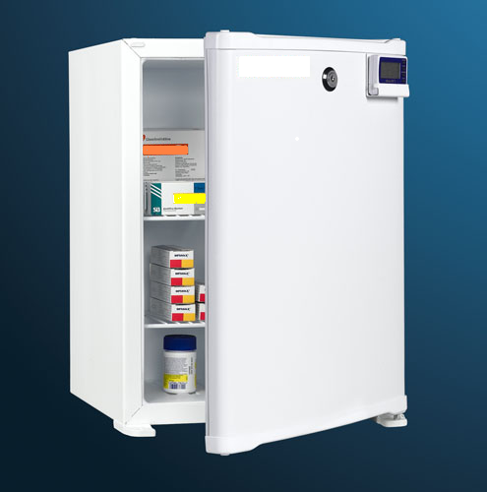
Vaccine Storage
X No food or medical specimens
X Do not place fridge near heat source & keep well ventilated
X Do not remove vaccines from original boxes until ready to use
X Do not store vaccines in fridge doors or in solid plastic trays/containers within the fridge
Use a dedicated specialised pharmaceutical refrigerator
Safeguard electricity supply
No more than 50% full
Group vaccines by type (Paediatric, Adult, Adolescent)
Rotate Stock
Defrost/calibrate fridge regularly
Ensure back up facilities are available in the event of fridge failing
Keep door opening to a minimum
Picture taken from www.medisave.co.uk

Slide 11
Vaccine Refrigerator
Specialised refrigerators are available for the storage of pharmaceutical products and must be used for vaccines and diluents
There should be a maintenance contract in place that allows for at east yearly servicing of fridges and calibration of temperature gauge. Records should be kept of this
Ice should not be allowed to build up. Records should be kept of servicing, defrosting and cleaning
Approved cool box or alternative fridge should be used when defrosting (temp monitored)-vaccines only replaced when fridge is at correct temperature
Vaccines are POMs and should be stored under
locked conditions

Slide 12
Vaccine refrigerator temperatures
Temperature readings should be continually monitored with a minimum-maximum thermometer
All fridges should ideally have two thermometers, one of which is independent of mains power
Strongly recommend use of data-loggers
Annual calibration / consider replacement of thermometer
Care should be taken that the thermometer probe cable does not interfere with the door seal
Opening and closing the refrigerator door should be kept to a minimum in order to maintain a constant temperature
Notes:
When cleaning the fridge it is essential to use another vaccine fridge
/ validated cool box to store vaccines in. Vaccines should only be
returned to the vaccine fridge when it is at the appropriate temperature.
Vaccines are POMs and must be kept undert locked conditions

Slide 13
Temperature Monitoring
Observe the 4 Rs
Read Record Reset React
Do make sure that the person making the recording
Records it at the same time every day during the week and signs the sheet
Records it in a standard fashion and on a standard form
Acts if temperature is outside of +2-+8°C
Resets the thermometer after every reading
Remember if stored outside of +2-+8°C as per licensing conditions is “off-label” and cannot be administered under PGD

Slide 14
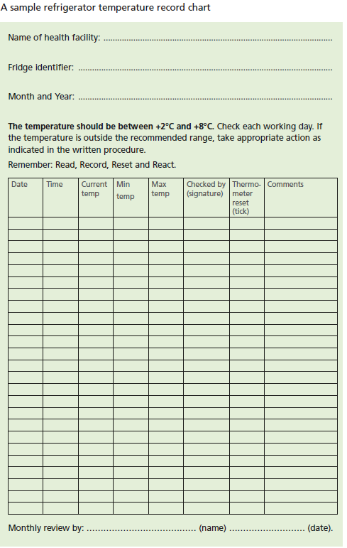
Temperature Records

Slide 15
Data Loggers
New standard recommends “Data Loggers”
Continually measure temperature of fridge and record every 5 minutes / more frequently
When plugged into computer allow continuous reading display since last read
Can tell how long has been outside of temperature range
Should be calibrated annually

Slide 16
Storage Temperature
Should never exceed 8°C or fall below 2°C
Aim for 5°C
Aim to maintain vaccine fridge as close as possible to 5°C as this gives a safety margin of + or – 3 °C

Slide 17
What to do if there has been a
Cold Chain failure
Prior to administration
Contact Pharmacy Department of local Trust for advice – depending on circumstances vaccine can sometimes be used
Any vaccine that has not been stored at a temperature of 2-8ºC as per its licensing conditions = unlicensed use / off-label
Where there is any doubt that cold chain has not been maintained, vaccines should not be used
Written procedure for the disposal of vaccines by incineration should be available locally (Inform Duty-room of vaccine wastage / email details of wastage straight to pha.immunisation.hscni.net )

Slide 18
What to do if there has been a
Cold Chain failure
Post administration
Treat as Serious Untoward Incident
Inform Practice Manager/Line Manager/PHA of the incident
Suspend all immunisation clinics until resolved
Ensure that everyone knows not to use vaccines until advice has been received from pharmacy
Duty-room can provide advice on re-vaccination if required

Slide 19
Ordering and Monitoring of Stock
Vaccine stocks should be monitored by designated person to avoid over ordering or stockpiling
There should be no more than 2-4 weeks supply
Stocks should be arranged so those with shorter expiry dates are used first
Out of date stock should be removed from fridge, and correctly disposed of
Vaccines must never be used past their expiry date unless advised otherwise by Manufacturer or PHA

Slide 20
Excess stock may:
Increase risk of vaccination with out of date vaccines
Increase dangers of over-packed fridge leading to poor airflow, potential freezing and poor stock rotation
Delay introduction of new vaccines until local stocks are used
Increase pressure on clinic fridges during period of high demand – e.g. during flu vaccine season

Slide 21
Storage of Vaccines
Must be kept in original packing
Must not be stored in door, bottom drawers or next to freezer plate – areas where temperatures most likely to go out of range
Allow enough space for air to circulate freely

Slide 22
Vaccine not used at clinic
All reconstituted vaccines and opened single and multi-dose vials must be used within manufacturers recommended time – and should be disposed of correctly.
Unopened vaccines, kept in cool box, can be returned to fridge, but should be labelled and used first next time.

Slide 23
Cool Boxes and Transporting vaccines
Do
Use a validated cool box & cool packs
Monitor max/min temperatures regularly when in use
Keep vaccines in original packaging
Do
Take only enough for particular session
Prevent direct contact with cool packs
Choose appropriate size of cool box
Mark vaccines removed & use as soon as possible after return
Do Not Freeze Cool Packs

Slide 24
Audit management of cold-chain
http://www.ips.uk.net/professional-practice/quality-improvement-tools/quality-improvement-tools/
Vaccine Storage and Transportation

Slide 25
