Slide 1

Flu Immunisation Programme for
Northern Ireland (2022/23)
Notes:
This training resource has been designed to educate healthcare practitioners involved in delivering the flu immunisation programme for the 2021/22 flu season. This resource does not cover the actual administration techniques involved in vaccination. If staff are required to deliver vaccinations they should refer to their line manager for additional training that may be required.

Slide 2
Key Messages
flu immunisation is one of the most effective interventions we can provide to reduce harm from flu and pressures on health and social care services during the winter
it is important to increase flu vaccine uptake in clinical risk groups because of increased risk of death and serious illness if people in these groups catch flu
Influenza during pregnancy may be associated with perinatal mortality, prematurity, smaller neonatal size, lower birth weight and increased risk of complications for mother
vaccination of health and social care workers protects them and reduces risk of spreading flu to their patients, service users, colleagues and family members
by preventing flu infection through vaccination, secondary bacterial infections such as pneumonia are prevented. This reduces the need for antibiotics and helps prevent antibiotic resistance

Slide 3
Impact of COVID pandemic on 2022-23 flu vaccine programme
As a result of non-pharmaceutical interventions in place for COVID-19 (such as mask-wearing, physical and social distancing, and restricted international travel) influenza activity levels were extremely low globally in 2021 to 2022. As a result, a lower level of population immunity against influenza is expected in 2022 to 2023.
Those most at risk from flu are also the most vulnerable to COVID-19 related morbidity and mortality. There is evidence that co-infection of COVID and flu can increase mortality.
Flu vaccine will continue to be extended to all 50 to 64 year olds this year

Slide 4

Flu Overview
Influenza (or flu) is a viral infection affecting the respiratory tract
Is highly infectious and spreads rapidly in closed communities
Can be spread by people with mild / no symptoms
Usually occurs most often in an 8-10 week period during the winter
Notes:
Influenza virus causes an acute viral infection of the respiratory tract commonly referred to as flu.
Flu is highly infectious and spreads rapidly in closed communities. It is possible to have been infected with flu and to have mild / no symptoms.
Serological studies in healthcare professionals have shown that approximately
30-50% of influenza infections can be asymptomatic (Wilde et al 1999). Asymptomatic people can still transmit flu to other people.
Most cases of flu occur during an 8-10 week period during the winter months but sometimes the flu season can start earlier. It is important that people are vaccinated by the end of December to prevent infection.
4

Slide 5
Type of Influenza viruses
There are three types of flu vaccines:
Type
A viruses | Causes the majority of seasonal flu cases Always the cause of pandemics Animal reservoir – birds, wildfowl, also carried by other mammals
B viruses | Associated with low-level sporadic disease Burden of disease mostly in children Predominantly found in humans
C viruses | Minor respiratory illness only
Notes:
There are three types of influenza virus that can cause disease in humans: A,B & C. Influenza A & B are responsible for most clinical illness.
Influenza A causes the majority of seasonal flu cases and is the cause of pandemics. The virus is found in many different animals and may spread between them. Birds, particularly wildfowl, are the main animal reservoir for influenza A.
The burden of Influenza B disease is mostly in children when the severity of illness can be similar to that associated with influenza A.

Slide 6

Flu A virus
Genetic material (RNA) in the centre
Two Surface Antigens
Two surface antigens:
Haemagglutinin (H)
Neuraminidase (N)
There are 18 different types of H and 11 different types of N
e.g. H3N2 or H1N1
Notes:
This slide shows a schematic model of an influenza A virus. Influenza A is an RNA Virus and there are two antigens on the surface of the virus as illustrated.
The role of the Hemagglutinin (H) antigen is to bind to the cells of the host.
There are currently 18 known different types of H surface antigen.
The role of the Neuraminidase (N) antigen is to release the virus from the host cell surface. There are currently 11 known different types of N surface antigen.
The different types of H and N antigens are identified by numbers that when combined provide the name of the influenza A virus e.g. H3N2 / H1N1.

Slide 7
Antigenic Drift
Minor changes (natural mutations) in the genes of flu viruses that occur gradually over time
Antigenic Drift
Notes:
Influenza A viruses are prone to antigenic variation / changes in the principal surface antigens.
Minor changes described as antigenic drift occur progressively from season to season.
The slide describes antigenic drift. These are minor changes that occur gradually over time and are occur progressively from season to season. This means that the circulating strain will differ every year and is the reason why the flu vaccine if given every year as the content may change.

Slide 8
Antigenic Shift
Two or more different strains combine. This abrupt major change results in a new subtype. Immunity from previous flu infections/vaccinations may not protect against the new subtype, potentially leading to a widespread epidemic or pandemic
Antigenic Shift
Notes:
Influenza A virus can also change abruptly when 2 or more different strains of influenza A combine, resulting in antigenic shift and a new subtype of influenza A, to which little / no immunity exists within the general population.
This potentially leads to a widespread epidemic / pandemic.
The World Health Organization (WHO) convenes a group that reviews the global influenza situation (once each year for the northern hemisphere and once for the southern hemisphere) and recommends which flu strains should go in the seasonal vaccine to be produced by manufacturers for the following season six to eight months later. This recommendation is based on information about the circulating viruses and epidemiological data from around the world at that time.
Trivalent vaccines e.g. aTIV contain two subtypes of influenza A and one B virus.
Quadrivalent vaccines for example Fluenz tetra intranasal vaccine (LAIV)/ the Sanofi Pasteur Quadrivalent Influenza vaccine (QIVe) / Flucelvax Tetra (QIVc)) offer additional protection against a second strain of influenza B.
The use of quadrivalent flu vaccines is expected to improve the matching of the vaccine to the circulating B strain(s).

Slide 9
Features of flu
  Easily transmitted by droplets, small-particle aerosols and by hand to mouth/eye contamination from a contaminated surface or respiratory secretions of infected person
  People with mild or no symptoms can still infect others
  Incubation period 1-5 days (average 2-3 days) though may be longer especially in people with immune deficiency
  Common symptoms include:
    Sudden onset of fever, chills, headache, muscle and joint pain and extreme fatigue
    Dry cough, sore throat and stuffy nose
    In young children, gastrointestinal symptoms such as vomiting and diarrhoea, may be seen
Notes:
Flu is easily transmitted by droplets, small particle aerosols and by hand to mouth/eye contamination from a contaminated surface or respiratory secretions of an infected person.
Serological studies in healthcare professionals have shown that approximately 30 to 50% of influenza infections can be asymptomatic¹ but the proportion of influenza infections that are asymptomatic may vary depending on the characteristics of the influenza strain.
In healthy individuals, flu is usually unpleasant but self-limiting with recovery within 2-7 days⁶. Common symptoms include fever, chills, muscle and joint pain and extreme fatigue. Symptoms may also include dry cough, sore throat and stuffy nose. Young children may also experience gastrointestinal symptoms such as vomiting and diarrhoea.

Slide 10
Possible complications of flu
Common:
  Bronchitis
  otitis media (children), sinusitis
  secondary bacterial pneumonia
Less common:
  meningitis, encephalitis, meningoencephalitis
  primary influenza pneumonia
Risk of most serious illness is higher in
      children under six months
      older people
      those with underlying health conditions such as respiratory disease, cardiac disease, long-term neurological conditions or immunosuppression
      pregnant women (flu during pregnancy may be associated with perinatal mortality, prematurity, smaller neonatal size and lower birth weight)
Notes:
Common complications of flu include bronchitis, otitis media in children, sinusitis and secondary bacterial pneumonia. Less commonly flu causes meningitis, encephalitis, meningoencephalitis and primary influenza pneumonia.
The risk of serious illness from flu is higher among children under six months of age, older people and those with underlying health conditions such as respiratory disease, cardiac disease or immunosuppression, as well as pregnant women. Flu in pregnancy is associated with perinatal mortality, prematurity, smaller neonatal size and lower birth weight.

Slide 11
Flu vaccine effectiveness (VE)
The UK has a well-established system to monitor influenza VE each season using data from primary care schemes in England, Scotland, Wales and Northern Ireland
VE varies from one season to the next
Growing flu viruses in eggs results in egg-adapted changes that cause differences between the viruses in the vaccine and the ones that circulate and thus reduce their effectiveness
Over the years, efficacy of the standard egg grown flu vaccines has been calculated around 50-60% for adults aged 18 to 65 years
Efficacy in elderly has always been lower for the non-adjuvanted egg grown inactivated vaccines
Adjuvented vaccines are used in this group because they have been shown to be more effective in reducing incidence of severe disease including bronchopneumonia, hospital admissions and mortality.

Slide 12
Flu vaccine effectiveness for last year - 2022/23
As a result of non-pharmaceutical interventions in place for COVID-19 (such as mask-wearing, physical and social distancing, and restricted international travel) influenza activity levels were extremely low globally in 2021 to 2022.
As a result, a lower level of population immunity against influenza is expected in 2022 to 2023. The majority of cases of respiratory viral infection were for COVID-19

Slide 13
Flu epidemiology

Slide 14
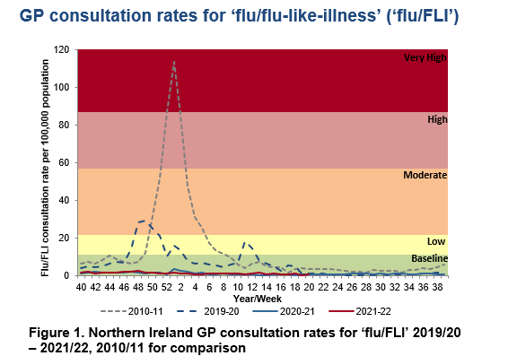
GP flu/FLI consultation rates
The baseline MEM threshold for Northern Ireland is 11.3 per 100,000 population for 2021-22. Low activity is 11.3 to <21.8, moderate activity 21.8 to <57.0, high activity 57.0 to <87.1 and very high activity is >87.1
Notes:
This graph shows the rate of influenza/influenza-like illness episodes in Northern Ireland per 100,000 consultations in primary care for the 2010/11 flu season, 2019/20 season, and 2021/2022. The data show that although flu viruses circulate each winter season, the degree of activity varies substantially.
Last year (2021/22), lower levels of flu activity were seen in comparison with 2010/11.

Slide 15
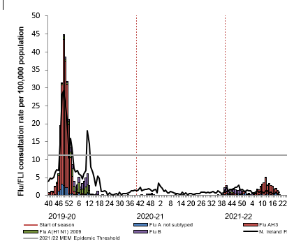
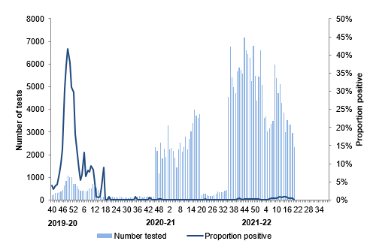
Weekly number of flu laboratory reports with weekly
GP consultation rates for ‘flu/FLI’ and proportion positivity
Note: there was no epidemiological week 53 in the 2019-20 seasonal influenza season
Notes:
Slide 15 – The weekly GP consultation rate for ‘flu/FLI’ remained below the baseline threshold for the duration of the 2021/2022 flu season. The rates observed were at a lower intensity level than observed in previous seasons. Low influenza activity.

Slide 16
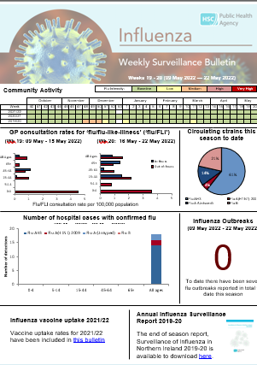
Influenza Weekly Surveillance Bulletin,
Northern Ireland
Public Health Agency weekly Flu Surveillance Bulletin
Notes:
Slide 16: updated image of bulletin to 2021/22 final bulletin
The PHA Health Protection Flu team monitors flu activity throughout the year. This includes information on primary care consultations, laboratory testing and positivity, strain types, indicators of severity including hospitalisations, intensive care admissions, respiratory deaths and excess all-cause mortality.
During the flu season (1st October to end of March) the flu bulletin is available every 2 weeks, and then weekly and can be accessed by PHA website.

Slide 17
National Flu Vaccination Programme
Late 1960s: recommended to directly protect those in clinical risk groups at higher risk of influenza associated morbidity and mortality
2000: extended to include all people aged 65 years or over
2010: pregnancy added as a clinical risk category for routine flu vaccine
2013: All pre-school children from 2 years and primary school children
2020: COVID Pandemic with increased flu vaccine target groups.
2021: Extension to 50-64 year olds, school age children to Year 12 & household contacts of immunocompromised individuals
Notes:
The flu vaccination programme was introduced into NI in the late 1960s and was recommended for those in clinical risk groups that have a higher risk of
associated morbidity and mortality. In 2000 the programme was extended to include everyone > 65 years of age. In 2010 pregnancy was added as a clinical risk category for routine flu immunisation. In 2013 the programme was extended to include pre-school children from 2 years and older and all primary school children
Last year the programme is being further extended to include Year 8 school children and household contacts of anyone who has received a shielding letter during the COVID-19 pandemic.
This year, the vaccination programme has been extended to additional cohorts, such as all healthy 50 to 64 year olds, year 9-12 school children and household contacts of immunocompromised individuals

Slide 18
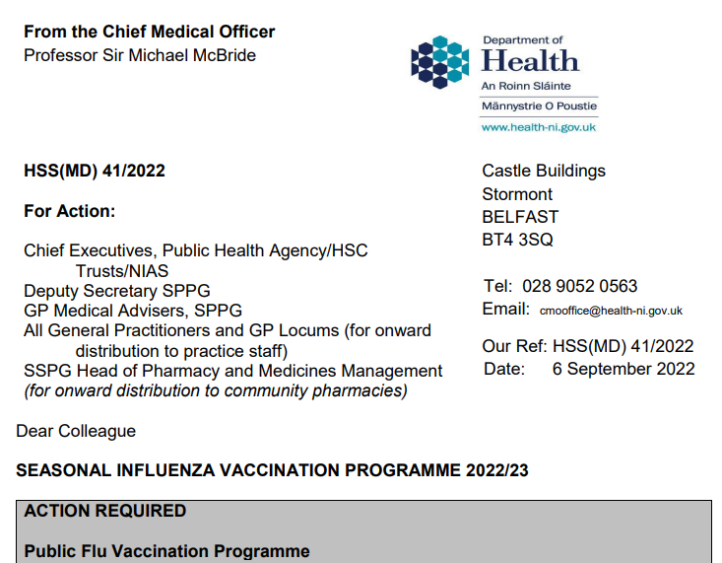
Northern Ireland Flu Vaccine Programme policy: outlined in annual CMO letter 2022/23
  Link to CMO letter published 06.09.2022
Notes:
Every year the Department of Health published the annual CMO season flu letter. This letter provides information on the policy for the seasonal flu programme. Eligible groups, types of vaccine and other relevant information is included within the letter.
As mentioned previously, the letter also states that based on vaccine availability and the uptake rates being achieved, the vaccination programme has been to additional cohorts, such as all healthy 50 to 64 year olds, Year 9-12 secondary school children and household contacts of immunocompromised individuals.

Slide 19
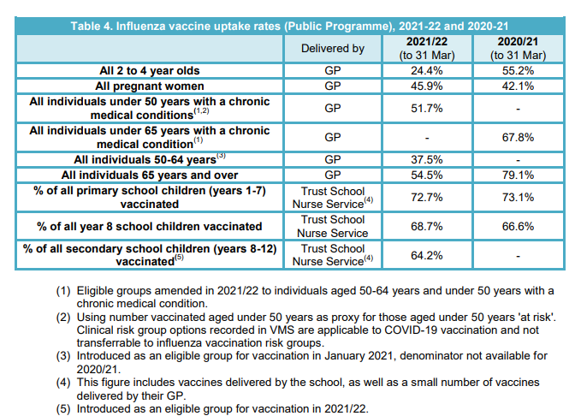
Vaccination Uptake Rates
Notes:
From CMO letter
Vaccine uptake ambitions for 2022 to 2023
PHA have reported flu vaccination uptake for 2021/22 from data extracted from the Vaccine Management System (VMS) (https://www.publichealth.hscni.net/sites/default/files/2022- 05/Flu%20Bulletin%20Week19-20.pdf) but they have advised that caution should be used when comparing VMS data to previous seasons, due to new methods of recording and extracting influenza vaccine data. The Department has therefore 7 also calculated uptake based on claims data provided throughout the 2021/22 programme by GPs.
50-64 years (not at risk), and 65 and over also by Community Pharmacies in 2021/22.

Slide 20
2022/23 uptake Targets
The aim of the influenza programme for 2022 to 2023 is to demonstrate a 100% offer and to achieve at least the uptake levels of 2021 to 2022 for each cohort, and ideally exceed them.
General practices and school providers should ensure all eligible patients are offered the opportunity to be vaccinated by an active call mechanism, supplemented with opportunistic offers where pragmatic.

Slide 21
Eligibility for 2022/23 season
all preschool children aged 2 to 4 years on 1 September 2022
all primary and secondary (up to year 12) school children
those aged six months to under 65 years in clinical risk groups (as defined by the influenza chapter in ‘Immunisation against infectious disease’ (the ‘Green Book’)
those aged 65 years and over on 31 March 2023 (i.e. born on or before 31 March 1958).
pregnant women
those in long-stay residential care homes
carers
Notes:
6 The HSS (MD) 16/2022 letter dated 20 April 2022 confirmed that those eligible for HSC flu vaccine in 2022/23 are:

Slide 22
Eligibility for 2022/23 season
close contacts of immunocompromised individuals
frontline health and social care workers (HSCWs) employed by:
Health and Social Care Trusts including NIAS
community HSC providers including GP practices, pharmacies, dentists, optometrists
registered independent sector residential care or nursing home
registered domiciliary care providers
voluntary managed hospice providers
Notes:
Cohorts that were eligible in the 2021/22 season but that are not included in the cohorts for 2022/23 are:
• those aged 50 to 64 years

Slide 23
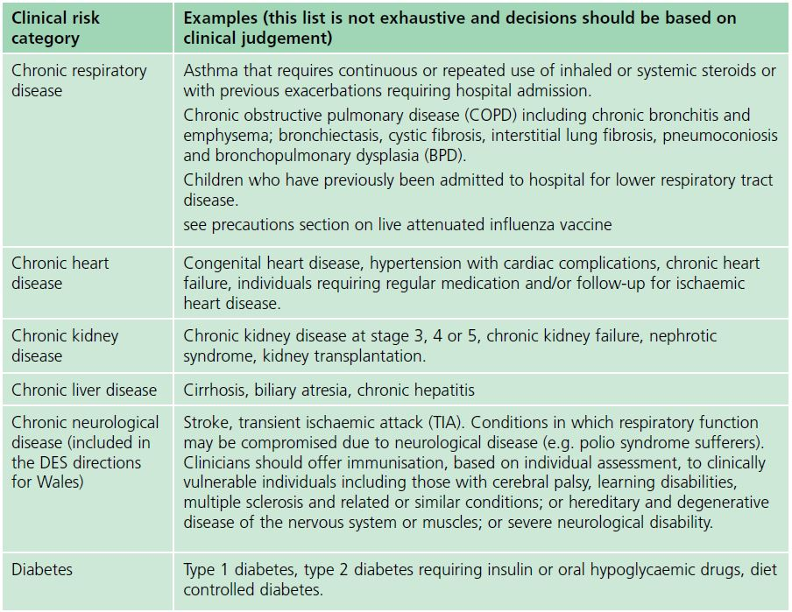
Clinical risk groups
The national flu immunisation programme 2017/18
Notes:
Clinical risk categories also include:
Chronic Respiratory Disease
Chronic Heart Disease
Chronic Kidney Disease
Chronic Liver Disease
Chronic Neurological Disease &
Diabetes
Increasing uptake of flu vaccine is important in clinical risk groups because of the increased risk of death and serious illness if people who are in these groups develop flu. In particular uptake rates in people with chronic liver and neurological disease need to be improved. Some of the highest mortality groups are associated with patients with liver and chronic Neurological disease.

Slide 24
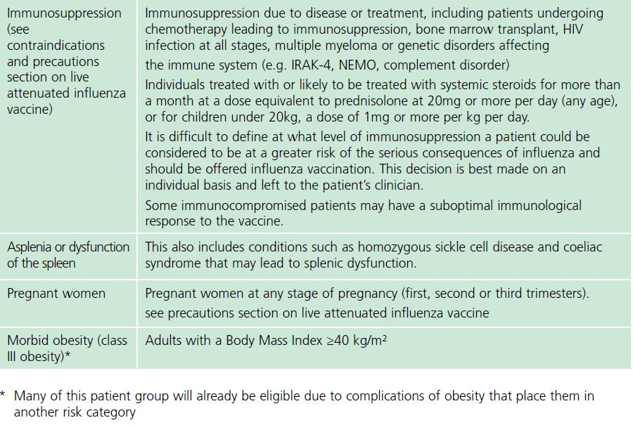
Clinical risk groups
Notes:
Clinical Risk categories also include:
Immunosuppression due to a disease / treatment
Asplenia / dysfunction of the spleen
Pregnant woman at any stage of pregnancy and
Morbid Obesity-many of the patients in this group will already be eligible for the flu vaccine due to complications of obesity that place them in a clinical risk category.

Slide 25
Other groups that should be vaccinated
The list of eligible groups is not exhaustive
Clinical judgement should be applied to take account the risk of exacerbating any underlying disease with flu, as well as the risk of serious illness from flu itself
Those involved in delivering the flu vaccine programmes should be familiar with the Green Book updated chapter October 2020 and the CMO Seasonal flu letter
Notes:
The list of eligible clinical risk groups is not exhaustive, and the healthcare practitioner should apply clinical judgement to take into account the risk of influenza exacerbating any underlying disease that a patient may have, as well as the risk of serious illness from flu itself. Flu vaccine should be offered in such cases even if the individual is not in one of the specified clinical risk groups.
The flu chapter of The Green Book has been updated this year and those involved in delivering flu vaccine programmes should be familiar with the updated chapter and the CMO Seasonal flu letter

Slide 26
Pregnant women
All pregnant women should be offered the inactivated flu vaccine by their G.P. irrespective of the stage of pregnancy
pregnant women are at increased risk of complications from flu
flu during pregnancy is associated with premature birth, and smaller birth weight
flu vaccination during pregnancy provides passive immunity against flu to infants in the first few months of life
studies on flu vaccine safety in pregnancy show that the inactivated flu vaccine can be safely and effectively administered during any trimester of pregnancy
no study to date has demonstrated an increased risk of either maternal complications or adverse fetal outcomes associated with inactivated flu vaccine
Notes:
All pregnant women are recommended to receive the inactivated flu vaccine
irrespective of their stage of pregnancy.
There is good evidence that pregnant women are at increased risk from
complications if they contract flu .In addition, there is evidence that
having flu during pregnancy may be associated with premature birth and
smaller birth size and weight and that flu vaccination may reduce the
likelihood of prematurity and smaller infant size at birth associated with an
influenza infection during pregnancy. Furthermore, a number of studies
show that flu vaccination during pregnancy provides passive immunity against
flu to infants in the first few months of life. A review of studies on the
safety of flu vaccine in pregnancy concluded that inactivated flu vaccine can
be safely and effectively administered during any trimester of pregnancy and
that no study to date has demonstrated an increased risk of either maternal
complications or adverse fetal outcomes associated with inactivated influenza
vaccine.
The ideal time to offer flu vaccination to pregnant women is before flu starts
circulating. However, even after flu is in circulation, vaccine should continue
to be offered to those at risk and newly pregnant women. If a woman becomes pregnant after the usual vaccinating period of October to January, it is still worth considering offering the vaccine if flu is still circulating in the community.

Slide 27
Rationale for vaccinating children against flu
Extension of the seasonal flu vaccination programme to children aims to appreciably lower the public health impact of flu by:
Providing direct protection thus preventing a large number of cases of flu infection in children
Providing indirect protection by lowering flu transmission from children:
      to other children
      to adults
      to those in the clinical risk groups of any age
Notes:
In July 2012, the JCVI recommended extending the annual flu programme to include healthy children aged 2 to their seventeenth birthday in order both
to lower the potentially serious impact of flu in vaccinated children and also to have a more profound effect on flu transmission. Children are the main
source of transmission in the population, and extending the flu programme to include healthy children should therefore reduce the spread of infection
from children to other children, to adults and to those in clinical risk groups of any age. In Northern Ireland the programme was started in pre-school
children > 2 years and all primary school children. From 2020/21, the programme has been extended to include Year 8 children in Northern Ireland.
From 2021/2022, the programme has been further extended to included Year 9-12 secondary children.
Reducing flu transmission in the community will avert many cases of severe flu and flu-related deaths in older adults and people with clinical risk factors.
Since the programme was introduced to pre-school and primary school children in Northern Ireland the levels of GP consultation rates has been lower compared to other parts of the UK and ROI where there was a more limited vaccination programme for healthy children.

Slide 28
Health and social care workers
Duty of care to protect patients and service users from infection
Flu vaccine reduces transmission of flu to:
  HSCW;
  Vulnerable patients, who may have impaired immunity and not respond well to immunisation;
  Colleagues and family members.
Significantly lowers rates of flu-like illness, hospitalisation and mortality in elderly in long-term healthcare settings
Reduces sickness absences and contributes to delivery of Health and Social Care services during winter pressures.
Notes:
Frontline health and social care workers have a duty of care to protect their patients and service users from infection. This includes getting vaccinated
against flu.
Flu outbreaks can occur in health and social care settings with both staff and their patients/service users being affected when flu is circulating in the
community. It is important that health and social care workers protect themselves by having the flu vaccine, and, in doing so, they reduce the risk of spreading flu to their patients, service users, colleagues and family members.
Vaccination of healthcare workers against flu has been shown to significantly lower rates of flu-like illness, hospitalisation and mortality in the elderly in
long-term healthcare settings. Vaccination of staff in acute care settings may provide similar benefits. Flu immunisation of frontline health and social
staff care staff may reduce the transmission of infection to vulnerable patients, some of whom may have impaired immunity, increasing their risks of flu. These people may not respond well to immunisation. Achieving a good uptake of flu vaccine in HCWs is even more important this year because of the increased risk of morbidity and mortality from co-infection with flu and COVID-19.
Vaccination of health and social care workers also helps to reduce the level of sickness absenteeism that can jeopardise health and social care services.

Slide 29
Which flu vaccine?

Slide 30
Types of flu vaccine
Over the years different flu vaccines have been developed to improve effectiveness overall, especially the elderly, and to avoid egg adaption changes
There are now the following types of vaccine available:
  Inactivated vaccines – by injection
    Egg Grown
    Cell Grown
    Adjuvanted
  Live attenuated – by nasal application
This year all vaccines used will be Quadrivalent vaccines contain two subtypes of Influenza A and both B virus types*
None of the flu vaccines can cause clinical influenza in those that can be vaccinated

Slide 31
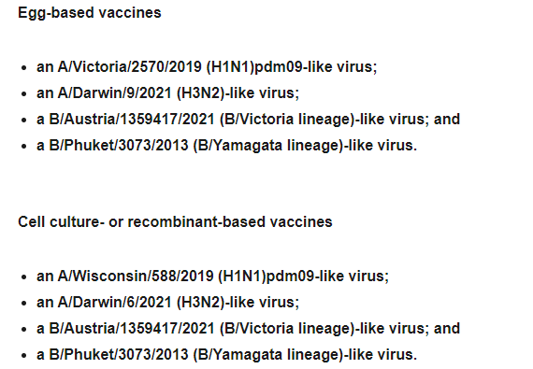
Vaccine Composition:
Northern Hemisphere 2022/23*
WHO.int link
/
Notes:
The World Health Organization (WHO) convenes a group that reviews the global influenza situation (once each year for the northern hemisphere and once for the southern hemisphere) and recommends which flu strains should go in the seasonal vaccine to be produced by manufacturers for the following season six to eight months later. This recommendation is based on information about the circulating viruses and epidemiological data from around the world at that time.
Recommended composition of influenza virus vaccines for use in the 2022-2023 northern hemisphere influenza season (who.int)

Slide 32
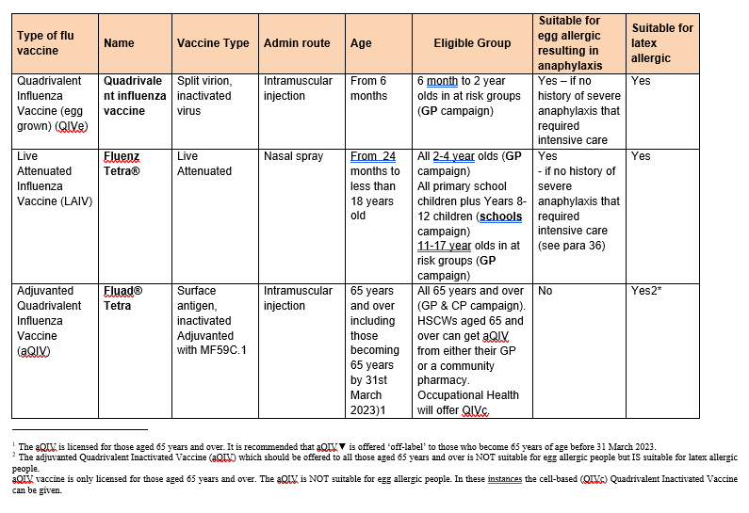
Vaccines for 2022-23 (1)

Slide 33
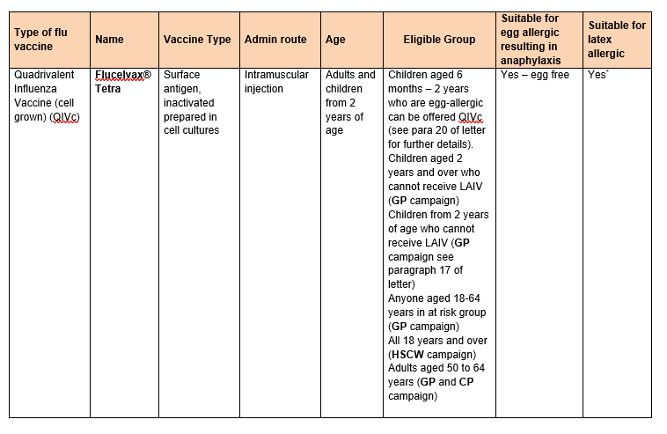
Vaccines for 2022-23 (2)
Notes:
In summary, the recommended vaccines are:
- for those aged 65 years and over an adjuvanted Quadrivalent Inactivated Vaccine (aQIV). The aQIV is more effective and cost-effective in the elderly than non-adjuvanted vaccines and reflects current JCVI advice and Green Book guidance.
- For under-65s (including those in at risk groups aged 2 years and over and pregnant women) offer a Quadrivalent Inactivated Vaccine (cell-based) (QIVc). Children over 2 years of age may also receive QIVc if they have a contraindication to Live Attenuated Influenza Vaccine (LAIV). This reflects current JCVI advice and Green Book guidance.
- A Live Attenuated Influenza Vaccine (LAIV) (Fluenz Tetra®) as first line for eligible children aged two years up to less than 18 years, except those 1 Chapter 14a of the Green Book provides information on what groups can be considered as directly involved in delivering care and is available at: Green Book: Chapter 14a COVID-19. with contraindications such as immunodeficiency, severe asthma or active wheezing.
- Children in clinical risk groups aged 6 months to less than 2 years should be offered Quadrivalent Inactivated Vaccine (egg-based) QIVe.
- None of the influenza vaccines contain thiomersal as an added preservative. Some influenza vaccines are restricted for use in particular age groups. The advice and contraindications and precautions sections in the Green Book influenza chapter and in the relevant Summary of Product Characteristics should be referred to

Slide 34
Vaccines for 2022-23 (3)
*Fluad Tetra and Flucelvax Tetra are supplied in single-dose prefilled syringes, with a plunger stopper (bromobutyl rubber), with attached needles. None of the components of this staked needle prefilled syringe presentation that are in direct contact with the vaccine (syringe barrel, plunger and rubber stopper) are made with natural rubber latex. The needle shield for Fluad Tetra and Flucelvax Tetra contains natural rubber latex. The risk of allergy is extremely small and is considered to be safe in those patients that have latex allergy / latex anaphylaxis.
Please refer to the Green Book Chapter 6: Contraindications and special considerations for further information pages 2&3. https://www.gov.uk/government/publications/contraindications-and-special-considerations-the-green-book-chapter-6

Slide 35
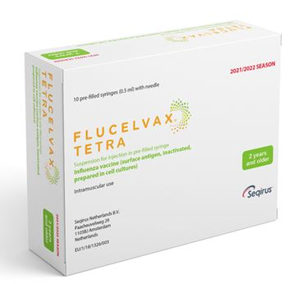
1. Flucelvax Tetra: cell-based Quadrivalent
Inactivated Flu vaccine (QIVc)
First line for all adults 18 to < 65 years who are eligible for the flu vaccine
Second line for adults 65 years and older with egg allergy
Second line for children over 2 years with contraindication to Fluenz Tetra®
Single i.m. injection
  One dose schedule required unless:
    Child is in a clinical risk group and under 9 years old and has not previously received a flu vaccine
  If second dose required leave at least 4 weeks between dose
Needle attached
Notes:
It is recommended for adults age 18 to < 65 years who are eligible. Second line for children over 2 years with contraindication to Fluenz Tetra®
It should be considered for use in Adults 65years+ who have an allergy to eggs .
One dose schedule unless:
Child is in a clinical risk group and
< 9 years old and
Has not previously received a flu vaccine
If second dose required leave at least 4 weeks between doses

Slide 36
Quadrivalent cell culture vaccine
(QIVc)
QIVc (Flucelvax TETRA) was first licenced in the US in 2016 and was licensed in the UK in December 2018 for adults and children from 9 years of age
Flucelvax TETRA is a quadrivalent vaccine containing two subtypes of Influenza A (H3N2 and H1N1pdm00) and both B virus lineages. As the vaccine contains both lineages of B viruses it may provide better protection against circulating flu B strain(s) than trivalent flu vaccines
QIVc has a similar safety profile to other flu vaccines (similar rate and type of adverse reactions reported). More than 36 million doses of cell-based vaccine have been administered with no serious safety concerns
the cell-based vaccine manufacturing process uses an animal cell line (Madin-Darby Canine Kidney, or MDCK) to grow the influenza virus rather than the traditional egg based manufacturing methods
this manufacturing process eliminates the risk of egg-adaptation and may result in the vaccine containing virus that is a closer match to wild-type circulating flu viruses

Slide 37
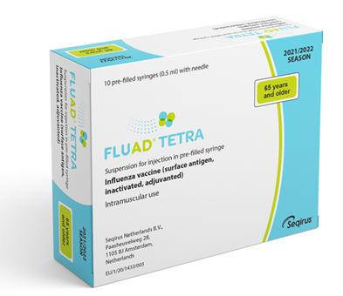
2. Adjuvanted Quadrivalent flu vaccine
(aQIV)
First line for adults 65 years and over
Only licensed for ≥ 65 years at the time of vaccination
Not suitable for those with egg allergies
Single i.m. injection
One dose schedule
Notes:
The vaccine is not suitable for anyone with any type of egg allergy regardless of the severity.
Should only be administered I.M.

Slide 38
Adjuvanted Quadrivalent Influenza Vaccine
(aQIV)
first used in the UK in the 2018 to 2019 flu season in 65y and over age group and was used widely elsewhere. It has been used for 20+ years and over 93 million doses have been distributed worldwide and it has an excellent safety record
Adjuvanted vaccines have higher immunogenicity and effectiveness than non-adjuvanted, normal dose vaccines in older people
An adjuvanted quadrivalent vaccine (aQIV) has replaced aTIV from 2021. This vaccine contains two subtypes of Influenza A (H3N2 and H1N1pdm09) and two type B virus
an adjuvant (MF59) has been added to the vaccine to enhance the immune response to counter the effect of immunosenescence (age related reduction in immune response)
MF59 adjuvant is an oil-in-water emulsion of squalene oil which is a naturally occurring substance found in humans, animals and plants. In humans, it is made in the liver and circulates in the bloodstream
aQIV is made using an egg-based manufacturing process
Notes:
An adjuvanted quadrivalent vaccine (aQIV) has replaced aTIV for 2021 to 2022. This vaccine contains two subtypes of Influenza A (H3N2 and H1N1pdm09) and two type B virus

Slide 39
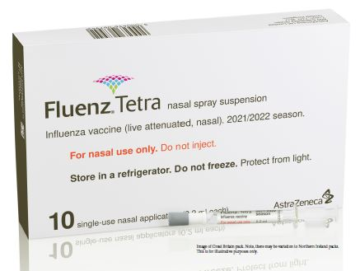
3. Fluenz tetra live attenuated influenza Vaccine (LAIV)
Recommended for children from age 2 years to < 18 years
Also, remains the vaccine of choice for at risk children aged 2 to <18 years – except where contraindicated.
Notes:
Fluenz Tetra is a live attenuated intranasal influenza vaccine.
As well as being the vaccine of choice for healthy children preschool (from age 2 upwards) and children p1-7 and this year, Year 8-12 (the programme delivered by the school nursing team), Fluenz Tetra is also the vaccine of choice for at-risk children age 2-17 years inclusive.
This has been shown to be more effective in children compared with inactivated influenza vaccines (administered by injection)
May offer some protection against strains not contained in the vaccine in addition to those that are, and has potential to offer better protection against virus strains that have undergone antigenic drift
Since this vaccine is comprised of weakened whole live virus, it also replicates natural infection which induces better immune memory (thereby offering better long-term protection to children than from the inactivated vaccines)
LAIV has a good safety profile in children aged two years and older
It is important to note that some Fluenz Tetra stocks may expire (18 week shelf life after released from manufacturer) before the end of December so expiry dates should be checked before use and an effort should be made to try and complete the programme by the end of December.

Slide 40

Fluenz Tetra® (LAIV)
  Ready to use nasal spray (suspension)
  Applicator contains 0.2ml (administered as 0.1ml per nostril)
  LAIV can be administered at the same time as, or at any interval from other vaccines including live vaccines
  Patient should breathe normally – no need to actively inhale
  The vaccine is rapidly absorbed so no need to repeat the dose if patient sneezes, blows their nose or their nose drips following
  One dose required unless:
    Child is in a clinical risk group and under 9 years old and has not previously received a flu vaccine
  If second dose required leave at least 4 weeks between doses
Notes:
Fluenz Tetra® is supplied as a single use prefilled nasal applicator.
It is a live attenuated nasal vaccine and must not be injected
The nasal applicator is ready to use. No reconstitution or dilution is required.
The nasal suspension is colourless to pale yellow, clear to opalescent. Small white particles may be present¹⁹.
Each applicator of Fluenz Tetra (LAIV) contains 0.2ml (that’s 0.1ml administered/ nostril).
One dose is required unless the child is in a clinical risk group and is < 9 years old and has not previously received a flu vaccine. If a second dose is required at least 4 weeks intervals should be left between doses. If the child attends primary school they will be offered the first vaccine in school but there is no mop up and at-risk children should attend their G.P. for vaccination if they have missed the first dose and / require a second dose of vaccine. If Fluenz tetra is not available for use when a child attends for their second vaccine because stocks have expired, the second dose can be replaced with an inactivated vaccine..

Slide 41
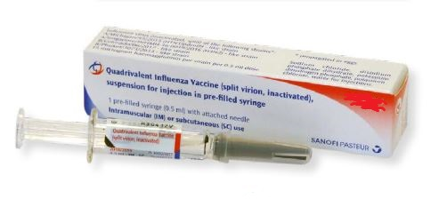
4. Egg-based Quadrivalent Influenza
Vaccine (QIVe)
First line for children 6m to < 2 years in risk groups
Second line if QVIc unavailable
One dose schedule OR
Two doses 4 weeks apart for < 9 years old in clinical risk group and no previous history of flu vaccine
Notes:
Sanofi Pasteur inactivated Quadrivalent flu vaccine is supplied in a pre-filled Syringe containing 0.5 ml dose.
One dose of the vaccine is required unless the patient is a child in a clinical at-risk group and they are < 9 years old and they have not previously received a flu vaccine. If a second vaccine is required an interval of at least 4 weeks should be left between the two vaccines.

Slide 42
Administration of flu vaccines given by injection
Patients taking anticoagulants / with bleeding disorder
Individuals on stable anticoagulation therapy (including individuals on warfarin who are up-to-date with their scheduled INR testing and whose latest INR was below the upper threshold of their therapeutic range) can receive intramuscular vaccination
if in any doubt, consult with the clinician responsible for prescribing or monitoring the individual’s anticoagulant therapy
Please see the relevant section in the Green Book Chapter 19
Notes:
Individuals on stable anticoagulation therapy (including individuals on warfarin who are up-to-date with their scheduled INR testing and whose latest INR was below the upper threshold of their therapeutic range) can receive intramuscular vaccination
if in any doubt, consult with the clinician responsible for prescribing or monitoring the individual’s anticoagulant therapy

Slide 43
Storage of all flu vaccine
  Efficacy, safety and quality may be adversely affected if vaccines are not stored at the temperatures specified in the licence
Must be stored in accordance with manufacturer’s instructions:
  store between +2⁰C and +8⁰C
  do not freeze
  store in original packaging
  protect from light
Check expiry dates regularly:
  the LAIV has an expiry date 18 weeks after manufacture – this is much shorter than inactivated flu vaccines
  it is important that the expiry date on the nasal spray applicator is checked before use
Notes:
Vaccines should be stored in the original packaging at +2°C to +8°C and protected from light. All vaccines are sensitive to some extent to heat and cold. Heat speeds up the decline in potency of most vaccines, thus reducing their shelf life. Efficacy, safety and quality may be adversely affected if vaccines are not stored at the temperatures specified in the licence. Freezing may cause increased reactogenicity and loss of potency for some vaccines and can also cause hairline cracks in the container, leading to contamination of the contents.
Vaccines are expensive and it is important to minimise wastage through inappropriate storage. We have had a few cold-chain failures recently where practices did not place vaccines in the Vaccine fridge on arrival to the practice, resulting in large vaccine losses and it is important to ensure that all staff responsible for handling / storing vaccines have received cold-chain training.
It is also important to check the expiry dates of flu vaccines and to rotate stock to prevent Vaccine loss. LAIV has a shelf life of 18 weeks that starts at the point of release from the manufacturer. This is a shorter shelf life than other influenza vaccines and some of this time will have passed when the vaccine reaches the place where it is to be administered. It is important that the expiry date on the nasal spray applicator is checked before use. If the expiry date has passed, arrangements should be made to have the vaccine disposed of safely.

Slide 44
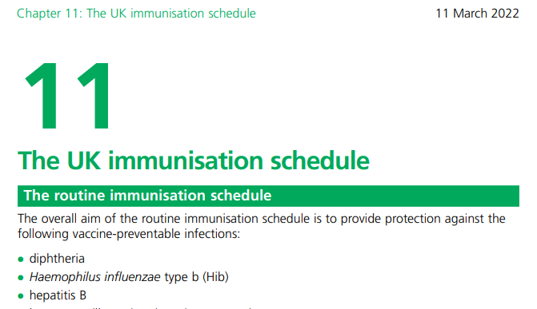
Vaccine Intervals
No interval required between live and inactivated flu vaccines
If two / more vaccines are given at the same time give in separate limbs / leave at least 2.5 cms between administration sites
Fluad should be administered in a separate limb if possible
See Chapter 11 The Green Book
Notes:
There is no interval required between inactivated and live vaccines / LAIV
and any other live vaccine. If it is necessary to administer the inactivated flu vaccine at the same time as other vaccines e.g. PPV / Shingles, the vaccines should be administered in separate limbs / leave at least 2.5 cms between vaccination sites.
aTIV should be administered in a separate limb if possible due to the increased risk of localised reaction. The vaccination sites should be recorded.

Slide 45
Contraindications (Inactivated Vaccines & LAIV)
There are very few individuals who cannot receive any flu vaccine
None of the influenza vaccines should be given to those who have had:
confirmed anaphylactic reaction to a previous dose of the vaccine
confirmed anaphylactic reaction to any component of the vaccine (except ovalbumin see precautions)
The aQIV is contra-indicated in anyone with an egg allergy
Note: Always refer to SPC for individual products when deciding which vaccine to give
Notes:
The SPCs for individual products should always be referred to when deciding which vaccine to give. There are very few individuals who cannot receive any flu vaccine.
None of the influenza vaccines should be given to those who have had:
confirmed anaphylactic reaction to a previous dose of the vaccine
confirmed anaphylactic reaction to any component of the vaccine (except ovalbumin see precautions)
It is important to note that the aTIV is contraindicated in anyone with an egg/ latex allergy. Always refer to the SPC for individual vaccines when deciding which vaccine to give.

Slide 46
Contraindications (LAIV)
The live attenuated flu vaccine (Fluenz Tetra) should not be given to children who are:
clinically severely immunodeficient due to conditions or immunosuppressive therapy:
        acute and chronic leukaemias
        lymphoma
        HIV infection not on highly active antiretroviral therapy
        cellular immune deficiencies
        high dose corticosteroids
receiving salicylate therapy
known to be pregnant
See subsequent slide for children with acute and severe asthma
Notes:
The live attenuated influenza vaccine (Fluenz Tetra®) should not be given to children or adolescents who are clinically severely immunodeficient due to conditions or immunosuppressive therapy such as: acute and chronic leukaemias; lymphoma; HIV infection not on highly active antiretroviral therapy (HAART); cellular immune deficiencies; and high dose corticosteroids. It is not contraindicated for use in children or adolescents with stable HIV infection receiving antiretroviral therapy; or who are receiving topical/inhaled corticosteroids or low-dose systemic corticosteroids or those receiving corticosteroids as replacement therapy, e.g. for adrenal insufficiency.
Chapter 6 of the Green Book on contraindications and special precautions gives further advice on the use of live vaccines in individuals who are severely immunosuppressed²². It states that the definition of “systemic high doses steroids” (and until at least three months after treatment has stopped) would include children who receive prednisolone, orally or rectally, at a daily dose (or its equivalent) of 2mg/ kg/day for at least one week, or 1mg/kg/day for one month. Occasionally, individuals on lower doses of steroids may be immunosuppressed and at increased risk from infections. In those cases, live vaccines should be considered with caution, in discussion with a relevant specialist physician”.
The live attenuated vaccine is contraindicated in children and adolescents receiving salicylate therapy (other than for topical treatment of localised conditions) because of the association of Reye's syndrome with salicylates and wild-type flu infection as described in the SPC for Fluenz Tetra®.
Safety data for the live attenuated flu vaccine when given in pregnancy is limited . Whilst there is no evidence of risk with live attenuated flu vaccine, inactivated flu vaccines are preferred for those who are pregnant. There is no need, however, to specifically test eligible girls for pregnancy or to advise avoidance of pregnancy in those who have been recently vaccinated.

Slide 47
Precautions to flu vaccines
Acutely unwell:
  defer until recovered
Heavy nasal congestion:
  defer live intranasal vaccine until resolved or, if the child is in a risk group, consider inactivated flu vaccine to provide protection without delay
Use with antiviral agents against flu:
live flu vaccine (LAIV) should not be administered at the same time or within 48 hours of cessation of treatment with flu antiviral agents
administration of flu antiviral agents within two weeks of administration of LAIV may adversely affect the effectiveness of the vaccine
Notes:
Minor illnesses without fever of systemic upset are not valid reasons to postpone vaccination. If the individual is acutely unwell, immunisation may be postponed until they have recovered. This is to avoid confusing the differential diagnosis of acute illness by wrongly attributing any signs or symptoms to the adverse effects of the vaccine.
There is no data on the effectiveness of LAIV when given to children with a heavily blocked or runny nose attributable to infection or an allergy. However as heavy nasal congestion might impede delivery of the vaccine to the nasopharyngeal mucosa, deferral of administration until nasal congestion has resolved should be considered or an appropriate alternative influenza vaccine that is administered by injection should be considered.
There is a potential for influenza antiviral agents to lower the effectiveness of the live attenuated influenza vaccine. Administration of influenza antiviral agents within two weeks of administration of LAIV may adversely affect the effectiveness of the vaccine.

Slide 48
Acute and severe asthma
Guidance from JCVI based on recent data (2019)
Children with asthma on inhaled corticosteroids may safely be given LAIV irrespective of the dose prescribed
LAIV is not recommended for children and adolescents currently experiencing an acute exacerbation of symptoms including - those who have had increased wheezing and/or - needed additional bronchodilator treatment in previous 72 hours
Such children should be offered a suitable inactivated influenza vaccine to avoid a delay in protection
Children who require regular oral steroids for maintenance of asthma control, or have previously required intensive care for asthma exacerbation should only be given LAIV on the advice of their specialist
As these children may be at higher risk from influenza infection, those who cannot receive LAIV should receive a suitable inactivated influenza vaccine
Children with significant asthma and aged under nine years who have not been previously vaccinated against influenza will require a second dose (of either LAIV or inactivated vaccine as appropriate).
Notes:
JCVI have advised (2019) that, on the basis of recent data, children with asthma on inhaled corticosteroids may safely be given LAIV, irrespective of the dose prescribed. LAIV is not recommended for children and adolescents currently experiencing an acute exacerbation of symptoms including those who have had increased wheezing and/or needed additional bronchodilator treatment in the previous 72 hours. Such children should be offered a suitable inactivated influenza vaccine to avoid a delay in protection (Sanofi Pasteur Quadrivalent Inactivated Vaccine).
There are limited safety data in children who require regular oral steroids for maintenance of asthma control, or have previously required intensive care for asthma exacerbation – such children should only be given LAIV on the advice of their specialist. As these children may be at higher risk from influenza infection, those who cannot receive LAIV should receive a suitable inactivated influenza vaccine. Children with significant asthma and aged under nine years who have not been previously vaccinated against influenza will require a second dose (of either LAIV or inactivated vaccine as appropriate).

Slide 49
Egg allergy – adults
aQIV vaccine is contraindicated in egg allergy & QIVc should be the preferred option for patients aged 65 and over who have an egg allergy (Cell based)
QIVc is also the vaccine recommended in our programme this year for those age 18-64 who are eligible for the flu vaccine. This vaccine can be used in patients with any type of an egg allergy

Slide 50
Egg allergy – children
Children with an egg allergy that did not result in an intensive care admission can be safely vaccinated with LAIV or QIVe (if aged under 2 years) in any setting (including primary care and schools)
Children aged 2 years of age and over with a history of egg allergy that required admission to intensive care for a previous severe anaphylaxis to egg can now be offered QIVc in any setting (including primary care and schools)
There is no licensed egg-free vaccine available for children under 2 years of age who were admitted to intensive care for severe anaphylaxis to egg. Administration of QIVe in a hospital setting should be considered
Notes:
Children
JCVI has advised that, except for those with severe anaphylaxis to egg which has previously required intensive care, children with an egg allergy can be safely vaccinated with Fluenz Tetra (LAIV) in any setting (including primary care and schools).
Children with a history of severe anaphylaxis to egg which has previously required an intensive care admission, can now be offered QIVc if they are age 2 or older in any setting
Egg-allergic children with asthma can receive LAIV if their asthma is well-controlled (see previous slide on severe asthma).
There is no licensed egg-free vaccine available for children under 2 years of age who were admitted to intensive care for severe anaphylaxis to egg. Administration of QIVe in a hospital setting should be considered

Slide 51
Transmission risk from live vaccine
Theoretical potential for transmission of live attenuated virus to immunocompromised contacts - risk is for one to two weeks following vaccination
Extensive use of live attenuated influenza vaccine in US – no reports of illness among immunocompromised patients inadvertently exposed to vaccinated children
However, where close contact with severely immunocompromised patients (e.g. bone marrow transplant patients requiring isolation) is likely/unavoidable (e.g. household members) consider an appropriate inactivated flu vaccine instead
No reports of transmission of vaccine virus in healthcare settings
As a precaution, however, very severely immunosuppressed healthcare workers should not administer LAIV
Notes:
There is a theoretical potential for transmission of live attenuated influenza virus in Fluenz Tetra to immunocompromised contacts for one to two weeks following vaccination.
In the US, where there has been extensive use of the live attenuated influenza vaccine there have been no reported instances of illness or infections from the vaccine virus among immunocompromised patients inadvertently exposed. Where close contact with very severely immunocompromised patients (e.g. bone marrow transplant patients requiring
isolation) is likely or unavoidable (for example, household members), QIVc / QIVe should considered instead depending on the age of the child.
There has not been any reports of the transmission vaccine virus in healthcare settings however as a precaution, very severely immunosuppressed healthcare workers should administer LAIV

Slide 52
Inadvertent administration of LAIV
if an immunocompromised individual receives LAIV, the degree of immunosuppression should be assessed
if patient is severely immunocompromised, antiviral prophylaxis should be considered
otherwise they should be advised to seek medical advice if they develop flu-like symptoms in the four days following administration of the vaccine
if antivirals are used for prophylaxis or treatment, patient should also be offered inactivated flu vaccine in order to maximise their protection in the forthcoming flu season (this can be given straight away)
Notes:
If an immunocompromised individual receives LAIV then the degree of
immunosuppression should be assessed. If the patient is severely immunocompromised, antiviral prophylaxis should be considered, otherwise they should be advised to seek medical advice if they develop flu-like symptoms in the four days (the usual incubation period) following administration of the vaccine. If antivirals are used for prophylaxis or treatment, then in order to maximise their protection in the forthcoming flu season, the patient should also be offered inactivated influenza vaccine. This can be given straight away.

Slide 53
Commonly reported adverse reactions
Following inactivated flu vaccine:
pain, swelling or redness at the injection site, low grade fever, malaise, shivering, sweating, fatigue, headache, myalgia and arthralgia
a small painless nodule may also form at the injection site
these symptoms usually disappear within one to two days without treatment
Following live attenuated flu vaccine:
nasal congestion/rhinorrhoea, reduced appetite, weakness and headache
Rarely, after live or inactivated vaccine, immediate reactions such as urticaria, angio-oedema, bronchospasm and anaphylaxis can occur
Notes:
Pain, swelling or redness at the injection site, low grade fever, malaise, shivering, sweating, fatigue, headache, myalgia and arthralgia are among the commonly reported symptoms after vaccination with inactivated vaccine. A small painless nodule (induration) may also form at the injection site. These symptoms usually disappear within one to two days without treatment.
Due to the adjuvant, a higher incidence of mild post-immunisation reactions has been reported with aTIV, compared to non-adjuvanted influenza vaccines
Nasal congestion/rhinorrhoea, reduced appetite, weakness and headache are common adverse reaction following administration of Fluenz Tetra® (LAIV).
Rarely immediate reactions such as urticaria, angio-oedema, bronchospasm and anaphylaxis can occur following administration of the inactivated / live vaccine.

Slide 54

Reporting suspected adverse reactions
All serious suspected reactions following flu vaccination should be reported to the Medicines and Healthcare products Regulatory Agency using the Yellow Card scheme at http://yellowcard.mhra.gov.uk/
All of the inactivated quadrivalent flu vaccines carry a black triangle symbol (▼) (as do all vaccines during the earlier stages of their introduction)
This is to encourage reporting of all suspected adverse reactions
Notes:
Flucelvax Tetra® and Sanofi Pasteur quadrivalent inactivated vaccine both carry a black triangle symbol (▼). This is a standard symbol added to the product information of a vaccine during the earlier stages of its introduction, to encourage reporting of all suspected adverse reactions.
All serious suspected reactions following flu vaccines should be reported to the Medicines and Healthcare products Regulatory Agency using the Yellow Card scheme at http://yellowcard.mhra.gov.uk/.

Slide 55
Vaccine Ordering
all injectable flu vaccines are purchased regionally for Northern Ireland
LAIV for children is purchased centrally by PHE for the UK
GP practices must order all flu vaccines via the Movianto online website
Trust Pharmacy should order through the normal pharmacy system for school nurses and HSCW programmes
Providers are responsible for ordering sufficient flu vaccine and taking all steps to avoid over ordering and vaccine wastage
PLEASE Don’t Over Order!
Movianto will deliver within 48 hours of an order being placed, will deliver as often as needed
Only order what you need for the next week
  This avoids large losses if fridge breaks down and being left over at end of campaign
Vaccine can’t be taken back once it has been delivered
Notes:
Please only order the amount of vaccines that you require and do not overstock flu Vaccine. Overstocking can result in loss of a large number of vaccines in the event of a cold-chain failure. Movianto will deliver vaccines within your quota on the next working day. Vaccines can not be returned to Movianto once they have been delivered.
It is particularly important this year to prevent avoidable vaccine losses because of the possibility of adding 50-64 year olds to eligible cohorts.

Slide 56
Recording flu vaccine given
As a wide variety of influenza vaccines are on the UK market each year, it is especially important that the following information be recorded:
vaccine name, product name, batch number and expiry date
dose administered
date immunisation given
route/site used
name and signature of vaccinator
This information should be recorded in: VMS (decision pending)
patient's GP record (or other patient record, depending on location)
personal Child Health Record (the ‘Red Book’) if a child
practice computer system
Child Health Information System

Slide 57
Delivery

Slide 58
2022/23 programme
The official launch date will be 19th September 2022
All Practices should receive initial deliveries of all flu vaccines before the end of September 2021
Practices can start clinics once they have received the vaccine
Leaflets can be downloaded from PHA web-site
PGDs available from end of August / start of September
Notes:
The vaccination programme will officially begin on 1 October 2020, however, those administering the vaccine can and should begin offering the vaccine as soon as they have received their first delivery of vaccine. Practices should receive initial delivery of vaccines before the end of September and should check the Movianto web-site regularly for updates.
Leaflets should be arriving in general practices by the last week in August and additional flu leaflets can also be downloaded from the PHA web-site http://www.publichealth.hscni.net/directorate-public-health/health-protection/immunisationvaccine-preventable-diseases.
HCW leaflets and posters should be available from xxxxxxxxxxx.

Slide 59
When to vaccinate
Vaccinate as soon as vaccine available so people are protected when flu begins to circulate in the community;
Try to vaccinate by December before flu circulation peaks;
However, do continue to offer vaccination throughout the season especially if level of flu activity is high;
Remember that immune response following flu vaccination takes about two weeks to develop fully;
Protection offered by the vaccine is thought to last for at least one influenza season;
As antibody levels are likely to reduce in subsequent seasons, and there may be changes to the circulating strains from one season to next, annual revaccination is important.
Notes:
Although influenza activity is not usually significant in the UK before the middle of November, the influenza season can start early and therefore the ideal time for immunisation is between September and early November. After immunisation, protective immune responses may be achieved within 14 days. Protection afforded by the vaccine is thought to last for at least one influenza season. However, as the level of protection provided in subsequent seasons is likely to reduce and there may be changes to the circulating strains from one season to the next, annual revaccination is important⁶.

Slide 60
General Practice Programme
GPs should actively call all patients aged 50 and over (anyone who will be 50 years of age or over by 31 March 2023)
and any eligible patients under 50 years old for flu vaccine
Notes:
These young people should be directed to Trust centres for co-administration of COVID and flu vaccination (injectable) and informed that they can be offered nasal flu vaccine but not COVID19 vaccine within the practice. This includes young people from 16 years of age 5 with morbid obesity. Children and young people with chronic neurological disease should be prioritised.

Slide 61
Children’s Vaccination Programme
GP Based
GPs should actively call and offer flu vaccine to:
all pre-school children aged two years or more on the 1 September 2022 i.e. those born between 2 July 2018 and 1 September 2020,
Children who miss their offer of a vaccine in school
young people aged 16 and 17 who are in a clinical risk group and who are born before 2 July 2007.
Children in at-risk groups for whom LAIV is unsuitable
Children aged 6 months to less than 2 years should be offered egg-grown quadrivalent influenza vaccine (QIVe).
Notes:
These young people should be directed to Trust centres for co-administration of COVID and flu vaccination (injectable) and informed that they can be offered nasal flu vaccine but not COVID19 vaccine within the practice. This includes young people from 16 years of age 5 with morbid obesity. Children and young people with chronic neurological disease should be prioritised.
The Joint Committee on Vaccination and Immunisation (JCVI) has advised that egg-allergic children aged less than 2 years can be offered the quadrivalent inactivated egg-free vaccine, QIVc (Flucelvax® TETRA). This is an off-label recommendation which is supported by unpublished data which shows non inferiority of immunogenicity and a very similar safety profile for QIVc compared with QIVe in children less than 2 years old.

Slide 62
Children’s Vaccination Programme
School Based
School Health teams offer the flu vaccine to:
all young people in years 8 to 12 of secondary school i.e. those born between 2 July 2006 and 1 July 2011.
all children (including those in a clinical risk group) attending primary school, special school and years 8-12 of secondary school during the 2022/23 academic year i.e. those born between 2 July 2006 to 1 July 2018.
School teams prioritise special schools for early vaccinations.
Notes:
Children in a clinical risk group that attend a mainstream school should receive their vaccine through the normal school health team arrangements. However, if there is high parental anxiety about a child in one of the clinical risk groups with higher risk of disease and where the school vaccine visit is scheduled later in the season (i.e. after end of November) or if flu starts to circulate earlier than previous sessions, GPs (or their paediatrician if they attend the hospital during the early season) are asked to facilitate where possible earlier vaccination if requested. Please see Chapter 19 of the Green Book, table 19.1, for relative risk rates of clinical risk groups in flu.

Slide 63
Health and Social Care Programme
All frontline Trust-employed and Independent Sector Health and Social Care Workers are eligible for the flu vaccine
The cell based Quadrivalent Inactivated Flu Vaccine (QIVc) only will be available including for those under 18 years and over 64 years of age, Suitable for egg / latex allergy
The Trust HSCW Programme is lead by Trust Flu Teams and will include a range of models of delivery like previous years
The Independent Sector HSCW Programme will include a range of delivery options including employer schemes, Trust OHD and community pharmacies

Slide 64
Community Pharmacy
Community pharmacies across NI will be offering the flu vaccine free of charge to
RQIA registered care home residents and staff
any person aged 50 or over
Carers
Pregnant women
frontline Health and Social Care Workers
Notes:
Community pharmacies have built strong links with the care home sector through the successful delivery of the COVID-19 spring booster programme to care home residents, and will offer flu vaccination to all RQIA registered care home residents and staff.
This year, they will also offer flu vaccination to carers and pregnant women to maximise opportunities for co-administration with the COVID-19 autumn booster programme.

Slide 65
Achieving high uptake
The GP practice checklist highlights good practice.
it is based upon the findings from a study examining the factors associated with higher vaccine uptake in general practice
GP practices are encouraged to review their systems in the light of the checklist
most recommendations will also apply to other settings where flu vaccine is given

Slide 66
GP Practice checklist
In order to obtain high vaccine uptake, it is recommended that GP practices:
Identify a named lead individual within the practice who is responsible for the flu vaccination programme
Hold a register that can identify all pregnant women and patients in the under 65 years at risk groups, those aged 65 years and over, and those aged two to four years
Update the patient register throughout the flu season, paying particular attention to the inclusion of women who become pregnant and patients who enter at-risk groups during the flu season
Submit accurate data on the number of its patients eligible to receive flu vaccine and the flu vaccinations given to its patients to HSCB
Order sufficient weekly flu vaccine that takes into account past and planned improved performance, expected demographic increase, and to ensure that everyone at risk is offered the flu vaccine.

Slide 67
GP Practice Checklist (cont.)
Actively invite those eligible to a flu vaccination clinic or to make an appointment (e.g. by letter, email, phone call, text)
Follow-up patients, especially those in at risk groups, who do not respond or fail to attend scheduled clinics or appointments
Start flu vaccination as soon as practicable after receipt of the vaccine
Collaborate with community midwives to offer and provide flu vaccination to pregnant women and to identify, offer and provide to newly pregnant women as the flu season progresses
offer flu vaccination in clinics and opportunistically
collaborate with Trust district nurses to identify and offer flu vaccination to residents in care homes, nursing homes and house-bound patients and to ensure that mechanisms are in place to update the patient record when flu vaccinations are given by other providers

Slide 68
Resources
DH CMO letter seasonal influenza 2022/2023
Flu healthcare worker’s factsheet
PHA flu page
The Green Book: Influenza Chapter
Flu patient information leaflets
Public Health Agency weekly Flu Surveillance Bulletin
Guidance on vaccine handling and storage in GP practices
PHA would like to acknowledge UKHSA for permission to adapt some of their slides and materials for use in Northern Ireland. Slides prepared by the Immunisation and Vaccination Team (PHA, Northern Ireland)
Notes:
Finally the following resources are available and include:
The Green Book’s revised chapter on influenza vaccination, the CMO letter, Flu leaflets and posters and a factsheet on flu vaccination for healthcare workers. This year PHA have added all of the information on flu (including the flu bulletin) to a separate page on the web-site and this can be accessed via the following link:
https://www.publichealth.hscni.net/directorate-public-health/health-protection/influenza

