Slide 1

Childhood Immunisation Programme for
Influenza
Northern Ireland (2022/23)
Notes:
This training resource has been designed to educate healthcare practitioners involved in delivering the childhood flu immunisation programme for the 2022/23 flu season. This resource does not cover all the actual administration techniques involved in vaccination. If staff are required to deliver vaccinations they should refer to their line manager for additional training that may be required.

Slide 2
Key messages
the childhood flu programme should reduce the impact of seasonal flu on children and reduce transmission of flu within the community
by reducing transmission of flu, it should also avert many cases of severe flu and flu-related deaths in older adults and people in clinical risk groups

Slide 3
Impact of COVID pandemic on 2022-23 flu vaccine programme
As a result of non-pharmaceutical interventions in place for COVID-19 (such as mask-wearing, physical and social distancing, and restricted international travel) influenza activity levels were extremely low globally in 2021 to 2022. As a result, a lower level of population immunity against influenza is expected in 2022 to 2023.
Those most at risk from flu are also the most vulnerable to COVID-19 related morbidity and mortality. There is evidence that co-infection of COVID and flu can increase mortality.
Eligible groups continue to include: all children up to School Year 12

Slide 4
Aims of resource
The purpose of this training resource is to:
develop the knowledge base of healthcare practitioners regarding the 2022/23 flu vaccination programme for children
support healthcare practitioners involved in discussing flu vaccination for children with parents and carers by providing evidence based information
promote high uptake of flu vaccination in children through increasing the knowledge of those involved in delivering the vaccination programme
provide information on the administration of the live attenuated intranasal influenza vaccine

Slide 5

What is Flu?
Influenza (or flu) is a viral infection affecting the respiratory tract
Is highly infectious and spreads rapidly in closed communities
Can be spread by people with mild / no symptoms
Usually occurs most often in an 8-10 week period during the winter
Notes:
Influenza virus causes an acute viral infection of the respiratory tract commonly referred to as flu. Flu is highly infectious and spreads rapidly in closed communities.
It is possible to have been infected with flu and to have mild / no symptoms. Serological studies in healthcare professionals have shown that approximately 30-50% of influenza infections can be asymptomatic (Wilde et al 1999). Asymptomatic people can still transmit flu to other people.
Most cases of flu occur during an 8-10 week period during the winter months but sometimes the flu season can start earlier. It is important that people are vaccinated by the end of December to prevent infection.
5

Slide 6
Type of Influenza viruses
There are three types of flu vaccines:
Type
A viruses | Causes the majority of seasonal flu cases Always the cause of pandemics Animal reservoir – birds, wildfowl, also carried by other mammals
B viruses | Associated with low-level sporadic disease Burden of disease mostly in children Predominantly found in humans
C viruses | Minor respiratory illness only
Notes:
There are three types of influenza virus that can cause disease in humans: A,B & C. Influenza A & B are responsible for most clinical illness.
Influenza A causes the majority of seasonal flu cases and is the cause of pandemics. The virus is found in many different animals and may spread between them. Birds, particularly wildfowl, are the main animal reservoir for influenza A.
The burden of Influenza B disease is mostly in children when the severity of illness can be similar to that associated with influenza A.

Slide 7

Flu A virus
Genetic material (RNA) in the centre
Two Surface Antigens
Two surface antigens:
Haemagglutinin (H)
Neuraminidase (N)
There are 18 different types of H and 11 different types of N
e.g. H3N2 or H1N1
Notes:
This slide shows a schematic model of an influenza A virus. Influenza A is an RNA Virus and there are two antigens on the surface of the virus as illustrated.
The role of the Hemagglutinin (H) antigen is to bind to the cells of the host.
There are currently 18 known different types of H surface antigen.
The role of the Neuraminidase (N) antigen is to release the virus from the host cell surface. There are currently 11 known different types of N surface antigen.
The different types of H and N antigens are identified by numbers that when combined provide the name of the influenza A virus e.g. H3N2 / H1N1.

Slide 8
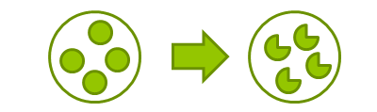
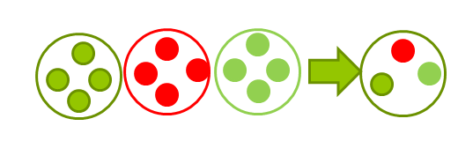
Genetic changes in the flu virus – what this means
Changes in surface antigens result in the virus constantly changing
Antigenic Drift: Minor changes (natural mutations) in the genes of flu A viruses occur gradually over time from season to season
Antigenic Shift: When two or more different strains combine. This abrupt change may result in a new Flu A subtype Immunity from previous flu infections/vaccinations may not protect against the new subtype potentially lead to widespread epidemic or pandemic
WHO monitors epidemiology throughout the world and the recommends the strains of influenza A and B predicted to be circulating in the forthcoming winter. These strains are included in the flu vaccine developed each year
Notes:
Influenza A viruses are prone to antigenic variation / changes in the principal surface antigens. There are two types of antigenic change that can occur:
Antigenic drift
Antigenic shift
The slide describes antigenic drift. These are minor changes that occur gradually over time and are occur progressively from season to season. This means that the circulating strain will differ every year and is the reason why the flu vaccine if given every year as the content may change.
This slides describes antigenic shift. This is when the when 2 or more different strains of influenza A combine abruptly resulting in a new influenza A subtype to which little / no immunity exists within the general population. This potentially leads to a widespread epidemic / pandemic.

Slide 9
Features of flu
  Easily transmitted by droplets, small-particle aerosols and by hand to mouth/eye contamination from a contaminated surface or respiratory secretions of infected person
  People with mild or no symptoms can still infect others
  Incubation period 1-5 days (average 2-3 days) though may be longer especially in people with immune deficiency
  Common symptoms include:
    Sudden onset of fever, chills, headache, muscle and joint pain and extreme fatigue
    Dry cough, sore throat and stuffy nose
    In young children, gastrointestinal symptoms such as vomiting and diarrhoea, may be seen
Notes:
Flu is easily transmitted by droplets, small particle aerosols and by hand to mouth/eye contamination from a contaminated surface or respiratory secretions of an infected person.
Serological studies in healthcare professionals have shown that approximately 30 to 50% of influenza infections can be asymptomatic¹ but the proportion of influenza infections that are asymptomatic may vary depending on the characteristics of the influenza strain.
In healthy individuals, flu is usually unpleasant but self-limiting with recovery within 2-7 days⁶. Common symptoms include fever, chills, muscle and joint pain and extreme fatigue. Symptoms may also include dry cough, sore throat and stuffy nose. Young children may also experience gastrointestinal symptoms such as vomiting and diarrhoea.

Slide 10
Possible complications of flu
Common:
  Bronchitis
  otitis media (children), sinusitis
  secondary bacterial pneumonia
Less common:
  meningitis, encephalitis, meningoencephalitis
  primary influenza pneumonia
Risk of most serious illness is higher in
      children under six months
      older people
      those with underlying health conditions such as respiratory disease, cardiac disease, long-term neurological conditions or immunosuppression
      pregnant women (flu during pregnancy may be associated with perinatal mortality, prematurity, smaller neonatal size and lower birth weight)
Notes:
Common complications of flu include bronchitis, otitis media in children, sinusitis and secondary bacterial pneumonia. Less commonly flu causes meningitis, encephalitis, meningoencephalitis and primary influenza pneumonia.
The risk of serious illness from flu is higher among children under six months of age, older people and those with underlying health conditions such as respiratory disease, cardiac disease or immunosuppression, as well as pregnant women. Flu in pregnancy is associated with perinatal mortality, prematurity, smaller neonatal size and lower birth weight.

Slide 11
Rationale for vaccinating children against flu
Extension of the seasonal flu vaccination programme to children aims to appreciably lower the public health impact of flu by:
providing direct protection thus preventing a large number of cases of flu in children
providing indirect protection by lowering flu transmission from children:
      to other children
      to adults
      to those in the clinical risk groups of any age
Reducing flu transmission in the community should avert many cases of severe flu and flu-related deaths in older adults and people with clinical risk factors
Annual administration of flu vaccine to children is expected to substantially reduce flu-related illness, GP consultations, hospital admissions and deaths

Slide 12
Flu epidemiology

Slide 13
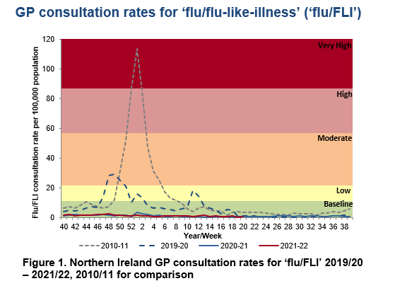
GP flu/FLI consultation rates
The baseline MEM threshold for Northern Ireland is 11.3 per 100,000 population for 2021-22. Low activity is 11.3 to <21.8, moderate activity 21.8 to <57.0, high activity 57.0 to <87.1 and very high activity is >87.1
Notes:
This graph shows the rate of influenza/influenza-like illness episodes in Northern Ireland per 100,000 consultations in primary care for the 2010/11 flu season, 2019/20 season, and 2021/2022. The data show that although flu viruses circulate each winter season, the degree of activity varies substantially.
Last year (2021/22), lower levels of flu activity were seen in comparison with 2010/11.

Slide 14
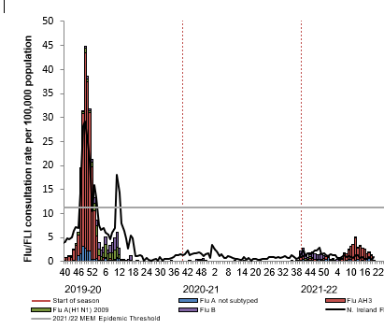
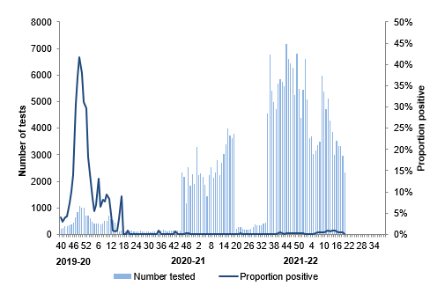
Weekly number of flu laboratory reports with weekly
GP consultation rates for ‘flu/FLI’ and proportion positivity
Note: there was no epidemiological week 53 in the 2019-20 seasonal influenza season
Notes:
Slide 14 – The weekly GP consultation rate for ‘flu/FLI’ remained below the baseline threshold for the duration of the 2021/2022 flu season. The rates observed were at a lower intensity level than observed in previous seasons. Low influenza activity.

Slide 15
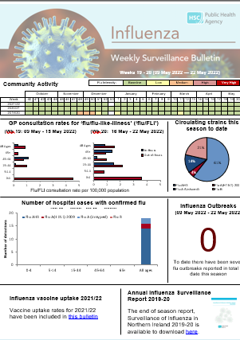
Influenza Weekly Surveillance Bulletin
Northern Ireland
Public Health Agency weekly Flu Surveillance Bulletin
Notes:
Slide 15: updated image of bulletin to 2020/21 final bulletin
The PHA Health Protection Flu team monitors flu activity throughout the year. This includes information on primary care consultations, laboratory testing and positivity, strain types, indicators of severity including hospitalisations, intensive care admissions, respiratory deaths and excess all-cause mortality.
During the flu season (1st October to end of March) the flu bulletin is available every 2 weeks, and then weekly and can be accessed by PHA website.

Slide 16
National Flu Vaccination Programme
Late 1960s: recommended to directly protect those in clinical risk groups at higher risk of influenza associated morbidity and mortality
2000: extended to include all people aged 65 years or over
2010: pregnancy added as a clinical risk category for routine flu vaccine
2013: All pre-school children from 2 years and primary school children
2020: COVID Pandemic with increased flu vaccine target groups.
2021: Extension to 50-64 year olds, school age children to Year 12 & household contacts of immunocompromised individuals
Notes:
The flu vaccination programme was introduced into NI in the late 1960s and was recommended for those in clinical risk groups that have a higher risk of
associated morbidity and mortality. In 2000 the programme was extended to include everyone > 65 years of age. In 2010 pregnancy was added as a clinical risk category for routine flu immunisation. In 2013 the programme was extended to include pre-school children from 2 years and older and all primary school children
Last year the programme was further extended to include Year 8 school children and household contacts of anyone who has received a shielding letter during the COVID-19 pandemic.
This year, the vaccination programme will continue to extend to additional cohorts, such as all healthy 50 to 64 year olds, year 9-12 school children and household contacts of immunocompromised individuals

Slide 17
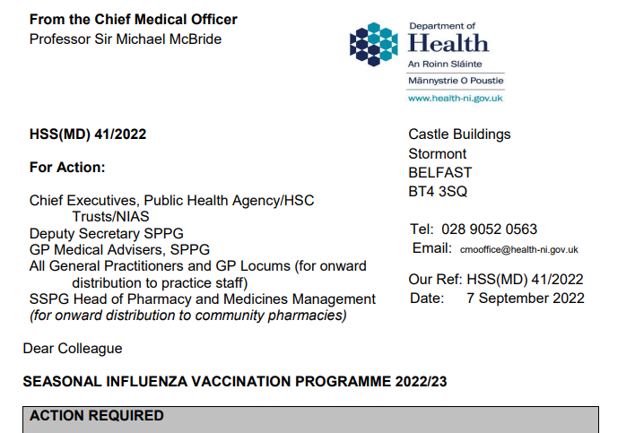
Northern Ireland Flu Vaccine Programme policy: outlined in annual CMO letter 2022/23
  Link to CMO letter published 07.09.2022
Notes:
Every year the Department of Health published the annual CMO season flu letter. This letter provides information on the policy for the seasonal flu programme. Eligible groups, types of vaccine and other relevant information is included within the letter.
As mentioned previously, the letter also states that based on vaccine availability and the uptake rates being achieved, the vaccination programme has been extended to additional cohorts, such as all healthy 50 to 64 year olds, Year 9-12 secondary school children and household contacts of immunocompromised individuals.

Slide 18
Eligibility for 2022/23 childhood flu vaccination programme
Note the eligibility groups remain expanded this year to (include
Year 9-12 school children)
The list of eligible groups is not exhaustive
Clinical judgement should be applied to take account the risk of exacerbating any underlying disease with flu, as well as the risk of serious illness from flu itself
The flu chapter of The Green Book has been updated this year and those involved in delivering flu vaccine programmes should be familiar with the updated chapter and the CMO Seasonal flu letter
Notes:
As already mentioned, the list of clinical risk groups is not exhaustive, and the healthcare practitioner should apply clinical judgement to take into account the risk of influenza exacerbating any underlying disease that a patient may have, as well as the risk of serious illness from flu itself. Flu vaccine should be offered in such cases even if the individual is not in one of the specified clinical risk groups.
Consideration should also be given to vaccinating (with inactivated vaccine), household contacts or carers of immunocompromised individuals, i.e. individuals who expect to share living accommodation on most days over the winter and for whom close contact is unavoidable.

Slide 19
2022/23 childhood flu vaccine programme
Individuals in a clinical risk group from aged six months;
all pre-school children aged two years or more on the 1 September 2022
all young people in academic years 8 to 12 of secondary school i.e. those born between 2 July 2006 and 1 July 2011.
all children (including those in a clinical risk group) attending primary school, special school and years 8-12 of secondary school during the 2022/23 academic year i.e. those born between 2 July 2006 to 1 July 2018.
Notes:
Details are included in the Department of Health (NI) CMO letter Department of Health (NI) CMO Letter
and Chapter 19 of The Green Book https://www.gov.uk/government/publications/influenza-the-green-book-chapter-19
Child contacts of very severely immunocompromised individuals should be given inactivated vaccine rather than the live intranasal vaccine that would normally be recommended for children age 2 to under 18 years.

Slide 20
Clinical risk groups
Clinical risk category | Examples (this list is not exhaustive and decisions should be based on clinical judgement)
Chronic respiratory disease | Asthma that requires continuous or repeated use of inhaled or systemic steroids or with previous exacerbations requiring hospital admission. Chronic obstructive pulmonary disease (COPD) including chronic bronchitis and emphysema; bronchiectasis, cystic fibrosis, interstitial lung fibrosis, pneumoconiosis and bronchopulmonary dysplasia (BPD). Children who have previously been admitted to hospital for lower respiratory tract disease. see precautions section on live attenuated influenza vaccine
Chronic heart disease | Congenital heart disease, hypertension with cardiac complications, chronic heart failure, individuals requiring regular medication and/or follow-up for ischaemic heart disease.
Chronic kidney disease | Chronic kidney disease at stage 3, 4 or 5, chronic kidney failure, nephrotic syndrome, kidney transplantation.
Chronic liver disease | Cirrhosis, biliary atresia, chronic hepatitis
Chronic neurological disease | Stroke, transient ischaemic attack (TIA), Parkinson’s disease, motor neurone disease. Conditions in which respiratory function may be compromised due to neurological disease (eg polio syndrome sufferers). Clinicians should offer immunisation, based on individual assessment, to clinically vulnerable individuals including those with cerebral palsy, learning disabilities, multiple sclerosis and related or similar conditions; or hereditary and degenerative disease of the nervous system or muscles; or severe neurological disability
Learning disability
Diabetes | Type 1 diabetes, type 2 diabetes requiring insulin or oral hypoglycaemic drugs, diet controlled diabetes.
Notes:
This slide and the next outline the clinical risk groups as described in the Green Book. The Green Book should be consulted for further and more detailed information.
Increasing uptake of flu vaccine is important in clinical risk groups because of the increased risk of death and serious illness if people who are in these groups develop flu. In particular uptake rates in people with chronic liver and neurological disease need to be improved. Some of the highest mortality groups are associated with patients with liver and chronic neurological disease.

Slide 21
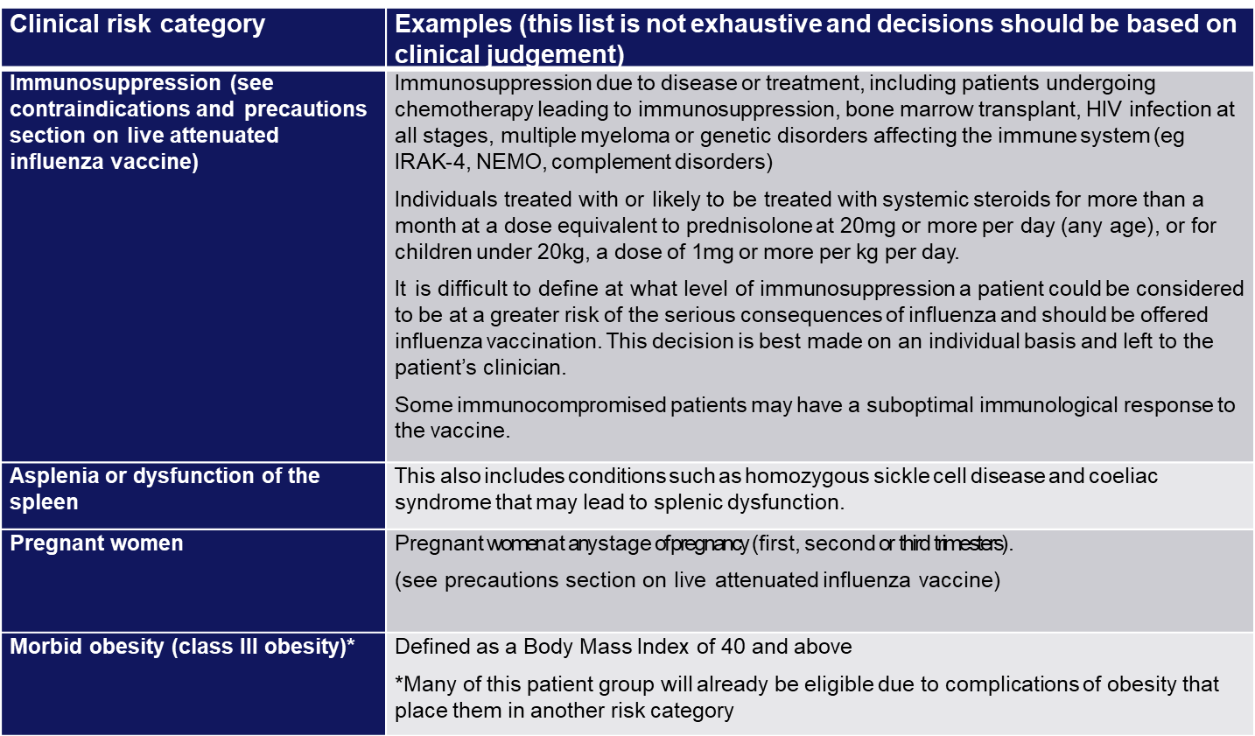
Clinical risk groups (cont.)

Slide 22
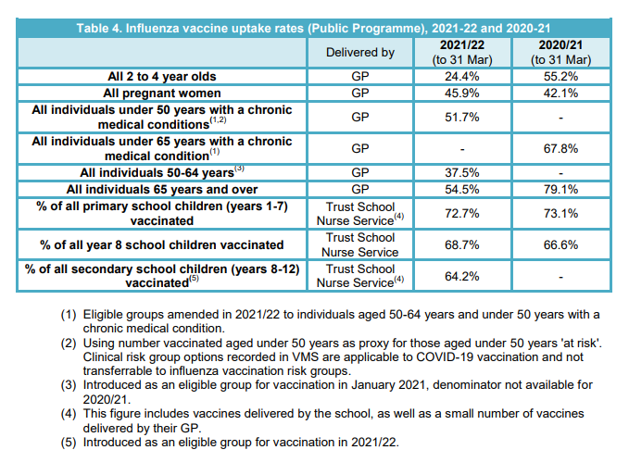
Vaccination Uptake Rates
Notes:
From CMO letter
Vaccine uptake ambitions for 2022 to 2023
PHA have reported flu vaccination uptake for 2021/22 from data extracted from the Vaccine Management System (VMS) (https://www.publichealth.hscni.net/sites/default/files/2022- 05/Flu%20Bulletin%20Week19-20.pdf) but they have advised that caution should be used when comparing VMS data to previous seasons, due to new methods of recording and extracting influenza vaccine data. The Department has therefore 7 also calculated uptake based on claims data provided throughout the 2021/22 programme by GPs.
50-64 years (not at risk), and 65 and over also by Community Pharmacies in 2021/22.

Slide 23
2022/23 Uptake Targets
The aim of the influenza programme for 2022 to 2023 is to demonstrate a 100% offer and to achieve at least the uptake levels of 2021 to 2022 for each cohort, and ideally exceed them.
General practices and school providers should ensure all eligible patients are offered the opportunity to be vaccinated by an active call mechanism, supplemented with opportunistic offers where pragmatic.

Slide 24
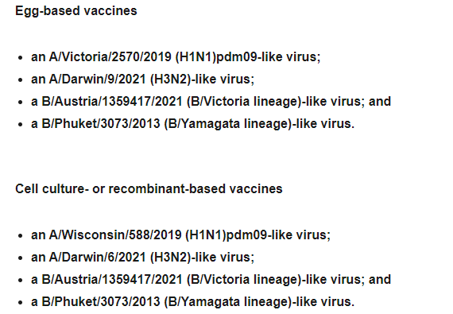
Vaccine Composition: Antigens
Northern Hemisphere 2022/23*
*https://www.who.int/influenza/vaccines/virus/recommendations/2020-21_north/en/
Notes:
The World Health Organization (WHO) convenes a group that reviews the global influenza situation (once each year for the northern hemisphere and once for the southern hemisphere) and recommends which flu strains should go in the seasonal vaccine to be produced by manufacturers for the following season six to eight months later. This recommendation is based on information about the circulating viruses and epidemiological data from around the world at that time.
Recommended composition of influenza virus vaccines for use in the 2022-2023 northern hemisphere influenza season (who.int)

Slide 25
Types of flu vaccines
Two main types of vaccine available:
  inactivated – by injection
  live attenuated – by nasal application
none of the flu vaccines can cause clinical influenza in those that can be vaccinated
both the live and inactivated flu vaccines supplied for children’s programme are quadrivalent vaccines – they contain two subtypes of Influenza A and both B virus types
the inactivated vaccine is recommended for children who cannot receive live attenuated vaccine
Notes:
Inactivated flu vaccines given by intramuscular injection have been used in the UK for many years. The live intranasal influenza vaccine (LAIV) was introduced into the UK schedule in 2013. However, a live intranasal flu vaccine called FluMist (same vaccine as Fluenz, different trade name) was introduced in the US schedule in 2003 so although the live vaccine is newer, there is well over a decade’s experience of widespread use of the vaccine in the US. We now have 6 years experience using Fluenz LAIV vaccine in the UK.
Inactivated flu vaccines used to be trivalent only, containing two subtypes of influenza A and one B virus. However, quadrivalent vaccines, containing two subtypes of influenza A and both B virus types are now used more widely in the UK. The live intranasal vaccine is a quadrivalent vaccine (hence the ‘Tetra’ part of the name Fluenz Tetra). An inactivated quadrivalent vaccine is available to order from ImmForm for children aged 6 months and over who are contraindicated to receive the LAIV.
NB The Fluenz vaccine used in the 2013/14 flu season was a trivalent live vaccine. The quadrivalent Fluenz Tetra vaccine was first used in the 2014/15 flu season and has been used in all flu seasons subsequently.

Slide 26
Vaccines procured in Northern Ireland for use in children 2022/23
Live attenuated intranasal vaccine (LAIV) Fluenz tetra
(Children aged 2 - 18 years)
Inactivated influenza vaccine (egg grown) (QIVe)
Sanofi Pasteur Quadrivalent Influenza Vaccine
(Children 6mths – 2years)
Inactivated influenza vaccine (cell grown) (QIVc) – Flucelvax Tetra
(Children >2 years if LAIV contraindicated in general practice and school nursing)
Notes:
There are 2 types of flu vaccine available:
The Live attenuated influenza vaccine is administered intranasally and the only vaccine available for use is Fluenz tetra – this is for use in children between the age of 2 and 18 years old
Inactivated flu vaccine is given by injection
Vaccines available for use in children, include a cell-based quadrivalent inactivated vaccine (QIVc) or Flucelvax tetra, and an egg-based quadrivalent inactivated vaccine.

Slide 27
1. Live attenuated influenza
Vaccine (LAIV) - Fluenz Tetra®
Recommended for children from age 2 years to < 18 years
Also, remains the vaccine of choice for at risk children aged 2 to <18 years – except where contraindicated.
Notes:
Fluenz Tetra is a live attenuated intranasal influenza vaccine.
As well as being the vaccine of choice for healthy children preschool (from age 2 upwards) and children p1-7 and this year, Year 8-12 (the programme delivered by the school nursing team), Fluenz Tetra is also the vaccine of choice for at-risk children age 2-17 years inclusive.
This has been shown to be more effective in children compared with inactivated influenza vaccines (administered by injection)
May offer some protection against strains not contained in the vaccine in addition to those that are, and has potential to offer better protection against virus strains that have undergone antigenic drift
Since this vaccine is comprised of weakened whole live virus, it also replicates natural infection which induces better immune memory (thereby offering better long-term protection to children than from the inactivated vaccines)
LAIV has a good safety profile in children aged two years and older
It is important to note that some Fluenz Tetra stocks may expire (18 week shelf life after released from manufacturer) before the end of December so expiry dates should be checked before use and an effort should be made to try and complete the programme by the end of December.

Slide 28

Fluenz Tetra® (LAIV)
  Ready to use nasal spray (suspension)
  Applicator contains 0.2ml (administered as 0.1ml per nostril)
  LAIV can be administered at the same time as, or at any interval from other vaccines including live vaccines
  Patient should breathe normally – no need to actively inhale
  The vaccine is rapidly absorbed so no need to repeat the dose if patient sneezes, blows their nose or their nose drips following
  One dose required unless:
    Child is in a clinical risk group and under 9 years old and has not previously received a flu vaccine
  If second dose required leave at least 4 weeks between doses
Notes:
Fluenz Tetra® is supplied as a single use prefilled nasal applicator.
It is a live attenuated nasal vaccine and must not be injected
The nasal applicator is ready to use. No reconstitution or dilution is required.
The nasal suspension is colourless to pale yellow, clear to opalescent. Small white particles may be present¹⁹.
Each applicator of Fluenz Tetra (LAIV) contains 0.2ml (that’s 0.1ml administered/ nostril).
One dose is required unless the child is in a clinical risk group and is < 9 years old and has not previously received a flu vaccine. If a second dose is required at least 4 weeks intervals should be left between doses. If the child attends primary school they will be offered the first vaccine in school but there is no mop up and at-risk children should attend their G.P. for vaccination if they have missed the first dose and / require a second dose of vaccine. If Fluenz tetra is not available for use when a child attends for their second vaccine because stocks have expired, the second dose can be replaced with Sanofi Pasteur quadrivalent inactivated vaccine.

Slide 29
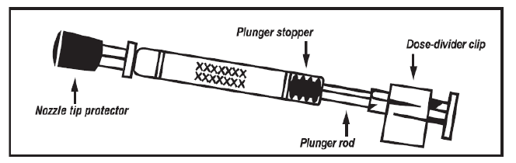
LAIV applicator
Image taken from Fluenz Tetra® SPC

Slide 30
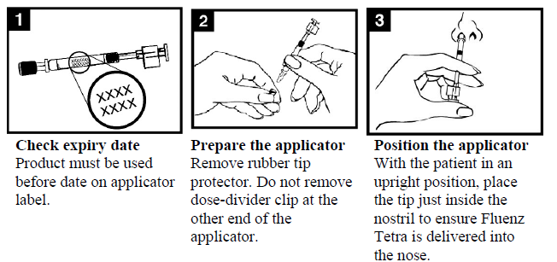
Administration of LAIV
Images taken from Fluenz Tetra® SPC
Notes:
Check the expiry date - the vaccine must be used before the date on the applicator label.
Prepare the applicator - remove the rubber tip protector. Do not remove the dose divider clip at the other end of the applicator.
Position the applicator – with the patient in an upright position, place the tip just inside the nostril to ensure LAIV is delivered into the nose.

Slide 31
Administration of LAIV
Images taken from Fluenz Tetra® SPC
Notes:
Depress the plunger – with a single motion, depress the plunger as rapidly as possible until the dose-divider clip prevents you from going further.
5. Remove the dose-divider clip – for administration in the other nostril, pinch and remove the dose-divider clip from the plunger.
6. Spray in other nostril – place the tip just inside the other nostril and with a single motion, depress the plunger as rapidly as possible to deliver remaining vaccine.

Slide 32
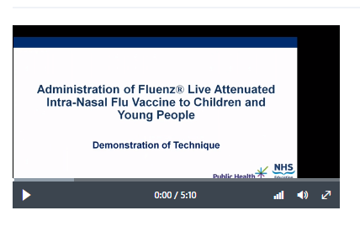
Seasonal Flu 22/23 Intra-Nasal
Vaccine Video
https://learn.nes.nhs.scot/63183/immunisation/seasonal-flu/administration-of-fluenz-tetra-video
Notes:
Video shared by PHS colleagues
NHS Education for Scotland (NES); Public Health Scotland (PHS)

Slide 33
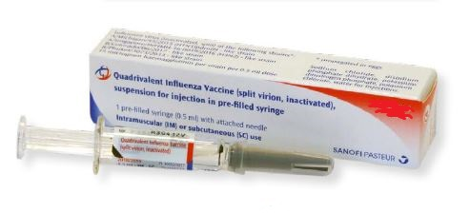
2. Egg-based Quadrivalent Influenza
Vaccine (QIVe)
First line for children 6m to < 2 years in risk groups
Second line if QVIc unavailable
One dose schedule OR
Two doses 4 weeks apart for < 9 years old in clinical risk group and no previous history of flu vaccine
Notes:
Sanofi Pasteur inactivated Quadrivalent flu vaccine is supplied in a pre-filled Syringe containing 0.5 ml dose.
One dose of the vaccine is required unless the patient is a child in a clinical at-risk group and they are < 9 years old and they have not previously received a flu vaccine. If a second vaccine is required an interval of at least 4 weeks should be left between the two vaccines.

Slide 34
Quadrivalent Inactivated
Vaccine (QIVe ) continued
One dose required unless:
  Child is in a clinical risk group and
  < 9 years old and
  Has not previously received a flu vaccine
If second dose required leave at least 4 weeks between doses
Notes:
Sanofi Pasteur inactivated Quadrivalent flu vaccine is supplied in a pre-filled
Syringe containing 0.5 ml dose.
One dose of the vaccine is required unless the patient is a child in a clinical at-risk group and they are < 9 years old and they have not previously received a flu vaccine.
If a second vaccine is required an interval of at least 4 weeks should be left between the two vaccines.

Slide 35
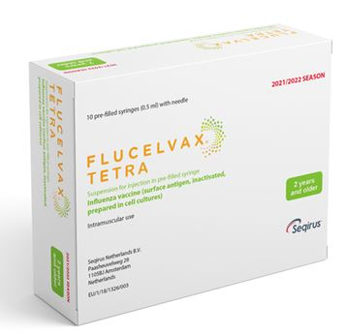
3. Flucelvax Tetra: cell-based Quadrivalent
Inactivated Flu vaccine (QIVc)
First line for all adults 18 to < 65 years who are eligible for the flu vaccine
Second line for adults 65 years and older with egg allergy
Second line for children over 2 years with contraindication to Fluenz Tetra®
Single i.m. injection
  One dose schedule required unless:
    Child is in a clinical risk group and under 9 years old and has not previously received a flu vaccine
  If second dose required leave at least 4 weeks between dose
Needle attached
Notes:
It is recommended for adults age 18 to < 65 years who are eligible. Second line for children over 2 years with contraindication to Fluenz Tetra®
It should be considered for use in Adults 65years+ who have an allergy to eggs .
One dose schedule unless:
Child is in a clinical risk group and
< 9 years old and
Has not previously received a flu vaccine
If second dose required leave at least 4 weeks between doses

Slide 36

Quadrivalent cell culture vaccine
(QIVc)
QIVc (Flucelvax TETRA) was licensed in the UK in December 2018 for adults and children from 9 years of age. It now also licensed for children from 2 years of age
Flucelvax TETRA is a quadrivalent vaccine containing two subtypes of Influenza A (H3N2 and H1N1pdm00) and both B virus lineages
QIVc has a similar safety profile to other flu vaccines (similar rate and type of adverse reactions reported). More than 36 million doses of cell-based vaccine have been administered with no serious safety concerns
the cell-based vaccine manufacturing process uses an animal cell line (Madin-Darby Canine Kidney, or MDCK) to grow the influenza virus rather than the traditional egg based manufacturing methods
this manufacturing process eliminates the risk of egg-adaptation and may result in the vaccine containing virus that is a closer match to wild-type circulating flu viruses
Notes:
QIVc (Flucelvax TETRA) was first licenced in the US in 2016 and was licensed in the UK in December 2018 for adults and children from 9 years of age.
This year It now also licensed for children from 2 years of age
Flucelvax TETRA is a quadrivalent vaccine containing two subtypes of Influenza A (H3N2 and H1N1pdm00) and both B virus lineages. As the vaccine contains both lineages of B viruses it may provide better protection against circulating flu B strain(s) than trivalent flu vaccines
QIVc has a similar safety profile to other flu vaccines (similar rate and type of adverse reactions reported). More than 36 million doses of cell-based vaccine have been administered with no serious safety concerns
the cell-based vaccine manufacturing process uses an animal cell line (Madin-Darby Canine Kidney, or MDCK) to grow the influenza virus rather than the traditional egg based manufacturing methods
this manufacturing process eliminates the risk of egg-adaptation and may result in the vaccine containing virus that is a closer match to wild-type circulating flu viruses

Slide 37
Storage of all flu vaccine
  Efficacy, safety and quality may be adversely affected if vaccines are not stored at the temperatures specified in the licence
Must be stored in accordance with manufacturer’s instructions:
  store between +2⁰C and +8⁰C
  do not freeze
  store in original packaging
  protect from light
Check expiry dates regularly:
  the LAIV has an expiry date 18 weeks after manufacture – this is much shorter than inactivated flu vaccines
  it is important that the expiry date on the nasal spray applicator is checked before use
Notes:
Vaccines should be stored in the original packaging at +2°C to +8°C and protected from light. All vaccines are sensitive to some extent to heat and cold. Heat speeds up the decline in potency of most vaccines, thus reducing their shelf life. Efficacy, safety and quality may be adversely affected if vaccines are not stored at the temperatures specified in the licence. Freezing may cause increased reactogenicity and loss of potency for some vaccines and can also cause hairline cracks in the container, leading to contamination of the contents.
Vaccines are expensive and it is important to minimise wastage through inappropriate storage. We have had a few cold-chain failures recently where practices did not place vaccines in the Vaccine fridge on arrival to the practice, resulting in large vaccine losses and it is important to ensure that all staff responsible for handling / storing vaccines have received cold-chain training.
It is also important to check the expiry dates of flu vaccines and to rotate stock to prevent Vaccine loss. LAIV has a shelf life of 18 weeks that starts at the point of release from the manufacturer. This is a shorter shelf life than other influenza vaccines and some of this time will have passed when the vaccine reaches the place where it is to be administered. It is important that the expiry date on the nasal spray applicator is checked before use. If the expiry date has passed, arrangements should be made to have the vaccine disposed of safely.

Slide 38
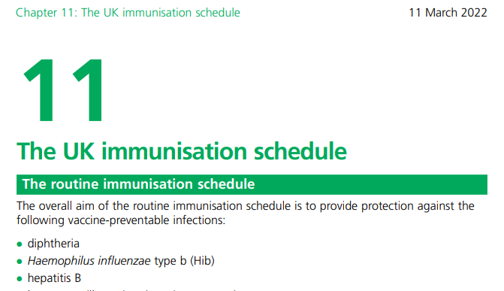
Vaccine Intervals
No interval required between live and inactivated flu vaccines
If two / more vaccines are given at the same time give in separate limbs / leave at least 2.5 cms between administration sites
See Chapter 11 The Green Book
Notes:
There is no interval required between inactivated and live vaccines / LAIV
and any other live vaccine. If it is necessary to administer the inactivated flu vaccine at the same time as other, the vaccines should be administered in separate limbs / leave at least 2.5 cms between vaccination sites.

Slide 39
Contraindications (Inactivated Vaccines & LAIV)
There are very few individuals who cannot receive any flu vaccine
None of the influenza vaccines should be given to those who have had:
confirmed anaphylactic reaction to a previous dose of the vaccine
confirmed anaphylactic reaction to any component of the vaccine (except ovalbumin see precautions)
Note: Always refer to SPC for individual products when deciding which vaccine to give
Notes:
The SPCs for individual products should always be referred to when deciding which vaccine to give. There are very few individuals who cannot receive any flu vaccine.
When there is doubt, appropriate advice should be sought promptly from the health protection duty-room or the patient’s consultant ,so that the period the individual is left unvaccinated is minimised.
For children aged 2 years up to their 18th birthday, where live flu vaccine cannot be given, it is likely that the Quadrivalent inactivated vaccine could be given instead.
None of the influenza vaccines should be given to those who have had:
confirmed anaphylactic reaction to a previous dose of the vaccine
confirmed anaphylactic reaction to any component of the vaccine (except ovalbumin see precautions)

Slide 40
Contraindications (LAIV)
The live attenuated flu vaccine (Fluenz Tetra) should not be given to children who are:
clinically severely immunodeficient due to conditions or immunosuppressive therapy:
        acute and chronic leukaemias
        lymphoma
        HIV infection not on highly active antiretroviral therapy
        cellular immune deficiencies
        high dose corticosteroids
receiving salicylate therapy
known to be pregnant
See subsequent slide for children with acute and severe asthma
Notes:
The live attenuated influenza vaccine (Fluenz Tetra®) should not be given to children or adolescents who are clinically severely immunodeficient due to conditions or immunosuppressive therapy such as: acute and chronic leukaemias; lymphoma; HIV infection not on highly active antiretroviral therapy (HAART); cellular immune deficiencies; and high dose corticosteroids. It is not contraindicated for use in children or adolescents with stable HIV infection receiving antiretroviral therapy; or who are receiving topical/inhaled corticosteroids or low-dose systemic corticosteroids or those receiving corticosteroids as replacement therapy, e.g. for adrenal insufficiency.
Chapter 6 of the Green Book on contraindications and special precautions gives further advice on the use of live vaccines in individuals who are severely immunosuppressed²². It states that the definition of “systemic high doses steroids” (and until at least three months after treatment has stopped) would include children who receive prednisolone, orally or rectally, at a daily dose (or its equivalent) of 2mg/ kg/day for at least one week, or 1mg/kg/day for one month. Occasionally, individuals on lower doses of steroids may be immunosuppressed and at increased risk from infections. In those cases, live vaccines should be considered with caution, in discussion with a relevant specialist physician”.
The live attenuated vaccine is contraindicated in children and adolescents receiving salicylate therapy (other than for topical treatment of localised conditions) because of the association of Reye's syndrome with salicylates and wild-type flu infection as described in the SPC for Fluenz Tetra®.
Safety data for the live attenuated flu vaccine when given in pregnancy is limited . Whilst there is no evidence of risk with live attenuated flu vaccine, inactivated flu vaccines are preferred for those who are pregnant. There is no need, however, to specifically test eligible girls for pregnancy or to advise avoidance of pregnancy in those who have been recently vaccinated.

Slide 41
Precautions to flu vaccines
Acutely unwell:
  defer until recovered
Heavy nasal congestion:
  defer live intranasal vaccine until resolved or, if the child is in a risk group, consider inactivated flu vaccine to provide protection without delay
Use with antiviral agents against flu:
live flu vaccine (LAIV) should not be administered at the same time or within 48 hours of cessation of treatment with flu antiviral agents
administration of flu antiviral agents within two weeks of administration of LAIV may adversely affect the effectiveness of the vaccine
Notes:
Minor illnesses without fever of systemic upset are not valid reasons to postpone vaccination. If the individual is acutely unwell, immunisation may be postponed until they have recovered. This is to avoid confusing the differential diagnosis of acute illness by wrongly attributing any signs or symptoms to the adverse effects of the vaccine.
There is no data on the effectiveness of LAIV when given to children with a heavily blocked or runny nose attributable to infection or an allergy. However as heavy nasal congestion might impede delivery of the vaccine to the nasopharyngeal mucosa, deferral of administration until nasal congestion has resolved should be considered or an appropriate alternative influenza vaccine that is administered by injection should be considered.
There is a potential for influenza antiviral agents to lower the effectiveness of the live attenuated influenza vaccine. Administration of influenza antiviral agents within two weeks of administration of LAIV may adversely affect the effectiveness of the vaccine.

Slide 42
Acute and severe asthma
Guidance from JCVI based on recent data (2019)
Children with asthma on inhaled corticosteroids may safely be given LAIV irrespective of the dose prescribed
LAIV is not recommended for children and adolescents currently experiencing an acute exacerbation of symptoms including - those who have had increased wheezing and/or - needed additional bronchodilator treatment in previous 72 hours
Such children should be offered a suitable inactivated influenza vaccine to avoid a delay in protection
Children who require regular oral steroids for maintenance of asthma control, or have previously required intensive care for asthma exacerbation should only be given LAIV on the advice of their specialist
As these children may be at higher risk from influenza infection, those who cannot receive LAIV should receive a suitable inactivated influenza vaccine
Children with significant asthma and aged under nine years who have not been previously vaccinated against influenza will require a second dose (of either LAIV or inactivated vaccine as appropriate).
Notes:
JCVI have advised (2019) that, on the basis of recent data, children with asthma on inhaled corticosteroids may safely be given LAIV, irrespective of the dose prescribed. LAIV is not recommended for children and adolescents currently experiencing an acute exacerbation of symptoms including those who have had increased wheezing and/or needed additional bronchodilator treatment in the previous 72 hours. Such children should be offered a suitable inactivated influenza vaccine to avoid a delay in protection (Sanofi Pasteur Quadrivalent Inactivated Vaccine).
There are limited safety data in children who require regular oral steroids for maintenance of asthma control, or have previously required intensive care for asthma exacerbation – such children should only be given LAIV on the advice of their specialist. As these children may be at higher risk from influenza infection, those who cannot receive LAIV should receive a suitable inactivated influenza vaccine. Children with significant asthma and aged under nine years who have not been previously vaccinated against influenza will require a second dose (of either LAIV or inactivated vaccine as appropriate).

Slide 43
Egg allergy – children
Children with an egg allergy that did not result in an intensive care admission can be safely vaccinated with LAIV or QIVe (if aged under 2 years) in any setting (including primary care and schools)
Children aged 2 years of age and over with a history of egg allergy that required admission to intensive care for a previous severe anaphylaxis to egg can now be offered QIVc in any setting (including primary care and schools)
There is no licensed egg-free vaccine available for children under 2 years of age who were admitted to intensive care for severe anaphylaxis to egg. Administration of QIVe in a hospital setting should be considered
Notes:
Children
JCVI has advised that, except for those with severe anaphylaxis to egg which has previously required intensive care, children with an egg allergy can be safely vaccinated with Fluenz Tetra (LAIV) in any setting (including primary care and schools).
Children with a history of severe anaphylaxis to egg which has previously required an intensive care admission, can now be offered QIVc if they are age 2 or older in any setting
Egg-allergic children with asthma can receive LAIV if their asthma is well-controlled (see previous slide on severe asthma).
There is no licensed egg-free vaccine available for children under 2 years of age who were admitted to intensive care for severe anaphylaxis to egg. Administration of QIVe in a hospital setting should be considered

Slide 44
Transmission risk from live vaccine
Theoretical potential for transmission of live attenuated virus to immunocompromised contacts - risk is for one to two weeks following vaccination
Extensive use of live attenuated influenza vaccine in US – no reports of illness among immunocompromised patients inadvertently exposed to vaccinated children
However, where close contact with severely immunocompromised patients (e.g. bone marrow transplant patients requiring isolation) is likely/unavoidable (e.g. household members) consider an appropriate inactivated flu vaccine instead
No reports of transmission of vaccine virus in healthcare settings
As a precaution, however, very severely immunosuppressed healthcare workers should not administer LAIV
Notes:
There is a theoretical potential for transmission of live attenuated influenza virus in Fluenz Tetra to immunocompromised contacts for one to two weeks following vaccination.
In the US, where there has been extensive use of the live attenuated influenza vaccine there have been no reported instances of illness or infections from the vaccine virus among immunocompromised patients inadvertently exposed. Where close contact with very severely immunocompromised patients (e.g. bone marrow transplant patients requiring
isolation) is likely or unavoidable (for example, household members), Sanofi Pasteur Quadrivalent Inactivated Influenza Vaccine should be considered instead.
in the US there has been extensive use of LAIV:
-No transmission of vaccine virus in healthcare settings has been reported
-No reported instances of illness or infections from the vaccine virus among healthcare workers inadvertently exposed
as a precaution, very severely immunosuppressed individuals should not administer LAIV
other healthcare workers who have less severe immunosuppression or are pregnant, should follow normal clinical practice to avoid inhaling the vaccine and ensure that they themselves are appropriately vaccinated

Slide 45
Inadvertent administration of LAIV
if an immunocompromised individual receives LAIV, the degree of immunosuppression should be assessed
if patient is severely immunocompromised, antiviral prophylaxis should be considered
otherwise they should be advised to seek medical advice if they develop flu-like symptoms in the four days following administration of the vaccine
if antivirals are used for prophylaxis or treatment, patient should also be offered inactivated flu vaccine in order to maximise their protection in the forthcoming flu season (this can be given straight away)
Notes:
If an immunocompromised individual receives LAIV then the degree of
immunosuppression should be assessed. If the patient is severely immunocompromised, antiviral prophylaxis should be considered, otherwise they should be advised to seek medical advice if they develop flu-like symptoms in the four days (the usual incubation period) following administration of the vaccine. If antivirals are used for prophylaxis or treatment, then in order to maximise their protection in the forthcoming flu season, the patient should also be offered inactivated influenza vaccine. This can be given straight away.

Slide 46
Commonly reported adverse reactions
Following inactivated flu vaccine:
pain, swelling or redness at the injection site, low grade fever, malaise, shivering, sweating, fatigue, headache, myalgia and arthralgia
a small painless nodule may also form at the injection site
these symptoms usually disappear within one to two days without treatment
Following live attenuated flu vaccine:
nasal congestion/rhinorrhoea, reduced appetite, weakness and headache
Rarely, after live or inactivated vaccine, immediate reactions such as urticaria, angio-oedema, bronchospasm and anaphylaxis can occur
Notes:
Pain, swelling or redness at the injection site, low grade fever, malaise, shivering, sweating, fatigue, headache, myalgia and arthralgia are among the commonly reported symptoms after vaccination with inactivated vaccine. A small painless nodule (induration) may also form at the injection site. These symptoms usually disappear within one to two days without treatment.
Nasal congestion/rhinorrhoea, reduced appetite, weakness and headache are common adverse reaction following administration of Fluenz Tetra® (LAIV).
Rarely immediate reactions such as urticaria, angio-oedema, bronchospasm and anaphylaxis can occur following administration of the inactivated / live vaccine.

Slide 47

Reporting suspected adverse reactions
All serious suspected reactions following flu vaccination should be reported to the Medicines and Healthcare products Regulatory Agency using the Yellow Card scheme at http://yellowcard.mhra.gov.uk/
All of the inactivated quadrivalent flu vaccines carry a black triangle symbol (▼) (as do all vaccines during the earlier stages of their introduction)
This is to encourage reporting of all suspected adverse reactions
Notes:
Flucelvax Tetra® and Sanofi Pasteur quadrivalent inactivated vaccine both carry a black triangle symbol (▼). This is a standard symbol added to the product information of a vaccine during the earlier stages of its introduction, to encourage reporting of all suspected adverse reactions.
All serious suspected reactions following flu vaccines should be reported to the Medicines and Healthcare products Regulatory Agency using the Yellow Card scheme at http://yellowcard.mhra.gov.uk/.

Slide 48
PLEASE
Don’t Over Order!
Movianto will deliver within 48 hours of order being placed
Will deliver as often as needed
Only order what you need for next week
This avoids:
Vaccine being left over at end of campaign
Vaccine can’t be taken back once it has been delivered
Large losses if fridge breaks down
Notes:
Please only order the amount of vaccines that you require and do not overstock flu Vaccine. Overstocking can result in loss of a large number of vaccines in the event of a cold-chain failure. Movianto will deliver vaccines within your quota on the next working day. Vaccines can not be returned to Movianto once they have been delivered.

Slide 49
Recording flu vaccine given
As a wide variety of influenza vaccines are on the UK market each year, it is especially important that the following information be recorded:
vaccine name, product name, batch number and expiry date
dose administered
date immunisation given
route/site used
name and signature of vaccinator
This information should be recorded in: VMS (decision pending)
patient's GP record (or other patient record, depending on location)
personal Child Health Record (the ‘Red Book’) if a child
practice computer system
Child Health Information System

Slide 50
Delivery

Slide 51
2022/23 programme
The official launch date will be 19th September 2022
Nasal flu vaccine for children should be available to order by mid-September
All Practices should receive initial deliveries of all flu vaccines before the end of September 2022
Practices can start clinics once they have received the vaccine
Leaflets can be downloaded from PHA web-site
PGDs available from early September
Notes:
The vaccination programme will officially begin on 19th September 2022, however, those administering the vaccine can and should begin offering the vaccine as soon as they have received their first delivery of vaccine. Practices should receive initial delivery of vaccines before the end of September and should check the Movianto web-site regularly for updates.
Leaflets should be arriving in general practices by the last week in August and additional flu leaflets can also be downloaded from the PHA web-site http://www.publichealth.hscni.net/directorate-public-health/health-protection/immunisationvaccine-preventable-diseases.

Slide 52
When to vaccinate
Vaccinate as soon as vaccine available so people are protected when flu begins to circulate in the community;
Try to vaccinate by December before flu circulation peaks;
However, do continue to offer vaccination throughout the season especially if level of flu activity is high;
Remember that immune response following flu vaccination takes about two weeks to develop fully;
Protection offered by the vaccine is thought to last for at least one influenza season;
As antibody levels are likely to reduce in subsequent seasons, and there may be changes to the circulating strains from one season to next, annual revaccination is important.
Notes:
Although influenza activity is not usually significant in the UK before the middle of November, the influenza season can start early and therefore the ideal time for immunisation is between September and early November. After immunisation, protective immune responses may be achieved within 14 days. Protection afforded by the vaccine is thought to last for at least one influenza season. However, as the level of protection provided in subsequent seasons is likely to reduce and there may be changes to the circulating strains from one season to the next, annual revaccination is important⁶.

Slide 53
Children’s Vaccination Programme
GP Based
GPs should actively call and offer flu vaccine to:
all pre-school children aged two years or more on the 1 September 2022 i.e. those born between 2 July 2018 and 1 September 2020,
Children who miss their offer of a vaccine in school
young people aged 16 and 17 who are in a clinical risk group and who are born before 2 July 2007.
Children in at-risk groups for whom LAIV is unsuitable
Children aged 6 months to less than 2 years should be offered egg-grown quadrivalent influenza vaccine (QIVe).
Notes:
These young people should be directed to Trust centres for co-administration of COVID and flu vaccination (injectable) and informed that they can be offered nasal flu vaccine but not COVID19 vaccine within the practice. This includes young people from 16 years of age 5 with morbid obesity. Children and young people with chronic neurological disease should be prioritised.
The Joint Committee on Vaccination and Immunisation (JCVI) has advised that egg-allergic children aged less than 2 years can be offered the quadrivalent inactivated egg-free vaccine, QIVc (Flucelvax® TETRA). This is an off-label recommendation which is supported by unpublished data which shows non inferiority of immunogenicity and a very similar safety profile for QIVc compared with QIVe in children less than 2 years old.

Slide 54
Children’s Vaccination Programme
School Based
School Health teams offer the flu vaccine to:
all young people in years 8 to 12 of secondary school i.e. those born between 2 July 2006 and 1 July 2011.
all children (including those in a clinical risk group) attending primary school, special school and years 8-12 of secondary school during the 2022/23 academic year i.e. those born between 2 July 2006 to 1 July 2018.
School teams prioritise special schools for early vaccinations.
Notes:
Children in a clinical risk group that attend a mainstream school should receive their vaccine through the normal school health team arrangements. However, if there is high parental anxiety about a child in one of the clinical risk groups with higher risk of disease and where the school vaccine visit is scheduled later in the season (i.e. after end of November) or if flu starts to circulate earlier than previous sessions, GPs (or their paediatrician if they attend the hospital during the early season) are asked to facilitate where possible earlier vaccination if requested. Please see Chapter 19 of the Green Book, table 19.1, for relative risk rates of clinical risk groups in flu.

Slide 55
Resources
DH CMO letter seasonal influenza 2022/2023
Flu healthcare worker’s factsheet
PHA flu page
The Green Book: Influenza Chapter
Flu patient information leaflets
Public Health Agency weekly Flu Surveillance Bulletin
COVID-19: Guidance for the remobilisation of services within health and care settings
Guidance on vaccine handling and storage in GP practices
PHA would like to acknowledge UKHSA for permission to adapt some of their slides and materials for use in Northern Ireland. Slides prepared by the Immunisation and Vaccination Team (PHA, Northern Ireland)
Notes:
Finally the following resources are available and include:
The Green Book’s revised chapter on influenza vaccination, the CMO letter, Flu leaflets and posters and a factsheet on flu vaccination for healthcare workers. This year PHA have added all of the information on flu (including the flu bulletin) to a separate page on the web-site and this can be accessed via the following link:
https://www.publichealth.hscni.net/directorate-public-health/health-protection/influenza

