Slide 1
COVID-19 Vaccination programme for adults Acknowledgments to UKHSA, PHW and PHS for use of their training slides These slides are provisional – subject to revision Provisional – Subject to revision – Use latest version link: x

Slide 2
Note to immunisers
This slide set contains a collection of core slides for use during the delivery of COVID-19 immunisation training. Immunisers should select the slides required depending on their background and experience, according to the role they will have in delivering the COVID-19 vaccine programme.
The information in this slide set was correct at time of publication. As COVID-19 is an evolving disease, a lot is still being learned about both the disease and the vaccines which have been developed to prevent it and the knowledge base is still being developed. For this reason, some of the information may change. Updates will be made to this slide set as new information becomes available. Please check online to ensure you are accessing the latest version. Trainers may need to update data and any information that changes between republications of this slide set.
Slides containing vaccine specific details (such as storage and reconstitution) have been added to the end of this slide set. Details for other vaccines will be added here as they receive regulatory approval. They are available at the end of the slide set so that trainers can specifically select those they need for the vaccine they are providing training about.

Slide 3
Content
Learning objectives, pre-requisites, key messages and introduction
International and UK COVID-19 timeline
Coronavirus
Developing a COVID-19 vaccine and vaccination programme
COVID-19 vaccination programme
Vaccine specific information

Slide 4
Learning objectives
By the end of this session, you should be able to:
explain what COVID-19 is and be aware of the UK epidemiology
understand the policy behind the COVID-19 vaccination programme
describe how vaccines are developed and trialled
identify the groups who are at high risk of COVID-19 infection and who should be prioritised to receive the COVID-19 vaccine
describe the key principles of how to correctly store, prepare and administer COVID-19 vaccines which have been authorised for use in the United Kingdom (UK)

Slide 5
Pre-requisites to administering COVID-19 vaccine
Before administering COVID-19 vaccine, it is recommended you:
have undertaken training in the management of anaphylaxis and Basic Life Support as specified by policy for your local area and are familiar with Resuscitation Council UK (RCUK) guidance on Management of Anaphylaxis in the Vaccination Setting
have undertaken any additional statutory and mandatory training as required by your employer
have received COVID-19 vaccine training through attending a taught session and/or the eLearning for Healthcare COVID-19 vaccine e-learning programme Immunisation - elearning for healthcare (e-lfh.org.uk)
have received practical training in COVID-19 vaccine preparation and administration
have completed the COVID-19 vaccinator competency assessment tool
have an understanding of the legal mechanisms by which immunisers can supply and administer COVID-19 vaccine
have an appropriate legal framework to supply and administer COVID-19 vaccine in place e.g. patient specific prescription, Patient Specific Direction (PSD), Patient Group Direction (PGD) or Protocol and be able to recognise the differences between these and understand which staff can use each of these
be able to describe the process of consent and how this applies when giving vaccines
accessed and familiarised yourself with the following key documents: Green Book COVID-19 chapter and the PHA Healthcare professional factsheet COVID-19 immunisation programme

Slide 6
Key messages
the global COVID-19 pandemic continues to cause millions of infections and has caused over six million deaths across the world
vaccination to prevent COVID-19 continues to be one of the key tools in controlling the pandemic
scientists across the world have worked to develop vaccines which have then been rigorously tested for safety and efficacy
it is crucial that the COVID-19 vaccine is safely and effectively delivered to as many of those eligible as possible
those with a role in delivering the COVID-19 vaccine programme need to be knowledgeable, confident and competent in order to promote confidence in the vaccination programme and deliver the vaccine safely
Notes:
https://coronavirus.jhu.edu/map.html
WHO Coronavirus (COVID-19) Dashboard | WHO Coronavirus (COVID-19) Dashboard With Vaccination Data

Slide 7
Introduction
a new virus emerged in Wuhan, China during December 2019
this virus, which causes respiratory disease, was identified as being part of the Coronavirus family and it rapidly spread to many other countries around the world
the clinical picture varies widely. A significant proportion of individuals are likely to have mild symptoms and may be asymptomatic at the time of diagnosis
common symptoms of COVID-19 include a high temperature, a continuous dry cough, loss or change to sense of smell and taste, muscle aches, sore throat, headache, diarrhoea and vomiting, loss of appetite, unexplained tiredness and a stuffy or runny nose
older people, individuals with underlying medical problems and pregnant women are more likely to develop serious illness or die from COVID-19
measures to contain the virus initially included the introduction of social distancing measures, travel restrictions, closure of public spaces and the wearing of face coverings
despite these measures, the number of positive cases and deaths continued to increase on a daily basis
Notes:
Latest data can be obtained from https://coronavirus.data.gov.uk/
COVID-19: the green book, chapter 14a - GOV.UK (www.gov.uk)

Slide 8
International and UK COVID–19 timeline – the first 7 months
The date of the first positive COVID-19 case in NI was 26/02/2020
The date of the first COVID -19 death in NI (as reported on the mortality reporting system) was 18/03/2020.
Note the definition for these deaths are those who have died within 28 days of a positive specimen

Slide 9
COVID-19 and Coronavirus
COVID-19 is the disease that is caused by infection with the SARS-CoV-2 virus which belongs to the Coronavirus family
- SARS-CoV-2 stands for Severe Acute Respiratory Syndrome (SARS) and CoV for coronavirus
- COVID-19 stands for Coronavirus Disease and 19 is from the year 2019 when it was first seen
Coronaviruses may cause illness in animals or humans and they are responsible for causing infections ranging from the common cold to more severe disease such as Severe Acute Respiratory Syndrome (SARS) and Middle East Respiratory Syndrome (MERS) which have been responsible for two outbreaks during the last twenty years
SARS-CoV-2 virus is the most recently discovered coronavirus and has now affected many countries globally
because of the global spread and the substantial number of people affected, the World Health Organisation (WHO) declared COVID-19 as a pandemic on 11/03/2020 (Pan (all) demos (people))

Slide 10
Viral infection
viruses are much smaller than bacteria and consist of a small amount of either DNA or RNA surrounded by a protein coat called a capsid
viruses cannot replicate themselves, but need to seek out the replication mechanism contained within a host cell
examples of vaccine preventable viral diseases include measles, mumps, rubella, influenza, hepatitis A and B
Influenza viruses, which are RNA viruses, are constantly mutating into slightly different forms, which is why we need to produce and give different flu vaccines every year
SARs-CoV-2 is an RNA virus

Slide 11
Coronavirus structure
the key parts of the coronavirus are the RNA and the spike proteins
the RNA is surrounded by an envelope which has different roles in the life cycle of the virus. These may include the assembly of new virus and helping new virus to leave the infected cell
the spike proteins (S) are anchored into the viral envelope and form a crown like appearance, like the solar corona, hence the name coronavirus. The spike proteins attach to the target cell and allow the virus to enter it
the RNA is inside the envelope and acts as a template so that once it is inside the host cell, the coronavirus can replicate itself and be released into the body
the Spike protein and the RNA have been used to develop and make different vaccines to protect against SARs-CoV-2
Notes:
Diagram of coronavirus virion structure showing spikes that form a "crown" like the solar corona, hence the name
https://commons.wikimedia.org/wiki/File:3D_medical_animation_coronavirus_structure.jpg

Slide 12
COVID-19 variants
all viruses change over time
mutations are changes to the genetic structure (RNA) of the virus and the means by which it adapts to survive
most mutations have little effect on the properties of the virus or its impact, however, some mutations have the potential to
increase how easily the virus spreads
cause more severe disease
escape immunity (the immune response is in some way less effective)
be less susceptible to the effects of the available vaccines, treatments or other public health and social measures
the original (sometimes termed wildtype or ancestral) SARS-CoV-2 virus has mutated, producing new variants, for example the Alpha, Delta, and Omicron variants
within a variant there may also be sub-variants, for instance, Omicron BA.1, BA.2, BA.3, BA.4 and BA.5
Notes:
Information on new variants under investigation is available at: https://www.gov.uk/ government/publications/ investigation-of-sars-cov-2-variants-technical-briefings

Slide 13
Transmission of COVID-19 infection
For transmission to occur, the SARs-CoV-2 virus needs to be transported to a susceptible person. To do this, it needs to have:
a portal of exit (from the place where it is living and replicating)
a mode of transmission (such as coughing or sneezing) and
a portal of entry (to the susceptible host)
COVID-19 spreads primarily from person to person through small droplets and aerosols from the nose or mouth which are expelled when a person with COVID-19 coughs, sneezes, or speaks.
Droplets can also survive on objects and surfaces such as tables, doorknobs and handrails. However, fomites appear to play a minor role in transmission.
People can catch COVID-19 if they breathe in droplets or aerosols from a person infected with the virus, or by touching contaminated objects or surfaces, then touching their eyes, nose or mouth.
Secondary attack rates within households are high.

Slide 14
COVID-19 Chain of infection

Slide 15
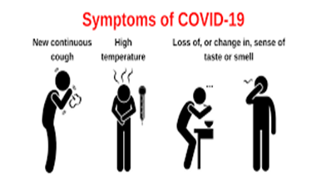
COVID-19 symptoms
The incubation period is 5 to 6 days but can vary between 1 and 11 days.
The symptoms of COVID-19 and other respiratory infections are very similar, they include:
new or continuous cough
high temperature, fever or chills
loss or change to sense of smell or taste
fatigue, lethargy and unexplained tiredness
shortness of breath
headache
sore throat
stuffy or runny nose
aching muscles
diarrhoea and vomiting
loss of appetite
Notes:
https://www.nidirect.gov.uk/articles/coronavirus-covid-19-symptoms

Slide 16
COVID-19 symptom progression
Symptoms may begin gradually and are usually mild.
the majority of people (around 80%) have asymptomatic to moderate disease and recover without needing hospital treatment
around 15% may get severe disease including pneumonia; older people and those with underlying medical problems such as high blood pressure, heart and lung problems, diabetes, or cancer are more likely to develop serious illness
around 5% become critically unwell. This may include septic shock and/or multi-organ and respiratory failure
the infection fatality ratios (IFR) for COVID-19 during the first wave in the UK, derived from combining mortality data with infection rates in seroprevalence studies, showed markedly higher IFR in the oldest age groups
Notes:
https://www.bmj.com/content/bmj/368/bmj.m800.full.pdf
https://www.gov.uk/government/publications/covid-19-the-green-book-chapter-14a

Slide 17
Complications of COVID-19 disease
Complications from COVID-19 can be severe and fatal.
The risk of developing complications increases with age and is greater in those with underlying
health conditions.
The type of complication that can develop may include:
venous thromboembolism
heart, liver and kidney problems
neurological problems
coagulation (blood clotting) failure
respiratory failure
multiple organ failure
septic shock
In the first year of the pandemic, cumulative death rates after COVID-19 infection were highest in those aged over 75; death rates in males also exceeded those in females.
Notes:
https://bestpractice.bmj.com/topics/en-us/3000168/complications
COVID-19: the green book, chapter 14a - GOV.UK (www.gov.uk)

Slide 18
COVID-19 complications in pregnancy (1)
the serious risks posed to women who become infected with the SARS-CoV-2 virus during pregnancy became increasingly clear as the COVID-19 pandemic progressed
the maternal mortality ratio (number of maternal deaths during a given time period) as a result of COVID-19 significantly increased from 1.4 per 100,000 live births in the Wildtype SARS-CoV-2 dominant period to 5.4 per 100,000 live births in the Delta dominant period
the proportion of pregnant women hospitalised with symptomatic COVID-19 increased from Wildtype to subsequent Alpha and Delta dominant periods, and the proportion admitted to intensive care units also increased
pregnant and recently pregnant women with COVID-19 are more likely to be admitted to an intensive care unit, have invasive ventilation or extracorporeal membrane oxygenation (ECMO) in comparison to non-pregnant women of the same age
Notes:
https://www.bmj.com/content/370/bmj.m3320
https://www.gov.uk/government/publications/covid-19-the-green-book-chapter-14a

Slide 19
COVID-19 complications in pregnancy (2)
pregnant women who are overweight or obese, are of black and Asian minority ethnic background, have co-morbidities such as diabetes, hypertension and asthma, or are 35 years or older are more likely to have severe COVID-19 infection
the majority of pregnant women who have been admitted to hospital with severe COVID-19 are unvaccinated Pregnant women urged to come forward for COVID-19 vaccination - GOV.UK (www.gov.uk)
in contrast to earlier periods in the pandemic, pregnant women infected with SARS-CoV-2 were substantially less likely to have a preterm birth or maternal critical care admission during the Omicron period. Despite this, even in the Omicron era, severity of COVID-19 was higher in unvaccinated than vaccinated women

Slide 20
COVID-19 complications in neonates
transmission of infection from mother to infant appears rare, however, neonates born to mothers with COVID-19 have an increased risk of preterm birth and admission to a neonatal unit
although stillbirth and neonatal death remain very rare, UK studies have suggested a higher rate of stillbirth in infected women and this appears to have increased during the Delta period
during the Delta dominant period, six neonatal deaths were recorded in the UK, whereas no neonatal deaths were reported in previous waves
fewer stillbirths and no neonatal deaths were observed in the Omicron period
Notes:
Knight et al., 2022. Characteristics and outcomes of pregnant women admitted to hospital with confirmed SARS-Co-V-2 infection in the UK: national population based cohort study: Characteristics and outcomes of pregnant women admitted to hospital with confirmed SARS-CoV-2 infection in UK: national population based cohort study | The BMJ
Greenbook COVID-19 chapter 14a (publishing.service.gov.uk)

Slide 21
Long COVID
for some people, COVID-19 can cause symptoms that last weeks or months after the infection has gone. This is sometimes called post-COVID-19 syndrome or ‘long COVID’
although many people feel better in a few days or weeks and most will make a full recovery within 12 weeks, for some people, symptoms can last longer
study findings reported in June 2021 from the National Institute for Healthcare Research, showed that over a third of people who tested positive for COVID-19 had symptoms that lasted for 12 weeks or longer (long COVID) and around one in ten people reported severe long COVID symptoms
increased age, women, people who are overweight or obese, and those who smoke, live in deprived areas, or have been admitted to hospital with COVID-19 have been reported in studies as being at greater risk
a review conducted by the UK Health Security Agency (UKHSA) found that having COVID-19 vaccine reduces the chances of having Long COVID
Notes:
Up to one in three people who have had COVID-19 report long COVID symptoms | NIHR
UKHSA review shows vaccinated less likely to have long COVID than unvaccinated - GOV.UK (www.gov.uk)

Slide 22
Symptoms of Long COVID
The most commonly reported symptoms are:
extreme tiredness (fatigue)
shortness of breath
Other common symptoms include:
chest pain or tightness joint pain and muscle aches
problems with memory and concentration depression and anxiety
difficulty sleeping tinnitus, earaches
heart palpitations dizziness
feeling sick, diarrhoeas, stomach aches, rashes
loss of appetite changes to sense of smell or taste
pins and needles headaches, sore throat, cough
Notes:
Long-term effects of coronavirus (long COVID) - NHS (www.nhs.uk)

Slide 23
COVID-19 vaccine taskforce
it quickly became apparent that as the majority of the population was susceptible (non-immune) to the SARS-CoV-2 virus and the virus spreads easily, a safe and effective vaccine would be needed to prevent further cases
a COVID-19 vaccine prepares the immune system so that in the event of an exposure to the virus, it is able to respond and prevent or reduce the severity of infection
during April 2020, a UK vaccine taskforce was set up to support the development of a SARS-CoV-2 vaccine
the taskforce supported research and industry to rapidly develop and scale up the manufacture of a vaccine to protect the population

Slide 24
COVID-19 vaccine development
scientists, industry and other organisations have worked collaboratively across the globe to complete the different phases of vaccine development in parallel, rather than sequentially to make safe and effective vaccines available as soon as possible
by knowing the genetic code for the SARS-CoV-2 virus, various methods to create vaccines can be used such as using the code itself (mRNA vaccines) or inserting part of this code into existing viruses (viral vector vaccines)
over 300 different COVID-19 vaccines are in development, in trials or in use
some vaccines have been made using currently used vaccine technology, others have been made using new approaches or methods used during previous emergencies such as the SARS pandemic and west African Ebola
Notes:
For more information about COVID vaccines in development, see the LSHTM COVID-19 vaccine tracker https://vac-lshtm.shinyapps.io/ncov_vaccine_landscape/

Slide 25
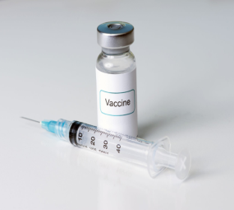
Properties of an ideal vaccine
Ideally, a vaccine will:
produce the same immune protection which usually follows natural infection but without causing disease
generate long lasting immunity so that the person is protected if they are exposed to the antigen several years after vaccination
interrupt the spread of infection by preventing carriage of the organism in the vaccinated person
Vaccines need to be safe and the risk from any side effects should be much lower than the benefit of preventing deaths and serious complications of the disease.
For the COVID-19 vaccines, many of these properties can be confirmed from the clinical vaccine trials.
Longer term ongoing surveillance of the disease and of those vaccinated will show whether:
vaccine protection is long lasting or booster or annual doses are needed
the vaccine prevents a vaccinated person from carrying and spreading the virus

Slide 26
Vaccine safety
before any of the COVID-19 vaccines could be authorised for widespread use in the population, the manufacturers had to demonstrate that they are safe and effective
tens of thousands of people across the world have received COVID-19 vaccines in clinical trials
no serious adverse reactions to the vaccines were seen in the trial participants who received them
any reactions reported were similar to those seen following other vaccines such as pain and tenderness at the injection site and fever, headache, muscle aches and fatigue
once vaccines are authorised and in use, the Medicines and Healthcare products Regulatory Agency (MHRA) continually monitors their safety to ensure that the benefits continue to outweigh any risks. Reported adverse reactions are thoroughly investigated and the MHRA work with their international equivalent agencies to rapidly share safety data and reports
Notes:
In extensive vaccination campaigns such as the COVID-19 vaccination programme when vaccines are being given to huge numbers of people, it is normal for potential adverse events following immunisation to occur which were not seen in clinical trials. This does not necessarily mean that the events are linked to vaccination itself, but they must be investigated to ensure that any safety concerns are addressed quickly.

Slide 27
Vaccine safety (continued)
when vaccines are being given to huge numbers of people, it is normal for potential adverse events following vaccination to occur which were not seen in clinical trials
this does not necessarily mean that the events are linked to the vaccination itself, but they are investigated to ensure that any safety concerns are addressed quickly
if it is thought that the adverse event may be, or is linked to vaccination, advice about use of that vaccine is carefully considered
for example, following widespread use of the AstraZeneca COVID-19 vaccination, a rare condition involving serious thromboembolic (blood clotting) events accompanied by thrombocytopaenia (low platelets) was reported. After thorough assessment of the overall risk benefit of the use of the AstraZeneca vaccine in the UK population, the Joint Committee on Vaccination and Immunisation (JCVI) advised that adults aged under 40 without underlying health conditions that put them at higher risk of severe COVID-19 disease, should be offered an alternative COVID-19 vaccine to the AstraZeneca vaccine
other conditions (such as Guillain-Barré syndrome, myocarditis, pericarditis, transverse myelitis and capillary leak syndrome) have also been reported and investigated

Slide 28
Effectiveness
manufacturers of the COVID-19 vaccines need to show evidence that they will be effective
they can do this by showing a reduction in virus levels in animal studies where the vaccines were used and that people in the trials have made an antibody response to the vaccine
vaccine effectiveness can be calculated by comparing the number of cases of COVID-19 disease in trial participants who received the COVID-19 vaccine with the number of trial participants who received the placebo or alternative (non-COVID-19) vaccine
Those running clinical trials will also look at antibody response:
- after one dose and two doses
- at different dosages of the vaccine
- with different time intervals between vaccine doses
- in different age groups
Over time, they will look at
how long the antibodies last and the effect on antibody levels if a booster dose is given
whether the vaccine only stops people from becoming severely ill or if it also stops them spreading the virus too

Slide 29
Real world effectiveness (1)
with several COVID-19 vaccines in general use in the UK population, the impact and effectiveness of the COVID-19 vaccination programme on symptomatic disease, hospitalisation, death and infection is being actively and continuously monitored
a single adult dose of either the Pfizer BioNTech or the AstraZeneca vaccines were shown to provide modest protection against symptomatic disease due to Alpha variant; with single vaccinated cases around 40% less likely to require hospital admission or to die, rising to around 80% protection against hospitalisation in local studies
protection against infection has also been seen in healthcare workers, where a single dose of Pfizer BioNTech vaccine provided >70% protection against both symptomatic and asymptomatic infection and in care home residents where a single dose of either Pfizer BioNTech or AstraZeneca vaccines reduced the risk of infection by around 60%
studies show that the COVID-19 vaccines have the potential to reduce transmission; one UK study showed that those who do become infected 3 weeks after receiving one dose of the Pfizer BioNTech or AstraZeneca vaccine were between 38% and 49% less likely to pass the virus on to their household contacts than those who were unvaccinated
Notes:
Further information about this can be found at www.gov.uk/government/publications/phe-monitoring-of-the-effectiveness-of-covid-19-vaccination
Lopez Bernal J, Andrews A, Gower C, et al. Early effectiveness of COVID-19 vaccination with BNT162b2 mRNA vaccine and ChAdOx1 adenovirus vector vaccine on symptomatic disease, hospitalisations and mortality in older adults in England https://www.medrxiv.org/content/10.1101/2021.03.01.21252652v1
Vasileiou E, Simpson CR, Robertson C, et al. Effectiveness of First Dose of COVID-19 Vaccines against hospital admissions in Scotland: National prospective cohort study of 5.4 million people. Available at: https://papers. ssrn.com/sol3/papers.cfm?abstract_id=3789264
Hall VJ, Foulkes S, Saei A, Andrews N, Oguti B et al. Effectiveness of BNT162b2 mRNA Vaccine Against Infection and COVID-19 Vaccine Coverage in Healthcare Workers in England, Multicentre Prospective Cohort Study (the SIREN Study).
Shah A, Gribben C, Bishop J et al. Effect of vaccination on transmission of COVID-19: an observational study in healthcare workers and their households View ORCID Profile

Slide 30
Real world effectiveness (2)
with the emergence of the heavily mutated Omicron variant, two doses of COVID-19 vaccine appear to be less effective at preventing infection from this variant compared to the Delta variant and protection declines to very low levels six months after the primary course
vaccine effectiveness data for Omicron confirms that protection against symptomatic disease soon after an mRNA booster dose increases to around 70-75% regardless of which vaccines were given for the primary course
more recent analysis confirms that protection after an mRNA booster has declined substantially by three months after the dose was given
protection against hospitalisation after an mRNA booster reaches over 90% in the two weeks after vaccination but is also showing some decline by about three months
in response to these findings, the JCVI have recommended additional booster doses for the groups most at risk of severe illness
booster programmes have provided high levels of protection against severe disease (from both Delta and Omicron variants) across the population
Notes:
Monitoring reports of the effectiveness of COVID-19 vaccination - GOV.UK (www.gov.uk)
A summary of the most recent data on real world effectiveness for each variant is now published and updated regularly. https://www.gov.uk/ government/publications/covid-19-vaccine-surveillance-report
https://www.gov.uk/government/publications/covid-19-the-green-book-chapter-14a

Slide 31
Regulatory approval and licencing
in the UK, vaccine manufacturers apply to the Medicines and Healthcare products Regulatory Agency (MHRA) or the European Medicines Agency (EMA) for a product licence but they may issue a temporary authorisation ahead of the full UK product licence
in exceptional situations, the MHRA may enact Regulation 174. This enables them to temporarily authorise the supply of an unlicensed medicinal product in response to certain identified public health risks, such as the SARS-CoV-2 pandemic
the MHRA assess all of the available safety, quality and efficacy data and considers whether the evidence supports the use of the medicine or vaccine under the legal basis of regulation 174 until it can be licensed
the process involves the same level of scrutiny as the usual licensing process and this exception is only used when strictly necessary to speed up access to a potentially life-saving intervention

Slide 32
Post authorisation surveillance
On-going studies of vaccines continue after the vaccine has been authorised for use.
These studies aim to assess long term efficacy and to detect any rare adverse effects
because in real life administration, compared to pre-licensure trials, there will be:
some variability in preparation of the vaccine as vaccines will come from different batches
possible variability in stability and storage, for example the cold chain may not be as rigidly maintained in practice as it was in a clinical trial
use of the vaccines in different groups than in pre-license studies, for example they will be given to people with underlying medical conditions who would not necessarily have been included in a pre-licensure clinical trial
mutations in the virus which may result in the vaccine being less effective

Slide 33
Licensure
following initial temporary authorisation from the MHRA under Regulation 174, the Moderna (Spikevax®), AstraZeneca (Vaxzevria®) and Pfizer BioNTech (Comirnaty®) COVID-19 vaccines sought Conditional Marketing Authorisation (CMA). Marketing authorisation is often referred to as a license
CMA is the fast-track approval of a medicine that fulfils an unmet medical need. During the COVID-19 pandemic, CMA has been used to expedite the approval of safe and effective COVID-19 vaccines
the medicine still has to meet rigorous standards for safety, efficacy and quality but it can be approved on the basis of less comprehensive data than is normally required for full licensure. The manufacturer has to continue to provide comprehensive clinical data to the MHRA after CMA has been granted and the CMA is valid for one year before renewal is required
once a vaccine is given CMA, the ‘Information for Healthcare Professionals’ and ‘Information for UK Recipients’ documents are replaced with a ‘Summary of Product Characteristics (SPC)’ and ‘Patient Information Leaflet (PIL)’, as are required for licensed medicines
Notes:
An SPC provides a description of a medicine or vaccine product’s properties and the officially approved conditions attached to its use. It is written for healthcare professionals and explains how to use and prescribe the medicine/vaccine.
The PIL is the leaflet included in the pack with a medicine or vaccine. It is written for patients and gives information about taking or using a medicine.

Slide 34
COVID-19 Vaccines
COVID-19 vaccines currently available for use in the UK national COVID-19 vaccination programme for adults include:
COVID-19 Vaccine Pfizer BioNTech (Comirnaty 30 micrograms/dose)
given authorisation for temporary supply by the MHRA on 2 December 2020 and then granted CMA on 9 July 2021. This vaccine is authorised for adults and adolescents from the age of 12 years
COVID-19 Vaccine Moderna (Spikevax)
given authorisation for temporary supply by the MHRA on 8 January 2021 and then granted CMA on 1 April 2021
COVID-19 vaccine Moderna (Spikevax® bivalent Original/Omicron BA.1)
granted CMA on 15 August 2022
COVID-19 Pfizer BioNTech bivalent vaccine (Comirnaty® Original/Omicron BA.1)
granted CMA on 02 September 2022. Authorised for vaccination in adults and adolescents from the age of 12 years

Slide 35
COVID-19 Vaccines (continued)
COVID-19 Pfizer BioNTech bivalent vaccine (Comirnaty® Original/Omicron BA.4-5)
granted CMA on 12 September 2022. Authorised for vaccination in adults and adolescents from the age of 12 years
COVID-19 vaccine Moderna (Spikevax® bivalent Original/Omicron BA.4-5)
granted CMA on 19 October 2022
COVID-19 Sanofi Pasteur vaccine (VidPrevtyn Beta®)
granted CMA on 10 November 2022. Authorised for booster vaccination
COVID-19 vaccine Novavax (Nuvaxovid®)
granted CMA on 03 February 2022. Authorised for primary and booster vaccination in those 12 years and older

Slide 36
COVID-19 mRNA vaccines (Pifzer BioNTech and Moderna)
the Pfizer BioNTech and Moderna COVID-19 vaccines are messenger ribonucleic acid (mRNA) vaccines
they contain the genetic sequence (mRNA) for the spike protein which is found on the surface of the SARS-CoV-2 virus, wrapped in a lipid envelope (referred to as a nanoparticle) to enable it to be transported into the cells in the body
when injected, the mRNA is taken up by the host’s cells which translate the genetic information and produce the spike proteins
these are then displayed on the surface of the cell. This stimulates the immune system to produce antibodies and activate T-cells which prepare the immune system to respond to any future exposure to the SARS-CoV-2 virus by binding to and disabling any virus encountered
as there is no whole or live virus involved, the vaccine cannot cause disease. The mRNA naturally degrades after a few days

Slide 37
Novavax COVID-19 vaccine (Nuvaxovid®)
Nuvaxovid® is the COVID-19 vaccine developed by Novavax
this vaccine uses a recombinant S protein (grown in baculovirus infected insect cells) as an antigen with the Matrix-MTM adjuvant
the adjuvant includes two saponins derived from tree bark
very few individuals will require a dose of Nuvaxovid, and it will therefore only be made available at a limited number of designated sites, with locally agreed referral and assessment pathways
Nuvaxovid® is for individuals aged 12 years or older who are not considered clinically suitable to receive an mRNA vaccine, or other locally available COVID-19 vaccines (Sanofi Pasteur COVID-19 vaccine VidPrevtyn Beta®)

Slide 38
Variant vaccines
following the recognition of the Omicron variant becoming the dominant global circulating strain during 2022, many vaccine manufacturers have rapidly developed second generation vaccines that may have broader coverage against SARS-CoV-2 variants
those approved or approaching licensure have been developed as boosters and have either replaced the spike protein from the original vaccine strain with another strain, or developed a bivalent formulation containing spike protein sequences from both the ancestral strain and a newer variant
so far, the emergence of new variants has been too rapid to enable incorporation of a new strain in time to pre-empt an increase in disease. In late 2022, incidence was largely driven by infection with Omicron BA.4 and BA.5
those which use a well established format, such as mRNA vaccines, have been licensed on the basis of immunobridging - i.e. by showing non-inferiority of the neutralising antibody response to the ancestral strain, with potentially higher neutralising antibody response to the variant strain

Slide 39
Bivalent COVID-19 vaccines
Moderna (Spikevax® bivalent Original/Omicron BA.1 and Spikevax® bivalent Original/Omicron BA.4-5 vaccines) contain 25 micrograms of mRNA directed against the ancestral strain and 25 micrograms of mRNA against Omicron BA.1 and Omicron BA. 4-5, respectively
similar formulations manufactured by Pfizer BioNTech (Original/Omicron BA.1 Comirnaty® and Original/Omicron BA.4-5 Comirnaty®) contain 15 micrograms of mRNA directed against the ancestral strain and 15 micrograms of mRNA against Omicron BA.1 and Omicron BA. 4-5, respectively

Slide 40
VidPrevtyn Beta (Sanofi Pasteur) vaccine
VidPrevtyn Beta® is the COVID-19 vaccine developed by Sanofi Pasteur
VidPrevtyn Beta® is a monovalent, recombinant-protein COVID-19 vaccine
VidPrevtyn Beta® combines the spike protein from a COVID-19 virus variant, Beta, with the ‘adjuvant’ AS03
this adjuvant was developed for use during pandemics and was employed as part of an H1N1v influenza vaccine in 2010-2011
the adjuvant contains squalene
Notes:
AS03 adjuvant is composed of squalene (10.69 milligrams), DL-α-tocopherol (11.86 milligrams) and polysorbate 80 (4.86 milligrams). VidPrevtyn Beta; COVID-19 vaccine (recombinant, adjuvanted) (europa.eu)
Squalene is a naturally occurring molecule found in plants and animals, and commercially extracted from fish oil. Squalene is an essential ingredient in the adjuvant system. Combined with surfactants and other immunostimulants, emulsions of squalene have been shown to enhance the immune response when added to antigens. The squalene used in VidPrevtyn Beta is extracted from shark liver oil.
EMA recommends approval of VidPrevtyn Beta as a COVID 19 booster vaccine | European Medicines Agency (europa.eu)

Slide 41
Additional COVID-19 vaccines
If more COVID-19 vaccines are considered for authorisation in the UK, information about these will be added to this slide set
Further details about presentation and preparation of the Pfizer BioNTech (Comirnaty®), Moderna (Spikevax®), Novavax (Nuvaxovid®) and Sanofi Pasteur (VidPrevtyn Beta®) vaccines are available on slides at the end of this slide set

Slide 42
Vaccine interchangeability
evidence suggests that those who receive mixed schedules, including mRNA and adenovirus vectored vaccines make a good immune response, although rates of side effects with a heterologous second dose are higher
accumulating evidence now supports the use of heterologous schedules for primary and reinforcing immunisation, and these are now recognised by the European Medicines Agency (EMA)
for individuals who started the schedule and who attend for vaccination where the same vaccine is not available or suitable, or if the first product received is unknown or not available, a dose of the locally available product should be given
individuals who do receive a different vaccine for their second dose should be informed that they may experience more reactions to the second dose

Slide 43
Key factors that inform UK vaccination policy
The Joint Committee on Vaccines and Immunisation (JCVI) consider the following before making vaccination policy recommendations to the Department of Health and Social Care (DHSC) and Devolved Administration Governments:
Availability of a safe and effective vaccine:
- there are currently over 300 COVID-19 vaccines in development and being trialled
- vaccines undergo extensive and vigorous testing before they are licensed and authorised for use as they have to be able to demonstrate quality, efficacy and safety
Whether there is a need for a vaccination programme;
- SARS-CoV-2 has caused a significant public health problem, transmission is widespread and has been sustained despite various interventions
- the virus affects all age groups and there have been frequent outbreaks in nursing and residential homes, schools and communities
- there is significant morbidity and mortality in certain groups. There are multi-system complications from having the disease and there have been tens of thousands of deaths from COVID-19 in the UK
Notes:
Note: In England it is a legislative requirement for DHSC to fund and implement a JCVI recommended vaccine programme
It is not a legislative requirement for the other devolved administrations but to date in NI no JCIV recommended programme has not been implemented

Slide 44
COVID-19 vaccine programme considerations
The overall aim of the COVID-19 vaccination programme is to protect those who are at most risk from serious illness or death.
In order to advise which groups of patients to vaccinate and in which order to prioritise vaccination of these groups, the JCVI consider all the available relevant information on:
vaccine efficacy and/or immunogenicity and the safety of administration in different age and risk groups
the effect of the vaccine on acquisition of infection and transmission
the epidemiological, microbiological and clinical characteristics of COVID-19
From this, they then make recommendations to the DHSC and planning to deliver vaccine and maximise uptake in these groups can begin.

Slide 45
Priority groups for COVID-19 vaccination
JCVI made recommendations as to how COVID-19 vaccine should be offered by identifying the priority groups for vaccination and the order in which they should be vaccinated
these groups are under regular review and prioritisation may change as more information about the vaccines becomes available
prioritisation will ensure that those at highest risk of severe illness and death are vaccinated early
the priority groups have been selected based on the epidemiology of the infection observed since the start of the pandemic: their risk of severe disease, mortality and other considerations such as ethnicity, deprivation and occupation
evidence from the UK indicates that the risk of poorer outcomes from COVID-19 infection increases dramatically with age in both healthy adults and in adults with underlying health conditions
those over the age of 65 years have by far the highest risk, and the risk increases with age
full details on vaccine eligibility, with detail on the at-risk conditions, are included in the Green Book COVID-19 chapter
Notes:
JCVI advises that the first priorities for the COVID-19 vaccination programme should be the prevention of mortality and the maintenance of the health and social care systems. As the risk of mortality from COVID-19 increases with age, prioritisation is primarily based on age. The order of priority for each group in the population corresponds with data on the number of individuals who would need to be vaccinated to prevent one death, estimated from UK data obtained from March to June 2020.

Slide 46
Vaccine priority groups: JCVI Phase One / NI Phases 1-3
Residents in a care home for older adults and their carers
All those 80 years of age and over
Frontline health and social care workers
All those 75 years of age and over
All those 70 years of age and over
Adults aged 16 to 69 in a high risk group1
All those 65 years of age and over
Adults aged 16 years to 64 years in an at-risk group2
All those 60 years of age and over
All those 55 years of age and over
All those 50 years of age and over
1 Previously known as ‘clinically extremely vulnerable
2 Please refer to Green Book chapter for list of ‘Clinical risk groups’
Notes:
JCVI advice 30/12/20 available at :
https://www.gov.uk/government/publications/priority-groups-for-coronavirus-covid-19-vaccination-advice-from-the-jcvi-30-december-2020/joint-committee-on-vaccination-and-immunisation-advice-on-priority-groups-for-covid-19-vaccination-30-december-2020
It is estimated that taken together, these groups represent around 99% of preventable mortality from COVID-19.

Slide 47
JCVI Phase Two / NI Phase 4
In Phase 2, efforts continued to maximise coverage amongst those prioritised in Phase 1 but who remained unvaccinated and completed delivery of second doses to all those given first doses in Phase 1.
JCVI advised that the offer of vaccination during Phase 2 should continue to be age-based starting with the oldest adults first and proceeding in the following order:
all those aged 40-49 years
all those aged 30-39 years
all those aged 18-29 years
Individuals in both phases who have not yet been vaccinated remain eligible for primary vaccination. Continued efforts should be made to offer them the vaccine and to complete delivery of second doses to all those given first doses.
As there is an increased risk of hospitalisation in males, those from certain ethnic minority backgrounds, those who are obese or morbidly obese, and those from socio-economically deprived areas, JCVI advises that specific focus should be used to promote and deliver vaccination to these groups.

Slide 48
Older adults resident in a care home
there is clear evidence that those living in residential care homes for older adults have been disproportionately affected by COVID-19
those living in care homes have a high risk of exposure to infection due to their close contact with staff (including bank staff) and other residents including those residents returning to the care home from hospital
the closed setting of the care home also increases the risk of outbreaks occurring as any asymptomatic residents and staff could be potential reservoirs for on-going transmission
given the increased risk of outbreaks, morbidity and mortality in these closed settings, older adults in care homes are considered to be at very high risk
JCVI have advised that this group should be the highest priority for vaccination
vaccination of residents and staff at the same time is considered to be a highly efficient strategy within a mass vaccination programme with the greatest potential impact
Notes:
https://www.gov.uk/government/statistics/vivaldi-1-coronavirus-covid-19-care-homes-study-report

Slide 49
Older adults
older adults are considered to be at very high risk if they develop COVID-19 infection
evidence strongly indicates that the single greatest risk of mortality from COVID-19 is increasing age and that the risk increases exponentially with age
disease severity, risk of hospitalisation and mortality increase from age 50 upwards, with the highest risk in those aged 80 years and above
data indicate that the absolute risk of mortality is higher in those over 65 years than that seen in the majority of younger adults with an underlying health condition
Notes:
Evidence strongly indicates that the single greatest risk of mortality from COVID-19 is increasing age and that the risk increases exponentially with age

Slide 50
Adults in a high risk group
people previously defined as clinically extremely vulnerable are considered to be at very high risk of severe illness from COVID-19
there are two ways an individual may have been identified as clinically extremely vulnerable:
- they have one or more of the conditions listed on the GOV.UK website, or
- a hospital clinician or GP added them to the Shielded patients list because they considered them to be at higher risk of serious illness from COVID-19
many of those who are clinically extremely vulnerable are in the oldest age groups and were among the first to receive vaccine - the remainder of this group were offered the vaccine alongside those aged 70-74 years of age
the overall risk of mortality for clinically extremely vulnerable younger adults is estimated to be roughly the same as the risk to persons aged 70-74 years
see Green Book COVID-19 chapter for more information about vaccination of this group
Notes:
COVID-19: guidance for people whose immune system means they are at higher risk - GOV.UK (www.gov.uk)
Many individuals who are clinically extremely vulnerable will have some degree of immunosuppression or be immunocompromised and may not respond as well to the vaccine. Therefore, those who are clinically extremely vulnerable should continue to follow Government advice on reducing their risk of infection.

Slide 51
Groups with underlying health conditions
As well as age, other risk factors have been identified that place individuals at risk of serious disease
or death from COVID-19. These include groups with certain underlying health conditions and may
include people who have:
chronic (long-term) respiratory disease
chronic heart disease
chronic kidney disease
chronic liver disease
chronic neurological disease
diabetes
a weakened immune system due to disease or treatment
asplenia or dysfunction of the spleen
morbid obesity (defined as BMI of 40 and above)
severe mental illness
Detailed information giving examples of conditions in each of the clinical risk groups which would
make individuals eligible for vaccination is provided in the COVID-19 Green Book chapter.
Notes:
www.gov.uk/government/publications/priority-groups-for-coronavirus-covid-19-vaccination-advice-from-the-jcvi-25-september-2020/jcvi-updated-interim-advice-on-priority-groups-for-covid-19-vaccination#fn:1
When compared to persons without underlying health conditions, the absolute increased risk in those with underlying health conditions is considered generally to be lower than the increased risk in persons over the age of 65 years (with the exception of the clinically extremely vulnerable).

Slide 52
Pregnancy (1)
the JCVI advise that women who are pregnant should be recommended to receive primary and booster immunisation, and that pregnancy is considered a clinical risk group
studies following the use of the COVID-19 vaccines in pregnant women have shown the vaccines to be safe and highly effective in preventing serious complications
a large amount of observational data from women vaccinated during pregnancy in the USA has not shown an increase in adverse pregnancy outcomes
around 150,000 women in England, 25,000 in Scotland and 4,500 in Wales have received at least one dose of COVID- 19 vaccine whilst pregnant. Initial analysis of birth outcomes in women who had received at least one dose of the vaccine and gave birth between January to November 2021 in England showed a similar or higher rate of good birth outcomes than in unvaccinated women
there is now extensive post-marketing experience of the use of the Pfizer BioNTech and Moderna vaccines with no safety signals so far. These vaccines are therefore the preferred vaccines to offer to pregnant women (for those under 18 years, Pfizer BioNTech vaccine (Comirnaty®) is preferred)
Notes:
https://www.gov.uk/government/news/pregnant-women-urged-to-come-forward-for-covid-19-vaccination
Further information about the safety of COVID-19 vaccines when given in pregnancy is available on the UKHSA website (www.gov.uk/government/publications/safety-of-covid-19-vaccines-when-given-in-pregnancy/the-safety-of-covid-19-vaccines-when-given-in-pregnancy)
https://assets.publishing.service.gov.uk/government/uploads/system/uploads/attachment_data/file/1036047/Vaccine_surveillance_report_-_week_47.pdf

Slide 53
Pregnancy (2)
there is no known risk associated with giving non-live vaccines during pregnancy. Since these vaccines cannot replicate, they cannot cause infection in either the woman or the unborn child
routine questioning about last menstrual period and/or pregnancy testing is not required before offering the vaccine
clinicians should discuss the risks and benefits of vaccination with the woman, who should be told about the current evidence of safety for the vaccine in pregnancy
women who are planning pregnancy or in the immediate postpartum can be vaccinated with a suitable product for their age and clinical risk group
if a woman finds out she is pregnant after she has started a course of vaccine, she may complete vaccination during pregnancy using the same vaccine product
termination of pregnancy following inadvertent immunisation should not be recommended. Women who are inadvertently vaccinated in early pregnancy should be offered the second dose of the same product

Slide 54
Health and Social care Workers
frontline health and social care workers are at increased personal risk of exposure to infection with COVID-19 and of transmitting that infection to susceptible and vulnerable patients in health and social care settings. As well as the risk to themselves, they can carry and transmit the virus to their families, friends, colleagues and vulnerable patients in health and social care settings (including those in residential and care homes)
this group includes those working in hospice care and community based services
the Green Book COVID-19 chapter contains details about the different groups of health and social care workers who may be offered COVID-19 vaccine

Slide 55
Deprivation and ethnicity
there is clear evidence that certain Black, Asian and minority ethnic (BAME) groups have higher rates of infection, and higher rates of serious disease, morbidity and mortality from SARS-Cov-2 infection
there is no strong evidence that ethnicity by itself (or genetics) is the sole explanation for observed differences in rates of severe illness and deaths
certain health conditions are associated with increased risk of serious disease, and these health conditions are often overrepresented in certain BAME groups
societal factors, such as occupation, household size, deprivation, and access to healthcare can increase susceptibility to COVID-19 and worsen outcomes following infection
good vaccine coverage in BAME groups will be the most important factor within a vaccine programme in reducing inequalities for this group
Notes:
https://www.nature.com/articles/s41586-020-2521-4.pdf
The JCVI have advised that NHS England and Improvement, the Department of Health and Social Care, Public Health England and the devolved administrations work together to ensure that inequalities are identified and addressed in implementation. This could be through culturally competent and tailored communications and flexible models of delivery, aimed at ensuring everything possible is done to promote good uptake in Black, Asian and minority ethnic groups and in groups who may experience inequalities in access to, or engagement with, healthcare services. These tailored implementation measures should be applied across all priority groups during the vaccination programme.

Slide 56
Other high risk groups
Household contacts
individuals who expect to share living accommodation on most days (and therefore continuing close contact is unavoidable) with people who are immunosuppressed
Carers
those who are eligible for a carer’s allowance, or those aged 16 years and over who are the sole or primary carer of an elderly or disabled person who is at increased risk of COVID-19 mortality and therefore clinically vulnerable
Refer to the Green Book, chapter 14a for definitions of immunosuppressed individuals, and clinically vulnerable to COVID-19 COVID-19: the green book, chapter 14a - GOV.UK (www.gov.uk)

Slide 57
Interval between COVID-19 vaccines and COVID-19 infection (1)
there are no safety concerns from vaccinating individuals with a past history of COVID-19 infection, or with detectable COVID-19 antibody
however, as clinical deterioration can occur up to two weeks after infection, vaccination should ideally be deferred until clinical recovery, to avoid confusing the differential diagnosis
there is no need to defer immunisation in individuals after recovery from a recent episode with compatible symptoms who were not tested for COVID-19

Slide 58
Interval between COVID-19 vaccines and COVID-19 infection (2)
the JCVI recommend that vaccination of care home residents with confirmed COVID-19 may go ahead, provided the residents are clinically stable. These populations are likely to be highly vulnerable and vaccination should be facilitated without the need for multiple visits, to maximise vaccination coverage in this vulnerable group
having prolonged COVID-19 symptoms is not a contraindication to receiving COVID-19 vaccine but if the patient is seriously debilitated, still under active investigation, or has evidence of recent deterioration, deferral of vaccination may be considered to avoid incorrect attribution of any change in the person’s underlying condition to the vaccine

Slide 59
Co-administration of COVID-19 and other vaccines (1)
initially data on co-administration of COVID-19 with other vaccines was limited, in the absence of such data first principles would suggest that interference between inactivated vaccines with different antigenic content is likely to be limited
there is no evidence of any safety concerns, although it may make the attribution of any adverse events more difficult
as COVID-19 vaccines are considered inactivated, where individuals in an eligible cohort present having recently received one or more other inactivated or a live vaccine, COVID-19 vaccination should still be given. The same applies for other live and inactivated vaccines where COVID-19 vaccination has been received first or where a individual presents requiring two or more vaccines
it is generally better for vaccination to proceed to avoid any further delay in protection and to avoid the risk of the individual not returning for a later appointment

Slide 60
Co-administration of COVID-19 and other vaccines (2)
where co-administration does occur, patients should be informed about the likely timing of potential adverse events relating to each vaccine
if the vaccines are not given together, they can be administered at any interval, although separating the vaccines by a day or two will avoid confusion over systemic side effects
a UK study of co-administration of AstraZeneca and Pfizer BioNTech COVID-19 vaccines with inactivated influenza vaccines confirmed acceptable immunogenicity and reactogenicity
although a study of co-administration of Novavax COVID-19 vaccine with inactivated influenza showed some attenuation of the antibody response to COVID-19, co-administration was still associated with high efficacy against COVID-19 in the phase 3 study
a recent study has shown an acceptable safety profile when COVID-19 is co-administered with inactivated shingles vaccine
Notes:
Lazarus et al, 2021 The safety and immunogenicity of concomitant administration of COVID-19 vaccines (ChAdOx1 or BNT161b2) with seasonal influenza vaccines in adults: a phase IV, multicentre randomised controlled trial with blinding (ComFluCOV). https://papers.ssrn.com/sol3/papers. cfm?abstract_id=3931758
Toback S, Galiza E, Cosgrove C. Safety, immunogenicity, and efficacy of a COVID-19 vaccine (NVX-CoV2373) co-administered with seasonal influenza vaccines: an exploratory substudy of a randomised, observer-blinded, placebo-controlled, phase 3 trial. Lancet 2022; 10: P167-179. DOI: https://doi.org/10.1016/S2213- 2600(21)00409-4
Heath PT, Galiza EP, Baxter DN, et al. Safety and Efficacy of the NVX-CoV2373 COVID-19 Vaccine at Completion of the Placebo-Controlled Phase of a Randomized Controlled Trial. Clin Infect Dis. 2022 Oct 10
Naficy A, Pirrotta P, Kuxhausen A et al. No safety concerns observed when the adjuvanted recombinant zoster vaccine (RZV) and the COVID-19 mRNA-1273 booster were co-administered in ≥50-year-olds. International Society for Infectious Diseases (ISID) Congress, 17–20 November 2022, Kuala Lumpur, Malaysia.

Slide 61
Breastfeeding
there is no known risk associated with giving non-live vaccines whilst breastfeeding
JCVI advises that breastfeeding women may be offered vaccination with any suitable COVID-19 vaccine
emerging safety data is reassuring: mRNA was not detected in the breast milk of recently vaccinated women and protective antibodies have been detected in breast milk
the developmental and health benefits of breastfeeding should be considered along with the woman’s clinical need for immunisation against COVID-19
there is no requirement to stop breastfeeding following vaccination
Notes:
Golan Y, Prahl M, Cassidy A, Lin C et al (2021) COVID-19 mRNA vaccine is not detected in human milk 8th March 2021 https://www.medrxiv.org/content/10.1101/2021.03.05.21252998v1
Juncker H, Mulleners S, van Gils M et al (2021) The Levels of SARS- CoV-2 Specific Antibodies in Human Milk Following Vaccination, JHL 27th June 2021 DOI: https://doi.org/10.1177/08903344211027112

Slide 62
Severely immunosuppressed (1)
JCVI advise that a third primary dose be offered to individuals aged 5 years and over who were severely immunosuppressed at the time of their first or second primary COVID-19 vaccine doses.
This includes individuals:
with primary or acquired immunodeficiency states at the time of vaccination due to certain conditions
on immunosuppressive or immunomodulating therapy at the time of vaccination
with chronic immune-mediated inflammatory disease who were receiving or had received immunosuppressive therapy prior to vaccination
who had received high-dose steroids (equivalent to >40mg prednisolone per day for more than a week) for any reason in the month before vaccination
Definitions of severe immunosuppression and details of timings are described in the JCVI statement and in the COVID-19 chapter of the Green Book.
Individuals in this group will also require booster doses, in line with the rest of the eligible population, to extend protection from their primary course. JCVI advise that the first reinforcing dose should be offered from three months after the third primary dose.
Notes:
https://www.gov.uk/government/publications/third-primary-covid-19-vaccine-dose-for-people-who-are-immunosuppressed-jcvi-advice/joint-committee-on-vaccination-and-immunisation-jcvi-advice-on-third-primary-dose-vaccination

Slide 63
Severely immunosuppressed (2)
from the end of the spring 2023 campaign, the primary course of COVID-19 vaccine will become a targeted offer to those at higher risk and only during seasonal campaigns. The main exception to this would be unvaccinated individuals aged five years and above who become or have recently become severely immunosuppressed. These individuals should be considered for primary vaccination, regardless of the time of year. Clinical judgement should be used to decide on the best timing to commence vaccination
in contrast to other eligible risk groups, those who are eligible for a booster due to severe immunosuppression who miss vaccination during the campaign period, may be considered for a booster at a later date based on individual clinical judgement, balancing their immediate level of risk against the advantages of waiting till the next seasonal campaign

Slide 64
Booster programme (1)
On 14 September 2021, JCVI advised that adults who received a primary course in Phase 1 of the COVID-19 vaccination programme (priority groups 1-9) should be offered a COVID-19 booster vaccine.
This includes:
those living in residential care homes for older adults
all adults aged 18 years or over
frontline health and social care workers
all those aged 16 to 39 years with underlying health conditions which put them at higher risk of severe COVID-19
adult carers and those experiencing homelessness
adult household contacts (aged 16 or over) of immunosuppressed individuals
Notes:
https://www.gov.uk/government/publications/jcvi-statement-september-2021-covid-19-booster-vaccine-programme-for-winter-2021-to-2022

Slide 65
Booster programme (2)
for those aged over 18 years, mRNA vaccines are recommended for booster dose (Pfizer BioNTech is preferred for 16 to 17 year olds).
initial booster dose should be offered from three months after completion of the primary vaccine course
On the 27th January 2023, the JCVI have advised the 2021 booster offer for persons aged 16 to 49 years who are not in a clinical risk group should no longer be offered following the close of the autumn 2022 vaccination campaign (31/03/2023)
Notes:
JCVI statement on the COVID-19 vaccination programme for 2023: 8 November 2022 - GOV.UK (www.gov.uk)

Slide 66
The autumn booster campaign 2022
the JCVI have recommended a move to regular, planned and targeted boosting as the most important strategy to control COVID-19
for the 2022 autumn booster programme, the primary objective was to augment immunity in those at higher risk from COVID-19 and thereby optimise protection against severe COVID- 19, specifically hospitalisation and death, over winter 2022/23
The following groups were offered a COVID-19 booster vaccine in the autumn of 2022:
residents in a care home for older adults and staff working in care homes for older adults
frontline health and social care workers
all adults aged 50 years and over
persons aged 5 to 49 years in a clinical risk group, as set out in in the Green Book, chapter 14a
persons aged 5 to 49 years who are household contacts of people with immunosuppression (as defined in tables 3 and 4 in the Green Book, chapter 14a)
persons aged 16 to 49 years who are carers (as defined in table 3 in the Green Book, chapter 14a)

Slide 67
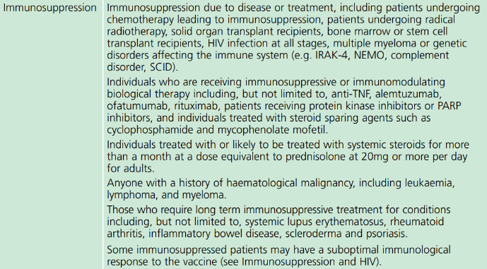
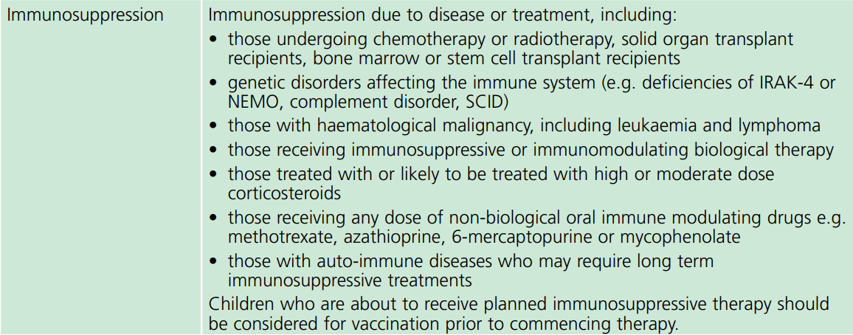
Spring booster 2023
the JCVI have recommended that a spring booster dose should be offered around six months after the last vaccine dose to:
adults aged 75 years and over
residents in a care home for older adults
individuals aged 5 years and over who are immunosuppressed (as defined in tables 3 & 4 in the Green Book, chapter 14a)
although vaccination should ideally be offered around six months from any previous dose, operational flexibility can be used e.g. individuals in care homes or housebound patients may be offered the booster alongside other residents providing there was at least three months from the previous dose
COVID-19 Green Book chapter 14a (publishing.service.gov.uk)
Notes:
JCVI statement on spring 2023 COVID-19 vaccinations, 22 February 2023 - GOV.UK (www.gov.uk)

Slide 68
Reinforcing vaccination
studies of boosting in the UK have shown that a third adult dose of AstraZeneca (Vaxzevria®), Novavax (Nuvaxovid®), Moderna (Spikevax®) and Pfizer BioNTech (Comirnaty®) vaccines successfully boosted individuals who had been primed with two doses of Pfizer BioNTech (Comirnaty®) or AstraZeneca (Vaxzevria®) vaccine around three months earlier
for mRNA vaccines, JCVI considered evidence around the differences in neutralising antibody after the bivalent vaccines compared to the original vaccines when used as a booster. The committee considered that the improvement in neutralising antibody levels were modest and likely to translate to only small improvements in protection against the BA.1 strain, with no clear advantage against other variants
for spring 2023, the committee expect mRNA bivalent vaccines targeting BA.4/5 strains to be available. These bivalent vaccines appear to be more immunogenic against the matched strains, and although BA.4/5 strains have been less prevalent in 2023, the committee agreed that the latest mRNA bivalent product should be used where authorised, available and deployed for that age group
Notes:
Munro et al, 2021 Safety and immunogenicity of seven COVID-19 vaccines as a third dose (booster) following two doses of ChAdOx1-nCov19 (AZD1222) or BNT162b2: A blinded, randomised controlled trial (COV-BOOST). Lancet 2021 (in press).

Slide 69
Reinforcing vaccination (continued)
based on evidence of similar immune responses as the bivalent mRNA vaccines three months after vaccination and against a range of variants, JCVI have advised that Sanofi Pasteur COVID-19 vaccine (VidPrevtyn Beta®) may also be used as a booster for older individuals in the spring 2023 campaign. The committee considered that an adjuvanted vaccine may offer some advantage for this age group
data in immunosuppressed individuals is limited for Sanofi Pasteur COVID-19 vaccine (VidPrevtyn Beta®), and so mRNA remains the preferred vaccine format in younger immunosuppressed individuals
eligible individuals should be clearly advised that boosting is required to ensure timely protection, and therefore to accept whichever booster vaccine they are offered

Slide 70
Booster vaccine doses
The JCVI have advised that the following vaccines are suitable for boosting irrespective of the vaccine used for the primary course:
Adults aged 18 - 74 years
full 0.3ml booster dose of bivalent (15/15 micrograms) Pfizer-BioNTech vaccine (Comirnaty® Original/Omicron BA.4-5 or Comirnaty® Original/Omicron BA.1)
full 0.5ml dose of the bivalent (25/25 micrograms) Moderna COVID-19 vaccine (Spikevax® bivalent original/Omicron BA.4-5 or Spikevax® bivalent Original/Omicron BA.1)
Adults aged 75 years and over
full 0.5ml booster dose of Sanofi Pasteur vaccine (VidPrevtyn Beta ®)
full 0.3ml booster dose of bivalent (15/15 micrograms) Pfizer-BioNTech vaccine (Comirnaty® Original/Omicron BA.4-5 or Comirnaty® Original/Omicron BA.1)
full 0.5ml dose of the bivalent (25/25 micrograms) Moderna COVID-19 vaccine (Spikevax® bivalent original/Omicron BA.4-5 or Spikevax® bivalent Original/Omicron BA.1)

Slide 71
Booster vaccine doses (continued)
as part of operational flexibility, eligible individuals aged 65 to 74 years may also receive Sanofi Pasteur vaccine (VidPrevtyn Beta ®) where it would simplify delivery in that setting. This includes vaccination in care homes for older adults and in domiciliary settings
when mRNA vaccines are not considered clinically suitable, Novavax COVID-19 vaccine (Nuvaxovid®) may be used for booster vaccination of adults, with Sanofi Pasteur (VidPrevtyn Beta ®) as an alternate in those over 65 years
for pregnant women in eligible groups, Pfizer BioNTech (Comirnaty®) and Moderna (Spikevax®) bivalent vaccines are the preferred vaccines for reinforcing vaccination (for those under 18 years, Pfizer BioNTech vaccine (Comirnaty®) is preferred), because of more extensive experience of their use in pregnancy
when mRNA vaccines are not considered clinically suitable, Novavax COVID-19 vaccine (Nuvaxovid®) may used for vaccination of pregnant women, including to complete a course or as a booster, although experience in pregnancy is relatively limited

Slide 72
Longer term COVID-19 vaccination programme
the UK COVID-19 pandemic vaccine programme was initiated in December 2020 with the primary objective to prevent severe disease, hospitalisations, and deaths
now that the vast majority of the UK adult population have been vaccinated and seroprevalence studies indicate that most of the adult and childhood population have been naturally infected, the UK COVID-19 vaccination programme is expected to transition during 2023 towards a longer-term more sustainable programme
an autumn 2023 programme is expected to be announced later in 2023, which will target only those at higher risk of severe disease
JCVI have advised that emergency surge vaccine responses may be required should a novel variant of concern emerge with clinically significant biological differences compared to the Omicron variant
Notes:
JCVI statement on the COVID-19 vaccination programme for 2023: 8 November 2022 - GOV.UK (www.gov.uk)

Slide 73
Contraindications to COVID-19 vaccines
the COVID-19 Pfizer BioNTech (Comirnaty), Moderna (Spikevax), Sanofi Pasteur (VidPrevtyn Beta) and Novavax (Nuvaxovid) vaccines should not be given to people who have had a confirmed anaphylactic reaction to the vaccine or any components of the vaccine. Expert advice should be sought where either contraindication is present
polyethylene glycol (PEG) is an allergen commonly found in medicines and also in household goods and cosmetics. Known allergy to PEG is extremely rare but would contraindicate receipt of Pfizer BioNTech (Comirnaty) and Moderna (Spikevax) vaccines
there is now evidence that many individuals with initial apparent allergic reaction to an mRNA vaccine can tolerate a second dose of the same vaccine. Where there were no objective signs of anaphylaxis and symptoms rapidly resolved (with no more than 1 dose of IM adrenaline), a further dose of the same vaccine can be given in any vaccination setting. If the reaction might have been anaphylaxis, obtain expert advice
Notes:
Anaphylaxis can be a rare risk of most vaccines and it is important that health professionals are vigilant in watching for the early signs and initiate prompt treatment, as occurred in these cases. The vast majority of people will not be at risk of anaphylaxis after being administered the COVID-19 vaccines.

Slide 74
Precautions to COVID-19 vaccines (1)
it is recommended recipients of the COVID-19 Pfizer BioNTech (Comirnaty), Moderna (Spikevax), Sanofi Pasteur (VidPrevtyn Beta) and Novavax (Nuvaxovid) vaccines should be kept for observation and monitored for a minimum of 15 minutes. In recognition of the need to accelerate delivery of the programme in response to the emergence of the Omicron variant, the UK Chief Medical Officers recommended a permanent suspension of this requirement (doh-hss-md-21-2022.pdf (health-ni.gov.uk)
the exceptions to this 15 minute suspension are:
individuals with a strong history of dangerous or unexplained allergic reactions (e.g. anaphylaxis)
facilities for management of anaphylaxis should be available at all vaccination sites
Notes:
Suspension of the 15-minute wait for vaccination with mRNA vaccine for COVID-19: UK CMOs' opinion - GOV.UK (www.gov.uk)

Slide 75
Precautions to COVID-19 vaccines (2)
individuals with a localised urticarial (itchy) skin reaction (without systemic symptoms) to the first dose of a COVID-19 vaccine should receive the second dose of vaccine with prolonged observation (30 minutes) in a setting with full resuscitation facilities (e.g. a hospital)
individuals with non-allergic reactions (vasovagal (fainting) episodes, non-urticarial skin reaction or non-specific symptoms) can receive the second dose of vaccine in any vaccination setting
Sanofi Pasteur (VidPrevtyn Beta) and Novavax (Nuvaxovid) COVID-19 vaccines do not contain PEG but do contain related compounds called polysorbate 80 (PS80). PS80 is widely used in medicines and foods, and is present in many medicines including monoclonal antibody preparations. Some injected influenza vaccines (including the main vaccine used in over 65 year olds) contain PS80. Individuals who have tolerated injections that contain polysorbate 80 (including the adjuvanted influenza vaccine, Fluad®) are likely to tolerate the Sanofi Pasteur (VidPrevtyn Beta) and Novavax (Nuvaxovid) vaccine
Notes:
The Sanofi Pasteur vaccine contains PS80 at a higher level than influenza vaccines, however, despite very limited experience with this vaccine, it is unlikely that individuals with an allergy to PEG would react to the Sanofi Pasteur vaccine, particularly if they have tolerated a previous influenza vaccine and/or an AstraZeneca or Novavax COVID-19 vaccine
The Sanofi Pasteur vaccine (VidPrevtyn Beta) also contains small amounts of polysorbate 20 (a similar compound).

Slide 76
Myocarditis and pericarditis
cases of myocarditis and pericarditis have been reported rarely after COVID-19 vaccines
the reported rate appears to be highest in those under 25 years of age and in males, and after the second dose
onset is within a few days of vaccination and most cases are mild and have recovered without any sequelae
those who develop myocarditis or pericarditis following the first COVID-19 vaccination should be assessed by an appropriate clinician to determine whether it is likely to be vaccine related
subsequent doses should be deferred pending further investigation
Specific information for healthcare professionals is available on the gov.uk website
Notes:
Myocarditis is inflammation of the heart muscle
Pericarditis is inflammation of the protective thin saclike membrane around the heart (pericardium)
https://www.gov.uk/government/publications/myocarditis-and-pericarditis-after-covid-19-vaccination/myocarditis-and-pericarditis-after-covid-19-vaccination-guidance-for-healthcare-professionals

Slide 77
Guillain-Barré syndrome (GBS)
GBS is a very rare and serious condition that affects the nerves- mainly in the feet, hands and limbs, causing numbness, weakness and pain. In severe cases, GBS can cause difficulty moving, walking, breathing and/or swallowing
very rare reports of GBS following COVID-19 vaccination have been received, however, no causal mechanism with COVID-19 vaccination has been proven, and cases of GBS following vaccination may occur by chance
in those who are diagnosed with GBS after the first dose of vaccine, the balance of risk benefit is in favour of completing a full COVID-19 vaccination schedule. Individuals who have a history of GBS should be vaccinated as appropriate for their age and underlying risk status
as there is no evidence to suggest that having had a prior diagnosis of GBS predisposes an individual to further episodes, in those who are diagnosed with GBS after the first dose of either of the mRNA vaccines, further vaccination can proceed as normal, once recovered
the same vaccine product may be used to complete the course, as using an alternative product may increase the chance of experiencing known side effects

Slide 78
Capillary leak syndrome
a small number of cases of capillary leak syndrome have been reported after AstraZeneca (Vaxzevria®) and Moderna (Spikevax®) vaccination, some of whom had a prior history of this condition
capillary leak syndrome causes fluid and proteins to leak out of tiny blood vessels (capillaries) into surrounding tissues. This may lead to very low blood pressure, low blood albumin levels and thickened blood due to a decrease in plasma volume. Initial symptoms may include tiredness, nausea, abdominal pain, extreme thirst and sudden increase in body weight. Complications can include general swelling, compartment syndrome, kidney failure and stroke
individuals with a prior history of this condition should be carefully counselled about the risks and benefits of vaccination and advice from a specialist should be sought

Slide 79
Immune thrombocytopenia (ITP)
Immune thrombocytopenia (ITP) is a condition where the immune system does not function correctly and attacks and destroys platelets in the blood. Platelets help the blood to clot so this can lead to bruising and bleeding
there is now emerging evidence of a small risk of ITP or ITP relapse following COVID-19 vaccination
to date, this has been reported extremely rarely and the MHRA Yellow Card summary states that this is usually short-lived and of minor severity
previous ITP is not a contraindication for vaccination but guidance produced by the UK ITP Forum Working Party advises discussing the potential for a fall in platelet count in patients with a history of ITP receiving any COVID-19 vaccine and recommends a platelet count check 2 to 5 days after vaccination
Notes:
British Society for Haematology https://b-s-h.org.uk/about-us/news/covid-19-updates/

Slide 80
Menstrual disorders and unexpected vaginal bleeding
the MHRA has continued to review reports of suspected side effects of menstrual disorders and unexpected vaginal bleeding following vaccination against COVID-19 in the UK
these reports are also being reviewed by the independent experts of the Commission on Human Medicines (CHM) COVID-19 Vaccines Benefit Risk Expert Working Group and the Medicines for Women’s Health Expert Advisory Group
evidence from the most recent review suggested a possible association between the Pfizer BioNTech (Comirnaty®) and Moderna (Spikevax®) COVID-19 vaccines and heavy menstrual bleeding
events were mostly non-serious and temporary in nature
the rigorous evaluation completed to date does not support a link between COVID-19 vaccines and other changes to menstrual periods
there is no evidence to suggest that COVID-19 vaccines will affect fertility or the ability to have children
Notes:
Coronavirus vaccine - summary of Yellow Card reporting - GOV.UK (www.gov.uk)

Slide 81
Local reactions at the vaccination site
the MHRA have received reports of skin reactions occurring around the vaccination site and extensive swelling of the vaccinated limb
the majority of the reports received have been following the Moderna (Spikevax®) and Pfizer BioNTech (Comirnaty®) vaccines
the reactions are characterized by a rash, swelling and tenderness that can cover the whole upper arm and may be itchy and/or painful and warm to the touch
the reactions are usually self-limiting and resolve within a day or two, although in some patients it can take slightly longer to disappear
individuals who experience this reaction after their first dose may experience a similar reaction in a shorter timeframe following the second dose, however, none of the reports received by the MHRA have been serious and people should still receive their second dose when invited
those who experience delayed local reactions after their COVID-19 vaccination which do not resolve within a few days should seek medical advice

Slide 82
Bell’s Palsy
Bell’s Palsy (BP) is a temporary weakness or paralysis affecting one side of the face that develops gradually; most people recover from this condition within a few months
BP is known to be associated with a number of infectious diseases, including the SARS-CoV-2 virus
whilst reporting of BP following COVID-19 vaccination is rare, the latest available data shows that there may be an increased risk of BP following COVID-19 vaccination
to raise awareness of this potential adverse event amongst healthcare professionals and patients, facial paralysis has been included in the product information for the AstraZeneca (Vaxzevria®), Pfizer BioNTech (Comirnaty®) and Moderna (Spikevax®) COVID-19 vaccines

Slide 83
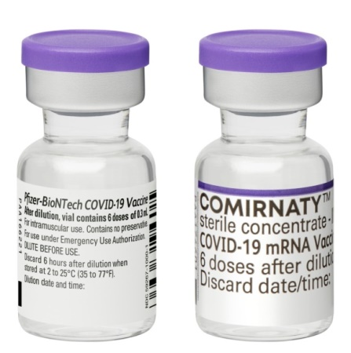
COVID-19 Pfizer BioNTech Comirnaty 30 micrograms/dose vaccine

Slide 84
COVID-19 Pfizer BioNTech (Comirnaty) vaccine
the vaccine contains BNT162b2 messenger RNA embedded in lipid nanoparticles
the vaccine does not contain preservative
the vaccine does not contain latex, milk, lactose, gluten, egg, maize/corn or peanuts
no animal products are used in the manufacture of this vaccine
full product information about the Pfizer BioNTech vaccine is available at https://www.ema.europa.eu/en/documents/product-information/comirnaty-epar-product-information_en.pdf
a video showing how to reconstitute and prepare the Pfizer BioNTech (Comirnaty) vaccine is available:
Comirnaty: www.comirnatyeducation.co.uk
Notes:
The vaccine does not contain any animal products

Slide 85
COVID-19 Pfizer BioNTech Comirnaty 30 micrograms/dose vaccine ingredients / excipients
In addition to the highly purified BNT162b2 messenger RNA, the vaccine also contains:
ALC-0315 = (4-hydroxybutyl) azanediyl)bis (hexane-6,1-diyl)bis(2-hexyldecanoate)
ALC-0159 = 2-[(polyethylene glycol)-2000]-N,N-ditetradecylacetamide
1,2-Distearoyl-sn-glycero-3-phosphocholine (DSPC)
cholesterol
potassium chloride
potassium dihydrogen phosphate
sodium chloride
disodium hydrogen phosphate dihydrate
sucrose
water for injections
sodium hydroxide
hydrochloric acid
Polyethylene glycol (PEG) is an allergen commonly found in medicines and also in household goods and cosmetics. Known allergy to PEG is extremely rare but would contraindicate receipt of this vaccine.
Notes:
Comirnaty | European Medicines Agency (europa.eu)

Slide 86
Adverse reactions following COVID-19 Pfizer BioNTech Comirnaty 30 micrograms/dose vaccine
The following reactions were reported by the vaccine clinical trial participants
Local reactions
Over 80% reported pain at the injection site. Redness and swelling was also commonly reported
Systemic reactions
The most frequently reported systemic reactions (reactions affecting the whole body) were
tiredness (> 60%) headache (> 50%)
muscle aches (> 30%) chills (> 30%)
joint pain (> 20%) raised temperature (pyrexia)(> 10%)
these symptoms were usually mild or moderate in intensity and resolved within a few days after vaccination
medicines such as paracetamol can be given for pain or fever if required
inform vaccinees these symptoms normally last less than a week but if their symptoms get worse or they are concerned, they should speak to their GP
the types of reactions reported in adolescents aged 12 to 15 years who received the Pfizer BioNTech vaccine in clinical trials were the same as those reported in older individuals but were reported slightly more frequently
Note: Swollen axilla or neck glands on the same side as the vaccination site can occur as an uncommon reaction, this can last for up to 10 days. If the vaccine recipient is due to attend for a mammogram, they should be advised to inform clinicians regarding date of vaccine administration.

Slide 87
COVID-19 Pfizer BioNTech Comirnaty 30 micrograms/ dose vaccine presentation
the vaccine packs contain 195 vials of vaccine
the vaccine is contained in a multidose clear glass vial. The vial has a rubber (bromobutyl) stopper, aluminium seal and a purple flip-off plastic cap. The stopper does not contain latex
each vial contains 0.45 ml of vaccine and should be diluted with 1.8 ml of Sodium Chloride 0.9% Solution for Injection (normal saline). Once diluted, each reconstituted vaccine will supply 6 doses of 0.3 ml
if the dose-sparing needles and syringes being supplied with the vaccine are used, it should be possible to obtain 6 full 0.3ml doses from the vial. Care should be taken to ensure a full 0.3 ml dose will be administered to the patient from the same vial. Where a full 0.3 ml dose cannot be extracted, the contents should be discarded
a separate ampoule containing a minimum of 2ml of normal saline is required for vaccine reconstitution
each ampoule of diluent is single use and any remaining diluent must be discarded after 1.8 ml has been withdrawn, regardless of the ampoule volume
Notes:
Bromobuty is a synthetic rubber – it does not contain latex so this vaccine is suitable for people with a latex allergy.

Slide 88
COVID-19 Pfizer BioNTech Comirnaty 30 micrograms/ dose vaccine dose and schedule
a single dose is 0.3 ml (30 micrograms)
two doses of COVID-19 Pfizer BioNTech (Comirnaty 30micrograms/dose) vaccine are required with a minimum 21-day interval between doses
currently, JCVI is recommending an interval of eight to twelve weeks between doses of all the available COVID-19 vaccines
operationally, this consistent interval should be used for all two dose vaccines to avoid confusion and simplify booking, and will help to ensure a good balance between achieving rapid and long-lasting protection
the main exception to the eight week lower interval would be those about to commence immunosuppressive treatment. In these individuals, the minimal interval between doses (21 days for Pfizer BioNTech Comirnaty 30micrograms/dose vaccine) may be followed to ensure that the vaccine is given whilst their immune system is better able to respond
the booster vaccination dose is also 0.3ml and should be given to eligible individuals no earlier than three months after the second dose

Slide 89
Storage and use of COVID-19 Pfizer BioNTech (Comirnaty) vaccine
the mRNA Vaccine Pfizer BioNTech has very specific storage, reconstitution and 'use within' requirements
all those involved in the delivery of the COVID-19 vaccination programme must be aware of the recommended storage requirements, refer to the vaccine product information.
The vaccine must not be given if you are not confident that it has been stored or reconstituted as recommended by the manufacturer or as advised by a vaccine expert
If the vaccine is stored incorrectly:
the vaccines should be labelled and quarantined, the vaccines should not be used until further notice
breaches in the cold-chain should be reported in line with local arrangements make alternative arrangements for immunisation clinics until resolved
further advice re use should be sought from the local Trust’s Pharmacy Department or Medicines Information Service
vaccine losses outside of secondary care should be reported to the PHA Duty Room (0300 555 0119) for further risk assessment, including whether patients need revaccination following a cold chain breach.

Slide 90
Storage of COVID-19 Pfizer BioNTech Comirnaty 30 micrograms/dose vaccine in a thawed state
the vaccine may be delivered to where it is going to be administered thawed but refrigerated between +2 and +8ºC
refrigerated vaccine must be transferred immediately to a vaccine fridge on arrival and stored in a carefully monitored temperature range of +2 and +8ºC
when removed from the freezer, the undiluted vaccine has a maximum shelf life of up to one month at +2 and +8ºC within the 18 month frozen shelf life
prior to use, the unopened vaccine can be stored for up to 2 hours at temperatures up to 30ºC
the Comirnaty pack has a space on the label on the front which should state the expiry date following removal from the freezer on it
vaccine should be stored in the original package to protect it from light. Exposure to room light should be minimised and exposure to direct sunlight and ultraviolet light should be avoided

Slide 91
COVID-19 Pfizer BioNTech Comirnaty 30 micrograms/ dose vaccine reconstitution
The following equipment is required for reconstitution:
one Pfizer BioNTech Comirnaty 30 micrograms/dose COVID-19 vaccine multidose vial
one plastic ampoule of Sodium Chloride 0.9% Solution for Injection - this will be supplied in multiple presentations (different manufacturers and different sized ampoules)
an alcohol swab and one of the combined needle and syringes supplied for dilution of the Pfizer BioNTech vaccine
After dilution the vaccine should be used as soon as is practically possible.
Reconstituted vaccine can be stored between or +2ºC and +30ºC but must be used within 6 hours following dilution

Slide 92
Reconstituting COVID-19 Pfizer BioNTech Comirnaty 30 micrograms/dose vaccine (1)
clean hands with alcohol-based gel or soap and water
assemble one ampule of Sodium Chloride 0.9% Solution for Injection, a single use alcohol swab, a needle with a green hub and a 2ml syringe
if removing the multidose vaccine vial directly from a ULT freezer:
frozen vials of Comirnaty may be thawed at temperatures of up to 30ºC for 30 minutes for immediate use. It must not be kept at room temperature (up to 30ºC) for any longer than 2 hours prior to dilution
if removing the multidose vaccine vial from cold storage between +2 and +8ºC, check that it has not been stored there for longer than one month (31 days)
confirm that the vial has a purple plastic cap
when the thawed vaccine is at room temperature, gently invert the vial 10 times prior to dilution. Do not shake
check the expiry date and the appearance of the vaccine. Prior to dilution, the vaccine should be an off-white solution with no particulates visible. Discard the vaccine if particulates or discolouration are present
clean the vial stopper with the single use alcohol swab and allow to air dry fully

Slide 93
Reconstituting COVID-19 Pfizer BioNTech Comirnaty 30 micrograms/dose vaccine (2)
draw up 1.8 ml of Sodium Chloride 0.9% Solution for Injection, then discard the diluent ampoule and any remaining diluent in it. Do not use any other type of diluent
add diluent to the vaccine vial. You may feel some pressure in the vial as you add the diluent. Equalise the vial pressure by withdrawing 1.8 ml of air into the empty diluent syringe before removing the needle from the vial
gently invert the diluted solution 10 times. Do not shake
the diluted vaccine should be an off-white solution with no particulates visible. Discard the diluted vaccine if particulates or discolouration are present
remove the needle from the vial and dispose into yellow sharps bin
the diluted vial should be clearly labelled with the date and time of discard on the vial label
Reconstituted vaccine should ideally be used immediately and must
be used within 6 hours following dilution
Notes:
Reconstituted vaccine can be returned to the fridge/cool box and stored between 2oC and 8oC (or up to 25°C if not in fridge) but must be used within 6 hours following dilution.

Slide 94
COVID-19 Pfizer BioNTech Comirnaty 30 micrograms/ dose vaccine dose preparation
if the vaccine has previously been reconstituted, check that the time of reconstitution was within the last 6 hours
clean top of vial with a single use alcohol swab and allow to air dry fully
unwrap one of the needle and syringes provided (recommended needle length depends on body mass of patient. Longer length (38mm) needles are recommended and being supplied for morbidly obese individuals to ensure the vaccine is injected into muscle)
withdraw a dose of 0.3 ml of diluted product for each vaccination. Ensure correct dose is drawn up
any air bubbles should be removed before removing the needle from the vial in order to avoid losing any of the vaccine dose
the same needle and syringe should be used to draw up and administer the dose of vaccine to prevent under dosing of the vaccine to the person
the needle should only be changed between the vial and the patient if it is contaminated or damaged

Slide 95
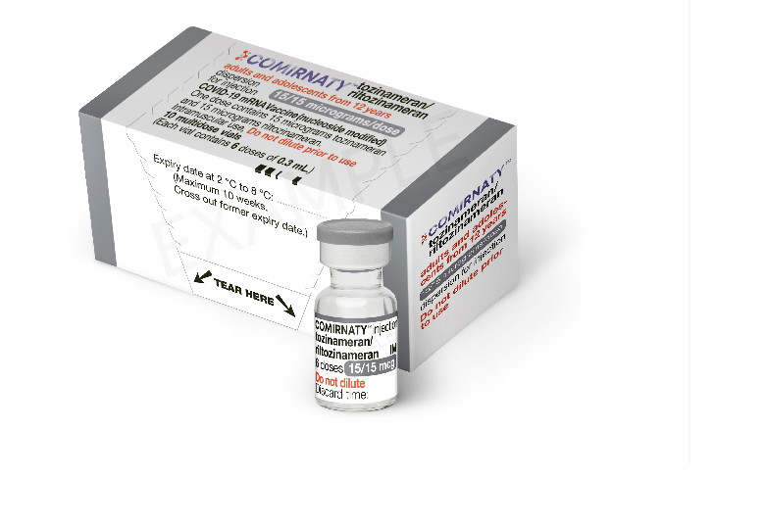
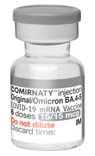
COVID-19 Vaccine Pfizer BioNTech Comirnaty Original/Omicron BA.1 and Comirnaty Original/Omicron BA.4-5

Slide 96
COVID-19 Pfizer BioNTech Comirnaty Original/Omicron BA.1 vaccine ingredients / excipients
In addition to the highly purified BNT162b2 messenger RNA (15 micrograms of tozinameran and 15 micrograms of riltozinameran), the vaccine also contains:
ALC-0315 = (4-hydroxybutyl) azanediyl)bis (hexane-6,1-diyl)bis(2-hexyldecanoate)
ALC-0159 = 2-[(polyethylene glycol)-2000]-N,N-ditetradecylacetamide
1,2-Distearoyl-sn-glycero-3-phosphocholine
cholesterol
trometamol
trometamol hydrochloride
sucrose
water for injections
Polyethylene glycol (PEG) is an allergen commonly found in medicines and also in household goods and cosmetics. Known allergy to PEG is extremely rare but would contraindicate receipt of this vaccine.
Notes:
Comirnaty, INN-COVID-19 mRNA Vaccine (nucleoside-modified) (europa.eu)

Slide 97
COVID-19 Pfizer BioNTech Comirnaty Original/Omicron BA.4-5 vaccine ingredients / excipients
In addition to the highly purified messenger RNA (15 micrograms of tozinameran and 15 micrograms of famtozinameran), the vaccine also contains:
ALC-0315 = (4-hydroxybutyl) azanediyl)bis (hexane-6,1-diyl)bis(2-hexyldecanoate)
ALC-0159 = 2-[(polyethylene glycol)-2000]-N,N-ditetradecylacetamide
1,2-Distearoyl-sn-glycero-3-phosphocholine
cholesterol
trometamol
trometamol hydrochloride
sucrose
water for injections
Polyethylene glycol (PEG) is an allergen commonly found in medicines and also in household goods and cosmetics. Known allergy to PEG is extremely rare but would contraindicate receipt of this vaccine.
Notes:
Comirnaty, INN-COVID-19 mRNA Vaccine (nucleoside-modified) (europa.eu)

Slide 98
Adverse reactions following COVID-19 Pfizer BioNTech Comirnaty Original/Omicron BA.1 and Comirnaty Original/Omicron BA.4-5 vaccine
The following reactions were reported by the vaccine clinical trial participants
Local reactions
Over 80% reported pain at the injection site. Redness and swelling was also commonly reported
Systemic reactions
The most frequently reported systemic reactions (reactions affecting the whole body) were
tiredness (> 60%) headache (> 50%)
muscle aches (> 30%) chills (> 30%)
joint pain (> 20%) raised temperature (pyrexia)(> 10%)
these symptoms were usually mild or moderate in intensity and resolved within a few days after vaccination
medicines such as paracetamol can be given for pain or fever if required
inform vaccinees these symptoms normally last less than a week but if their symptoms get worse or they are concerned, they should speak to their GP
all boosters led to short term local and systemic reactions, similar to those seen after the primary course, including local pain, fatigue, headache and muscle pain. Rates of reactions were higher with heterologous than homologous boosters and in those aged under 70 years when compared to older recipients
Notes:
Note: Swollen axilla or neck glands on the same side as the vaccination site can occur as an uncommon reaction, this can last for up to 10 days. If the vaccine recipient is due to attend for a mammogram, they should be advised to inform clinicians regarding date of vaccine administration.

Slide 99
COVID-19 Pfizer BioNTech Comirnaty Original/Omicron BA.1 and Comirnaty Original/Omicron BA.4-5 vaccine presentation, dose and schedule
the vaccine packs contain 10 multidose vials of vaccine
the vaccine is contained in a multidose clear glass vial. The vial has a rubber (chlorobutyl) stopper, aluminium seal and a grey flip-off plastic cap
a single dose is 0.3 ml
the vaccine does not require dilution
if the dose-sparing needles and syringes are used, it should be possible to obtain at least 6 full 0.3ml doses from the vial
a booster dose of Pfizer BioNTech Comirnaty Original/Omicron BA.1 or Comirnaty Original/Omicron BA.4-5 vaccine should be given to eligible individuals no earlier than three months after a previous dose of COVID-19 vaccination

Slide 100
COVID-19 Pfizer BioNTech Comirnaty Original/Omicron BA.1 and Comirnaty Original/Omicron BA.4-5 vaccine storage and use
The COVID-19 Pfizer BioNTech Comirnaty Original/Omicron BA.1 and Comirnaty Original/Omicron BA.4-5 vaccine will be stored frozen in facilities with appropriate freezers to store the vaccine vials between -90ºC to -60ºC until ready for use
shelf-life is 18 months at -90ºC to -60ºC
when stored frozen at -90 °C to -60 °C, 10-vial packs of the vaccine can be thawed at +2°C to +8°C for 6 hours or individual vials can be thawed at room temperature (up to +30°C) for 30 minutes
the vaccine may then be delivered to where it is going to be administered thawed but refrigerated between +2ºC and +8ºC
thawed vaccine must be transferred immediately to a vaccine fridge on arrival and stored in a carefully monitored temperature range of +2ºC and +8ºC
once thawed, the unopened vaccine may be stored refrigerated at +2ºC to +8ºC, protected from light, for up to 10 weeks
the unopened vaccine may be stored at +8ºC to +30ºC for up to 12 hours after removal from refrigerated conditions
Notes:
Comirnaty, INN-COVID-19 mRNA Vaccine (nucleoside-modified) (europa.eu)

Slide 101
COVID-19 Pfizer BioNTech Comirnaty Original/Omicron BA.1 and Comirnaty Original/Omicron BA.4-5 vaccine preparation (1)
COVID-19 Pfizer BioNTech Comirnaty Original/Omicron BA.1 and Comirnaty Original/ Omicron BA.4-5 vaccines do not require dilution
before drawing up a dose of vaccine from the multidose vial, clean hands with alcohol-based gel or soap and water
each multidose vial should be clearly labelled with the date and time of expiry (which will be 12 hours from when it was first punctured)
do not use the vaccine if the time of first puncture was more than 12 hours previously
check the appearance of the vaccine. It should be white to off-white and may contain white or translucent product-related particulates. Discard the vaccine if particulates or discolouration are present.
gently mix by inverting vials 10 times prior to use. Do not shake the vaccine vial
the vial bung should be wiped with an alcohol swab and allowed to air-dry fully
Notes:
Comirnaty, INN-COVID-19 mRNA Vaccine (nucleoside-modified) (europa.eu)

Slide 102
COVID-19 Pfizer BioNTech Comirnaty Original/Omicron BA.1 and Comirnaty Original/Omicron BA.4-5 preparation (2)
a 1 ml dose-sparing syringe with a 23g, 25mm fixed-needle should be used to draw up and administer the vaccine
separate 38mm length needles and syringes should be used for morbidly obese patients to ensure the vaccine can be injected into the muscle
withdraw a dose of 0.3 ml for each vaccination. Take particular care to ensure the correct dose is drawn up as a partial dose may not provide protection
any air bubbles should be removed before removing the needle from the vial in order to avoid losing any of the vaccine dose

Slide 103
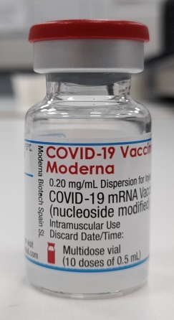
COVID-19 Vaccine Moderna (Spikevax)

Slide 104
COVID-19 Vaccine Moderna (Spikevax) ingredients / excipients
In addition to the highly purified messenger RNA, the vaccine also contains:
Lipid SM-102 Acetic acid
1,2-distearoyl-sn-glycero-3-phosphocholine (DSPC) Cholesterol
Trometamol (Tris) Sucrose
Trometamol hydrochloride (Tris HCl) Water for injections
Sodium acetate trihydrate
1,2-Dimyristoyl-rac-glycero-3-methoxypolyethylene glycol*-2000 (PEG2000-DMG)
The vaccine does not contain preservative and there no animal products are contained in the vaccine.
Polyethylene glycol (PEG) is from a group of known allergens commonly found in medicines, many household goods and cosmetics. Known allergy to PEG is rare but would contraindicate receipt of this vaccine.
Notes:
Spikevax (previously COVID-19 Vaccine Moderna) | European Medicines Agency (europa.eu)

Slide 105
Adverse reactions following COVID-19 vaccine Moderna (Spikevax)
The following reactions were reported by the vaccine clinical trial participants
Local reactions
92% reported pain at the injection site. Swelling (15%) and redness (10%) was also reported.
Systemic reactions
The most frequently reported systemic reactions (reactions affecting the whole body) were
tiredness (70%) headache (65%)
muscle aches (62%) chills (46%)
joint pain (46%) raised temperature (fever) (16%)
these symptoms were usually mild or moderate in intensity and resolved within a few days after vaccination
a slightly lower rate of reactions was seen in older age groups (those aged 65 years and above) than in those aged 18 to under 65 years. Reactions were more frequently reported after the second dose than the first dose
medicines such as paracetamol can be given for post-vaccination pain or fever if required

Slide 106
COVID-19 Vaccine Moderna (Spikevax) presentation
the vaccine packs contain 10 multidose vials of vaccine
the vaccine is contained in a multidose clear glass vial. The vial has a rubber (chlorobutyl) stopper, aluminium seal and a red flip-off plastic cap. The stopper does not contain latex
if the dose-sparing needles and syringes being supplied with the vaccine are used, it should be possible to obtain at least 10 full 0.5ml doses

Slide 107
COVID-19 vaccine Moderna (Spikevax) dose and schedule
a single dose is 0.5 ml
two doses of COVID-19 Vaccine Moderna (Spikevax) are required with a minimum 28-day interval between doses
currently, JCVI is recommending an interval of 8 to 12 weeks between doses of all the available COVID-19 vaccines
operationally, this consistent interval should be used for all two dose vaccines to avoid confusion and simplify booking, and will help to ensure a good balance between achieving rapid and long-lasting protection
the main exception to the eight week lower interval would be those about to commence immunosuppressive treatment. In these individuals, the minimal interval between doses (28 days for Moderna) may be followed to ensure that the vaccine is given whilst their immune system is better able to respond

Slide 108
COVID-19 Vaccine Moderna (Spikevax) storage and use
The COVID-19 Vaccine Moderna (Spikevax) will be stored frozen in facilities with appropriate freezers to store the vaccine vials between -50ºC to -15ºC until ready for use
shelf-life is 9 months at -50ºC to -15ºC
the vaccine may then be delivered to where it is going to be administered thawed but refrigerated between +2ºC and +8ºC
refrigerated vaccine must be transferred immediately to a vaccine fridge on arrival and stored in a carefully monitored temperature range of +2ºC and +8ºC
once thawed, the unopened vaccine may be stored refrigerated at +2ºC to +8ºC, protected from light, for up to 30 days
the vaccine pack should have a label on the front stating the time it was removed from the freezer into storage at +2ºC to +8ºC and the date and time by which it must be discarded 30 days later if it has not been used
the unopened vaccine may be stored at +8ºC to +25ºC for up to 24 hours after removal from refrigerated conditions

Slide 109
COVID-19 Vaccine Moderna (Spikevax) preparation (1)
COVID-19 Vaccine Moderna (Spikevax) does not require reconstitution
before drawing up a dose of vaccine from the multidose vial, clean hands with alcohol-based gel or soap and water
each multidose vial should be clearly labelled with the date and time of expiry (which will be 6 hours from when it was first punctured)
from a microbiological point of view, the product should be used immediately. Do not use the vaccine if the time of first puncture was more than 6 hours previously
check the appearance of the vaccine. It should be white to off-white and may contain white or translucent product-related particulates. Discard the vaccine if particulates or discolouration are present.
swirl the vial gently after thawing and between each withdrawal. Do not shake the vaccine vial
the vial bung should be wiped with an alcohol swab and allowed to air-dry fully

Slide 110
COVID-19 Vaccine Moderna (Spikevax) preparation (2)
a 1 ml dose-sparing syringe with a 23g, 25mm fixed-needle should be used to draw up and administer the vaccine (these will usually be supplied with the vaccine)
separate 38mm length needles and syringes should be used for morbidly obese patients to ensure the vaccine can be injected into the muscle
withdraw a dose of 0.5 ml for each vaccination. Take particular care to ensure the correct dose is drawn up as a partial dose may not provide protection
any air bubbles should be removed before removing the needle from the vial in order to avoid losing any of the vaccine dose

Slide 111
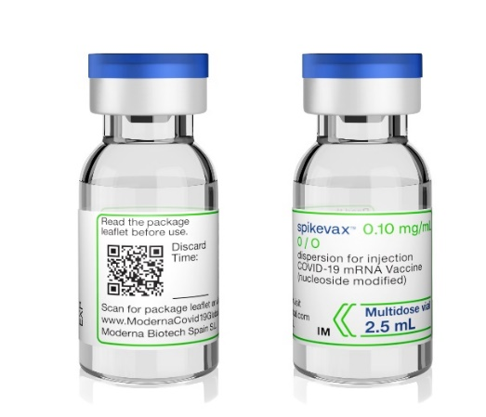
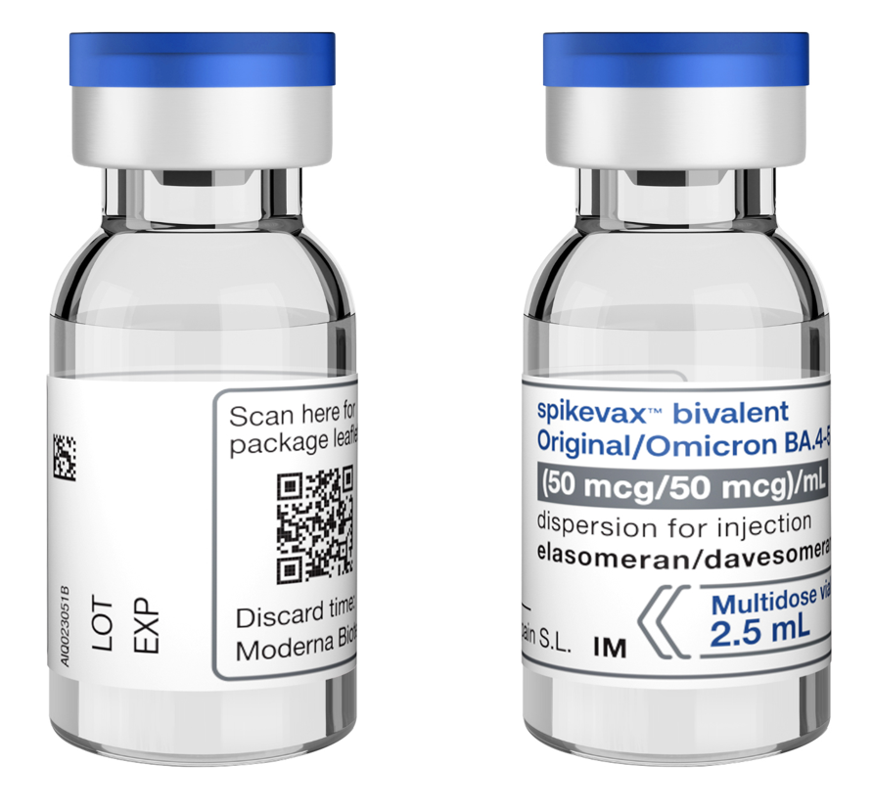
COVID-19 Vaccine Moderna Spikevax bivalent Original/Omicron BA.1 and Spikevax bivalent Original/Omicron BA.4-5

Slide 112
COVID-19 Vaccine Moderna Spikevax bivalent Original/Omicron BA.1 and Spikevax bivalent Original/Omicron BA.4-5 ingredients / excipients
In addition to the highly purified messenger RNA, the vaccine also contains:
Lipid SM-102 Acetic acid
1,2-distearoyl-sn-glycero-3-phosphocholine (DSPC) Cholesterol
Trometamol (Tris) Sucrose
Trometamol hydrochloride (Tris HCl) Water for injections
Sodium acetate trihydrate
1,2-Dimyristoyl-rac-glycero-3-methoxypolyethylene glycol*-2000 (PEG2000-DMG)
The vaccine does not contain preservative and there no animal products are contained in the vaccine.
Polyethylene glycol (PEG) is from a group of known allergens commonly found in medicines, many household goods and cosmetics. Known allergy to PEG is rare but would contraindicate receipt of this vaccine.
Notes:
Spikevax (previously COVID-19 Vaccine Moderna) | European Medicines Agency (europa.eu)

Slide 113
Adverse reactions following COVID-19 vaccine Moderna Spikevax bivalent Original/Omicron BA.1 and Spikevax bivalent Original/Omicron BA.4-5
The following reactions were reported by the vaccine clinical trial participants
Local reactions
92% reported pain at the injection site. Swelling (15%) and redness (10%) was also reported.
Systemic reactions
The most frequently reported systemic reactions (reactions affecting the whole body) were
tiredness (70%) headache (65%)
muscle aches (62%) chills (46%)
joint pain (46%) raised temperature (fever) (16%)
these symptoms were usually mild or moderate in intensity and resolved within a few days after vaccination
medicines such as paracetamol can be given for post-vaccination pain or fever if required
all boosters led to short term local and systemic reactions, similar to those seen after the primary course, including local pain, fatigue, headache and muscle pain. Rates of reactions were higher with heterologous than homologous boosters and in those aged under 70 years when compared to older recipients

Slide 114
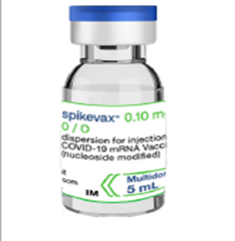
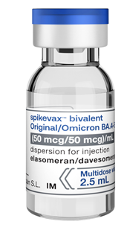
COVID-19 Vaccine Moderna Spikevax bivalent Original/Omicron BA.1 and Spikevax bivalent Original/Omicron BA.4-5 presentation
the bivalent Moderna Original/Omicron BA.1 and Original/Omicron BA.4-5 boosters are supplied in multidose vials containing 5 doses of 0.5ml
the vaccine is a white to off white dispersion
the vaccine is contained in a multidose clear glass vial. The vial has a rubber (chlorobutyl) stopper, aluminium seal and a blue flip-off plastic cap. The stopper does not contain latex
if the dose-sparing needles and syringes being supplied with the vaccine are used, it should be possible to obtain at least 5 full doses of 0.5 mL each from the vial

Slide 115
COVID-19 vaccine Moderna Spikevax bivalent Original/Omicron BA.1 and Spikevax bivalent Original/Omicron BA.4-5 dose and schedule
the booster dose of Moderna Spikevax bivalent Original/Omicron and Spikevax bivalent Original/Omicron BA.4-5 vaccine is 0.5ml
a single dose contains 50 micrograms mRNA (25 micrograms of mRNA directed against the original strain and 25 micrograms of mRNA against Omicron BA.1 and Omicron BA.4-5, respectively)
a booster dose of Moderna Spikevax bivalent Original/Omicron BA.1 or Spikevax bivalent Original/Omicron BA.4-5 vaccine should be given to eligible individuals no earlier than three months after a previous dose of COVID-19 vaccination

Slide 116
COVID-19 Vaccine Moderna Spikevax bivalent Original/Omicron BA.1 and Spikevax bivalent Original/Omicron BA.4-5 storage and use
The COVID-19 Vaccine Moderna (Spikevax) will be stored frozen in facilities with appropriate freezers to store the vaccine vials between -50ºC to -15ºC until ready for use
shelf-life is 9 months at -50ºC to -15ºC
the vaccine may then be delivered to where it is going to be administered thawed but refrigerated between +2ºC and +8ºC
refrigerated vaccine must be transferred immediately to a vaccine fridge on arrival and stored in a carefully monitored temperature range of +2ºC and +8ºC
once thawed, the unopened vaccine may be stored refrigerated at +2ºC to +8ºC, protected from light, for up to 30 days. Within this period, up to 12 hours may be used for transportation
the vaccine pack should have a label on the front stating the time it was removed from the freezer into storage at +2ºC to +8ºC and the date and time by which it must be discarded 30 days later if it has not been used
the unopened vaccine may be stored at +8ºC to +25ºC for up to 24 hours after removal from refrigerated conditions

Slide 117
COVID-19 Vaccine Moderna Spikevax bivalent Original/Omicron BA.1 and Spikevax bivalent Original/Omicron BA.4-5 preparation (1)
COVID-19 Vaccine Moderna Spikevax bivalent Original/Omicron BA.1 and Spikevax bivalent Original/Omicron BA.4-5 do not require reconstitution
before drawing up a dose of vaccine from the multidose vial, clean hands with alcohol-based gel or soap and water
each multidose vial should be clearly labelled with the date and time of expiry (which will be 6 hours from when it was first punctured)
from a microbiological point of view, the product should be used immediately. Do not use the vaccine if the time of first puncture was more than 6 hours previously
check the appearance of the vaccine. It should be white to off-white and may contain white or translucent product-related particulates. Discard the vaccine if particulates or discolouration are present.
swirl the vial gently after thawing and between each withdrawal. Do not shake the vaccine vial
the vial bung should be wiped with an alcohol swab and allowed to air-dry fully

Slide 118
COVID-19 Vaccine Moderna Spikevax bivalent Original/Omicron BA.1 and Spikevax bivalent Original/Omicron BA.4-5 preparation (2)
a 1 ml dose-sparing syringe with a 23g, 25mm fixed-needle should be used to draw up and administer the Moderna Spikevax bivalent Original/Omicron BA.1 or Spikevax bivalent Original/Omicron BA.4-5 vaccine
separate 38mm length needles and syringes should be used for morbidly obese patients to ensure the vaccine can be injected into the muscle
withdraw a dose of 0.5 ml for each vaccination. Take particular care to ensure the correct dose is drawn up as a partial dose may not provide protection
any air bubbles should be removed before removing the needle from the vial in order to avoid losing any of the vaccine dose

Slide 119
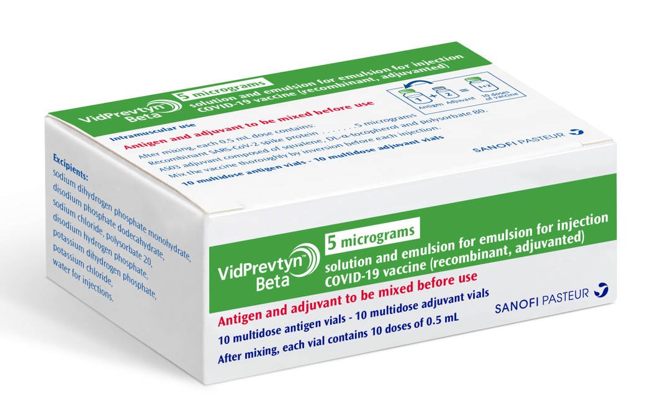
COVID-19 VidPrevtyn Beta (Sanofi Pasteur) vaccine Provisional – Subject to revision – Use latest version link: x

Slide 120
COVID-19 VidPrevtyn Beta (Sanofi Pasteur) vaccine ingredients / excipients
In addition to the SARS-CoV-2 spike protein, the vaccine also contains:
Adjuvant:
AS03 adjuvant is composed of squalene* (10.69 milligrams), DL-α-tocopherol (11.86 milligrams) and
polysorbate 80 (4.86 milligrams)
Sodium chloride
Disodium hydrogen phosphate
Potassium dihydrogen phosphate
Potassium chloride
Water for injections
Antigen:
Sodium dihydrogen phosphate monohydrate
Disodium phosphate dodecahydrate
Polysorbate 20
VidPrevtyn Beta may contain traces of octylphenol ethoxylate.
Notes:
*Squalene is a naturally occurring molecule found in plants and animals, and commercially extracted from fish oil. Squalene is an essential ingredient in the adjuvant system. Combined with surfactants and other immunostimulants, emulsions of squalene have been shown to enhance the immune response when added to antigens. The squalene used in VidPrevtyn Beta is extracted from shark liver oil.
VidPrevtyn Beta does not contain latex or rubber.
Produced by recombinant DNA technology using a baculovirus expression system in an insect cell line that is derived from Sf9 cells of the fall armyworm, Spodoptera frugiperda.
VidPrevtyn Beta; COVID-19 vaccine (recombinant, adjuvanted) (europa.eu)

Slide 121
Adverse reactions following COVID-19 VidPrevtyn Beta (Sanofi Pasteur) vaccine
The following reactions were reported by the vaccine clinical trial participants
Local reactions
Over 75% reported pain at the injection site
Systemic reactions
The most frequently reported systemic reactions (reactions affecting the whole body) were
headache (> 40%) joint pain (> 28%)
muscle aches (> 37%) chills (> 19%)
these symptoms were usually mild or moderate in intensity and resolved within a few days after vaccination
inform vaccinees these symptoms normally last less than a week but if their symptoms get worse or they are concerned, they should speak to their GP
VidPrevtyn Beta was trialled as a first booster in individuals previously vaccinated with mRNA or adenovirus vector vaccines

Slide 122
COVID-19 VidPrevtyn Beta (Sanofi Pasteur) vaccine presentation
two multidose vials, an antigen vial and an adjuvant vial
the antigen and adjuvant vials must be mixed immediately before use. After mixing, the vaccine vial contains 10 doses of 0.5 ml
each pack contains 10 multidose antigen vials and 10 multidose adjuvant vials
the batch number for the antigen vials appears only on the outer packaging

Slide 123
COVID-19 VidPrevtyn Beta (Sanofi Pasteur) vaccine presentation (continued)
VidPrevtyn Beta is presented as:
2.5 ml antigen solution in a multidose vial with a stopper (chlorobutyl) and an aluminium seal with a green plastic flip- off cap
2.5 ml adjuvant emulsion in a multidose vial with a stopper (chlorobutyl) and an aluminium seal with a yellow plastic flip- off cap
the antigen solution is a colourless, clear liquid
the adjuvant emulsion is a whitish to yellowish homogeneous milky liquid

Slide 124
COVID-19 VidPrevtyn Beta (Sanofi Pasteur) vaccine dose and schedule
a single dose is 0.5 ml
currently, JCVI is recommending VidPrevtyn Beta as a booster for active immunisation to prevent COVID-19 in adults (> 75 years*)
a booster dose of VidPrevtyn Beta (Sanofi Pasteur) vaccine should be given to eligible individuals no earlier than three months after a previous dose of COVID-19 vaccination
Notes:
*As part of operational flexibility, eligible individuals aged 65 to 74 years may also receive Sanofi Pasteur vaccine (VidPrevtyn Beta®) where it would simplify delivery in that setting. This includes vaccination in care homes for older adults and in domiciliary settings

Slide 125
COVID-19 VidPrevtyn Beta (Sanofi Pasteur) vaccine storage and use
shelf-life is 1 year at +2ºC to +8ºC
the vaccine must be transferred immediately to a vaccine fridge on arrival and stored in a carefully monitored temperature range of +2ºC and +8ºC
from a microbiological point of view, the vaccine should be used immediately after mixing, however chemical and physical in-use stability has been demonstrated for 6 hours at +2°C - +8°C from the time of first needle puncture and mixing, to administration
after mixing, the product must be used within 6 hours
after mixing the Summary of Product Characteristics advises returning the product to the fridge and protecting it from light. A MHRA review of quality data has shown that the mixed antigen/adjuvant for VidPrevtyn Beta is stable at +23 to +27°C for several hours. UKHSA have advised that, as any risk of microbial growth would be minimal within a few hours of mixing, the 10 doses of VidPrevtyn Beta could be used as soon as practicably possible, without returning to the fridge. The mixed vaccine should be discarded after 6 hours

Slide 126
COVID-19 VidPrevtyn Beta (Sanofi Pasteur) vaccine preparation (1)
VidPrevtyn Beta is supplied as 2 separate vials: an antigen vial and an adjuvant vial. Prior to administration, the two components must be mixed
before drawing up a dose of the vaccine, clean hands with alcohol-based gel or soap and water
place the vials (one antigen and one adjuvant vial) at room temperature (up to 25 °C) for a minimum of 15 minutes before mixing
each reconstituted vaccine vial should be clearly labelled with the date and time of expiry (which will be 6 hours from when it was first mixed)
do not use the vaccine if the time of mixing was more than 6 hours previously
gently invert each vial. Do not shake the vials

Slide 127
COVID-19 VidPrevtyn Beta (Sanofi Pasteur) vaccine preparation (2)
inspect vials visually for any particulate matter or discoloration. Discard the antigen and/or adjuvant if particulates or discolouration are present
after removing the flip-off caps, wipe both vial stoppers with alcohol swabs and allow to air-dry fully
using the needle and syringe provided, withdraw the entire contents from the adjuvant vial (yellow cap) into a syringe. Invert the adjuvant vial to facilitate the withdrawal of the full contents
transfer the full syringe contents into the antigen vial (green cap)
remove the syringe with the needle from the antigen vial and mix the contents by inverting the vial 5 times. Do not shake
the mixed vaccine is a whitish to yellowish homogeneous milky liquid emulsion
using appropriate syringe and needle, withdraw 0.5 ml from the vial containing the mixed vaccine and administer intramuscularly (IM)

Slide 128
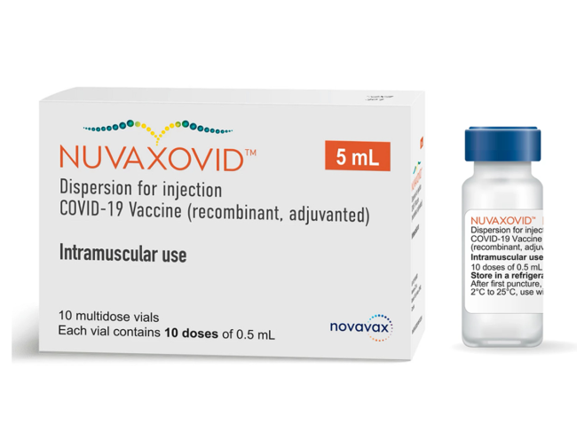
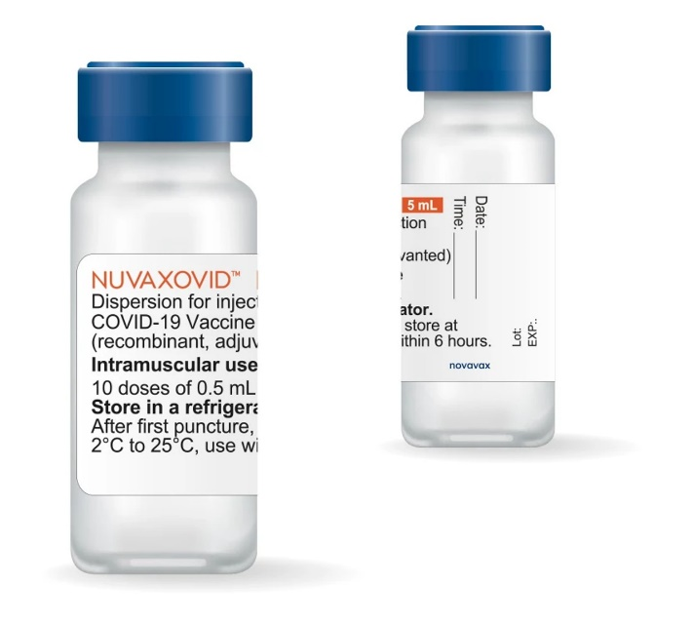
COVID-19 Vaccine Novavax (Nuvaxovid®)

Slide 129
COVID-19 Novavax (Nuvaxovid) vaccine ingredients / excipients
In addition to the SARS-CoV-2 spike protein, the vaccine also contains:
adjuvant Matrix-M Fraction-A (42.5 micrograms) and Fraction-C (7.5 micrograms) of Quillaja saponaria Molina extract
cholesterol
phosphatidylcholine (including all-rac-α-Tocopherol)
potassium dihydrogen phosphate
potassium chloride
disodium hydrogen phosphate dihydrate
disodium hydrogen phosphate heptahydrate
sodium dihydrogen phosphate monohydrate
sodium chloride
polysorbate 80
sodium hydroxide
hydrochloric acid
water for injections
Notes:
https://www.ema.europa.eu/en/documents/product-information/nuvaxovid-epar-product-information_en.pdf
Nuvaxovid® vaccine does not contain PEG but does contain a related compound called polysorbate 80. Some people with PEG allergy may also be allergic to polysorbate 80. However, polysorbate 80 is widely used in medicines and foods, and is present in many medicines including monoclonal antibody preparations. Some injected influenza vaccines (including the main vaccine used in over 65 year olds) contain polysorbate 80. Individuals who have tolerated injections that contain polysorbate 80 (such as certain influenza vaccines) are likely to tolerate the Nuvaxovid ® vaccine.
Produced by recombinant DNA technology using a baculovirus expression system in an insect cell line that is derived from Sf9 cells of the Spodoptera frugiperda species.

Slide 130
Adverse reactions following COVID-19 Novavax (Nuvaxovid) vaccine
Side effects after the vaccine are similar to other COVID-19 vaccines, with slightly lower rates of local reactions and systemic effects when compared to mRNA vaccines.
The following reactions were reported by the vaccine clinical trial participants:
Local reactions
50-70% reported pain at the injection site, swelling and redness was also reported.
Systemic reactions
The most frequently reported systemic reactions (reactions affecting the whole body) were
tiredness (40-50%) headache (40-50%)
muscle aches (40-50%) joint pain (40-50%)
raised temperature (fever) (<10%)
these symptoms were usually mild or moderate in intensity and resolved within a few days after vaccination
overall, there was a higher incidence of adverse reactions in younger age group (18-64 years)
small numbers of cases of myocarditis or pericarditis were reported across the trials but judged to be within background rates
Notes:
Green Book, chapter 14a

Slide 131
COVID-19 Novavax (Nuvaxovid) vaccine presentation
the vaccine packs contain 10 multidose vials of vaccine
the vaccine is contained in a multidose clear glass vial. The vial has a rubber (chlorobutyl) stopper, aluminium seal and a blue flip-off plastic cap
each vial contains 10 doses of 0.5 ml
the vaccine is a colourless to slightly yellow, clear to mildly opalescent fluid

Slide 132
COVID-19 Novavax (Nuvaxovid) vaccine dose and schedule
a single dose is 0.5 ml
the primary course is two doses of COVID-19 Novavax (Nuvaxovid) vaccine with a minimum 3 week interval between doses
currently, JCVI is recommending an interval of 8 to 12 weeks between doses of all the available COVID-19 vaccines
operationally, this consistent interval should be used for all two dose vaccines to avoid confusion and simplify booking, and will help to ensure a good balance between achieving rapid and long-lasting protection
the main exception to the eight week lower interval would be those about to commence immunosuppressive treatment. In these individuals, the minimal interval between doses (3 weeks for COVID-19 Novavax (Nuvaxovid)) may be followed to ensure that the vaccine is given whilst their immune system is better able to respond

Slide 133
COVID-19 Novavax (Nuvaxovid) vaccine storage and use
shelf-life is 9 months at +2ºC to +8ºC*
the vaccine must be transferred immediately to a vaccine fridge on arrival and stored in a carefully monitored temperature range of +2ºC and +8ºC
the unopened vaccine may be stored at +8ºC to +25ºC for up to 12 hours after removal from refrigerated conditions
from a microbiological point of view, after first opening (first needle puncture), the vaccine should be used immediately, however chemical and physical in-use stability has been demonstrated for 6 hours at 2°C to 25°C from the time of first needle puncture to administration
Notes:
*On 24 February 2023 a Batch Specific Variation was approved in the UK for Nuvaxovid Dispersion for Injection, COVID-19 Vaccine. The product has been extended from 9 months to 12 months. The storage conditions remain unchanged.
The concerned batches affected by this variation and updated expiry dates are shown below:
Batch number Printed Expiry Date Updated Expiry Date
4302MF024 February 2023 May 2023
4302MF025 March 2023 June 2023

Slide 134
COVID-19 Novavax (Nuvaxovid) vaccine preparation
COVID-19 Novavax (Nuvaxovid) vaccine does not require reconstitution
before drawing up a dose of vaccine from the multidose vial, clean hands with alcohol-based gel or soap and water
each multidose vial should be clearly labelled with the date and time of expiry (which will be 6 hours from when it was first punctured)
do not use the vaccine if the time of first puncture was more than 6 hours previously
check the appearance of the vaccine. It should be a colourless to slightly yellow, clear to mildly opalescent fluid. Discard the vaccine if particulates or discolouration are present.
swirl the vial gently after thawing and between each withdrawal. Do not shake the vaccine vial
the vial bung should be wiped with an alcohol swab and allowed to air-dry fully

Slide 135
Guidance on handling multiple COVID-19 vaccines
As more COVID-19 vaccines become available, it is important to ensure there are procedures in place to make certain that each person gets the
right dose of the right vaccine at the right time
and that the vaccine has been stored and handled as specified in the product’s authorisation documentation.
The different COVID-19 vaccines have different storage, handling and preparation requirements, different dosages and different observation periods following vaccination. There may also be differences in the contraindications for each vaccine and in the advice that should be given about possible anticipated side effects.
Ensure you know what these are in order to minimise the risk of errors where multiple vaccines are available.
https://www.gov.uk/government/publications/covid-19-vaccination-vaccine-product-information-poster
Notes:
The Specialist Pharmacy Service has put together guidance on safe practice for handling multiple vaccines from receipt through to administration. Vaccinators are encouraged to read through this guidance in order to minimise the risk of errors where multiple vaccines are available.

Slide 136
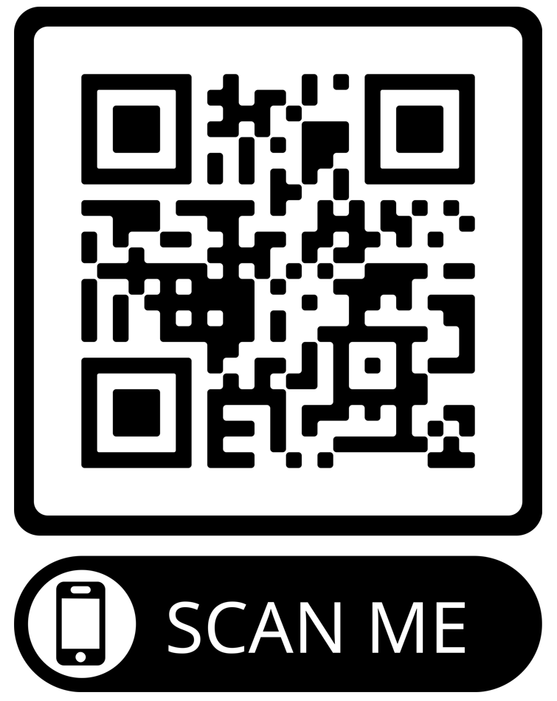
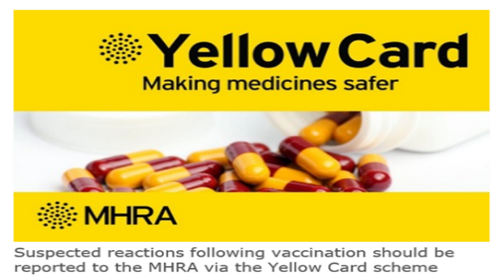
Reporting adverse reactions
Suspected adverse reactions or suspected side effects should be reported to the MHRA through the online Yellow Card | Making medicines and medical devices safer (mhra.gov.uk) or the Yellow Card app
Anyone (patients and health care workers) can make a Yellow Card report, even if they are uncertain as to whether a vaccine caused the condition
The QR code can be used for quick and easy access to the Yellow Card reporting site

Slide 137
Further information
UK vaccine policy can be found in the online publication commonly referred to as the
"Green Book" . This can be found on the Immunisation page of the GOV.UK website
Green Book recommendations are based upon JCVI’s expert opinion and should
always be followed, even when they differ from those made by the vaccine
manufacturer
PHA COVID-19 immunisation programme Information for healthcare practitioners
This document provides additional information, answers to frequently asked questions
and actions to take in the event of inadvertent errors.
It is important to read this document before you start vaccinating and also to refer to the
online version regularly as it will be updated as more information becomes available
and to address any issues or frequently arising questions as COVID-19 vaccines are
delivered more widely.

