Slide 1
Children’s Health in Northern Ireland
Summary
2021/22

Slide 2
COVID-19
Please note that data for 2021/22 will be impacted by the
COVID-19 pandemic and should be interpreted
with a degree of caution.

Slide 3
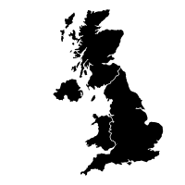
Mothers – Summary
Highest live birth rate (11.6) in United Kingdom, 2021
2% of births to teenage mums, 2021/22
2010/11: 15.5%
Women who smoke (antenatal booking)
4% of births to older mums (40+), 2021/22
2021/22: 11.3%
2020/21: 15.0%
Highest fertility rate across UK (1.81, 2021)
Women with diabetes
Over 1 in 4 women obese at antenatal booking (27%), 2021/22
2010/11: 1.8%
Graphics downloaded from: thenounproject.com

Slide 4
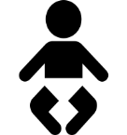
Children – Summary
Almost 36% of infants born by Caesarean Section, 2021/22
5.8% of singleton infants born pre-term (<37 weeks gestation), 2021/22
3% of infants born as a multiple, 2021/22
6.1% low birth weight (<2,500g, live infants), 2021/22
51.2% of infants breastfed (partial/total), 2021/22
14.1% high birth weight (≥4,000g, live infants), 2021/22
Overweight & obese (IOTF), 2021/22:
25% of P1 girls
18% of P1 boys
Graphics downloaded from: thenounproject.com

Slide 5
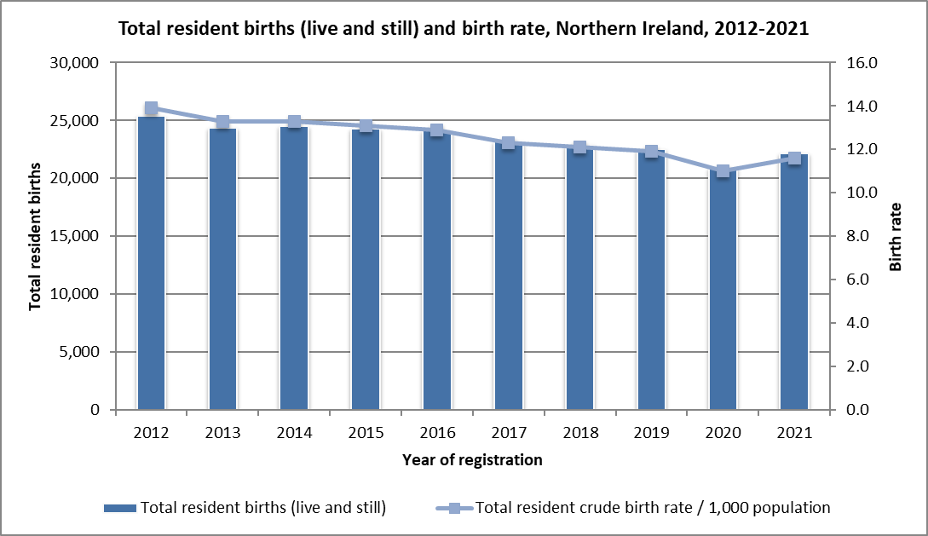
Trends in births
2021:
22,160 registered births to NI residents (total births).
Birth rate of 11.6 per 1,000 population (total births).
Live birth rate (11.6) is the highest across the four UK countries, but lower than Republic of Ireland (11.7).
89 registered stillbirths.
17.4% of live births to mothers whose country of birth was not NI.
Report – Tables 1.1 and 1.2
Source: Northern Ireland Statistics and Research Agency, Office for National Statistics (other UK) and Central Statistics Office (RoI)
https://www.nisra.gov.uk/statistics/births-deaths-and-marriages/births
https://www.ons.gov.uk/peoplepopulationandcommunity/populationandmigration/populationestimates/datasets/vitalstatisticspopulationandhealthreferencetables
https://data.cso.ie/

Slide 6
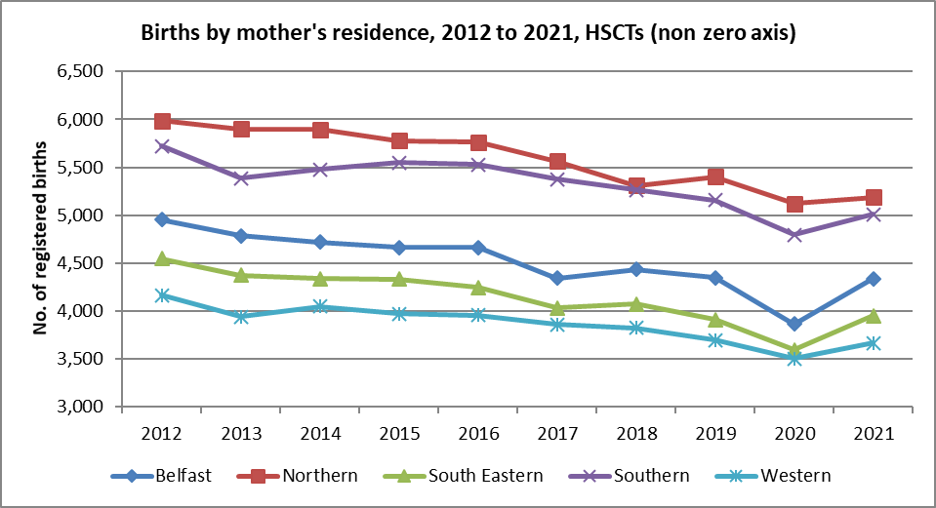
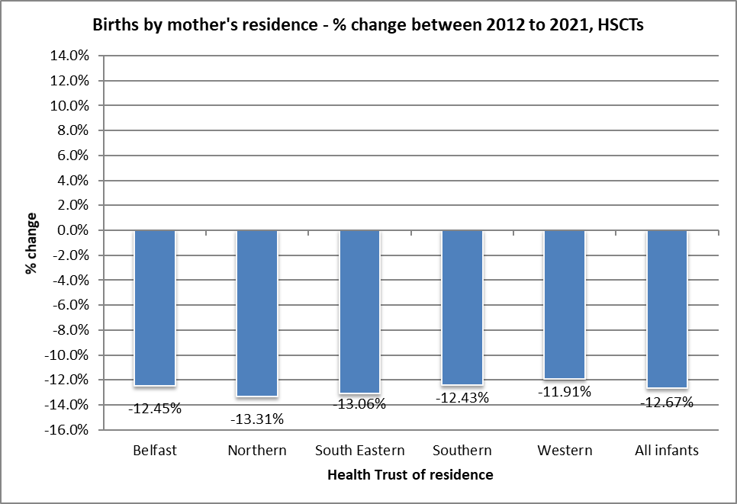
Trends in births – Health Trusts
2021:
Largest number of registered births recorded to NHSCT residents (5,189), with the lowest number in the WHSCT (3,669).
Percentage share of births:
BHSCT = 19.6%
NHSCT = 23.4%
SEHSCT = 17.8%
SHSCT = 22.6%
WHSCT = 16.6%
Report – Table 1.2
Source: Northern Ireland Statistics and Research Agency https://www.nisra.gov.uk/statistics/births-deaths-and-marriages/births

Slide 7
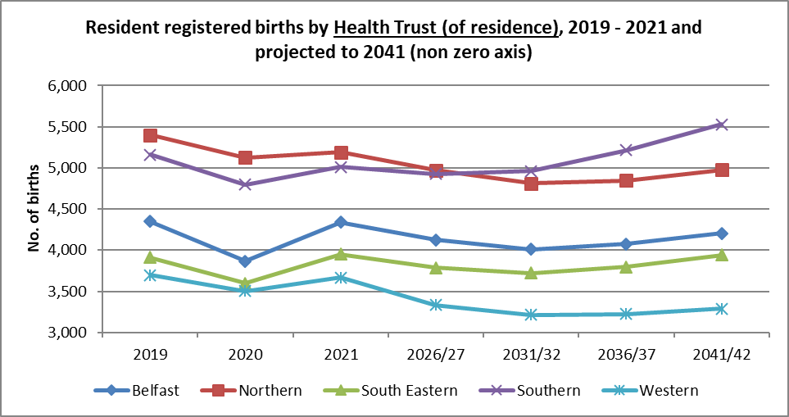
Trends - Projected Births
In the next 20 years (2021-2041), the number of births is projected to increase in Southern (10%), but decrease in all other Trusts
Report – Table 1.3
Source: Northern Ireland Statistics and Research Agency https://www.nisra.gov.uk/statistics/births-deaths-and-marriages/births

Slide 8
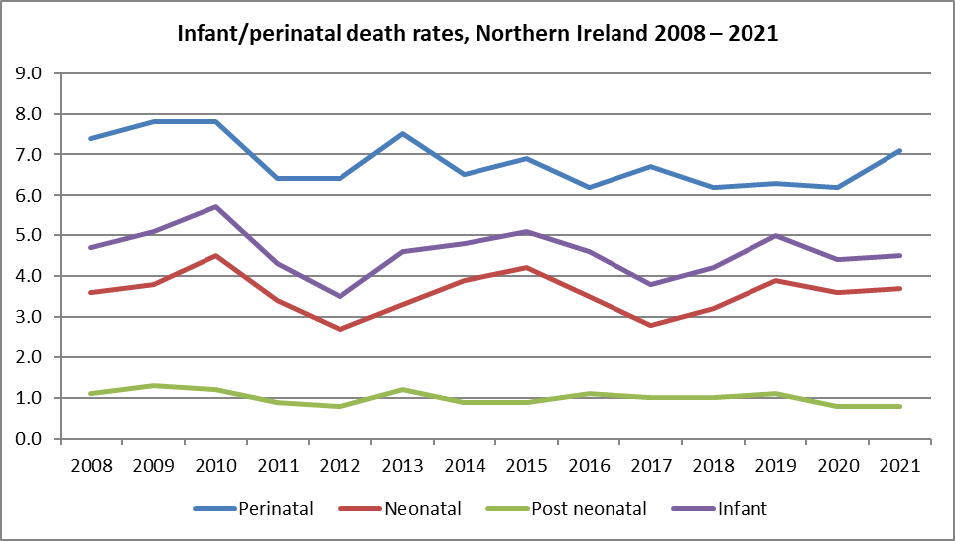
Trends - Infant Mortality
Infant mortality is considered a key indicator of the health of a population. In the last ten years, although fluctuating, mortality rates for children less than one year old in NI, have seen small overall decreases. Risk factors for infant mortality include younger mothers, smoking during pregnancy and not breastfeeding. (Report Sections 3, 6 and 10)
Perinatal deaths continue to have the highest rate of death in children aged less than one year (157 deaths in 2021).
Source: Northern Ireland Statistics and Research Agency
https://www.nisra.gov.uk/statistics/births-deaths-and-marriages
Perinatal mortality rate: Number of stillbirths and deaths in the first week of life per 1,000 live and stillbirths per annum.
Neonatal mortality rate: Number of deaths in the first four weeks of life per 1,000 live births per annum.
Post neonatal mortality rate: Number of deaths after the first four weeks but before the end of the first year per 1,000 live births per annum.
Infant mortality rate: Number of deaths in the first year of life per 1,000 live births per annum.
Rates include non Northern Ireland residents.

Slide 9
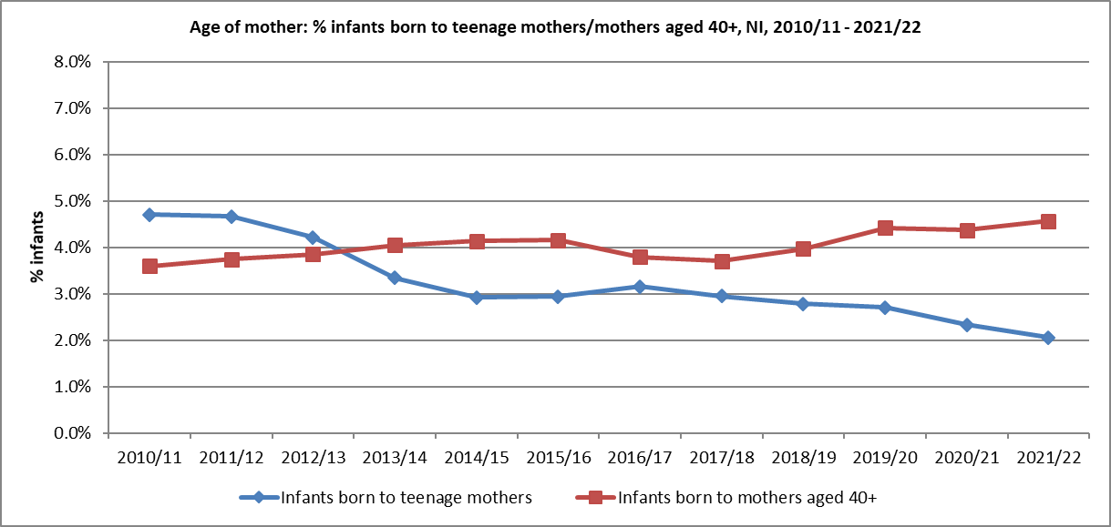
Age of mother
2021/22
Teenage mothers (<20 years):
Number of births to teenage mothers in 2021/22 = 449
2.1% of all births were to teenage mothers.
3.7% of births in the most deprived areas, 0.8% in the least deprived areas (NIMDM 2017).
Older mothers (aged 40+):
Overall % births increasing since 2018/19 (% births in 2021/22 = 4.6%).
3.4% in the most deprived areas, 6.2% in the least deprived areas (NIMDM 2017).
Report – Table 3.1
Source: Child Health System
Source: Northern Ireland Statistics and Research Agency, NI Multiple Deprivation Measure 2017 https://www.nisra.gov.uk/statistics/deprivation/northern-ireland-multiple-deprivation-measure-2017-nimdm2017

Slide 10
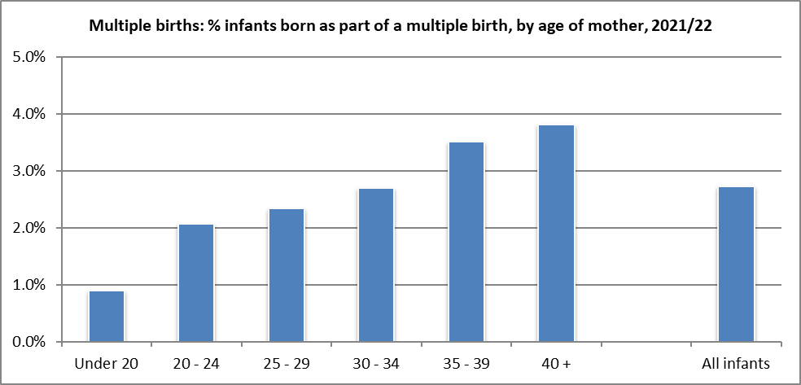
Multiple Births
2021/22:
The proportion of infants born as part of a multiple birth pregnancy increased with mother’s age (0.9% of those aged under 20 years who gave birth in 2021/22, compared to 3.8% of those aged 40+ years)
There was little difference in the proportion of infants born as a multiple when considering ethnic group of mother, Trust of residence of mother or deprivation status (NIMDM 2017).
Report – Table 4.2
Source: Child Health System
Source: Northern Ireland Statistics and Research Agency, NI Multiple Deprivation Measure 2017 https://www.nisra.gov.uk/statistics/deprivation/northern-ireland-multiple-deprivation-measure-2017-nimdm2017

Slide 11
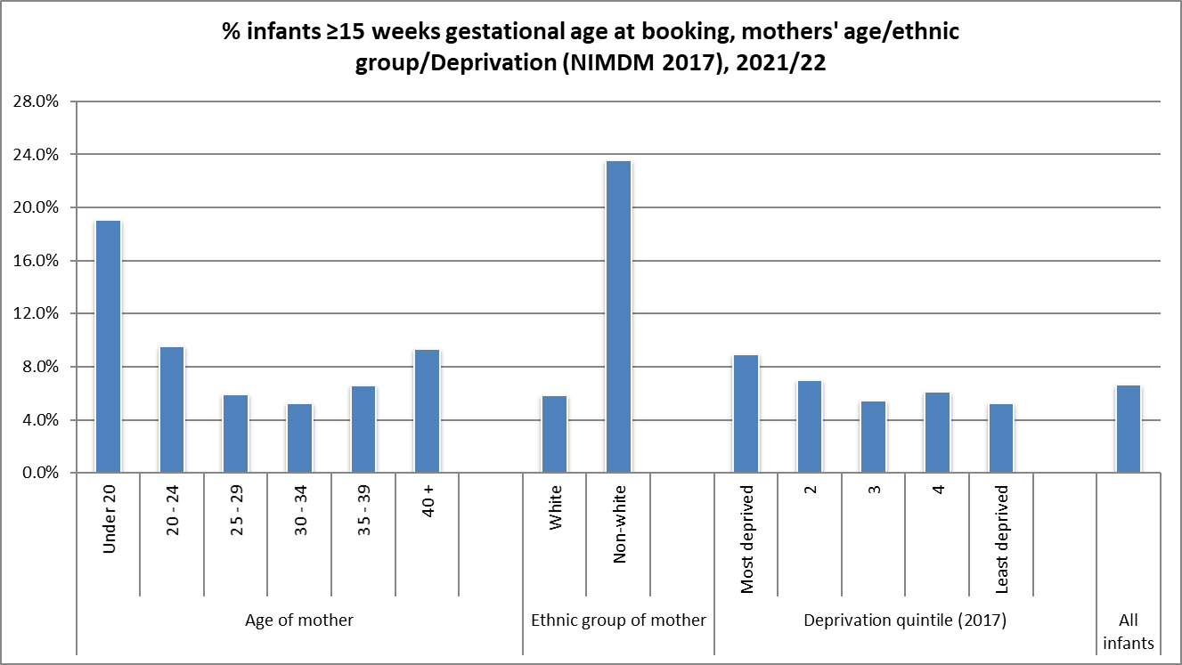
Infant Gestation - Booking
2021/22:
The proportion of infants born to mothers booking at 15 or more weeks varies by age of mother, with younger mothers less likely to book for antenatal care before 15 weeks gestation.
There are substantial differences in the timescales of when mothers book by ethnic group.
Report – Table 5.2
Source: NI Maternity System
Source: Northern Ireland Statistics and Research Agency, NI Multiple Deprivation Measure 2017
https://www.nisra.gov.uk/statistics/deprivation/northern-ireland-multiple-deprivation-measure-2017-nimdm2017

Slide 12
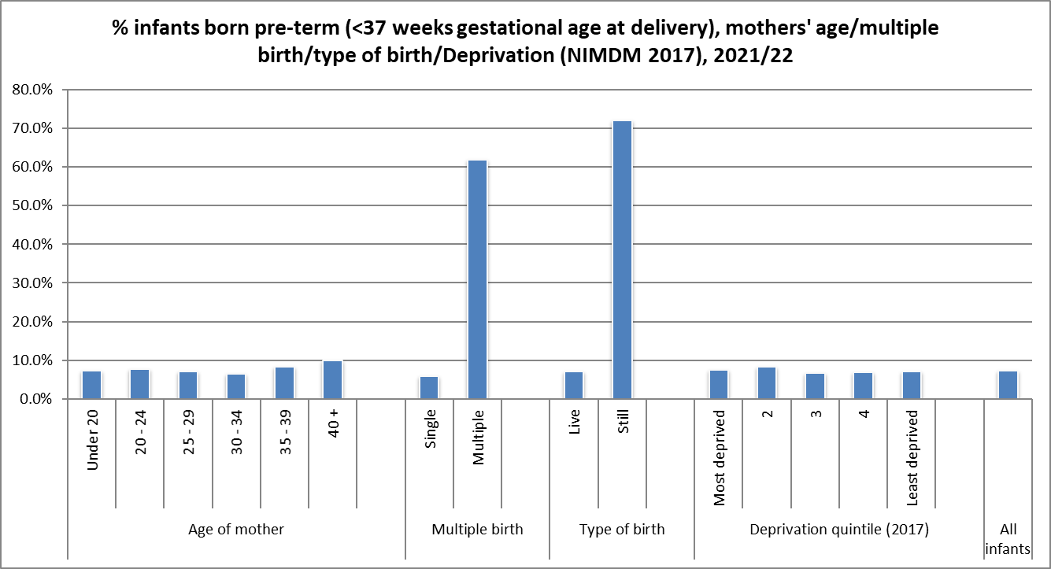
Infant Gestation - Delivery
2021/22:
A higher proportion of infants born still or as part of a multiple birth born pre-term.
Slight differences by age of mother – slightly higher proportion of infants born pre-term to older mothers (40+ year) than to younger mothers.
Report – Table 5.4
Source: NI Maternity System
Source: Northern Ireland Statistics and Research Agency, NI Multiple Deprivation Measure 2017
https://www.nisra.gov.uk/statistics/deprivation/northern-ireland-multiple-deprivation-measure-2017-nimdm2017

Slide 13
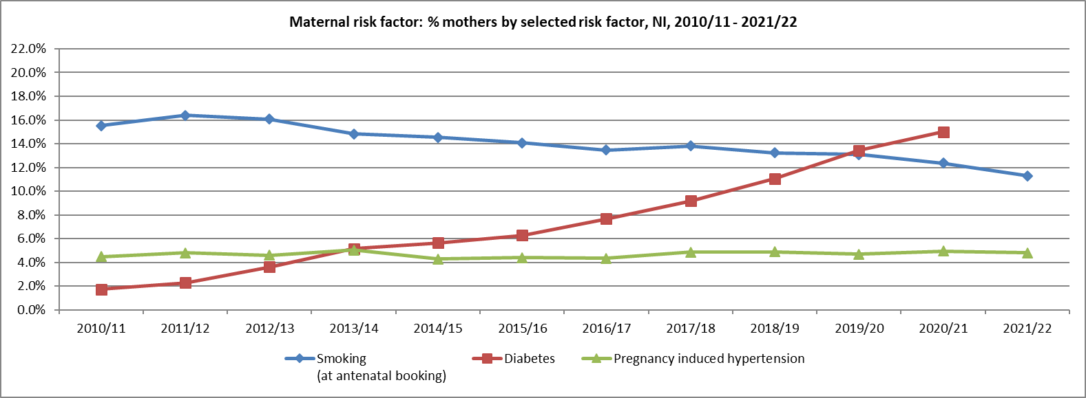
Maternal risk factors
In 2021/22, 11.3% of mothers smoked (2010/11 = 15.5%)
In 2021/22, 4.8% had pregnancy induced hypertension (2010/11 = 4.5%)
In 2020/21, 15.0% of mothers had diabetes (2010/11 = 1.8%) Note: increase may be due in part to improved recording of diabetes on NIMATS/CHS
Report – Table 6.1
Source: Child Health System (2010/11 - 2016/17), NI Maternity System (2017/18 onwards)
DIABETES - due to data validation issues, it is not possible to provide data for mothers with diabetes who gave birth during 2021/22, therefore only data up to 2020/21 has been provided

Slide 14
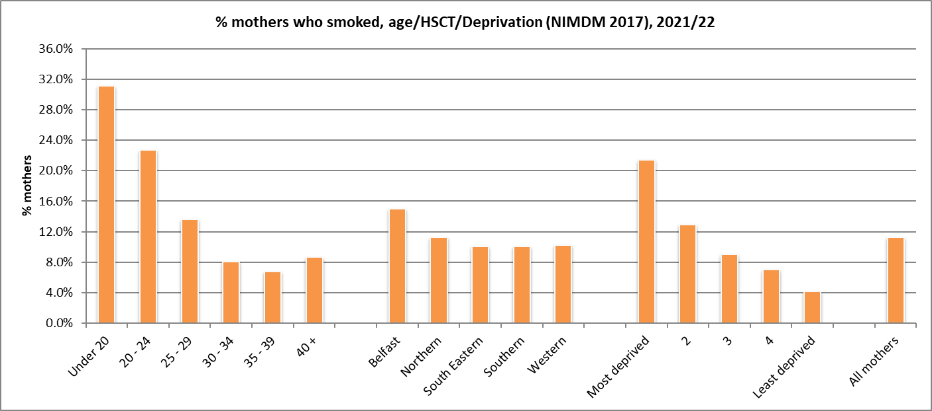
Maternal risk factors - Smoking
2021/22:
% mothers who smoked at booking decreased with age: 31.1% of those aged <20 years, 8.7% of those aged 40+.
A smaller proportion of first time mothers smoked (9.1%), compared to those who were pregnant before (12.2%).
Almost 15% of mothers in Belfast Health and Social Care Trust area smoked, compared to 10% in South Eastern HSCT and Southern HSCT (NI=11.3%).
In the most deprived areas (NIMDM 2017), 21.4% of mothers smoked, compared to 4.1% in the least deprived areas.
Report – Table 6.2
Source: NI Maternity System
Source: NISRA, NI Multiple Deprivation Measure 2017 https://www.nisra.gov.uk/statistics/deprivation/northern-ireland-multiple-deprivation-measure-2017-nimdm2017

Slide 15
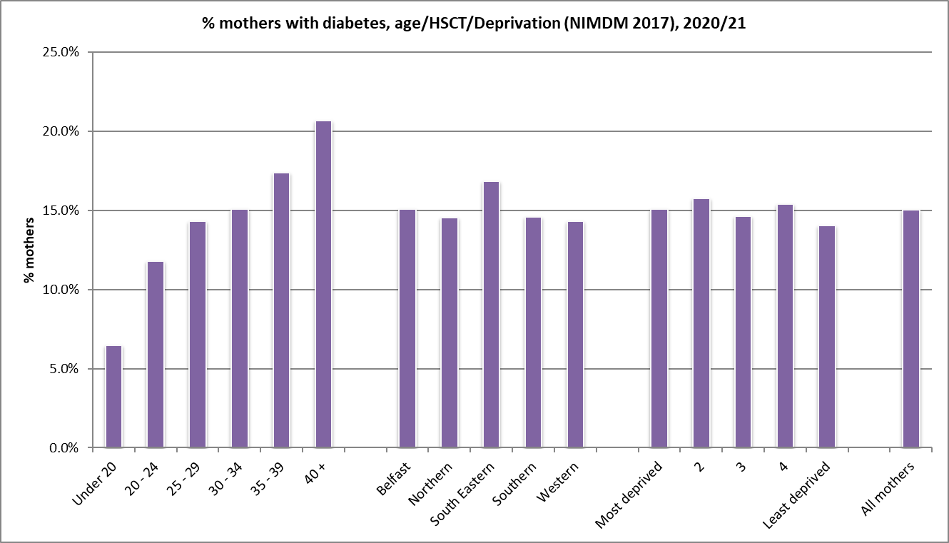
Maternal risk factors - Diabetes
2020/21:
% mothers with diabetes increased with age – 6.5% of those aged less than 20 years, rising to 20.7% of those aged 40+. (All mothers = 15.0%).
Only slight variation by deprivation quintile (NIMDM 2017).
Report – Table 6.3, 2020/21 report: https://www.publichealth.hscni.net/directorates/operations/statistics
Source: NI Maternity System
Source: Northern Ireland Statistics and Research Agency, NI Multiple Deprivation Measure 2017 https://www.nisra.gov.uk/statistics/deprivation/northern-ireland-multiple-deprivation-measure-2017-nimdm2017

Slide 16
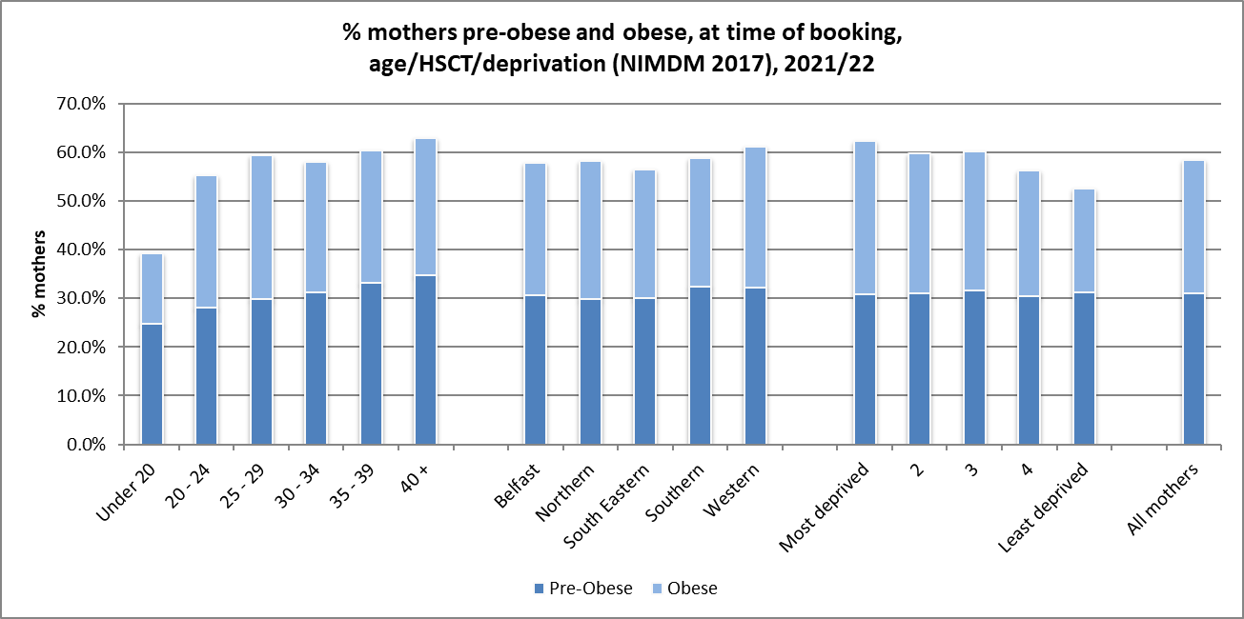
Maternal Body Mass Index (BMI)
2021/22 (at antenatal booking appointment):
58% of mothers giving birth measured as pre-obese or obese. 31% pre-obese, 27% obese.
% obese has increased year on year since 2011/12 (18.5%).
31% of mothers from most deprived areas (NIMDM 2017) were classified as obese, compared to 21% from least deprived areas.
Report – Tables 7.1 and 7.2
Source: NI Maternity System
Source: Northern Ireland Statistics and Research Agency, NI Multiple Deprivation Measure 2017
https://www.nisra.gov.uk/statistics/deprivation/northern-ireland-multiple-deprivation-measure-2017-nimdm2017

Slide 17
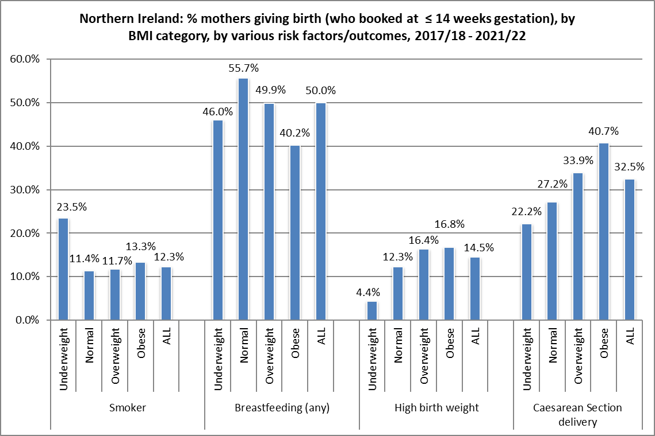
Maternal Body Mass Index (BMI)
2017/18 – 2021/22:
Figures show that a larger proportion of women (who booked at ≤ 14 weeks gestation) with a higher BMI, were more likely to have a larger baby, or deliver by Caesarean Section.
A higher proportion of women who smoke were more likely to be underweight.
Report – Table 7.4
Source: NI Maternity System

Slide 18
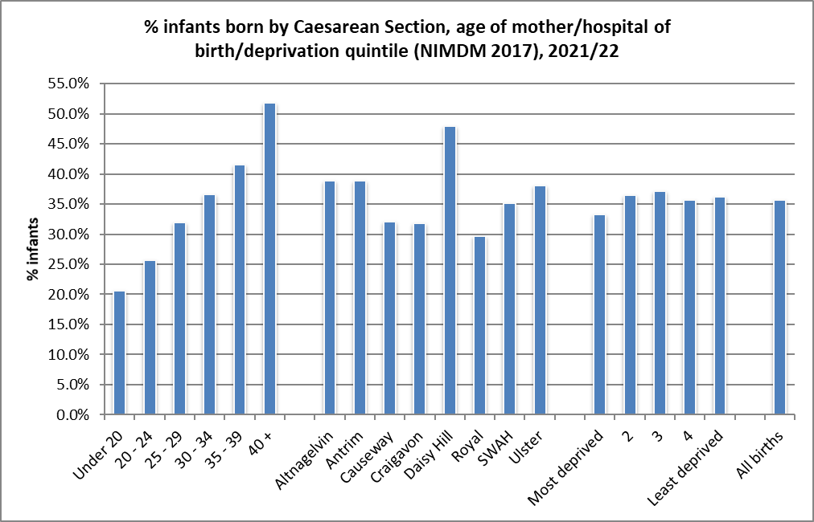
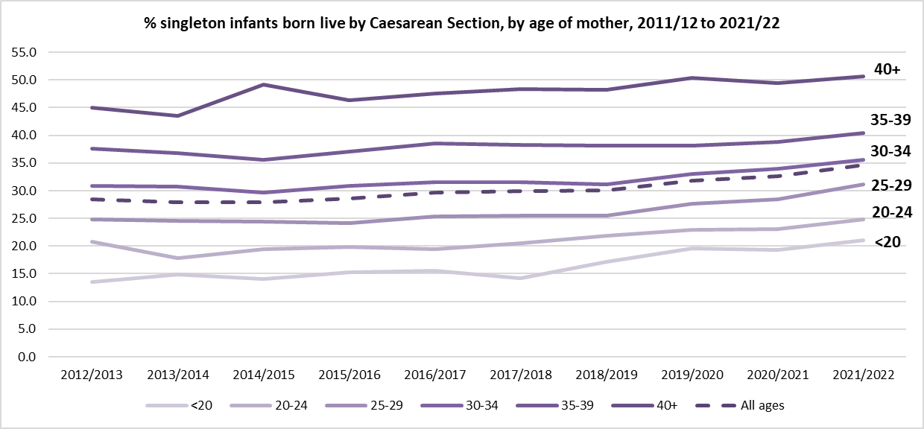
Method of Delivery
2021/22:
35.7% of infants born by Caesarean Section (CS), 52.5% had a normal delivery, 11.8% had another type of delivery e.g. breech, forceps.
Daisy Hill Hospital continues to have the highest % CS (47.9%).
2021/22:
Proportion of infants born by CS increased with age of mother, from 20.6% of those under 20 years old, to 51.8% of those aged 40+ years.
Report – Table 8.2
Source: NI Maternity System
Source: Northern Ireland Statistics and Research Agency, NI Multiple Deprivation Measure 2017 https://www.nisra.gov.uk/statistics/deprivation/northern-ireland-multiple-deprivation-measure-2017-nimdm2017

Slide 19
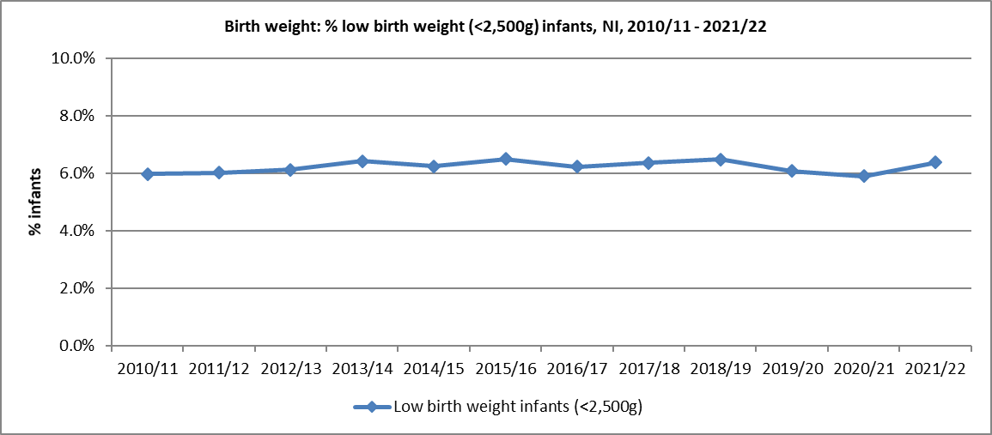
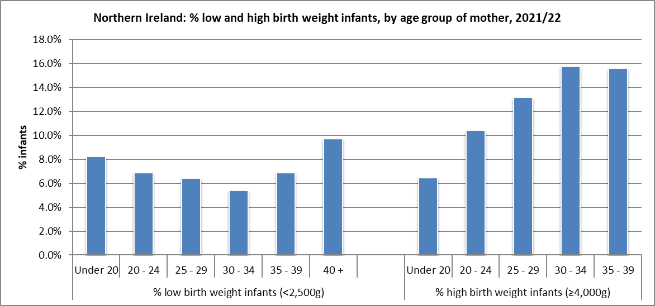
Infant Birth Weight
2021/22:
6.4% of all births were of a low birth weight (6.1% live, 69.2% still).
% low birth weight slightly higher in those mothers aged over 40 (9.7%). (Note that this age group has a higher proportion of multiple births).
14.1% of live infants were born with a higher birth weight (4,000g+) and of these, 1.8% with a birth weight of 4,500g+.
Mothers from a ‘white’ ethnic group were more likely to have a baby born with a high birth weight (4,000g+) (14.5%). ‘Non-white’ = 5.5%.
Report – Tables 9.1 and 9.2
Source: Child Health System and NI Maternity System

Slide 20
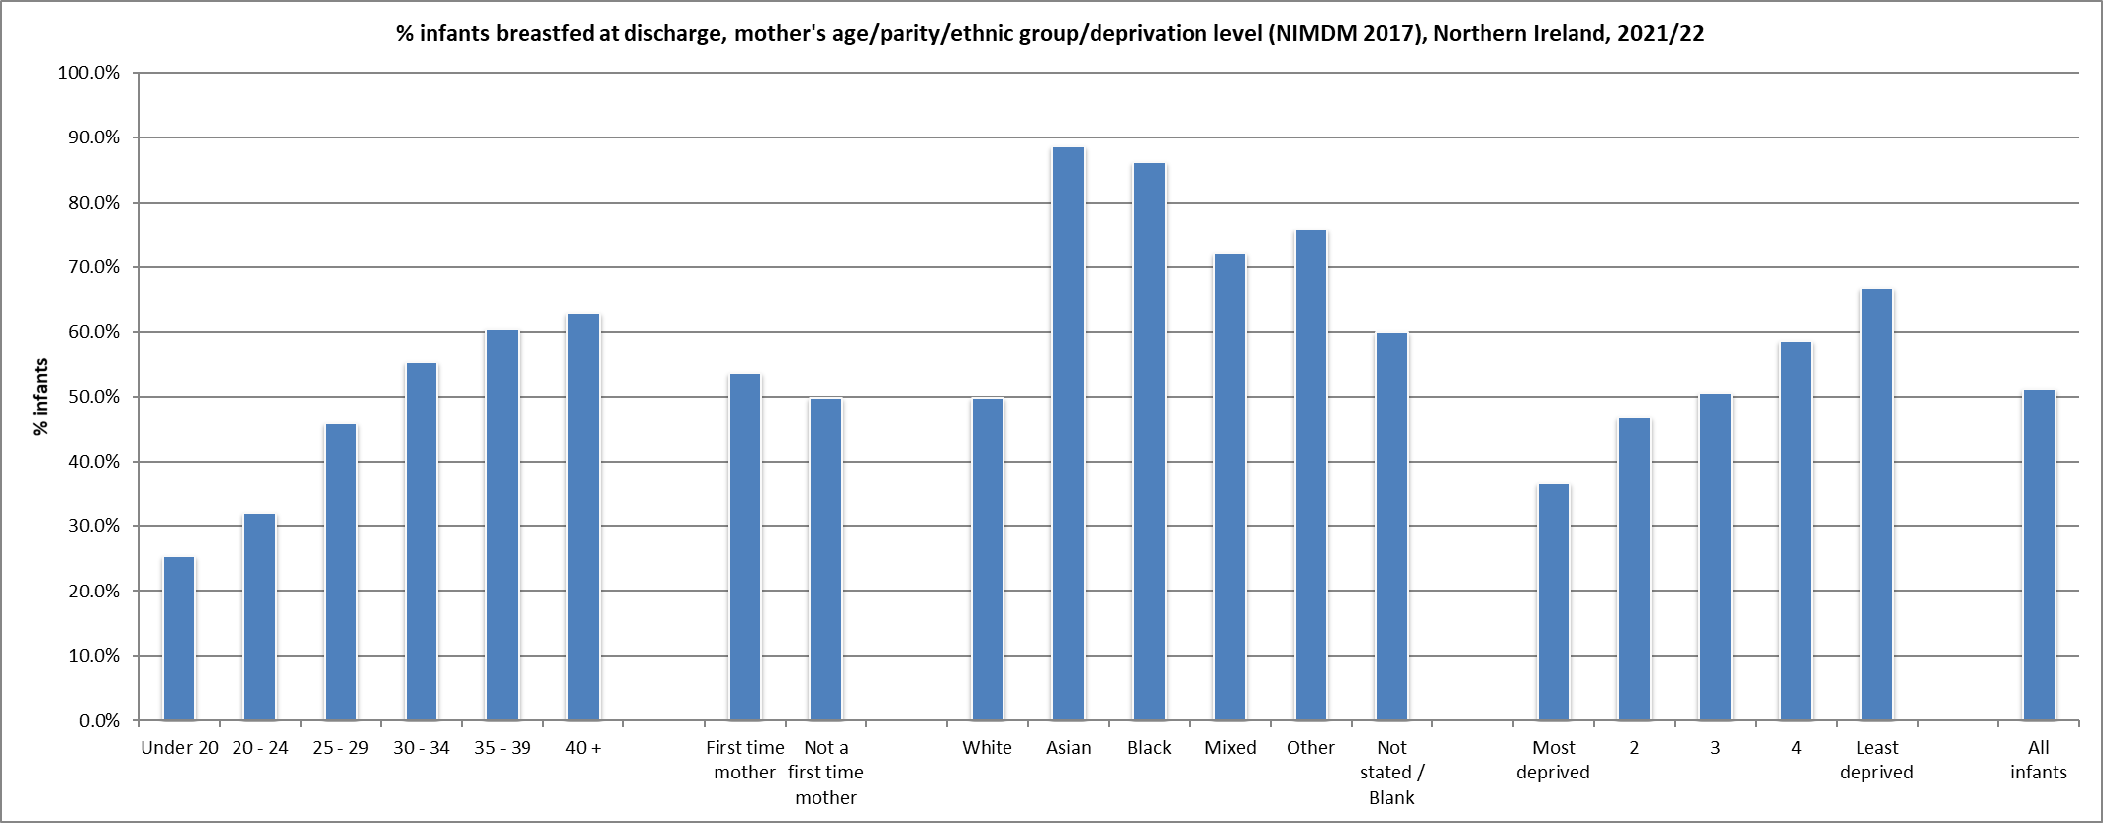
Breastfeeding (total/partial) – at discharge
2021/22:
51.2% of live infants breastfed at discharge.
Increases with age of mother: aged <20 = 25.5%, 40+ = 63.0%.
Much higher rates in infants born to mothers whose ethnic origin was not ‘white’.
By Council area, % breastfed ranges from 40.9% in Derry City & Strabane to 63.3% in Lisburn & Castlereagh.
Markedly lower in more deprived areas (36.7%). Least deprived = 66.8%.
Report – Table 10.2
Source: Child Health System and NI Maternity System
Source: Northern Ireland Statistics and Research Agency, NI Multiple Deprivation Measure 2017
https://www.nisra.gov.uk/statistics/deprivation/northern-ireland-multiple-deprivation-measure-2017-nimdm2017

Slide 21
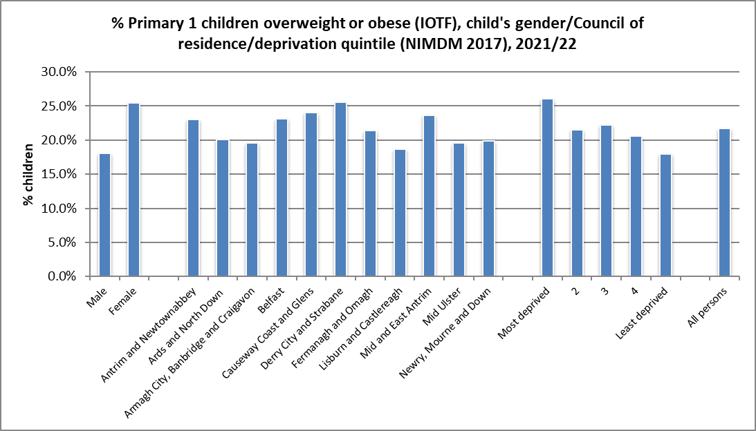
Body Mass Index – Primary 1
2021/22 (IOTF):
Higher proportion of girls were overweight/obese (25.4%) compared to boys (18.1%). All children = 21.7%.
Derry City and Strabane LGD had the highest proportion of children overweight/obese = 25.5%.
26.1% of children living in the most deprived areas were overweight/obese, compared to 17.9% of children from the least deprived areas.
Report – Table 12.2
Source: Child Health System
Source: Northern Ireland Statistics and Research Agency, NI Multiple Deprivation Measure 2017 https://www.nisra.gov.uk/statistics/deprivation/northern-ireland-multiple-deprivation-measure-2017-nimdm2017

Slide 22
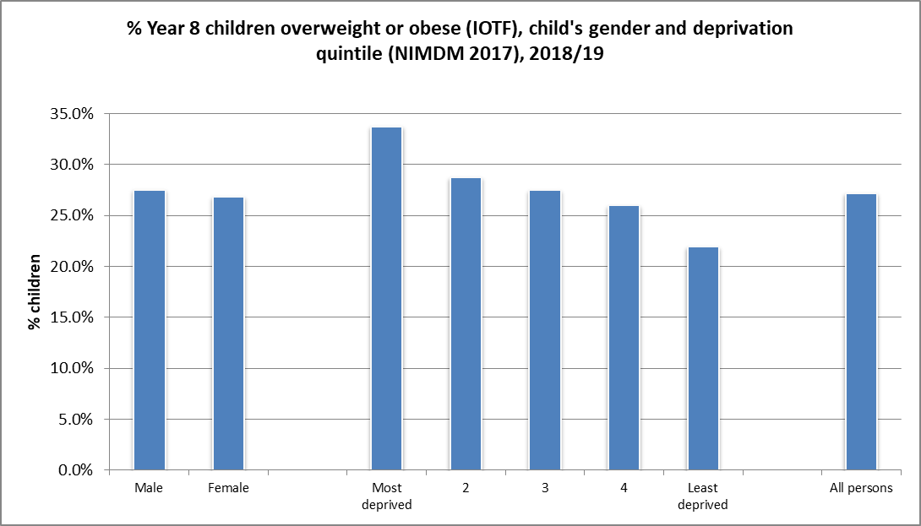
Body Mass Index – Year 8
2018/19 (IOTF):
NOTE THAT DATA DOES NOT INCLUDE CHILDREN FROM WHSCT AREA AS MEASUREMENTS WERE NOT TAKEN IN 2018/19.
27.2% of children measured as overweight/obese.
Little difference in the proportion overweight/obese between the two genders (27.5% male, 26.8% female).
Larger proportion of children from more deprived areas were measured as overweight/obese (33.7%), compared to those living in the least deprived areas (21.9%).
Report – Table 12.5
Source: Child Health System
Source: Northern Ireland Statistics and Research Agency, NI Multiple Deprivation Measure 2017 https://www.nisra.gov.uk/statistics/deprivation/northern-ireland-multiple-deprivation-measure-2017-nimdm2017

Slide 23
Children’s Health in Northern Ireland
Produced by Public Health Agency
Health Intelligence Unit
www.publichealth.hscni.net
26 May 2023

