Slide 1
Managing incomplete immunisation histories using the UKHSA algorithm March 2023
Notes:
This training resource has been designed to educate healthcare practitioners involved in immunisation of persons with uncertain or incomplete vaccination histories.
Participants should have a copy of the UKSHA Algorithm for reference and working through scenarios
Vaccination of individuals with uncertain or incomplete immunisation status (publishing.service.gov.uk)

Slide 2
Learning Outcomes
Describe the principles of completing incomplete immunisations
Understand how to use the UKHSA algorithm to support decision making in practice
Confidently advise on assessing individuals with incomplete immunisation status
The session will consider:
The general principles for completing individuals vaccination schedule
The process and resources needed
Scenario’s to work through the process using the algorithm and other resources, to identify which vaccines are needed to bring people up to date
The session also links to maximising vaccine uptake and consideration of who might be impacted by incomplete immunisation and the barriers

Slide 3
Why is this Important?
High vaccination coverage is necessary for herd / community protection and to prevent diseases that are no longer common from resurgence in the population
The overall aim of the UK routine immunisation schedule is to provide protection against key vaccine preventable diseases.
All individuals living in the UK should have received the vaccines appropriate for their age
If individuals are left unvaccinated, they remain susceptible
Travel to and from the UK leaves the population at risk

Slide 4
Who might be affected
Anyone….! But particularly consider:
Migrants to the UK
Families who move frequently
Looked after children
Travelling Community
Families who find it hard to access health services
Children who have been unwell during childhood
Families/individuals who are vaccine hesitant/vaccine refusers – some or all vaccines
Notes:
4

Slide 5
The Algorithm
Notes:
Vaccination of individuals with uncertain or incomplete immunisation status (publishing.service.gov.uk)

Slide 6
The process to catch-up/manage incomplete vaccination
This takes Time
Two

Slide 7
Establishing the vaccine history
‘Documented or reliable vaccine history’
Unless there is a documented or reliable vaccine history,
individuals should be assumed to be unimmunised and a full course of immunisations planned
Written records
Verbal history
Pictures on mobile phone
Web search vaccine names/translations
Document any investigation and conversations with individuals and families
Comparison of the records or history with web-based resources
Notes:
Link to WHO schedules by country
Vaccine Scheduler | ECDC (europa.eu)
UK and international immunisation schedules comparison tool - GOV.UK (www.gov.uk)
Check an update links

Slide 8
Identify the missing vaccines and recommend
The algorithm process is grouped by age. For some vaccines there is a lower or upper age limit generally based on the risk of specific disease for the UK population over a certain age
For example;
PCV and MenB vaccines are not routinely given > 2 years and Hib and pertussis not routinely given in UK > 10 years
Recommend missing vaccines for individual according to age for them or parents to consent

Slide 9
Plan the schedule
General principle – Plan catch-up immunisation schedule with minimum
number of visits and within a minimum possible timescale – aim to protect the
individual in shortest time possible:
• Provide prompt protection – best to offer the missing vaccines as soon as possible
• Maximise opportunity to vaccinate, having too many appointments risks people not completing and coming back - there is no limit to the number of vaccines you can give
• If the vaccine records subsequently turn up and individuals end up having additional vaccines this is not an ‘error’ the plan is based on the best advice and in the best interest of the patient with the history available this is part of the consent process

Slide 10
Scheduling guidance
In most cases vaccines can be given together on the same
day. The immune system will respond to each individual antigen.
Additional doses of one antigen may be required to complete
a course of other antigens; e.g.
DTaP/IPV/Hib/HepB vaccine will be needed to complete a course of tetanus, diphtheria and pertussis in a
child over 2 and additional doses of HIB and Hep b vaccine will be given.
In general; - minimum 4 week gap is recommended for doses of the same vaccine
Notes:
Green book chapter 11 The UK immunisation schedule (publishing.service.gov.uk)

Slide 11
Scheduling guidance
Where the primary course consists of 2 doses only; - a longer gap between the 1st and 2nd dose provides better protection [i.e meningococcal B vaccine, COVID-19 vaccines and Shingrix®].
A longer interval will often produce a better immune response - risks the individual being left susceptible for longer.
Some countries have a booster dose of Diphtheria, Tetanus, Polio and other vaccines between one and 2 years. These infants will still need the UK pre school,1st booster, at 3 years 4 months to ensure there is enough of a gap between doses.
Shorter intervals may be advised for rapid protection, e.g. for travel, individuals particularly susceptible or during an outbreak. NB this may lead to a lower immune response, particularly in infants.

Slide 12
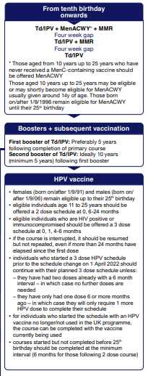
Scenario 1
15 year old refugee with no reliable vaccine history and no medical records available - Therefore need to assume they are unimmunised and proceed
Plan the catch up schedule:
• Tetanus, diphtheria, polio,
• meningococcal ACWY and
• MMR
Provide advice on booster doses at 5 years and 10 years
• Need to also include HPV

Slide 13
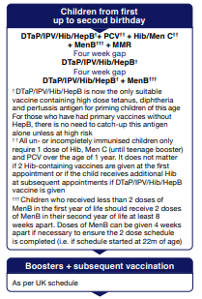
Scenario 2
Infant aged 14 months Immunisation history:
8 weeks: DTaP/IPV/Hib/HepB, MenB, & rotavirus
12 weeks: DTaP/IPV/Hib/HepB, rotavirus and PCV
Therefore missing the 16 week and 12 month vaccines
Plan the schedule:
• 12 month vaccines; MMR, HIB/MenC, PCV, MenB
• 3rd DTaP/IPV/Hib/HepB, to complete primary course Footnotes;
• Men B - will need 2nd dose of Men B after 8 weeks. Assurance that additional doses of HiB are ok to give
Provide advice re boosters; transfer onto the UK schedule and immunised as appropriate for age
Pre school booster can be given at 3 years 4 months providing there is a minimum of 1 year gap from the end of the primary course

Slide 14
Scenario 3
Child born in Poland is now 7 years of age hasn’t received any vaccines since arriving in the UK age 2
Records show they have received all vaccines as per the Polish schedule up till then
Child has received:
Birth – BCG, Hep B
Aged 2 months, Rotaviris, DTaP/Hib, Hep B, PCV
Aged 4 months – DTaP/IPV/Hib, PCV
Aged 6 months - DTaP/IPV/Hib
Aged 7 months – Hep B
Aged 13 months - PCV, MMR
Aged 16 months - DTaP/IPV/Hib

Slide 15
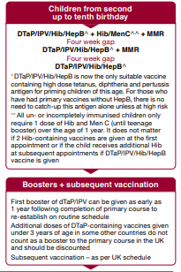
Scenario 3
Plan the schedule:
• Preschool booster dose DTaP/IPV
a 4th dose of DTaP was given around 16 months; this is too soon for the UK schedule so needs to be discounted and a further dose given. They also need the 4th polio
• Child under 10 - Men C so give Hib/MenC Although a 4th dose of Hib was given they need the MenC so additional Hib is also given
• 2nd MMR

Slide 16
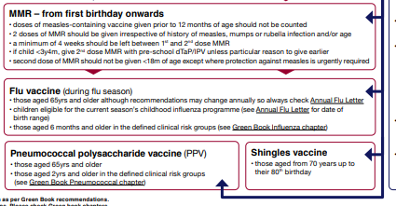
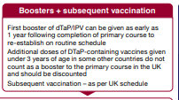
The Algorithm – Further Information
The baseline MEM threshold for Northern Ireland is 11.3 per 100,000 population for 2020-21. Low activity is 11.3 to <21.8, moderate activity 21.8 to <57.0, high activity 57.0 to <87.1 and very high activity is >87.1

Slide 17
Summary
• Immunisation programmes aim to protect individuals and the wider population
• Every effort is needed to complete immunisation schedules to ensure maximum protection
• Unless there is a reliable vaccine history, assume individuals are unimmunised and plan for a full
course of immunisations
• The risk of not vaccinating outweighs any potential for adverse vaccine reaction.
• Some individuals may need additional vaccines beyond the ‘algorithm’ if in specific clinical risk
groups
• You cannot overdose on vaccines (except BCG which shouldn’t be given twice).
• Many people get extra doses of vaccines with no major ill effects.

Slide 18
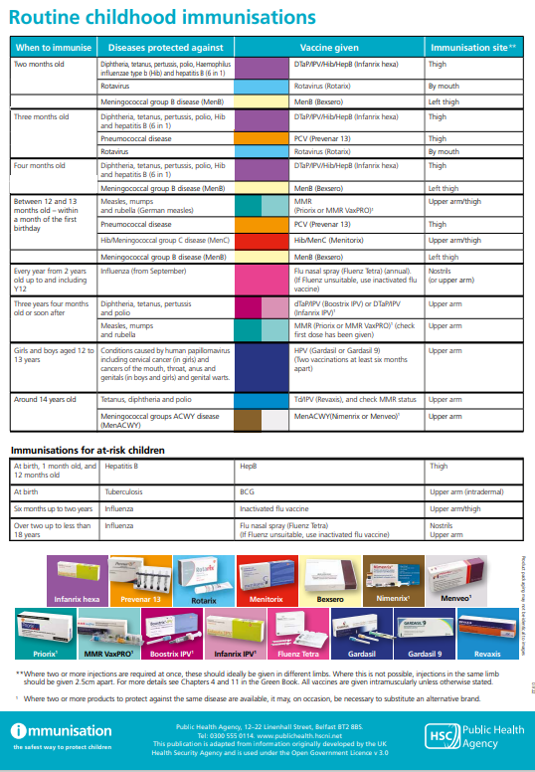
Notes:
Click link above

Slide 19
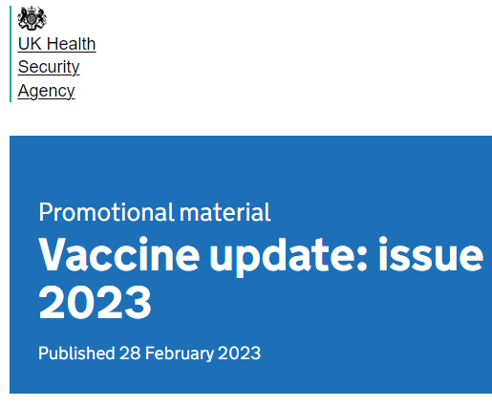
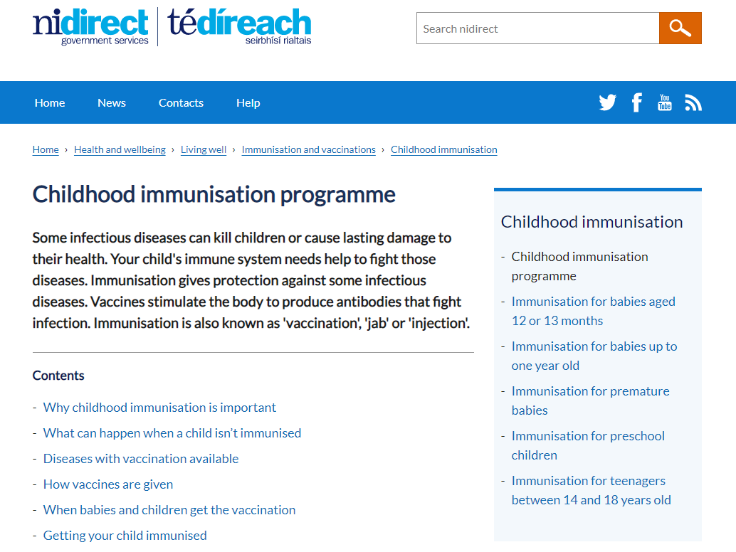
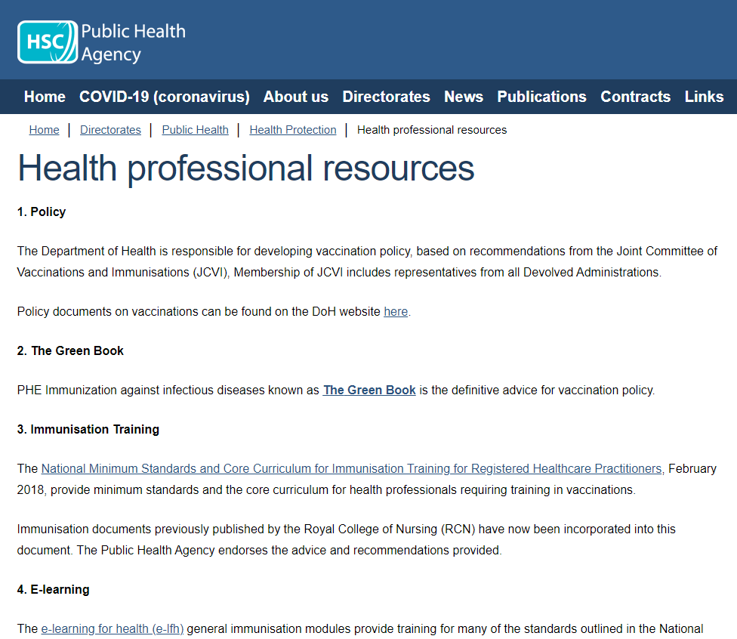
Questions
Online green book
Vaccine Update
NI Direct Webpages
PHA Health Protection Resources
Notes:
Online green book
Immunisation against infectious disease - GOV.UK (www.gov.uk)
Vaccine Update
Vaccine update - GOV.UK (www.gov.uk)
NI Direct Webpages
Childhood immunisation programme | indirect
PHA Health Protection Resources
Health professional reso urces | HSC Public Health Agency (hscni.net)

Slide 20
Your local Health Protection Team
PHA Duty Room
Public Health Agency
Linenhall Street Unit
12-22 Linenhall Street
Belfast, BT2 8BS
Tel: 0300 555 0119
PHA.dutyroom@hscni.net
Your local Health Protection Team

