Slide 1
Vaccinations during pregnancy

Slide 2
Objectives
Why vaccinations during pregnancy are important
How the antenatal vaccination programme is delivered
Vaccines used in the antenatal programme and the infections they protect against
Common queries around vaccines and useful information sources

Slide 3
Why vaccination is important
Immune system changes
More vulnerability to infection
Vaccines are recommended during pregnancy
Vaccines are free of charge if you are registered with a GP

Slide 4
How vaccines are delivered
During pregnancy you will be invited for vaccination by your GP, Midwife or Trust Vaccination Team
You can book your vaccine online using this QR code
If you don't hear anything after 16 weeks of pregnancy or have any questions about vaccination talk to your GP or Midwife

Slide 5
Vaccines during pregnancy
Covid and Flu
Pertussis
(Whooping Cough)
RSV

Slide 6
Influenza (flu)
Symptoms of flu:
Fever
Headache
Muscle pain
Extreme tiredness
Dry cough
Sore throat
Complications include:
Bronchitis and pneumonia, meningitis, ear infection and sometimes death
Pregnant women are more likely to develop serious complications such as pneumonia which may require hospitalisation

Slide 7
Pertussis (Whooping Cough)
Whooping cough is a serious disease
Causes long bouts of coughing and choking
Young babies are more at risk
Complications include:
pneumonia
permanent brain damage in babies
death
Northern Ireland - large increase in cases
The maternal vaccine protects your baby until they receive their newborn vaccines

Slide 8
Covid-19
Can cause severe illness in pregnancy
Can lead to hospital admission and premature birth
Pregnant women are more at risk of COVID-19 if they have underlying health conditions such as:
immune problems
diabetes
high blood pressure
asthma
overweight
over 35
are in the 3rd trimester of pregnancy (28 weeks)

Slide 9
RSV
PROTECT YOUR BABY WITH THE MATERNAL VACCINE
RSV is a common virus
Can cause a lung infection called bronchiolitis
In young babies RSV can make it hard to breathe and to feed
Some babies can have complications and are hospitalised with bronchiolitis
Infants with severe bronchiolitis may need intensive care and could be fatal
More likely to be serious in babies born prematurely, those with conditions affecting the heart, breathing or immune system

Slide 10
Common queries around vaccines
Vaccines have not led to an increase in Autism, Asthma or other auto immune disorders
Do not cause allergies
Do not overload or weaken the immune system
There is no evidence that vaccines are unsafe for you or your baby

Slide 11
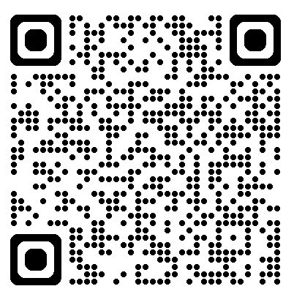
Protecting your baby after birth
Vaccines are one of the safest ways to protect your baby’s health
Babies are eligible for vaccines from 8 weeks old
The PHA have developed a parental webinar with all the information you need to know. Follow the QR code to find out more information on your baby’s vaccine journey

Slide 12
THANK YOU

