Slide 1






HPV
VACCINATION
THE KEY TO CANCER PREVENTION

Slide 2





Agenda
  Hi!
  HPV
  Our Experts
  HPV Vaccination and Screening
  Next steps
  Bye!

Slide 3





What is HPV
  HPV is a common virus
  Usually causes no symptoms in most people
  There are 100 different types of HPV viruses
  Some HPV virus types can cause cancer
  HPV cancers can affect both men and women
Hi there!

Slide 4






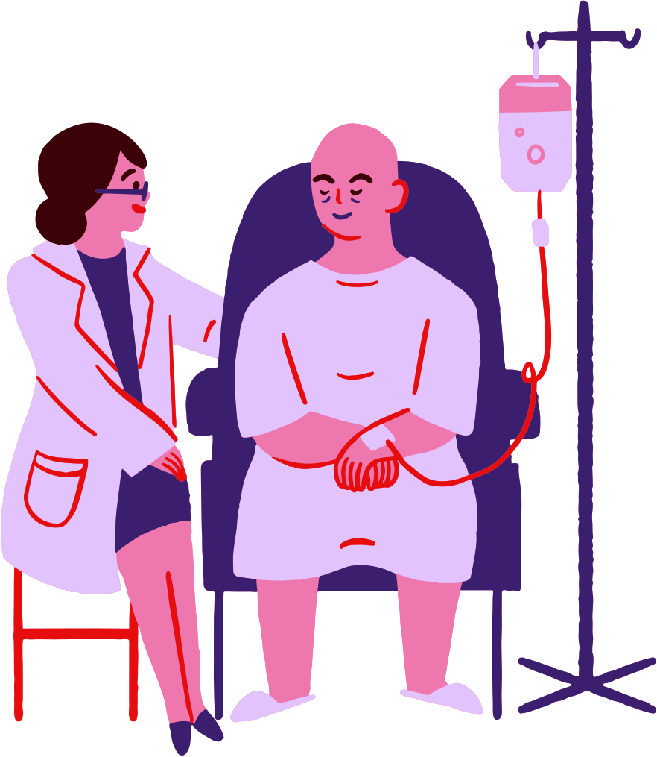


HPV
Did you know.......
THE HPV VIRUS CAN CAUSE DIFFERENT TYPES OF CANCER INCLUDING:
Cervical Cancer (lower part of the womb)
Penile and Anal Cancers
Head and Neck Cancers
HPV also causes genital warts
Andika

Slide 5




Breaking
News
↓ READ MORE ↓
I don’t need a HPV vaccine to be protected
DID YOU KNOW HPV CANCERS ARE PREVENTABLE?
HAVING YOUR HPV VACCINATION DURING YEAR 9 OR YEAR 10 AT SCHOOL BY YOUR SCHOOL NURSE, PROVIDES PROTECTION FROM HPV CANCERS FOR BOTH BOYS AND GIRLS
It will hurt
Vaccines don’t work
THIS

Slide 6

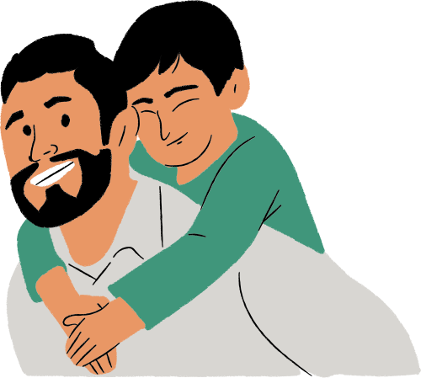


Vaccination is effective for boys and girls
Protects your future and others around you
WHY GET
Can eliminate cervical cancer for women
Better long term health impacts
HPV VACCINATION
Only takes 5 minutes to get your vaccine
Reduce the risk of HPV related cancer treatments in later life

Slide 7


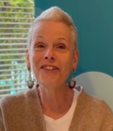
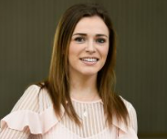
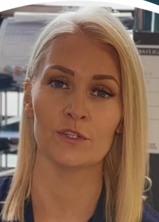


Meet our experts
Katrina Jones
Dr Eimhear Hayes
Katrina’s Journey - Katrina was diagnosed with cervical cancer in 2022, this is Katrina’s story
GP Doctor and GAA Armagh camogie all star player
Vicky Burns Clinical Lead Nurse NHSCT
Vicky is the clinical lead nurse for hysteroscopy and colposcopy (procedures used to detect and treat cancer)

Slide 8



Katrina HPV vaccine on Vimeo

Slide 9
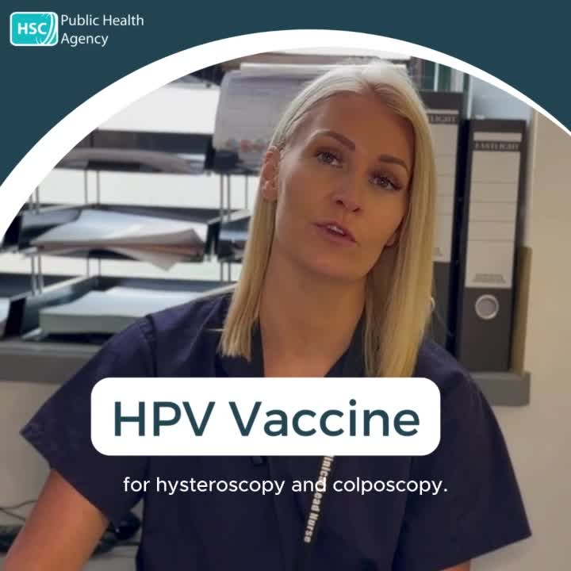

Slide 10

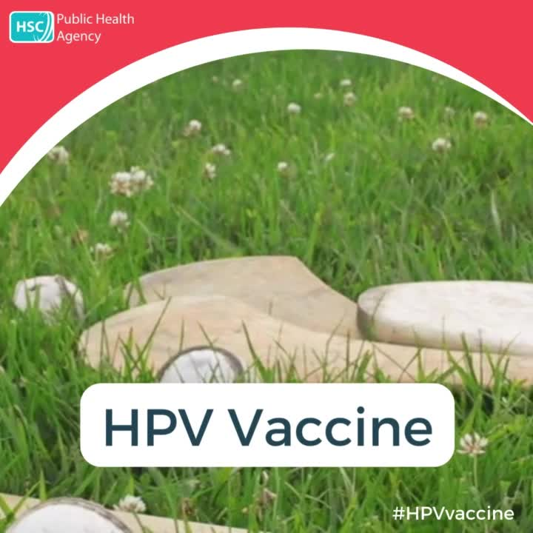

Slide 11



HPV VACCINATION
2. PARENT/GUARIDAN SIGN AND RETURN
1. CONSENT FORM
3. GET VACCINATED
Your school nurse will provide you with a consent form
Your school nurse will vaccinate you, it will take 5 minutes but has life changing long term benefits
Your parent or guardian can sign your consent form and return your form back to school

Slide 12

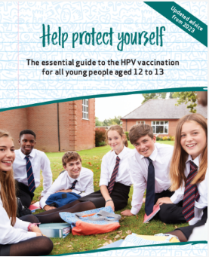
HPV
  PROTECT YOUR FUTURE HEALTH WITH HPV VACCINATION
Vaccination
Any questions ask your school nurse
  MISSION
  VISION
To ensure everyone has the opportunity to get their HPV vaccine in school
A world without HPV related cancers

Slide 13

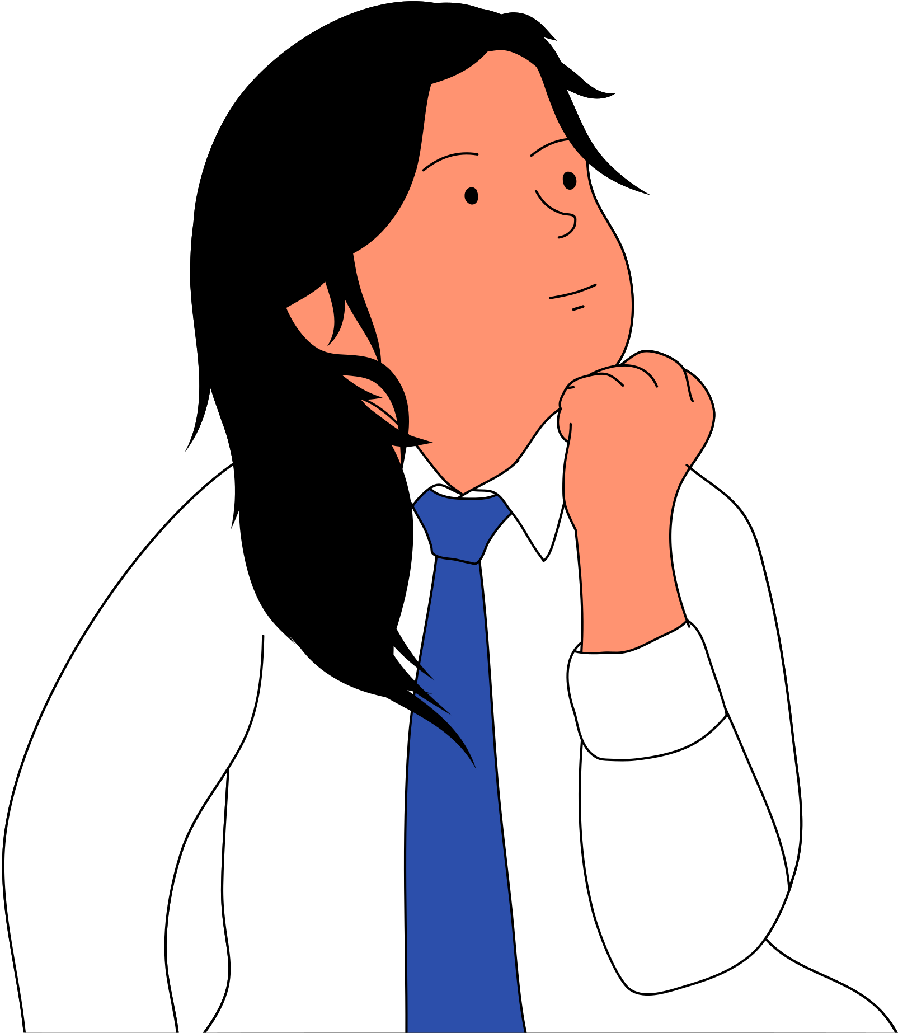
CERVICAL SCREENING IS ALSO USED ALONGSIDE HPV VACCINATION TO REDUCE YOUR FUTURE RISK OF CERVICAL CANCER
Future screening
Women aged between 25 and 49 years of age are routinely invited for cervical screening every three years, or every five years for women aged between 50 and 64 years
YOU DONT NEED TO THINK ABOUT IT NOW, BUT YOU WILL RECEIVE A LETTER INVITING YOU TO BOOK AN APPOINTMENT WHEN THAT TIME COMES

Slide 14
THANK
YOU!

Slide 15

Protect your health
HPV vaccination and screening saves lives

