Slide 1

Influenza (flu) Immunisation Programme
Northern Ireland
PHA would like to acknowledge the UK Health Security Agency (UKHSA) for sharing their training resources for adaption and use in Northern Ireland
Notes:
This training resource has been designed to deliver core information for healthcare practitioners involved in delivering the influenza immunisation programme for the 2025/26 flu season. This resource does not cover the actual administration techniques involved in vaccination. If staff are required to deliver vaccinations they should refer to their line manager for additional training that may be required.

Slide 2
Key messages
influenza (flu) immunisation is one of the most effective interventions we can provide to reduce harm associated with influenza and to reduce pressures on health and social care services during the winter
it is important to increase flu vaccine uptake in clinical risk groups because of increased risk of death and serious illness if people in these groups catch flu
influenza during pregnancy can be associated with perinatal mortality, prematurity, small for gestational age (SGA), low birth weight and increased risk of complications for the mother
vaccination of health and social care workers protects them and reduces the risk of spreading influenza to their patients, service users, colleagues and family members
by preventing influenza infection through vaccination, secondary bacterial infections such as pneumonia are prevented. This reduces the need for antibiotics and helps prevent antibiotic resistance
Notes:
Vaccination has been shown to have many benefits including reducing the risk of influenza illness, hospitalisation and influenza-related death. Whilst it may not prevent every person who is vaccinated from getting influenza, flu vaccination has been shown to reduce the severity of illness.

Slide 3

Influenza
Influenza (or flu):
is a viral infection affecting the respiratory tract
is highly infectious and spreads rapidly in closed communities
can be spread by people with mild / no symptoms
usually occurs in an 8-10 week period during the winter
Notes:
Influenza virus causes an acute viral infection of the respiratory tract commonly referred to as flu.
Flu is highly infectious and spreads rapidly in closed communities, such as nursing and residential homes.
It is possible to have been infected with flu and to have mild symptoms, or remain asymptomatic. Serological studies in healthcare professionals have shown that approximately 30-50% of influenza infections can be asymptomatic. Asymptomatic people can still transmit flu to other people.
Most cases of flu occur during an 8-10 week period during the winter months but sometimes the flu season can start earlier. It is important that those at higher risk are vaccinated by the end of December to prevent infection.
Green book chapter 19 Influenza (publishing.service.gov.uk)
3

Slide 4
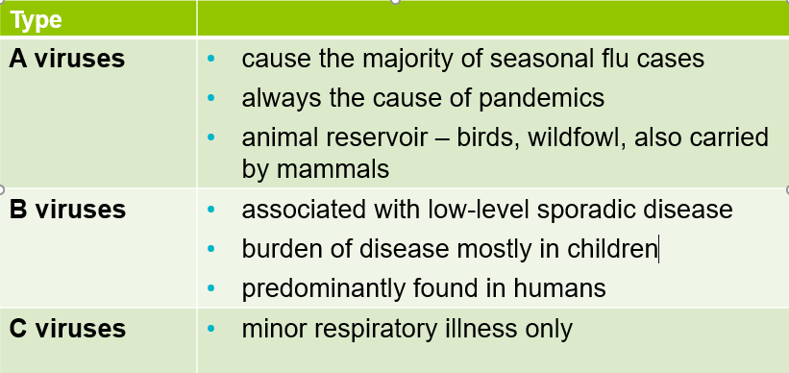
Types of influenza virus
There are three main types of influenza virus
Notes:
There are three types of influenza virus that can cause disease in humans: A, B & C. Influenza A & B are responsible for most clinical illness.
Influenza A causes the majority of seasonal influenza cases and outbreaks, and it is the usual cause of epidemics/pandemics. The virus is found in many different animal species and may spread between them. Birds, particularly wildfowl, are the main animal reservoir for influenza A.
The burden of Influenza B disease is mostly in children when the severity of illness can be similar to that associated with influenza A.
A fourth type of influenza virus (D virus), primarily affects cattle and is not known to infect or cause illness in humans.
Green book chapter 19 Influenza (publishing.service.gov.uk)

Slide 5

Influenza A virus
Genetic material (RNA) in the centre
Two surface antigens
Two surfce antigens:
Haemagglutinin (H)
Neuraminidase (N)
There are 18 different types of H and 11 different types of N
e.g. H3N2 or H1N1
Notes:
This slide shows a schematic model of an influenza A virus. Influenza A is an RNA virus and there are two antigens on the surface of the virus as illustrated.
The role of the Hemagglutinin (H) antigen is to bind to the cells of the host. There are currently 18 known different types of H surface antigen.
The role of the Neuraminidase (N) antigen is to release the virus from the host cell surface. There are currently 11 known different types of N surface antigen.
The different types of H and N antigens are identified by numbers that when combined provide the name of the influenza A virus e.g. H3N2 / H1N1.
NHSE elfh Hub (e-lfh.org.uk)

Slide 6
Antigenic drift
Changes in the surface antigens (H and N) result in the influenza virus constantly changing (mutating).
Antigenic drift = minor changes (natural mutations) in the genes of influenza viruses that occur gradually over time.
Antigenic Drift
Notes:
Influenza A viruses are prone to antigenic variation / changes in the principal surface antigens.
Minor changes described as antigenic drift occur progressively from season to season. This means that the circulating strain will differ every year and is the reason why the flu vaccine is given every year, as the content may change.

Slide 7
Antigenic shift
Two or more different strains combine. This abrupt major change results in a new subtype. Immunity from previous flu infections / vaccinations may not protect against the new subtype, potentially leading to a widespread epidemic or pandemic.
Antigenic Shift
Notes:
Influenza A virus can also change abruptly when two or more different strains of influenza A combine, resulting in antigenic shift and a new subtype of influenza A, to which little / no immunity exists within the general population. This potentially leads to a widespread epidemic / pandemic.
The World Health Organization (WHO) convenes a group that reviews the global influenza situation (once each year for the northern hemisphere and once for the southern hemisphere) and recommends which influenza strains should go in the seasonal vaccine to be produced by manufacturers for the following season six to eight months later. This recommendation is based on information about the circulating viruses and epidemiological data from around the world at that time.
Trivalent vaccines for example, the IIVc and aIIV, contain two subtypes of influenza A (A-H1N1 and A-H3N2) and one subtype of B virus (Victoria lineage).

Slide 8
Influenza: Characteristics
  Easily transmitted by droplets, small-particle aerosols and by hand to mouth/eye contamination from a contaminated surface or respiratory secretions of an infected person.
  People with mild or no symptoms can still infect others.
  Incubation period 1-5 days (average 2-3 days), although may be longer especially in people with immune deficiency (immunosuppression).
  Common symptoms include:
    sudden onset of fever, chills, headache, muscle and joint pain and extreme fatigue
    dry cough, sore throat and stuffy nose
    in young children, gastrointestinal symptoms such as vomiting and diarrhoea, may be seen.
Notes:
Serological studies in healthcare professionals have shown that approximately 30 to 50% of influenza infections can be asymptomatic; but the proportion of influenza infections that are asymptomatic may vary depending on the characteristics of the influenza strain.
In healthy individuals, flu is usually unpleasant but self-limiting with recovery within 2-7 days.
Cases of influenza in the UK tend to occur during an 8 to 10 week period during the winter, however the timing, extent and severity of this ‘seasonal’ influenza can all vary.
Green book chapter 19 Influenza (publishing.service.gov.uk)

Slide 9
Influenza: Complications
Common:
  bronchitis
  otitis media (children), sinusitis
  secondary bacterial pneumonia
Less common:
  meningitis, encephalitis, meningoencephalitis
  primary influenza pneumonia
Risk of complications is higher in:
- children under 6 months | - Older people
- those with underlying health conditions such as respiratory disease, cardiac disease, long term neurological conditions or immunosuppression | - pregnant women (influenza during pregnancy is also associated with perinatal mortality, prematurity, small for gestational age (SGA) and low birth weight)
Notes:
Primary influenza pneumonia is a rare complication that may occur at any age and carries a high case fatality rate, it was seen more frequently during the 2009 pandemic and the following influenza season.
Green Book Chapter 19 Influenza (publishing.service.gov.uk)

Slide 10
Flu epidemiology

Slide 11
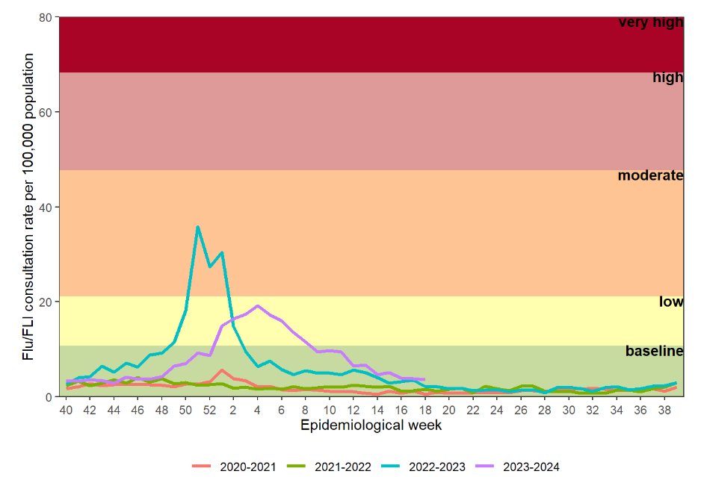
GP influenza/flu-like illness (FLI) consultation rates
Weekly all age GP influenza-like illness rates for 2023 to 2024 and past seasons Influenza Weekly Surveillance Bulletin | HSC Public Health Agency (hscni.net)
Notes:
This graph shows the rate of influenza/influenza-like illness episodes in Northern Ireland per 100,000 consultations in primary care for the 2020/21 to 2023/24 flu seasons. The data show that although flu viruses circulate each winter season, the degree of activity varies substantially.
Weekly GP consultations in Northern Ireland in the 2022/23 and 2023/24 seasons were higher than observed in the 2021 to 2022 and 2020 to 2021 seasons, but lower than seen in the 2017 to 2018 season.
Influenza activity in England is monitored by the UK Health Security Agency (UKHSA) Surveillance of influenza and other seasonal respiratory viruses in the UK, winter 2022 to 2023 - GOV.UK (www.gov.uk)

Slide 12
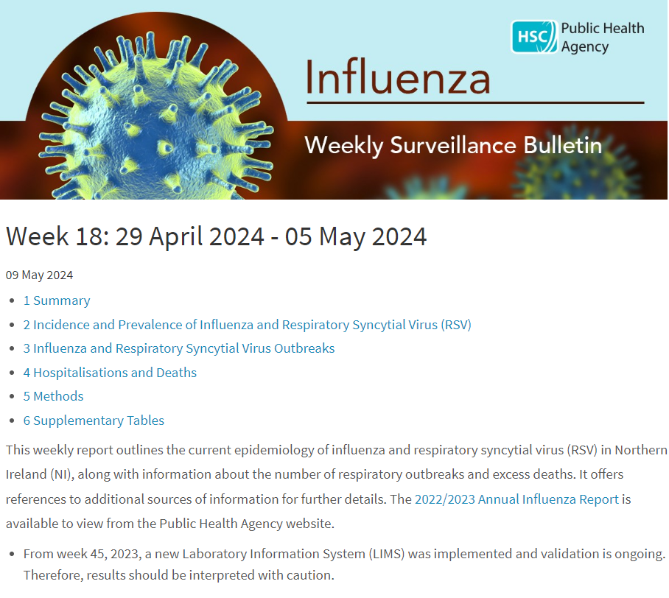
Influenza Weekly Surveillance Bulletin,
Northern Ireland
Public Health Agency weekly Flu Surveillance Bulletin
Notes:
The PHA Health Protection Flu team monitors flu activity throughout the year. This includes information on primary care consultations, laboratory testing and positivity, strain types, indicators of severity including hospitalisations, intensive care admissions, respiratory deaths and excess all-cause mortality.
During the flu season (1st October to end of March) the flu bulletin is available every 2 weeks, and then weekly and can be accessed by PHA website.

Slide 13
History of the national flu vaccination programme
Late 1960s: influenza immunisation recommended in the UK to directly protect those in clinical risk groups at higher risk of influenza associated morbidity and mortality
2000: extended to include all people aged 65 years or over
2010: pregnancy added as a clinical risk group
2014: morbid obesity added as a clinical risk group
2013: all pre-school children from 2 years and primary school children
2020: school aged children in Year 8
2021: extension to 50-64 year olds*, school age children up to Year 12 and household contacts of immunocompromised individuals
2024: flu vaccine programme offer to clinical risk groups, all aged 65 years and over, and all children aged 2 up to school age Year 12
Notes:
* unlike the previous few years, the flu vaccine will not be available during the 2024/25 programme to everyone aged 50-64 years of age; only those aged 50 – 64 who are in a clinical at risk group doh-hss-md-23-2023.pdf (health-ni.gov.uk)
The flu vaccination programme was introduced into NI in the late 1960s and was recommended for those in clinical risk groups that have a higher risk of associated morbidity and mortality. In 2000 the programme was extended to include everyone > 65 years of age. In 2010 pregnancy was added as a clinical risk category for routine flu immunisation. In 2013 the programme was extended to include pre-school children from 2 years and older and all primary school children
In 2020/21, the programme was extended to include Year 8 school children and household contacts of anyone who had received a shielding letter during the COVID-19 pandemic.
In 2021/22, the vaccination programme was further extended to additional cohorts, such as all healthy 50 to 64 year olds, year 9 -12 school children and household contacts of immunocompromised individuals.
In 2023/24, the extension to 50 – 64 year olds was removed

Slide 14
Flu vaccine: Effectiveness
Vaccine effectiveness varies from one season to the next.
The UK has a well-established system to monitor flu vaccine effectiveness each season, using data from primary care schemes in England, Scotland, Wales and Northern Ireland.
Overall flu vaccine effectiveness has been estimated at 30%-60% for adults aged 18 to 65 years. It’s lower in the elderly, although immunisation has been shown to reduce incidence of severe disease, hospital admission and mortality.
In recent years, new flu vaccines such as adjuvanted, cell-based, recombinant and quadrivalent vaccines have been introduced in order to try to improve the protection for those receiving the vaccine;
growing flu viruses in eggs results in egg-adapted changes that cause differences between the viruses in the vaccine and the ones that circulate and thus reduce their effectiveness
efficacy in the elderly has always been lower for the non-adjuvanted egg grown inactivated vaccines. Adjuvanted vaccines are used in this group because they have been shown to be more effective in reducing incidence of severe disease including bronchopneumonia, hospital admissions and mortality.
Notes:
Influenza activity is monitored in the UK through a variety of schemes based in primary and secondary care. One important indicator is based on reports of new consultations for influenza-like illness from GP practices, combined with virologic surveillance.
All authorised influenza vaccines need to meet safety, efficacy and quality standards set by the Commission on Human Medicines.
Mismatches between the components in the vaccine and circulating viruses do occur from time to time and explains much of the variation in estimates of vaccine effectiveness. When antigenic drift occurs, vaccination is still recommended as some degree of protection may be conferred against the drifted strain and the vaccine should still offer protection against the other strains in the vaccine.
After immunisation, protective immune responses may be achieved within 14 days.
NHSE elfh Hub (e-lfh.org.uk)
Influenza: the green book, chapter 19 - GOV.UK (www.gov.uk)

Slide 15
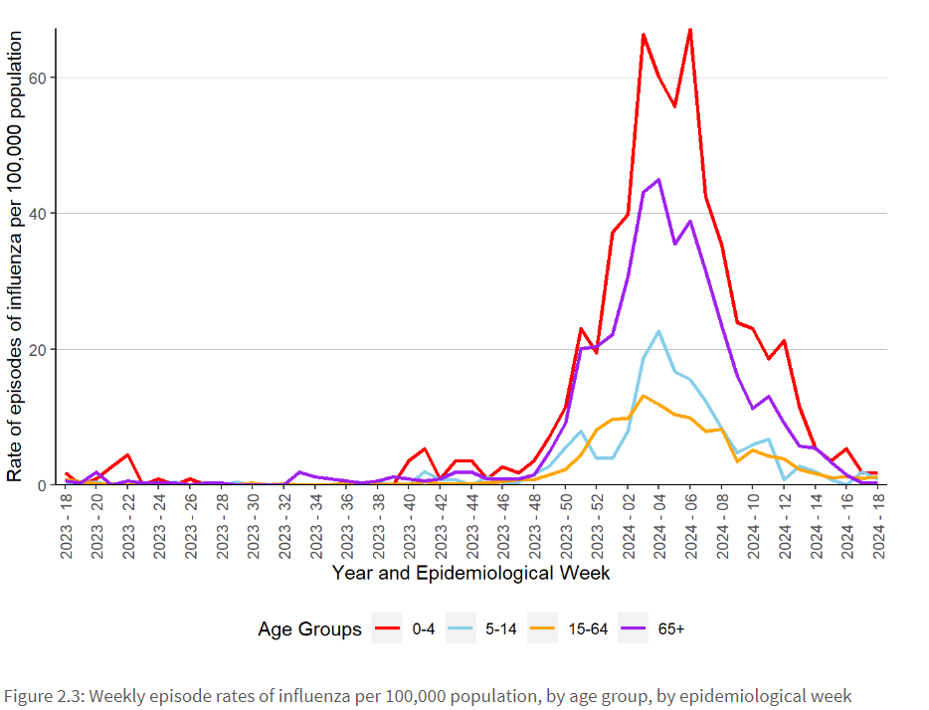
Flu vaccine: effectiveness last year (23/24)
In 2023/24, influenza activity throughout the UK was concentrated in a relatively short period.
Activity was higher than levels observed during the 2021 to 2022 season, when non-pharmaceutical control measures were in place during the COVID-19 pandemic (these also suppressed influenza transmission).
Provisional end of season vaccine effectiveness estimates against hospitalisation was higher in children (74%) than in adults (30%).
Notes:
International evidence continues to accumulate on the effectiveness of the newer vaccines (ECDC 2020). JCVI keeps its advice on seasonal influenza vaccines under regular review Surveillance of influenza and other seasonal respiratory viruses in the UK - GOV.UK (www.gov.uk)
It is important to remember that flu vaccination remains the best way to protect people from flu. It not only protects people who have received the vaccine, but also those around them.

Slide 16
Flu Vaccination Programme 2025/26

Slide 17
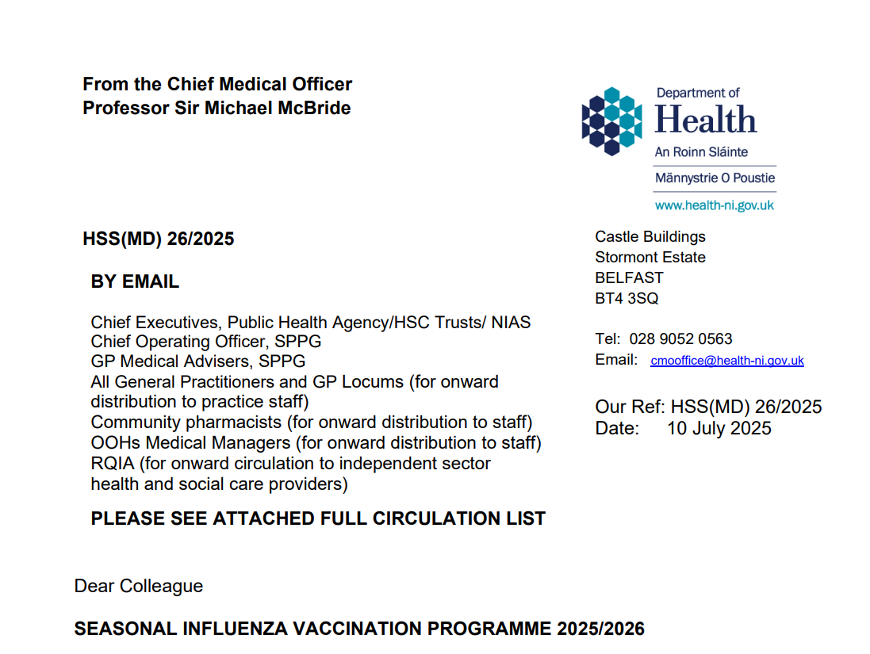
Flu Vaccination Programme: Policy outlined in annual CMO letter 2025/26
  Link to CMO letter published
  HSS MD 26 2025 - SEASONAL INFLUENZA VACCINATION PROGRAMME 2025 2026.pdf
Notes:
Every year the Department of Health publishes the annual CMO season flu letter. This letter provides information on the policy for the seasonal flu programme in NI. Eligible groups, types of vaccine and other relevant information is included within the letter.

Slide 18
Flu Vaccination Programme: Eligibility
Eligible cohorts for flu vaccination in 2025/26 include:
all preschool children aged 2 to 4 years on 1 September 2025
all primary and secondary school children (up to year 12)
those aged six months to 64 years in clinical risk groups (as defined by the influenza chapter in ‘Immunisation against infectious disease’ (the ‘Green Book’)
all those aged 65 years and over on 31 March 2026
all pregnant women
those in long-stay residential care homes
health and social care workers*
carers
close contacts of immunocompromised individuals**
Notes:
*Health and social care workers (HSCWs) employed by:
• Health and Social Care (HSC) Trusts, including NIAS
• community HSC providers including GP practices, pharmacies, dentists
• registered independent sector residential care or nursing home
• registered domiciliary care providers
• voluntary managed hospice provider.
**vaccination should also be offered to household contacts of immunocompromised individuals, those individuals who expect to share living accommodation on most days over the winter and therefore for whom continuing close contact is unavoidable.
The objectives of the influenza immunisation programme are to protect those who are most at risk of serious illness or death should they catch influenza and to reduce transmission of the infection, thereby contributing to the protection of vulnerable patients who may have a suboptimal response to their own immunisations.

Slide 19
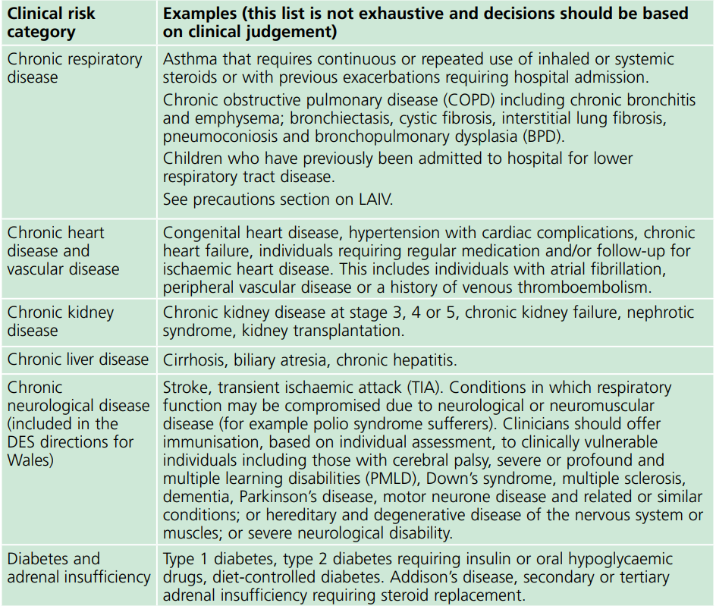
Clinical risk groups
The national flu immunisation programme 2017/18
Notes:
Increasing uptake of flu vaccine is important in clinical risk groups because of the increased risk of death and serious illness if people who are in these groups develop flu. In particular uptake rates in people with chronic liver and neurological disease need to be improved. Some of the highest mortality groups are associated with patients with liver and chronic neurological disease.
Green Book Chapter 19 Influenza (publishing.service.gov.uk)

Slide 20
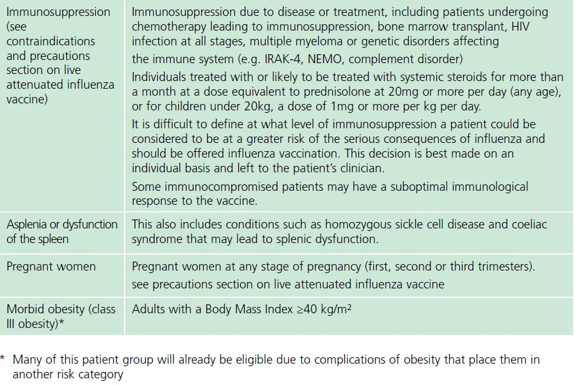
Clinical risk groups (continued)
Notes:
The list of eligible clinical risk groups is not exhaustive, and the healthcare practitioners should apply clinical judgement to take into account the risk of influenza exacerbating any underlying disease that a patient may have, as well as the risk of serious illness from influenza itself. Flu vaccine should be offered in such cases even if the individual is not in one of the specified clinical risk groups.
The flu chapter of The Green Book has been updated and those involved in delivering flu vaccine programmes should be familiar with the updated chapter and the CMO Seasonal flu letter

Slide 21
Pregnant women
All pregnant women should be offered the inactivated flu vaccine irrespective of the stage of pregnancy
pregnant women are at increased risk of complications from influenza, including bronchitis, pneumonia and hospitalisation
influenza during pregnancy is also associated with premature birth, small for gestational age (SGA), low birth weight and perinatal mortality
flu vaccination during pregnancy protects the mother, and provides passive immunity against influenza to infants in the first few months of life
studies on flu vaccine safety in pregnancy show that the inactivated flu vaccine can be safely and effectively administered during any trimester of pregnancy
no study to date has demonstrated an increased risk of either maternal complications or adverse fetal outcomes associated with inactivated flu vaccine
women should be offered flu vaccine in every pregnancy
Notes:
All pregnant women are recommended to receive the inactivated flu vaccine (including those women who become pregnant during the influenza season), irrespective of their stage of pregnancy.
There is good evidence that pregnant women are at increased risk from complications if they contract influenza. In addition, studies show that having influenza during pregnancy is associated with premature birth, infants that are small for gestational age (SGA) and low birth weight. Flu vaccination during pregnancy not only reduces these risks, it also provides passive immunity against influenza to infants in the first few months of life through antibodies passing across the placenta.
A review of studies on the safety of flu vaccine in pregnancy concluded that inactivated flu vaccine can be safely and effectively administered during any trimester of pregnancy. No study to date has demonstrated an increased risk of either maternal complications or adverse fetal outcomes associated with inactivated influenza vaccine.
The ideal time to offer flu vaccination to pregnant women is before flu starts circulating. However, even after flu is in circulation, vaccine should continue to be offered to those at risk and newly pregnant women. If a woman becomes pregnant after the usual vaccinating period of October to January, it is still worth considering offering the vaccine if flu is still circulating in the community.
Green Book Chapter 19 Influenza (publishing.service.gov.uk)

Slide 22
Health and social care workers (HSCWs)
health professionals have a duty of care to protect patients and service users from infections
flu vaccination reduces transmission of influenza to:
  HSCWs (those involved in directly delivering Health and Social Care (HSC) services are at increased risk of exposure to influenza)
  vulnerable patients, who may have impaired immunity and not respond well to immunisation
  colleagues and family members
flu vaccine uptake in HSCWs significantly lowers rates of flu-like illness, hospitalisation and mortality in elderly individuals in long-term healthcare settings
flu vaccination reduces sickness absences and contributes to delivery of HSC services during winter pressures
Notes:
health and social care workers have a duty of care to protect their patients and service users from infection. This includes getting vaccinated against flu.
Flu outbreaks can occur in HSC settings with both staff and their patients/service users being affected when flu is circulating in the community. It is important that HSCWs protect themselves by having the flu vaccine, and, in doing so, they reduce the risk of spreading flu to their patients, service users, colleagues and family members.
Vaccination of healthcare workers against flu has been shown to significantly lower rates of flu-like illness, hospitalisation and mortality in the elderly in long-term healthcare settings. Vaccination of staff in acute care settings may provide similar benefits. Flu immunisation of frontline health and social staff care staff may reduce the transmission of infection to vulnerable patients, some of whom may have impaired immunity, increasing their risks of flu. These people may not respond well to immunisation. Achieving a good uptake of flu vaccine in HSCWs is even more important this year because of the increased risk of morbidity and mortality from co-infection with flu and COVID-19.
Vaccination of health and social care workers also helps to reduce the level of sickness absenteeism that can jeopardise health and social care services.

Slide 23
Rationale for vaccinating children against flu
Extension of the seasonal flu vaccination programme to children aims to considerably lower the public health impact of flu by:
providing direct protection thus preventing a large number of cases of influenza in children
providing indirect protection by lowering influenza transmission from children:
      to other children
      to adults
      to those in clinical risk groups of any age.
Reducing influenza transmission in the community should avert many cases of severe influenza and influenza-related deaths in older adults and people with clinical risk factors.
Studies have shown that administration of flu vaccine to children has reduced GP consultations for influenza-like illness, swab positivity in primary care, laboratory confirmed hospitalisations and percentage of respiratory emergency department attendances.
Notes:
In July 2012, the Joint Committee for Vaccination and Immunisation (JCVI) recommended extending the annual flu programme to include healthy children aged 2 to 17 in order both to lower the potentially serious impact of flu in vaccinated children and also to have a more profound effect on flu transmission. Children are the main source of transmission in the population, and extending the flu programme to include healthy children should therefore reduce the spread of infection from children to other children, to adults and to those in clinical risk groups of any age.
Reducing flu transmission in the community should avert many cases of severe influenza and influenza-related deaths in older adults and people with clinical risk factors.
In Northern Ireland the programme was started in pre-school children > 2 years and all primary school children. From 2020/21, the programme has been extended to include Year 8 children in Northern Ireland.
From 2021/2022, the programme has been further extended to included Year 9-12 secondary children.
Since the programme was introduced to pre-school and primary school children in Northern Ireland the levels of GP consultation rates has been lower compared to other parts of the UK and ROI where there was a more limited vaccination programme for healthy children.

Slide 24
Vaccination uptake rates: 2024/25
final flu uptake data shows that by the end of March 2025 HSC services had vaccinated 74% of those aged over 65 years in Northern Ireland compared to approximately 78% in 2023/24
80% of care home residents were vaccinated against flu in 2024/25
uptake in care home staff was only 6.5% compared to 10.2% in 2023/24
uptake in all other frontline HSCWs was 21.7% compared to 21.5 % in the previous 2023/24 programme
Notes:
PHA have reported flu vaccination uptake for 2023/24 from data extracted from the Vaccine Management System (VMS): Influenza Weekly Surveillance Bulletin, Northern Ireland, 2023/24 | HSC Public Health Agency (hscni.net). The HSS (MD) 23/2024 letter also set out the flu uptake for 2023/24: doh-hss-md-17-2024.pdf (health-ni.gov.uk)

Slide 25
2025/26 programme: uptake targets
Vaccine uptake varies widely between the individual eligible groups and by age category for those with underlying clinical risk factors.
The aim of the influenza programme for 2025/26 is to demonstrate a 100% offer and to achieve at least the uptake levels of 2024/25 for each cohort, and ideally exceed them.
General practices, school nursing and community pharmacies should ensure all eligible patients are offered the opportunity to be vaccinated by an active call mechanism, supplemented with opportunistic offers where pragmatic.
The goals outlined by the Department of Health for 2025/26 are to
increase uptake rates across all eligible cohorts, particularly those in at-risk groups, pre-school and secondary school children, pregnant women, and frontline HSCWs.
Notes:
Whilst the strong uptake rate in the age 65 and over cohort is positive, the Department of Health urge providers to repeat this commitment and resolve in 2024/25, with the goal of increasing uptake rates across all eligible cohorts, particularly pre-school and secondary school children, those in at-risk groups, pregnant women, and frontline HSCWs, where uptake has been disappointing during 2023/24.
The annual flu immunisation programme is a critical element of the system-wide approach for delivering robust and resilient health and care services during the winter.
doh-hss-md-43-2023.pdf (health-ni.gov.uk)

Slide 26
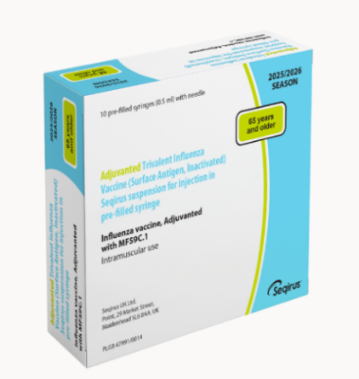
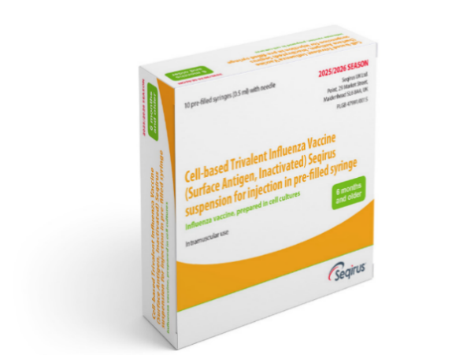
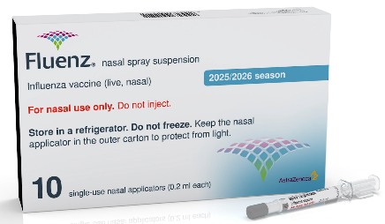
Flu vaccines 2025/26
aIIV
“adjuvanted”
IIVc
LAIV - Fluenz®
“cell-based”
“Live-attenuated”
Notes:
All vaccines procured for 2025/26 are trivalent formulations, as recommended by JCVI advice and WHO.
aIIV = Adjuvanted Influenza Vaccine (no commercial brand name)
IIVc = Cell-based, Inactivated Influenza Vaccine (no commercial brand name)
LAIV = Live Attenuated Influenza Vaccine (commercial brand = Fluenz®)
See slide 32 for further explanation of aIIV and IIVc abbreviation change.

Slide 27
Types of flu vaccine
over the years different flu vaccines have been developed to improve overall effectiveness, especially in the elderly, and to avoid egg adaption changes
there are now the following types of vaccine available:
  Inactivated vaccines – by injection
    cell grown
    adjuvanted
  Live attenuated – by nasal application
this year the inactivated flu vaccines will be trivalent vaccines containing two subtypes of Influenza A and one B virus type
the live flu vaccine is a trivalent formulation, containing two A and one B virus types
none of the flu vaccines can cause clinical influenza in those that are eligible for the vaccine*
Notes:
*all but one of the influenza vaccines available in the UK are inactivated and cannot cause clinical influenza in those that are vaccinated. One vaccine, the live attenuated influenza vaccine (LAIV), contains live viruses that have been attenuated (weakened) and adapted to cold so that they can only replicate at the lower temperatures found in the nasal passage. These live viruses cannot replicate efficiently elsewhere in the body but may cause mild coryzal symptoms. LAIV should not be given to children or adolescents who are clinically severely immunocompromised due to conditions or immunosuppressive therapy. It is also contraindicated in children and adolescents receiving salicylate therapy (other than for topical treatment of localised conditions.
The adjuvanted trivalent influenza vaccine (aIIV) recommended for those aged 65 years and over, is a surface antigen vaccine with an adjuvant added to boost the immune response made to it.
Since March 2020, there have been no confirmed detections of wild type B/Yamagata lineage by the UK national influenza centre or internationally through any WHO influenza collaborating centres (as at August 2023). The public health risk from B/Yamagata is now considerably lower than at the time of the introduction of quadrivalent vaccines and B/Yamagata may be extinct. Therefore trivalent influenza vaccines, without a B/Yamagata strain, are currently considered clinically suitable. As manufacturers start to produce trivalent products, their use will be preferred over the equivalent quadrivalent formulation.
In 2024, the live attenuated vaccine will revert to a trivalent formulation as recommended by the WHO.
NHSE elfh Hub (e-lfh.org.uk)

Slide 28
Vaccine composition:
Northern Hemisphere 2025/26*
The WHO recommends that trivalent vaccines for use in the 2025-2026 northern hemisphere influenza season contain the following:
Egg-based vaccines
an A/Victoria/4897/2022 (H1N1)pdm09-like virus
an A/Croatia/10136RV/2023 (H3N2)-like virus
a B/Austria/1359417/2021 (B/Victoria lineage)-like virus
Cell culture-, recombinant protein- or nucleic acid-based vaccines
an A/Wisconsin/67/2022 (H1N1)pdm09-like virus
an A/District of Columbia/27/2023 (H3N2)-like virus
a B/Austria/1359417/2021 (B/Victoria lineage)-like virus
The previous recommendation for the B/Yamagata lineage component of quadrivalent
influenza vaccine has changed, hence the below strain will no longer be included:
a B/Phuket/3073/2013 (B/Yamagata lineage)-like virus.
Notes:
*The World Health Organization (WHO) convenes a group that reviews the global influenza situation (once each year for the northern hemisphere and once for the southern hemisphere) and recommends which influenza strains should go in the seasonal flu vaccines to be produced by manufacturers for the following season six to eight months later. This recommendation is based on information about the circulating viruses and epidemiological data from around the world at that time.
https://www.who.int/news/item/28-02-2025-recommendations-announced-for-influenza-vaccine-composition-for-the-2025-2026-northern-hemisphere-influenza-season

Slide 29
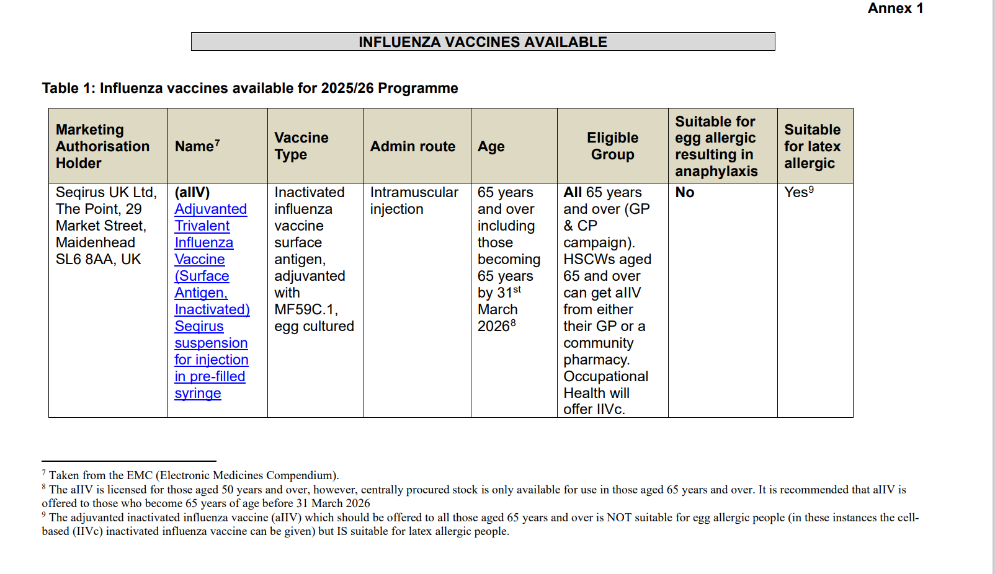
Vaccines for 2025-26 (1)
Notes:
Each year, the JCVI reviews all the available data for the currently licensed flu vaccines and makes recommendations as to which vaccines should be offered to the different patient groups in the forthcoming flu season in order to maximise their protection against flu.
The recommendations change from year to year as a wider and improved range of vaccines becomes available and more is known about the effectiveness of the different vaccines.
Different flu vaccines are recommended for different age groups. It is important to know which vaccine to give to which individuals.
doh-hss-md-43-2023.pdf (health-ni.gov.uk)

Slide 30
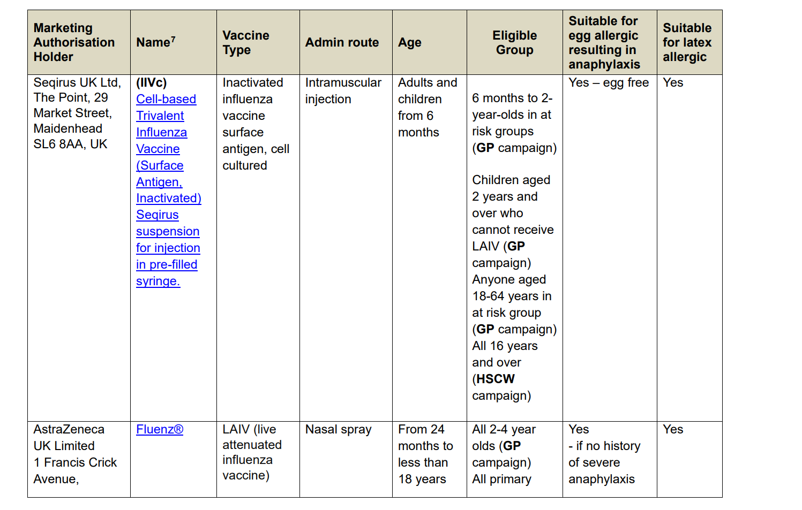
Vaccines for 2025-26 (2)
Notes:
*aIIV and IIVc are supplied in single-dose prefilled syringes, with a plunger stopper (bromobutyl rubber), with attached needles. None of the components of this staked needle prefilled syringe presentation that are in direct contact with the vaccine (syringe barrel, plunger and rubber stopper) are made with natural rubber latex. The needle shield for aIIV and IIVc contains natural rubber latex. The risk of allergy is extremely small and is considered to be safe in those patients that have latex allergy / latex anaphylaxis.
doh-hss-md-43-2023.pdf (health-ni.gov.uk)

Slide 31
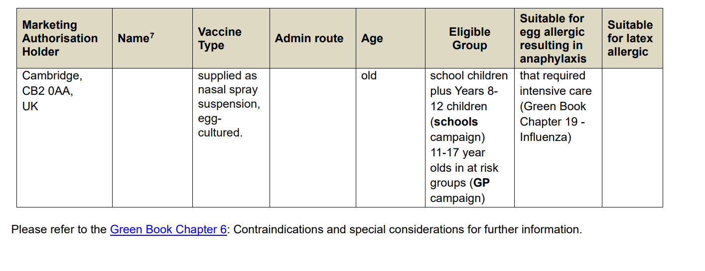
Vaccines for 2025-26 (3)
Notes:
doh-hss-md-43-2023.pdf (health-ni.gov.uk)

Slide 32
Abbreviation Change
Both aIIV and IIVc vaccines are trivalent formulations, but are now referred to as “inactivated influenza vaccines” or IIV.
aIIV
IIVc
“adjuvanted”
“cell-based”
Notes:
**Please note**
The inactivated influenza vaccines (aIIV and IIVc) procured for 2025/2026 are trivalent influenza vaccines, and the vaccine packaging and PIL will still make reference to “trivalent” vaccines.
This is an important consideration for all colleagues involved in vaccine stock ordering and vaccine administration.
Explanation:
Following the WHO and JCVI advice, the inclusion of the B/Yamagata lineage in the influenza formulation is no longer warranted, hence the recommended vaccine type for 2025/2026 moved to trivalent formulations, opposed to the quadrivalent formulation used last year.
The UKHSA Flu programme board advised a change to the influenza vaccine formulation abbreviation, moving away from TIV “trivalent” or QIV “quadrivalent” to the new abbreviation of IIV “inactivated influenza vaccine” instead, for two reasons:
This serves to future proof the abbreviation conventions for future campaigns, where the number of strains may change depending on the circulating lineages.
Helps to prevent the public misconception that a trivalent formulation is inferior to a quadrivalent formulation, having fewer strains.
Please refer to the PHA operational letter for further detail Autumn-25-26-Flu-Covid-19-Programme-PHA-OPERATIONAL-LETTER-08092025.pdf

Slide 33
1. Adjuvanted inactivated flu vaccine
(aIIV)
first line for adults 65 years and over
only licensed for ≥ 65 years at the time of vaccination
not suitable for those with egg allergy
single intramuscular (IM) injection
one dose schedule
aIIV
“adjuvanted”
Notes:
aIIV is a trivalent formulation
aIIV made using an egg-based manufacturing process.
aIIV is used in several other countries worldwide and it has an excellent safety record. It has higher immunogenicity and effectiveness than non-adjuvanted, standard dose egg-based flu vaccines in older people.
Should only be administered I.M.
SmPC (Summary of Product Characteristics): Adjuvanted Trivalent Influenza Vaccine (Surface Antigen, Inactivated) Seqirus suspension for injection in pre-filled syringe - Summary of Product Characteristics (SmPC) - (emc) | 10444

Slide 34
Adjuvanted inactivated influenza vaccine (aIIV)
adjuvanted vaccines were first used in the UK in the 2018/19 flu season in 65 years and over age group. They have been used globally for over 20 years and over 93 million doses have been distributed worldwide (with an excellent safety record)
adjuvanted vaccines have higher immunogenicity and effectiveness than non-adjuvanted, normal dose vaccines in older people
an adjuvanted inactivated influenza vaccine (aIIV) replaced aQIV from 2025. The aIIV vaccine contains two subtypes of Influenza A (H3N2 and H1N1pdm09) and one type B virus
an adjuvant (MF59C.1) has been added to the vaccine to enhance the immune response to counter the effect of immunosenescence (age related reduction in immune response)
MF59C.1 adjuvant is an oil-in-water emulsion of squalene oil which is a naturally occurring substance found in humans, animals and plants. In humans, it is made in the liver and circulates in the bloodstream
aIIV is made using an egg-based manufacturing process
Notes:
Squalene is also found in a variety of foods, cosmetics, over-the-counter medications and health supplements. The squalene used in pharmaceutical products and vaccines is commercially extracted from fish oil and is then highly purified during the manufacturing process.
JCVI have advised that in those aged 65 years and over aIIV, IIVr, and IIV-HD are the preferred vaccines and if these are not available then IIVc is considered an acceptable alternative. The IIVe (inactivated egg-cultured) vaccine is not recommended for use in adults aged 65 years and over.
JCVI statement: https://www.gov.uk/government/publications/flu-vaccines-2025-to-2026-jcvi-advice/jcvi-statement-on-influenza-vaccines-for-2025-to-2026
Green Book Chapter 19 Influenza (publishing.service.gov.uk)

Slide 35
2. Cell-based inactivated influenza vaccine
(IIVc)
First line for all adults 18 to < 65 years who are eligible for the flu vaccine
Second line for adults 65 years and older; including those with severe egg allergy who are contraindicated to receive aQIV
First line for all children aged 6 months to 2 years who are eligible for the flu vaccine
Second line for children over 2 years with contraindication to Fluenz® (LAIV)
Single intramuscular (IM) injection
One dose schedule required unless: child is in a clinical risk group and under 9 years old and has not previously received a flu vaccine
  If second dose required leave at least 4 weeks between doses.
IIVc
“cell-based”
Notes:
For 2025/26, IIVc is formulated as a trivalent vaccine.
JCVI statement on influenza vaccines for 2025 to 2026 - GOV.UK has recommended that IIVc can be given to children in at risk groups less than 2 years of age.
Green Book Chapter 19 Influenza:
Children aged 6 months to under 9 years who are in clinical risk groups and have not received influenza vaccine previously, or who are household contacts of individuals with immunosuppression should be offered a second dose of vaccine.
Children who have received 1 or more doses of any influenza vaccine before should be considered as previously vaccinated (see later section on children).
JCVI has advised that children aged 2 years to under 9 years of age who are not in a clinical risk group only require a single dose of LAIV irrespective of whether they have received influenza vaccine previously. This advice differs from that in the SmPC for LAIV.
Healthy children under 9 years whose parents request they receive IIV instead of LAIV should be offered a single dose, even if they have not previously received influenza vaccine. The same applies to healthy children who cannot receive LAIV due to contraindications.
SmPC (Summary of Product Characteristics): Cell-based Trivalent Influenza Vaccine (Surface Antigen, Inactivated) Seqirus suspension for injection in pre-filled syringe - Summary of Product Characteristics (SmPC) - (emc) | 15818

Slide 36
Cell-based inactivated influenza vaccine (IIVc)
IIVc is licensed for adults and children from 6 months of age
IIVc is a trivalent vaccine containing two subtypes of Influenza A (H3N2 and H1N1pdm00) and one B virus lineages
IIVc has a similar safety profile to other flu vaccines (similar rate and type of adverse reactions reported). Millions of doses of cell-based vaccine have been administered with no serious safety concerns
the cell-based vaccine manufacturing process uses an animal cell line (Madin-Darby Canine Kidney or MDCK) to grow the influenza virus rather than the traditional egg based manufacturing methods
this manufacturing process eliminates the risk of egg-adaptation and may result in the vaccine containing virus that is a closer match to wild-type circulating flu viruses
IIVc is egg free
Notes:
IIVc is licensed for adults and children from 6 months of age.
Cell cultured vaccines such as IIVc should overcome some of the issues associated with egg-adaptation seen in vaccines which use virus grown in eggs (IIVe and IIVe) and which alters the antigenic profile of the A(H3N2) egg propagated vaccine virus compared with the wild type reference strain.
Green Book Chapter 19 Influenza (publishing.service.gov.uk)

Slide 37
3. Live attenuated influenza vaccine
(LAIV) - Fluenz®
recommended for children from age 2 years to < 18 years
remains the vaccine of choice for at risk children aged 2 to <18 years – except where contraindicated
LAIV - Fluenz®
“Live-attenuated”
Notes:
Fluenz® is a live attenuated intranasal influenza vaccine, and is trivalent as recommended by JCVI advice and WHO.
As well as being the vaccine of choice for healthy preschool children (from age 2 upwards) and children p1-7 and Years 8-12 (the programme delivered by the school nursing team), Fluenz® is also the vaccine of choice for at-risk children age 2 -17 years inclusive.
LAIV:
has been shown to be more effective in children compared with inactivated influenza vaccines
may offer some protection against strains not contained in the vaccine in addition to those that are, and has potential to offer better protection against virus strains that have undergone antigenic drift
since this vaccine is comprised of weakened whole live virus, it also replicates natural infection which induces better immune memory (thereby offering better longer-term protection to children than from the inactivated vaccines)
LAIV has a good safety profile in children aged two years and older.
It is important to note that some Fluenz stocks may expire (15 week shelf life after released from manufacturer) before the end of December so expiry dates should be checked before use and an effort should be made to try and complete the programme by the end of December.
SmPC (Summary of Product Characteristics): Fluenz nasal spray suspension Influenza vaccine (live, nasal) - Summary of Product Characteristics (SmPC) - (emc) | 15790

Slide 38
Fluenz® (LAIV)
  ready to use nasal spray (suspension)
  applicator contains 0.2ml (administered as 0.1ml per nostril)
  LAIV can be administered at the same time as, or at any interval between other vaccines, including live vaccines
  children should breathe normally – no need to actively inhale
  the vaccine is rapidly absorbed so no need to repeat the dose if child sneezes, blows their nose or their nose drips following administration
  one dose required unless:
    child is in a clinical risk group and is under 9 years old and has not previously received a flu vaccine
  if second dose required leave at least 4 weeks between doses
Notes:
Fluenz® is supplied as a single use prefilled nasal applicator.
It is a live attenuated nasal vaccine and must not be injected.
The nasal applicator is ready to use. No reconstitution or dilution is required.
The nasal suspension is colourless to pale yellow, clear to opalescent. Small white particles may be present.
Each applicator of Fluenz (LAIV) contains 0.2ml (0.1ml administered/ nostril).
One dose is required unless the child is in a clinical risk group and is < 9 years old and has not previously received a flu vaccine. If a second dose is required at least 4 weeks interval should be left between doses.
If the child attends primary school they will be offered the first vaccine in school but there is no mop up and at-risk children should attend their GP for vaccination if they have missed the first dose and/or require a second dose of vaccine. If Fluenz is not available for use when a child attends for their second vaccine because stocks have expired, the second dose can be replaced with IIVc.

Slide 39
Administration of flu vaccines given by injection
The inactivated influenza vaccines should normally be administered by intramuscular (IM) injection into the deltoid muscle in the upper arm (or anterolateral aspect of the thigh in infants).
aIIV and IIVc are both supplied in single-dose prefilled syringes, containing a 0.5ml dose.
The available inactivated flu vaccines do not require reconstitution.
Patients taking anticoagulants / with bleeding disorder
individuals on stable anticoagulation therapy (including individuals on warfarin who are up-to-date with their scheduled INR testing and whose latest INR was below the upper threshold of their therapeutic range) can receive intramuscular (IM) vaccination
if in any doubt, consult with the clinician responsible for prescribing or monitoring the individual’s anticoagulant therapy.
Notes:
There is a lack of evidence that the subcutaneous route of vaccination is any safer than the intramuscular route in people taking anticoagulants. The subcutaneous route can itself be associated with an increase in localised reactions.
Individuals on stable anticoagulation therapy, including individuals on warfarin who are up-to-date with their scheduled International Normalised Ratio (INR) testing and whose latest INR was below the upper threshold of their therapeutic range, can receive intramuscular vaccination. A fine needle (23 or 25 gauge) should be used for the vaccination, followed by firm pressure applied to the site (without rubbing) for at least 2 minutes.
Immunisation procedures: the green book, chapter 4 - GOV.UK (www.gov.uk)

Slide 40
Storage of all flu vaccine
  Efficacy, safety and quality may be adversely affected if vaccines are not stored at the temperatures specified in the licence.
Must be stored in accordance with manufacturer’s instructions:
  store between +2⁰C and +8⁰C
  do not freeze
  store in original packaging
  protect from light.
Check expiry dates regularly:
  the LAIV has an expiry date 15 weeks after manufacture – this is much shorter than inactivated flu vaccines
  it is important that the expiry date on the nasal spray applicator is checked before use.
Notes:
Vaccines should be stored in the original packaging at +2°C to +8°C and protected from light. All vaccines are sensitive to some extent to heat and cold. Heat speeds up the decline in potency of most vaccines, thus reducing their shelf life. Freezing may cause increased reactogenicity and loss of potency for some vaccines and can also cause hairline cracks in the container, leading to contamination of the contents.
LAIV may be left out of the refrigerator/removed from the cold chain for a maximum period of 12 hours at a temperature not above 25°C. If the vaccine has not been used after this 12-hour period, it should be disposed of.
Vaccines are expensive and it is important to minimise wastage through inappropriate storage. We have had a few cold-chain failures recently where practices did not place vaccines in the vaccine fridge on arrival to the practice, resulting in large vaccine losses and it is important to ensure that all staff responsible for handling / storing vaccines have received cold-chain training Guidance on vaccine handling and storage in GP practices | HSC Public Health Agency (hscni.net)
It is also important to check the expiry dates of flu vaccines and to rotate stock to prevent vaccine loss. LAIV has a shelf life of 15 weeks that starts at the point of release from the manufacturer. This is a shorter shelf life than other influenza vaccines and some of this time will have passed when the vaccine reaches the place where it is to be administered. It is important that the expiry date on the nasal spray applicator is checked before use. If the expiry date has passed, arrangements should be made to have the vaccine disposed of safely.

Slide 41
Co-administration of flu and other vaccines
flu vaccine can be given at the same time as, or at any interval from the COVID-19, Shingrix®, pneumococcal and other live and inactivated vaccines
for older adults, flu vaccine should not routinely be scheduled to be given on the same day as the RSV vaccine as it may reduce the immune response made to both vaccines (although the vaccines can be given together, if it is thought that the individual is unlikely to return for a second appointment or immediate protection is necessary)
flu vaccine can be given at the same time as the RSV vaccine to pregnant women
if not given on the same day, no specific interval is required between administering the RSV and flu vaccines (all cohorts)
Notes:
Older adults: flu and RSV vaccines
There is some data which shows that in older adults, administering the RSV vaccine, Abrysvo®, at the same time as seasonal influenza vaccine may reduce the immune response to the RSV vaccine. There is also data that suggests that the response to the influenza A(H3N2) component of seasonal influenza vaccine (the influenza subtype which most severely affects older adults) may be diminished when RSV and seasonal influenza vaccine are co-administered to older adults.
The clinical significance of any reduced response is unknown, but influenza immune response is known to correlate with protection against infection, and there is emerging data that RSV immune response also correlates with clinical protection. It is therefore recommended that these vaccines should not routinely be scheduled to be given at the same appointment or on the same day. No specific interval is required between administering the vaccines.
If it is thought that the individual is unlikely to return for a second appointment or immediate protection is necessary, Abrysvo® can be administered at the same time as the influenza vaccine.
Pregnant women: Influenza and RSV vaccines
The RSV vaccine, Abrysvo®, can be given concomitantly with inactivated influenza vaccine to pregnant women. Similarly, there are no safety or effectiveness concerns around giving Abrysvo® to pregnant teenagers who are due to have or who have recently had a live attenuated influenza vaccine nasal spray.

Slide 42
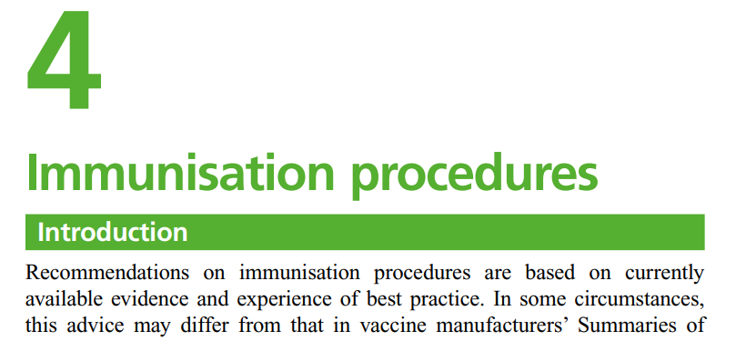
Co-administration of flu and other vaccines
(continued)
where possible, it is preferable that flu and COVID-19 vaccines are co-administered for eligible individuals in the 2025/26 autumn campaign
if two or more intramuscular vaccines are given at the same time, they should be:
- given in separate sites (preferably
a separate limb) and leave at least
2.5 cms between administration sites
- LAIV can also be given at the same
time as other live or inactivated vaccines
See Green-Book-Chapter-4.
Notes:
There is no interval required between inactivated and live flu vaccines and any other vaccines. If it is necessary to administer the inactivated flu vaccine at the same time as other vaccines e.g. COVID-19, PPV, Shingles, the vaccines should be administered in separate limbs / leave at least 2.5 cms between vaccination sites.
aIIV should be administered in a separate limb if possible due to the increased risk of localised reaction. The vaccination sites should be recorded.
LAIV triggers an immune response in the nasal mucosa. This is unlikely to interfere with the body’s response to other vaccines. Similarly, it’s unlikely that the response to LAIV will be affected by the immune response from intramuscular vaccines.

Slide 43
Flu vaccine for pregnancy
pregnant women should be offered flu vaccine, as pregnancy has been identified as a clinical risk for serious illness from influenza
a review of studies on the safety of influenza vaccine in pregnancy concluded that inactivated influenza vaccine can be safely and effectively administered during any trimester of pregnancy
data is more limited for LAIV
there is no evidence of risk with LAIV. The live attenuated viruses cannot replicate efficiently elsewhere in the body and therefore there is no theoretical basis for concern about infection of the fetus or the mother
inactivated influenza vaccines are, however, preferred for those who are pregnant
there is no need to specifically ask about or test for pregnancy when offering LAIV to eligible girls or to advise avoidance of pregnancy in those who have been recently vaccinated

Slide 44
Contraindications:
(inactivated flu vaccines)
There are very few individuals who cannot receive any flu vaccines.
None of the influenza vaccines should be given to those who have had:
confirmed anaphylactic reaction to a previous dose of the vaccine
confirmed anaphylactic reaction to any component of the vaccine (except ovalbumin - see precautions)
The aIIV is contraindicated in individuals with an egg allergy – see slides on egg allergy
Note: Always refer to SPC for individual products when deciding which vaccine to give
Notes:
The Summary of Product Characteristics (SPCs) for individual products should always be referred to when deciding which vaccine to give via the EMC website: Home - electronic medicines compendium (emc)
There are very few individuals who cannot receive any flu vaccine. Confirmed anaphylaxis is rare (see Chapter 8 of the Green Book for further information). Other allergic conditions such as rashes may occur more commonly and are not contraindications to further immunisation. A careful history of the event will often distinguish between true anaphylaxis and other events that are either not due to the vaccine or are not life threatening. In the latter circumstance, it may be possible to continue the immunisation course. Specialist advice must be sought on the vaccines and the circumstances in which they could be given. The risk to the individual of not being immunised must be taken into account.
Green Book Chapter 19 Influenza (publishing.service.gov.uk)

Slide 45
Contraindications: live attenuated flu vaccine (LAIV)
The live attenuated flu vaccine (Fluenz®) should not be given to children or adolescents who are:
clinically severely immunodeficient due to conditions or immunosuppressive therapy, such as:
        acute and chronic leukaemias
        lymphoma
        HIV infection not suppressed by antiretroviral therapy
        cellular immune deficiencies
        high dose corticosteroids
receiving salicylate therapy*
known to be pregnant.
See subsequent slide for children with acute and severe asthma
Notes:
*because of the theoretical risk of Reye’s syndrome following administration of the LAIV to children on aspirin therapy or other salicylate-containing medicine, they should not be given LAIV and should instead be offered an inactivated flu vaccine.
LAIV is not contraindicated for use in children or adolescents:
living with HIV who are receiving antiretroviral therapy and attaining viral suppression
those who are receiving topical corticosteroids, inhaled corticosteroids or low-dose systemic corticosteroids
those receiving corticosteroids as replacement therapy, for example for adrenal insufficiency.
LAIV is contraindicated in children and adolescents receiving salicylate therapy (other than for topical treatment of localised conditions) because of the association of Reye’s syndrome with salicylates and wild-type influenza infection.
Chapter 6 of the Green Book on contraindications and special precautions gives further advice on the use of live vaccines in individuals who are immunosuppressed Contraindications and special considerations: the green book, chapter 6 - GOV.UK (www.gov.uk)
Safety data for the live attenuated flu vaccine when given in pregnancy is limited. Whilst there is no evidence of risk with live attenuated flu vaccine, inactivated flu vaccines are preferred for those who are pregnant. There is no need, however, to specifically test eligible girls for pregnancy or to advise avoidance of pregnancy in those who have been recently vaccinated.

Slide 46
Precautions to flu vaccines
Acutely unwell:
defer flu vaccine until recovered
Heavy nasal congestion:
  defer LAIV until resolved or, if the child is in a risk group, consider inactivated flu vaccine (IIVc) to provide protection without delay
  Cochlear implants:
  children with cochlear implants can be given LAIV safely, although ideally not in the week prior to implant surgery or for 2 weeks afterwards, or if there is evidence of on-going cerebrospinal fluid (CSF) leak
Use with antiviral agents against influenza:
LAIV should not be administered at the same time or within 48 hours of cessation of treatment with influenza antiviral agents
administration of influenza antiviral agents within two weeks of administration of LAIV may adversely affect the effectiveness of the vaccine
Notes:
Minor illnesses without fever of systemic upset are not valid reasons to postpone vaccination. If the individual is acutely unwell, immunisation may be postponed until they have recovered. This is to avoid confusing the differential diagnosis of acute illness by wrongly attributing any signs or symptoms to the adverse effects of the vaccine.
There is no data on the effectiveness of LAIV when given to children with a heavily blocked or runny nose attributable to infection or an allergy. However as heavy nasal congestion might impede delivery of the vaccine to the nasopharyngeal mucosa, deferral of administration until nasal congestion has resolved should be considered or an appropriate alternative influenza vaccine that is administered by injection should be considered.
There is a potential for influenza antiviral agents to lower the effectiveness of the live attenuated influenza vaccine. Administration of influenza antiviral agents within two weeks of administration of LAIV may adversely affect the effectiveness of the vaccine.
Green Book Chapter 19 Influenza (publishing.service.gov.uk)

Slide 47
Acute wheezing and severe asthma
The Joint Committee on Vaccination and Immunisation (JCVI) advise:
children with asthma on inhaled corticosteroids may safely be given LAIV irrespective of the dose prescribed
LAIV is not recommended for children and adolescents currently experiencing an acute exacerbation of symptoms including: - those who have had increased wheezing and/or - needed additional bronchodilator treatment in previous 72 hours
such children should be offered a suitable inactivated influenza vaccine (IIVc) to avoid a delay in protection
children who require regular oral steroids for maintenance of asthma control, or have previously required intensive care for asthma exacerbation should only be given LAIV on the advice of their specialist
as these children may be at higher risk from influenza infection, those who cannot receive LAIV should receive a suitable inactivated influenza vaccine
Notes:
There are limited safety data in children who require regular oral steroids for maintenance of asthma control, or have previously required intensive care for asthma exacerbation – such children should only be given LAIV on the advice of their specialist.
Children with significant asthma and aged under nine years who have not been previously vaccinated against influenza will require a second dose (of either LAIV or inactivated vaccine as appropriate).

Slide 48
Egg allergy: Adults
aIIV is contraindicated in individuals with a history of egg allergy
IIVc should be the preferred option for patients aged 65 and over who have a confirmed allergy to egg
aIIV
IIVc
“adjuvanted”
“cell-based”
Notes:
Inactivated influenza vaccines that are egg-free or have a very low ovalbumin content (<0.12 micrograms/ml - equivalent to <0.06 micrograms for a 0.5 ml dose) are available and studies show they may be used safely in individuals with egg allergy.
In all settings providing vaccination, facilities should be available and staff trained to recognise and treat anaphylaxis.
Green Book Chapter 19 Influenza (publishing.service.gov.uk)

Slide 49
Egg allergy: Children
children with an egg allergy that did not result in an intensive care admission can be safely vaccinated with LAIV in any setting (including primary care and schools)
children aged 2 years of age and over with a history of egg allergy that required admission to intensive care for a previous severe anaphylaxis to egg can now be offered IIVc in any setting (including primary care and schools)
LAIV - Fluenz®
IIVc
“Live-attenuated”
“cell-based”
Notes:
JCVI has advised that, except for those with severe anaphylaxis to egg which has previously required intensive care, children with an egg allergy can be safely vaccinated with Fluenz® (LAIV) in any setting (including primary care and schools).
Inactivated influenza vaccines that are egg-free or have a very low ovalbumin content (<0.12 micrograms/ml - equivalent to <0.06 micrograms for a 0.5 ml dose) may be used safely in individuals with egg allergy. LAIV which previously had an upper ovalbumin limit of 1.2 micrograms/ml, has been shown to be safe for use in egg-allergic children.
The ovalbumin content of LAIV has been further reduced since 2016 (≤0.024 micrograms per 0.2ml dose).
For additional detail refer to the SmPC for each vaccine product, website links provided in the notes section of previous slides
Green Book Chapter 19 Influenza (publishing.service.gov.uk)

Slide 50
Latex allergy
aIIV and IIVc are supplied in single-dose prefilled syringes, with a plunger stopper (bromobutyl rubber), with attached needles. None of the components of this staked needle prefilled syringe presentation that are in direct contact with the vaccine (syringe barrel, plunger and rubber stopper) are made with natural rubber latex. The needle shield for both vaccines contains natural rubber latex. The risk of allergy is extremely small and is considered to be safe in those patients that have latex allergy / latex anaphylaxis.
Please refer to the Green Book Chapter 6: Contraindications and special considerations for further information https://www.gov.uk/government/publications/contraindications-and-special-considerations-the-green-book-chapter-6
Notes:
Some pre-filled syringes may contain latex proteins in the tip cap and/or rubber plunger of the syringe.
It is theoretically possible that latex protein from these tip caps, plungers or vial stoppers may cause allergic reactions when the vaccines are administered to latex-sensitive individuals. There is little evidence that such a risk exists and any such risk would be extremely small.
Greenbook_chapter_6.pdf (publishing.service.gov.uk)

Slide 51
Porcine gelatine
the LAIV contains a highly purified form of gelatine derived from pigs
gelatine is used in LAIV as a stabiliser - it protects the live viruses from the effects of temperature
gelatine is commonly used in a range of pharmaceutical products, including many capsules and some vaccines
there is no other live attenuated flu vaccine available that does not contain porcine gelatine. The manufacturer of LAIV (Fluenz®) tested 40 potential stabilisers – gelatine was chosen because without it, stability was significantly reduced
for eligible children whose parents refuse LAIV due to the porcine gelatine content, the injectable IIVc can be offered

Slide 52
LAIV and ‘viral shedding’
LAIV does not create an external mist of vaccine virus in the air when children are being vaccinated and others in the room should not be at risk of ‘catching’ the vaccine virus
administration of the intranasal vaccine delivers just 0.1ml of fluid straight into each nostril and almost all the fluid is immediately absorbed into the child’s nose
although vaccinated children are known to shed virus a few days after vaccination, the vaccine virus that is shed is less able to spread from person to person than natural flu infection
the amount of virus shed is normally below the levels needed to pass on infection to others and the virus does not survive for long outside of the body. This is in contrast to natural flu infection, which spreads easily during the flu season

Slide 53
Transmission risk from live vaccine
there is a theoretical potential for transmission of live attenuated virus to immunocompromised contacts - risk is for one to two weeks following vaccination with LAIV
extensive use of LAIV in the UK (over 25 million doses) – no reports of illness among immunocompromised patients inadvertently exposed to vaccinated children
however, where close contact with severely immunocompromised patients (e.g. bone marrow transplant patients requiring isolation) is likely/unavoidable (e.g. household members) consider an appropriate inactivated flu vaccine instead
no reports of transmission of vaccine virus in healthcare settings
as a precaution, however, very severely immunosuppressed healthcare workers should not administer LAIV
Notes:
There is a theoretical potential for transmission of live attenuated influenza virus in Fluenz® to immunocompromised contacts for one to two weeks following vaccination.
For children > 2 years of age who are close contacts with severely immunocompromised patients, offer IIVc as an alternative to LAIV (Fluenz®).
In theory, healthcare workers may have low level exposure to LAIV viruses during administration of the vaccine and/or from recently vaccinated patients. The vaccine viruses are cold-adapted and attenuated and are unlikely to cause symptomatic influenza.
Green book chapter 19 Influenza (publishing.service.gov.uk)

Slide 54
Inadvertent administration of LAIV
if an immunocompromised individual receives LAIV the degree of immunosuppression should be assessed
if patient is severely immunocompromised, antiviral prophylaxis should be considered
otherwise they should be advised to seek medical advice if they develop flu-like symptoms in the four days following administration of the vaccine
if antivirals are used for prophylaxis or treatment, patient should also be offered inactivated flu vaccine in order to maximise their protection (this can be given straight away)

Slide 55
Adverse reactions
Commonly reported following inactivated flu vaccine:
pain, swelling or redness at the injection site, low grade fever, malaise, shivering, sweating, fatigue, headache, myalgia (muscle pain) and arthralgia (joint pain)
a small painless nodule (induration) may also form at the injection site
these symptoms usually disappear within one to two days without treatment.
Commonly reported following live attenuated flu vaccine:
nasal congestion/rhinorrhoea, reduced appetite, weakness and headache.
Rarely, after live or inactivated vaccine:
immediate reactions such as urticaria, angio-oedema, bronchospasm and anaphylaxis can occur.
Notes:
Due to the adjuvant, a higher incidence of mild post-immunisation reactions has been reported with aIIV, compared to non-adjuvanted influenza vaccines.
Rarely immediate reactions such as urticaria, angio-oedema, bronchospasm and anaphylaxis can occur following administration of the inactivated / live vaccine.
The following adverse events have been reported very rarely after influenza vaccination over the past 30 years but no causal association has been established: neuralgia, paraesthesia, convulsions and transient thrombocytopenia, vasculitis with transient renal involvement and neurological disorders such as encephalomyelitis.
Green book chapter 19 Influenza (publishing.service.gov.uk)

Slide 56
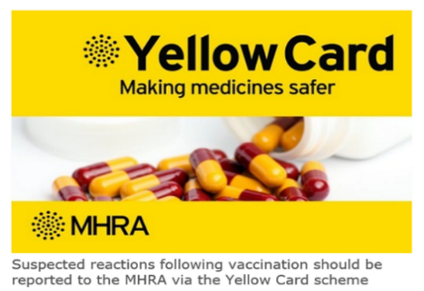

Reporting suspected adverse reactions
Suspected adverse reactions (or side effects) following flu vaccination should be reported to the Medicines and Healthcare Products Regulatory Agency (MHRA) Yellow Card | Making medicines and medical devices safer (mhra.gov.uk) or the Yellow Card app.
Anyone (patients and health care workers) can make a Yellow Card report, even if they are uncertain as to whether a vaccine caused the condition.
The inactivated quadrivalent flu vaccines (IIVc and aIIV) carry a black triangle symbol (▼) (as do all vaccines during the earlier stages of their introduction). This is to encourage reporting of all suspected adverse reactions.
Notes:
As with all other vaccines serious adverse reaction after vaccination should be reported using the online yellow card system.
The QR code can be used for quick and easy access to the Yellow Card reporting site.

Slide 57
Programme delivery 2025/26

Slide 58
2025/26 flu programme
The 2025/26 flu programme will launch from September 2025
Service providers can commence ordering vaccine stock from mid September. It is advisable to order stock two weeks prior to any planned clinics
General Practices can start pre-school clinics once they have received the vaccine
leaflets can be downloaded from PHA web-site
PGDs available from early September
Notes:
The vaccination programme will begin in September 2025. Practices should receive initial delivery of vaccines before the end of September and should check the Movianto website regularly for updates.
Leaflets should be arriving in General Practices by the last week in August and additional flu leaflets can also be downloaded from the PHA website http://www.publichealth.hscni.net/directorate-public-health/health-protection/immunisationvaccine-preventable-diseases.

Slide 59
When to vaccinate
try to vaccinate by December 2025 before influenza circulation peaks
however, do continue to offer vaccination throughout the season (until 31st March 2026), especially if level of influenza activity is high
remember that immune response following flu vaccination takes about two weeks to develop fully
protection offered by the vaccine is thought to last for at least one influenza season
as antibody levels are likely to reduce in subsequent seasons, and there may be changes to the circulating strains from one season to next, annual revaccination is important
Notes:
Although influenza activity is not usually significant in the UK before the middle of November, the influenza season can start early and therefore the ideal time for immunisation is between September and early November. After immunisation, protective immune responses may be achieved within 14 days. Protection afforded by the vaccine is thought to last for at least one influenza season. However, as the level of protection provided in subsequent seasons is likely to reduce and there may be changes to the circulating strains from one season to the next, annual revaccination is important.

Slide 60
General Practice: Adult programme
GPs should actively call all patients:
aged 65 years and over (anyone who will be 65 years of age or over by 31 March 2026)
aged 16 to under 65 years in clinical risk groups (as defined by the influenza chapter in ‘Immunisation against infectious disease’ (the ‘Green Book’)
who are close contacts of immunocompromised individuals
16 – 17 year olds who are frontline health and social care workers or carers.

Slide 61
General Practice: Children’s programme
GPs should actively call and offer flu vaccine to:
all pre-school children aged two years or more on the 1 September 2024 i.e. those born between 2 July 2021 and 1 September 2023
children who miss their offer of a vaccination in school
young people aged 16 and 17 who are in a clinical risk group and who are born before 2 July 2009
children in at-risk groups for whom LAIV is unsuitable
children aged 6 months to less than 2 years*.
Notes:
*Offer cell-grown quadrivalent influenza vaccine (IIVc)

Slide 62
Children’s vaccination programme
School based
School Health teams offer the flu vaccine to:
all children (including those in a clinical risk group) attending primary school, special school and years 8-12 of secondary school during the 2025/26 academic year i.e. those born between 2 July 2009 to 1 July 2021
school teams should prioritise special schools for early vaccinations.
Notes:
Children in a clinical risk group that attend a mainstream school should receive their vaccine through the normal school health team arrangements. However, if there is high parental anxiety about a child in one of the clinical risk groups with higher risk of disease and where the school vaccine visit is scheduled later in the season (i.e. after end of November) or if flu starts to circulate earlier than previous sessions, GPs (or their paediatrician if they attend the hospital during the early season) are asked to facilitate where possible earlier vaccination if requested.
Some children in eligible school years above might have a date of birth outside of the date ranges stated (for instance if a child has been accelerated or held back a year), these children should be offered immunisation along with their class peers.
Please see Chapter 19 of the Green Book, table 19.1, for relative risk rates of clinical risk groups in flu.

Slide 63
Health and Social Care programme
all Trust-employed and Independent Sector Health and Social Care Workers (HSCWs) are eligible for the flu vaccine
the Trust HSCW Programme is lead by Trust Vaccination Teams (occupational health teams in BHSCT and NHSCT) and will include a range of models of delivery like previous years
the Independent Sector HSCW programme will include a range of delivery options including employer schemes, Trust clinics and community pharmacies. Care home staff will also be able to be vaccinated by the community pharmacist their home is paired with for the resident programme
Notes:
Health and social care workers (HSCWs) employees eligible for flu vaccine:
• Health and Social Care (HSC) Trusts, including NIAS
• community HSC providers including GP practices, pharmacies, dentists
• registered independent sector residential care or nursing home
• registered domiciliary care providers
• voluntary managed hospice provider.

Slide 64
Community Pharmacy
Participating community pharmacies across Northern Ireland will be offering the flu vaccine free of charge to:
RQIA registered care home residents and staff
All eligible adults, including:
  65+
  At risk adults
  Carers
  Pregnant women
  Health and social care workers
Notes:
Community pharmacies have built strong links with the care home sector through the successful delivery of the COVID-19 booster programmes to care home residents, and will offer flu vaccination to all RQIA registered care home residents and staff.
They will also offer flu vaccination to carers, pregnant women and >65’s to maximise opportunities for co-administration with the COVID-19 autumn 2025 programme.

Slide 65
Vaccine ordering
all injectable flu vaccines are purchased regionally for Northern Ireland
LAIV for children is purchased centrally by UKHSA for the UK
GP practices must order all flu vaccines via the Movianto online website
Trust Pharmacy should order through the normal pharmacy system for school nurses and HSCW programmes
providers are responsible for ordering sufficient flu vaccine and taking all steps to avoid over ordering and vaccine wastage
While there is no shortage of stock, PLEASE Don’t Over Order!
Movianto will deliver within 48 hours of an order being placed, and will deliver as often as needed. Allow up to five days during busier periods (for example, at the beginning of the programme)
only order what you need for the next week
  this avoids large losses if fridge breaks down (cold chain failure) and being left over at end of campaign
vaccine stock cannot be taken back once it has been delivered
Notes:
Please only order the amount of vaccines that you require and do not overstock flu vaccine. Overstocking can result in loss of a large number of vaccines in the event of a cold-chain failure. Movianto will deliver vaccines within your quota on the next working day. Vaccines can not be returned to Movianto once they have been delivered.
It is important to prevent avoidable vaccine losses.

Slide 66
Achieving high uptake
The GP practice checklist highlights good practice.
It is based upon the findings from a study examining the factors associated with higher vaccine uptake in general practice.
GP practices are encouraged to review their systems in the light of the checklist.
Most recommendations will also apply to other settings where flu vaccine is given.

Slide 67
GP checklist
In order to obtain high vaccine uptake, it is recommended that GP practices:
identify a named lead individual within the practice who is responsible for the flu vaccination programme
hold a register that can identify all pregnant women and patients in the under 65 years at risk groups, those aged 65 years and over, and those aged two to four years
update the patient register throughout the flu season, paying particular attention to the inclusion of women who become pregnant and patients who enter at-risk groups during the flu season
submit accurate data on the number of patients eligible to receive flu vaccine and the flu vaccinations given to patients to SPPG
order sufficient weekly flu vaccine that takes into account past and planned improved performance, expected demographic increase, and to ensure that everyone at risk is offered the flu vaccine.

Slide 68
GP checklist (continued)
actively invite those eligible to a flu vaccination clinic or to make an appointment (e.g. by letter, email, phone call, text)
follow-up patients, especially those in at risk groups, who do not respond or fail to attend scheduled clinics or appointments
start flu vaccination as soon as practicable after receipt of the vaccine
collaborate with community midwives to offer and provide flu vaccination to pregnant women and to identify, offer and provide to newly pregnant women as the flu season progresses
offer flu vaccination in clinics and opportunistically
collaborate with Trust district nurses to identify and offer flu vaccination to house-bound patients and to ensure that mechanisms are in place to update the patient record when flu vaccinations are given by other providers

Slide 69
Further resources
HSS MD 26 2025 - SEASONAL INFLUENZA VACCINATION PROGRAMME 2025 2026.pdf
Flu healthcare worker’s factsheet
PHA flu page
The Green Book: Influenza Chapter
Flu Immunisation - elearning for healthcare (e-lfh.org.uk)
Flu patient information leaflets
Public Health Agency weekly Flu Surveillance Bulletin
Guidance on vaccine handling and storage in GP practices
Flu immunisation training recommendations - GOV.UK (www.gov.uk)
Notes:
Finally the following resources are available and include:
The Green Book, the CMO letter, Flu leaflets and posters and a factsheet on flu vaccination for healthcare workers. PHA have added all of the information on flu (including the flu bulletin) to a separate page on the web-site and this can be accessed via the following link:
https://www.publichealth.hscni.net/directorate-public-health/health-protection/influenza
JCVI statement on influenza vaccines for 2025 to 2026 - GOV.UK
SmPCs links to EMC Website:
aIIV Adjuvanted Trivalent Influenza Vaccine (Surface Antigen, Inactivated) Seqirus suspension for injection in pre-filled syringe - Summary of Product Characteristics (SmPC) - (emc) | 10444
IIVc Cell-based Trivalent Influenza Vaccine (Surface Antigen, Inactivated) Seqirus suspension for injection in pre-filled syringe - Summary of Product Characteristics (SmPC) - (emc) | 15818
LAIV Fluenz nasal spray suspension Influenza vaccine (live, nasal) - Summary of Product Characteristics (SmPC) - (emc) | 15790

