Slide 1
COVID-19 vaccination programme for Adults
Northern Ireland
Acknowledgments to UKHSA, PHW and PHS for use of information from their training slides
Provisional – Subject to revision – Use latest version link: x
Notes:
Acknowledgments to the UK Health Security Agency (UKHSA), Public Health Wales (PHW) and Public Health Scotland (PHS).
These slides are provisional – subject to revision

Slide 2
Note to immunisers
This slide set contains a collection of core slides for use during the delivery of COVID-19 immunisation training. Immunisers should select the slides required depending on their background and experience, according to the role they will have in delivering the COVID-19 vaccine programme.
The information in this slide set was correct at time of publication. As COVID-19 is an evolving disease, a lot is still being learned about both the disease and the vaccines which have been developed to prevent it and the knowledge base is still being developed. For this reason, some of the information may change. Updates will be made to this slide set as new information becomes available. Please check online to ensure you are accessing the latest version. Trainers may need to update data and any information that changes between republications of this slide set.
Slides containing vaccine specific details (such as storage and preparation) have been added to the end of this slide set. They are available at the end of the slide set so that trainers can specifically select those they need for the vaccine they are providing training about.

Slide 3
Content
Learning objectives, key messages and introduction
International and UK COVID-19 epidemiology
Coronavirus
COVID-19: vaccine 2025/26
COVID-19: vaccination programme
Vaccine specific information

Slide 4
1. Learning objectives
By the end of this session, you should be able to:
explain what COVID-19 is and be aware of the UK epidemiology
understand the policy behind the COVID-19 vaccination programme
identify the groups who are at high risk of COVID-19 infection and who are eligible to receive the COVID-19 vaccine
describe the key principles of how to correctly store, prepare and administer COVID-19 vaccines which are currently in use in Northern Ireland (NI)

Slide 5
Pre-requisites to administering COVID-19 vaccine
Before administering COVID-19 vaccine, it is recommended you:
have undertaken training in the management of anaphylaxis and Basic Life Support as specified by policy for your local area and are familiar with Resuscitation Council UK (RCUK) guidance on Management of Anaphylaxis in the Vaccination Setting
have undertaken any additional statutory and mandatory training as required by your employer
have received COVID-19 vaccine training through attending a taught session and/or the eLearning for Healthcare COVID-19 vaccine e-learning programme Immunisation - elearning for healthcare (e-lfh.org.uk)
have received practical training in COVID-19 vaccine preparation and administration
have completed the COVID-19 vaccinator competency assessment tool
have an understanding of the legal mechanisms by which immunisers can supply and administer COVID-19 vaccine
have an appropriate legal framework to supply and administer COVID-19 vaccine in place e.g. patient specific prescription, Patient Specific Direction (PSD) or Patient Group Direction (PGD) and be able to recognise the differences between these and understand which staff can use each of these
be able to describe the process of consent and how this applies when giving vaccines
accessed and familiarised yourself with the following key documents: Green Book COVID-19 chapter and the PHA Healthcare professional factsheet COVID-19 immunisation programme
Notes:
COVID-19: vaccinator competency assessment tool - GOV.UK (www.gov.uk)

Slide 6
Key messages
the global COVID-19 pandemic caused hundreds of millions of infections and over seven million deaths across the world
scientists across the world worked to develop vaccines which were then rigorously tested for safety and efficacy
it continues to be crucial that the COVID-19 vaccine is safely and effectively delivered to as many of those eligible as possible
vaccination to prevent COVID-19 continues to be a key measure to protect those who are at highest risk from serious illness, hospitalisation and death
those with a role in delivering the COVID-19 vaccine programme need to be knowledgeable, confident and competent in order to promote confidence in the vaccination programme and deliver the vaccine safely
Notes:
NHSE elfh Hub (e-lfh.org.uk)

Slide 7
Introduction
a virus emerged in Wuhan, China during December 2019
this virus, which causes respiratory disease, was identified as being part of the Coronavirus family and it rapidly spread to many other countries around the world
the clinical picture varies widely. A significant proportion of individuals are likely to have mild symptoms and may be asymptomatic
common symptoms of COVID-19 include a high temperature, a continuous dry cough, loss or change to sense of smell and taste, muscle aches, sore throat, headache, diarrhoea and vomiting, loss of appetite, unexplained tiredness and a stuffy or runny nose
older people, individuals with underlying medical problems and pregnant women are more likely to develop serious illness or die from COVID-19
measures to contain the virus initially included the introduction of social distancing measures, travel restrictions, closure of public spaces and the wearing of face coverings
despite these measures, the number of positive cases and deaths continued to increase on a daily basis
Notes:
COVID-19: the green book, chapter 14a - GOV.UK (www.gov.uk)

Slide 8
2. COVID–19 timeline in the UK and Northern Ireland
the first COVID-19 cases were initially detected in the United Kingdom (UK) in January 2020, with further cases being detected in February
cases continued to rise in the UK throughout March until a national lockdown was introduced on 23 March 2020
the date of the first positive COVID-19 case in Northern Ireland (NI) was 26/02/2020
the date of the first COVID -19 death in NI (as reported on the mortality reporting system) was 18/03/2020
Notes:
Note: the definition for deaths are those who died within 28 days of a positive specimen.

Slide 9
3. COVID-19 and Coronavirus
COVID-19 is the disease that is caused by infection with the SARS-CoV-2 virus which belongs to the Coronavirus family
      - SARS-CoV-2 stands for Severe Acute Respiratory Syndrome (SARS) and CoV for coronavirus
      - COVID-19 stands for Coronavirus Disease and 19 is from the year 2019 when it was first seen
Coronaviruses may cause illness in animals or humans and they are responsible for causing infections ranging from the common cold to more severe disease such as Severe Acute Respiratory Syndrome (SARS) and Middle East Respiratory Syndrome (MERS) which have been responsible for two outbreaks during the last twenty years
SARS-CoV-2 virus is the most recently discovered coronavirus and has now affected many countries globally
because of the global spread and the substantial number of people affected, the World Health Organisation (WHO) declared COVID-19 as a pandemic on 11/03/2020 (Pan (all) demos (people))

Slide 10
Viral infections
viruses are much smaller than bacteria and consist of a small amount of either DNA or RNA surrounded by a protein coat called a capsid
viruses cannot replicate themselves, but need to seek out the replication mechanism contained within a host cell
examples of vaccine preventable viral diseases include measles, mumps, rubella, influenza, hepatitis A and B
Influenza viruses, which are RNA viruses, are constantly mutating into slightly different forms, which is why we need to produce and give different flu vaccines every year
SARs-CoV-2 is an RNA virus
Notes:
NHSE elfh Hub (e-lfh.org.uk)

Slide 11
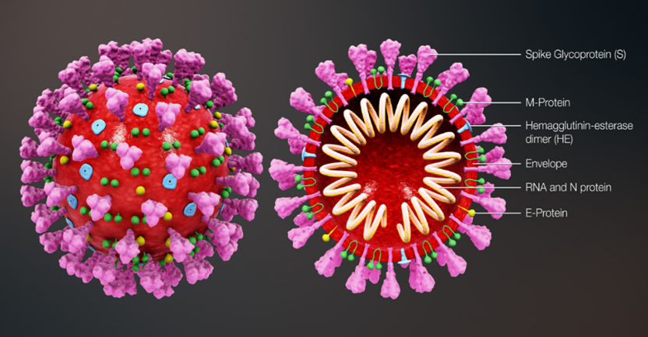
Coronavirus structure
the key parts of the coronavirus are the RNA and the spike proteins
the RNA is surrounded by an envelope which has different roles in the life cycle of the virus. These may include the assembly of new virus and helping new virus to leave the infected cell
the spike proteins (S) are anchored into the viral envelope and form a crown like appearance, like the solar corona, hence the name coronavirus. The spike proteins attach to the target cell and allow the virus to enter it
the RNA is inside the envelope and acts as a template
- so that once it is inside the host cell, the coronavirus
- can replicate itself and be released into the body
the spike proteins and the RNA have been used to:
- develop and make different vaccines to protect against
- SARs-CoV-2
Notes:
Diagram of coronavirus virion structure showing spikes that form a "crown" like the solar corona, hence the name
https://commons.wikimedia.org/wiki/File:3D_medical_animation_coronavirus_structure.jpg

Slide 12
COVID-19: variants
all viruses change over time
mutations are changes to the genetic structure (RNA) of the virus and the means by which it adapts to survive
most mutations have little effect on the properties of the virus or its impact, however, some mutations have the potential to:
    increase how easily the virus spreads
    cause more severe disease
    escape immunity (the immune response is in some way less effective)
    be less susceptible to the effects of the available vaccines, treatments or other public health and social measures
the original (sometimes termed wildtype or ancestral) SARS-CoV-2 virus has mutated, producing new variants, for example Alpha, Delta, and Omicron variants
within a variant there may also be sub-variants, for instance, Omicron BA.1, BA.4, BA.5, XBB 1.5 BA.2.86 and JN.1
Notes:
Overall, Omicron and subvariants of Omicron, have been shown to cause less severe disease than the previous strains, albeit on a background of a population with immunity due to vaccination and previous infection.
Between January and July 2023, successive strains of the Omicron sub-lineage denoted XBB have emerged and have not been associated with any major increases in incidence. A novel strain, denoted BA.2.86 was first detected in August 2023 with a very divergent genome from the predominant XBB strains.
Information on new variants under investigation is available at: SARS-CoV-2 variants of public health interest - GOV.UK (www.gov.uk)

Slide 13
COVID-19: transmission
For transmission to occur, the SARs-CoV-2 virus needs to be transported to a susceptible person. To do this, it needs to have:
a portal of exit (from the place where it is living and replicating)
a mode of transmission (such as coughing or sneezing) and
a portal of entry (to the susceptible host).
COVID-19 spreads primarily from person to person through small droplets and aerosols from the nose or mouth which are expelled when a person with COVID-19 coughs, sneezes, or speaks.
Droplets can also survive on objects and surfaces such as tables, doorknobs and handrails. However, fomites appear to play a minor role in transmission.
People can catch COVID-19 if they breathe in droplets or aerosols from a person infected with the virus, or by touching contaminated objects or surfaces, then touching their eyes, nose or mouth.
Secondary attack rates within households are high.
Notes:
Viral RNA can persist in respiratory samples for 7-12 days after symptom onset, and viral loads are highest soon after symptom onset.
COVID-19: the green book, chapter 14a - GOV.UK (www.gov.uk)

Slide 14
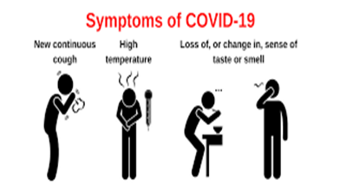
COVID-19: symptoms
The incubation period is 5 to 6 days but can vary between 1 and 14 days.
Symptoms of COVID-19 and other respiratory infections are similar, including:
new or continuous cough
high temperature, fever or chills
loss or change to sense of smell or taste
fatigue, lethargy and unexplained tiredness
shortness of breath
headache
sore throat
stuffy or runny nose
aching muscles
diarrhoea and vomiting
loss of appetite
Notes:
Symptoms of respiratory infections including COVID-19 | nidirect

Slide 15
COVID-19: symptom progression and complications
symptoms may begin gradually and are usually mild
the majority of people have asymptomatic to moderate disease and recover without needing hospital treatment
in severe cases, COVID-19 can lead to pneumonia, acute respiratory distress syndrome, multiple organ failure and death
older people and those with underlying medical problems such as high blood pressure, heart and lung problems, diabetes and cancer have an increased risk of severe disease
the risk of dying with COVID-19 is highest in the elderly, notably those aged 75 years and over
Notes:
Complications from COVID-19 can be severe and fatal, complications include:
venous thromboembolism
heart, liver and kidney problems
neurological issues
coagulation (blood clotting) failure
respiratory failure
multiple organ failure
septic shock.
COVID-19: the green book, chapter 14a - GOV.UK (www.gov.uk)
NHSE elfh Hub (e-lfh.org.uk)

Slide 16
Long COVID
for some people, COVID-19 can cause symptoms that last weeks or months after the infection has gone. This is sometimes called post-COVID-19 syndrome or ‘long COVID’
although many people feel better in a few days or weeks and most will make a full recovery within 12 weeks, for some people, symptoms can last longer
study findings reported in June 2021 from the National Institute for Healthcare Research, showed that over a third of people who tested positive for COVID-19 had symptoms that lasted for 12 weeks or longer (long COVID) and around one in ten people reported severe long COVID symptoms
increased age, women, people who are overweight or obese, and those who smoke, live in deprived areas, or have been admitted to hospital with COVID-19 have been reported in studies as being at greater risk
a review conducted by the UK Health Security Agency (UKHSA) found that having COVID-19 vaccine reduces the chances of having Long COVID
Notes:
Up to one in three people who have had COVID-19 report long COVID symptoms | NIHR
UKHSA review shows vaccinated less likely to have long COVID than unvaccinated - GOV.UK (www.gov.uk)

Slide 17
Long COVID: symptoms
The most commonly reported symptoms are:
extreme tiredness (fatigue)
shortness of breath
Other common symptoms include:
chest pain or tightness joint pain and muscle aches
problems with memory and concentration depression and anxiety
difficulty sleeping tinnitus, earaches
heart palpitations dizziness
feeling sick, diarrhoeas, stomach aches rashes
loss of appetite changes to sense of smell or taste
pins and needles headaches, sore throat, cough
Notes:
Long-term effects of coronavirus (long COVID) - NHS (www.nhs.uk)

Slide 18
COVID-19: vaccine development and safety
the recognition of the COVID-19 pandemic accelerated the development and testing of several vaccines using different vaccine platforms
before any of the COVID-19 vaccines could be authorised for widespread use in the population, the manufacturers had to demonstrate that they were safe and effective
tens of thousands of people across the world have received COVID-19 vaccines in clinical trials
no serious adverse reactions were seen in the trial participants who received them
any reactions reported were similar to those seen following other vaccines such as pain and tenderness at the injection site and fever, headache, muscle aches and fatigue
once vaccines are authorised and in use, the Medicines and Healthcare products Regulatory Agency (MHRA) continually monitors their safety to ensure that the benefits continue to outweigh any risks
Notes:
In the UK, the Medicines and Healthcare products Regulatory Agency (MHRA) is responsible for independent regulatory oversight of vaccine manufacture.
Reported adverse reactions are thoroughly investigated and the MHRA work with their international equivalent agencies to rapidly share safety data and reports.
Further information on COVID-19 vaccine development can be found at: NHSE elfh Hub (e-lfh.org.uk)

Slide 19
COVID-19: vaccine safety (continued)
when vaccines are being given to huge numbers of people, it is normal for potential adverse events following vaccination to occur which were not seen in clinical trials
this does not necessarily mean that the events are linked to the vaccination itself, but they are investigated to ensure that any safety concerns are addressed quickly
if it is thought that the adverse event may be, or is linked to vaccination, advice about use of that vaccine is carefully considered
for example, following widespread use of the AstraZeneca COVID-19 vaccination, a rare condition involving serious thromboembolic (blood clotting) events accompanied by thrombocytopaenia (low platelets) was reported. After thorough assessment of the overall risk benefit of the use of the AstraZeneca vaccine in the UK population, the Joint Committee on Vaccination and Immunisation (JCVI) advised that adults aged under 40 without underlying health conditions that put them at higher risk of severe COVID-19 disease, should be offered an alternative COVID-19 vaccine to the AstraZeneca vaccine
other conditions (such as Guillain-Barré syndrome, myocarditis, pericarditis, transverse myelitis, capillary leak syndrome and heavy menstrual bleeding) have also been reported and investigated
Notes:
Post marketing vaccine safety monitoring - once vaccines are authorised and in use, the MHRA continually monitors their safety to ensure that the benefits of the vaccine continue to outweigh any risks.
AstraZeneca COVID-19 vaccine (Vaxzevria®) was used extensively during the primary vaccination campaign but was not routinely used as a booster and is no longer available in the UK.

Slide 20
COVID-19: vaccine effectiveness (1)
now that COVID-19 vaccines are in general use in the population, the impact and effectiveness of the COVID-19 vaccination programme is being actively monitored
the UK Health Security Agency (UKSHA) look at the impact of the vaccines on symptomatic disease, hospitalisation, death and infection (both symptomatic and asymptomatic)
the Joint Committee for Vaccination and Immunisation (JCVI) uses this data to inform their recommendations about changes to the COVID-19 vaccination programme
several studies have now provided evidence that the COVID-19 vaccines are effective at preventing severe infection
Notes:
The COVID-19 vaccination programme in England was estimated to have prevented over 24.4 million infections and 127,500 deaths in the UK up to 24 September 2021. Estimates also indicated that the vaccination programme had prevented over 261,500 hospitalisations in those aged 45 years and over in England.
Several studies of vaccine effectiveness have been conducted in the UK which indicated that 2 doses of vaccine were between 65% and 95% effective at preventing symptomatic disease with COVID-19 with the Delta variant, with higher levels of protection against severe disease including hospitalisation and death.
Monitoring reports of the effectiveness of COVID-19 vaccination - GOV.UK (www.gov.uk)

Slide 21
COVID-19: vaccine effectiveness (2)
after a primary course of COVID-19 vaccine, effectiveness against symptomatic disease appears to wear off with time
overall, vaccine effectiveness against severe outcomes such as hospital admission remains high for several months after completing the primary course but greater waning has been seen in older adults and those with underlying medical conditions compared to young, healthy adults
additional benefits have also been seen, for example, a household transmission study in England found that household contacts of cases vaccinated with a single dose of COVID-19 vaccine had approximately 35% to 50% reduced risk of becoming a confirmed case of COVID-19
Notes:
NHSE elfh Hub (e-lfh.org.uk)

Slide 22
4. COVID-19 Vaccines
All COVID-19 Vaccines used for Spring 2026
Eligible people 18 and older:
A 0.5ml (50mcg) dose of Moderna COVID-19 vaccine (Spikevax LP.8.1)
A 0.5ml (5mcg) dose of Sanofi COVID-19 vaccine (Nuvaxovid JN.1)
Eligible people aged 12 to 17 years:
A 0.3ml (30mcg) dose of Pfizer BioNTech COVID-19 vaccine (Comirnaty 30 LP.8.1)
(If not deemed suitable for an mRNA vaccine, then Nuvaxovid JN.1 can be given)
Eligible children aged 5-11 years:
A 0.3ml (10mcg) dose of Pfizer BioNTech COVID-19 vaccine (Comirnaty 10 LP.8.1)
Eligible children aged 6 months to 4 years:
A 0.3ml (3mcg) dose of Pfizer BioNTech COVID-19 vaccine (Comirnaty 3 LP.8.1)
**This slideset covers adult vaccines only **
For information on the young people and children’s COVID-19 vaccines please refer to the separate slideset
Notes:
For Spring 2026, operationally in Northern Ireland:
GP practices are allocated the Moderna Spikevax vaccine
Community Pharmacies and HSC Trusts are allocated the Sanofi Nuvaxovid vaccine
HSCT Trusts are also allocated the Pfizer Comirnaty but strictly for vaccinating immunosuppressed 12 – 17-year-olds only.
Vaccination of those in whom mRNA vaccines are clinically unsuitable requires an individual clinical judgment (see section on immunisation in those with a history of allergy in Green Book).
Pfizer BioNTech vaccine is the preferred vaccine for children due to a slightly lower reported rate of myocarditis. Where an mRNA vaccine is not considered suitable, Nuvaxovid JN.1 can be used in people aged 12 to 17.

Slide 23
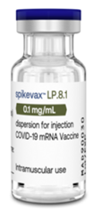
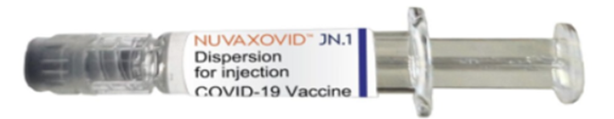
4. COVID-19 Vaccines
Adult COVID-19 Vaccines For Spring 2026
Eligible people 18 years and older:
A 0.5ml (50 micrograms) dose of Moderna COVID-19 vaccine (Spikevax LP.8.1)
A 0.5ml (5 micrograms) dose of Sanofi COVID-19 vaccine (Nuvaxovid JN.1)
Slide 62 onwards will provide further detail on vaccine specific information.
Notes:
For Spring 2026, operationally in Northern Ireland:
GP practices are allocated the Moderna Spikevax vaccine
Community Pharmacies and HSC Trusts are allocated the Sanofi Nuvaxovid vaccine
HSCT Trusts are also allocated the Pfizer Comirnaty but strictly for vaccinating immunosuppressed 12 – 17-year-olds only.
Vaccination of those in whom mRNA vaccines are clinically unsuitable requires an individual clinical judgment (see section on immunisation in those with a history of allergy in Green Book).
Pfizer BioNTech vaccine is the preferred vaccine for children due to a slightly lower reported rate of myocarditis. Where an mRNA vaccine is not considered suitable, Nuvaxovid JN.1 can be used in people aged 12 to 17.

Slide 24
COVID-19 mRNA vaccines (Pifzer BioNTech and Moderna)
the Pfizer BioNTech (Comirnaty) and Moderna (Spikevax) COVID-19 vaccines are messenger ribonucleic acid (mRNA) vaccines
they contain the genetic sequence (mRNA) for the spike protein which is found on the surface of the SARS-CoV-2 virus, wrapped in a lipid envelope (referred to as a nanoparticle) to enable it to be transported into the cells in the body
when injected, the mRNA is taken up by the host’s cells which translate the genetic information and produce the spike proteins
these are then displayed on the surface of the cell. This stimulates the immune system to produce antibodies and activate T-cells which prepare the immune system to respond to any future exposure to the SARS-CoV-2 virus by binding to and disabling any virus encountered
as there is no whole or live virus involved, the vaccine cannot cause disease. The mRNA naturally degrades after a few days

Slide 25
Variant vaccines
following the recognition of the Omicron variant becoming the dominant global circulating strain during 2021, many vaccine manufacturers rapidly developed second generation vaccines that may have broader coverage against SARS-CoV-2 variants
initially developed as boosters, variant COVID-19 vaccines have either replaced the spike protein from the original vaccine strain with another strain, or developed a bivalent formulation containing spike protein sequences from both the ancestral strain and a newer variant, plus or minus those from the ancestral strain
so far, the emergence of new variants has been too rapid to enable incorporation of a new strain in time to pre-empt an increase in disease. In late 2022, incidence was largely driven by infection with Omicron BA.4 and BA.5
those which use a well established format, such as mRNA vaccines, have been licensed on the basis of immunobridging - i.e. by showing non-inferiority of the neutralising antibody response to the ancestral strain, with potentially higher neutralising antibody response to the variant strain

Slide 26
mRNA variant COVID-19 vaccines
bivalent original and Omicron BA.1 mRNA vaccines were approved and first became available for booster vaccination in the UK during the autumn of 2022
following the clinical data generated for BA.1 containing vaccines, an mRNA vaccine targeted against the BA.4/5 strains was approved in the UK in November 2022
in the early summer of 2023, based on emerging evidence of superior immunogenicity against matched strains with good evidence of back-boosting against historic strains, regulators expressed a preference for moving from bivalent to monovalent variant vaccines. Monovalent XBB mRNA vaccines produced by Pfizer BioNTech and Moderna were approved and available for use by October 2023
mRNA vaccines targeting the JN.1 subvariant were approved for use in July and September 2024, and KP.2 for 2025/2026.

Slide 27
Additional COVID-19 vaccines
If more COVID-19 vaccines are considered for authorisation in the UK, information about these will be added to this slide set
Further details about vaccine presentation and preparation is available on slides at the end of this slide set.

Slide 28
Vaccine interchangeability
evidence suggests that those who receive mixed schedules, including mRNA and adenovirus vectored vaccines make a good immune response, although rates of side effects with a heterologous second dose are higher
accumulating evidence now supports the use of heterologous schedules for primary and reinforcing immunisation, and these are now recognised by the European Medicines Agency (EMA)
if the course is interrupted or delayed, it can be resumed during the next seasonal campaign
individuals who have been vaccinated abroad are likely to have received a vaccine based on the spike protein or an inactivated whole viral vaccine and are expected to be boosted by the vaccines currently used in the UK. Specific advice on vaccination of those who received COVID-19 vaccine overseas is available from UKHSA COVID-19 vaccination: information for healthcare practitioners - GOV.UK (www.gov.uk)
Notes:
COVID-19 greenbook chapter 14a (publishing.service.gov.uk)

Slide 29
Interval between COVID-19 vaccines and COVID-19 infection
there are no safety concerns from vaccinating individuals with a past history of COVID-19 infection, or with detectable COVID-19 antibody
vaccination of individuals who may be infected or asymptomatic or incubating COVID-19 infection is unlikely to have a detrimental effect on the illness
there is no need to defer immunisation in individuals after recovery from a recent episode with compatible symptoms who were not tested for COVID-19
the JCVI recommend that vaccination of care home residents with confirmed COVID-19 may go ahead, provided the residents are clinically stable. These populations are likely to be highly vulnerable and vaccination should be facilitated without the need for multiple visits, to maximise vaccination coverage in this vulnerable group
having prolonged COVID-19 symptoms is not a contraindication to receiving COVID-19 vaccine but if the patient is seriously debilitated, still under active investigation, or has evidence of recent deterioration, deferral of vaccination may be considered to avoid incorrect attribution of any change in the person’s underlying condition to the vaccine

Slide 30
Administering COVID-19 vaccine at the same time as Abrysvo® (RSV)
As you may know, the RSV programme is being expanded to include those over the age of 80 from 1st April 2026, following the letter issued by the Department of Health.
As per the updated Green Book guidance, the RSV vaccine can now be safely co-administered with the COVID-19 vaccine.
GP practices may therefore wish to consider offering RSV and COVID-19 at the same appointment to eligible cohorts. GP practices should follow existing RSV vaccine ordering processes with support from their local HSC Trust Pharmacy and consider local storage capacity when planning clinics.
Referrals can also be made for co-administration of COVID-19 and RSV to HSC Trust vaccination teams, in line with usual processes.

Slide 31
Co-administration of COVID-19 and other vaccines (1)
initially data on co-administration of COVID-19 with other vaccines was limited, in the absence of such data first principles would suggest that interference between inactivated vaccines with different antigenic content is likely to be limited
there is no evidence of any safety concerns, although it may make the attribution of any adverse events more difficult
as COVID-19 vaccines are considered inactivated, where individuals in an eligible cohort present having recently received one or more other inactivated or a live vaccine, COVID-19 vaccination should still be given. The same applies for other live and inactivated vaccines where COVID-19 vaccination has been received first or where a individual presents requiring two or more vaccines
it is generally better for vaccination to proceed to avoid any further delay in protection and to avoid the risk of the individual not returning for a later appointment

Slide 32
Co-administration of COVID-19 and other vaccines (2)
where co-administration does occur, patients should be informed about the likely timing of potential adverse events relating to each vaccine
if the vaccines are not given together, they can be administered at any interval, although separating the vaccines by a day or two will avoid confusion over systemic side effects
a UK study of co-administration of AstraZeneca and Pfizer BioNTech COVID-19 vaccines with inactivated influenza vaccines confirmed acceptable immunogenicity and reactogenicity
a recent study has shown an acceptable safety profile when COVID-19 is co-administered with inactivated shingles vaccine
where possible, co-administration of COVID-19 and influenza vaccines is recommended
Notes:
Lazarus et al, 2021 The safety and immunogenicity of concomitant administration of COVID-19 vaccines (ChAdOx1 or BNT161b2) with seasonal influenza vaccines in adults: a phase IV, multicentre randomised controlled trial with blinding (ComFluCOV). https://papers.ssrn.com/sol3/papers. cfm?abstract_id=3931758
Naficy A, Pirrotta P, Kuxhausen A et al. No safety concerns observed when the adjuvanted recombinant zoster vaccine (RZV) and the COVID-19 mRNA-1273 booster were co-administered in ≥50-year-olds. International Society for Infectious Diseases (ISID) Congress, 17–20 November 2022, Kuala Lumpur, Malaysia.

Slide 33
Pregnancy
REMINDER: Following the latest JCVI advice on COVID-19 vaccination in 2025/2026, the COVID-19 vaccine is no longer offered to people who are pregnant. Only those who are immunosuppressed and pregnant i.e. specific population group.
there is no known risk associated with giving non-live vaccines during pregnancy. Since these vaccines cannot replicate, they cannot cause infection in either the woman or the unborn child
routine questioning about last menstrual period and/or pregnancy testing is not required before offering the vaccine
clinicians should discuss the risks and benefits of vaccination with the woman, and advise about the current evidence of safety for the vaccine in pregnancy
women who are planning pregnancy or in the immediate postpartum can be vaccinated with a suitable product for their age and clinical risk group
if a woman finds out she is pregnant after starting a course of vaccine, she may complete vaccination during pregnancy using the same vaccine product
termination of pregnancy following inadvertent immunisation should not be recommended
Notes:
The Royal College of Obstetricians and Gynaecologists (RCOG) have developed a range of information for healthcare professionals and pregnant women about COVID-19 vaccination: Vaccination | RCOG

Slide 34
Breastfeeding
REMINDER: Following the latest JCVI advice on COVID-19 vaccination in 2025/2026, the COVID-19 vaccine is no longer offered to people who are pregnant. Only those who are immunosuppressed and pregnant i.e. specific population group.
there is no known risk associated with giving non-live vaccines whilst breastfeeding
JCVI advises that breastfeeding women may be offered vaccination with any suitable COVID-19 vaccine
emerging safety data is reassuring: mRNA was not detected in the breast milk of recently vaccinated women and protective antibodies have been detected in breast milk
the developmental and health benefits of breastfeeding should be considered along with the woman’s clinical need for immunisation against COVID-19
there is no requirement to stop breastfeeding following vaccination
Notes:
Golan Y, Prahl M, Cassidy A, Lin C et al (2021) COVID-19 mRNA vaccine is not detected in human milk 8th March 2021 https://www.medrxiv.org/content/10.1101/2021.03.05.21252998v1
Juncker H, Mulleners S, van Gils M et al (2021) The Levels of SARS- CoV-2 Specific Antibodies in Human Milk Following Vaccination, JHL 27th June 2021 DOI: https://doi.org/10.1177/08903344211027112

Slide 35
Contraindications to COVID-19 vaccines
the COVID-19 Moderna (Spikevax) and Pfizer BioNTech (Comirnaty) vaccines should not be given to people who have had a confirmed anaphylactic reaction to the vaccine or any components of the vaccine. Expert advice should be sought where either contraindication is present
polyethylene glycol (PEG) is an allergen commonly found in medicines and also in household goods and cosmetics. Known allergy to PEG is extremely rare but would contraindicate receipt of Pfizer BioNTech (Comirnaty) and Moderna (Spikevax) vaccines
there is now evidence that many individuals with initial apparent allergic reaction to an mRNA vaccine can tolerate a second dose of the same vaccine. Where there were no objective signs of anaphylaxis and symptoms rapidly resolved (with no more than 1 dose of IM adrenaline), a further dose of the same vaccine can be given*. If the reaction might have been anaphylaxis, obtain expert advice
Notes:
*if a decision is made to administer the same vaccine, then this should be done under medical supervision in the hospital setting.
Anaphylaxis can be a rare risk of most vaccines and it is important that health professionals are vigilant in watching for the early signs and initiate prompt treatment.
The vast majority of people will not be at risk of anaphylaxis after being administered the COVID-19 vaccines.

Slide 36
Precautions to COVID-19 vaccines (1)
it is recommended recipients of the COVID-19 Moderna (Spikevax) and Pfizer BioNTech (Comirnaty) vaccines should be kept for observation and monitored for a minimum of 15 minutes. In recognition of the need to accelerate delivery of the programme in response to the emergence of the Omicron variant, the UK Chief Medical Officers recommended a permanent suspension of this requirement (doh-hss-md-21-2022.pdf (health-ni.gov.uk)
the exceptions to this 15 minute suspension are:
  - individuals with a strong history of dangerous or unexplained allergic reactions (e.g. anaphylaxis)
facilities for management of anaphylaxis should be available at all vaccination sites
Notes:
Following COVID-19 vaccine administration, individuals should be observed for any immediate reactions whilst they are receiving any verbal post vaccination information and exiting the centre.
Suspension of the 15-minute wait for vaccination with mRNA vaccine for COVID-19: UK CMOs' opinion - GOV.UK (www.gov.uk)

Slide 37
Precautions to COVID-19 vaccines (2)
individuals with a localised urticarial (itchy) skin reaction (without systemic symptoms) to the first dose of a COVID-19 vaccine should receive the second dose of vaccine with prolonged observation (30 minutes) in a setting with full resuscitation facilities (e.g. a hospital)
individuals with non-allergic reactions (vasovagal (fainting) episodes, non-urticarial skin reaction or non-specific symptoms) can receive the second dose of vaccine in any vaccination setting

Slide 38
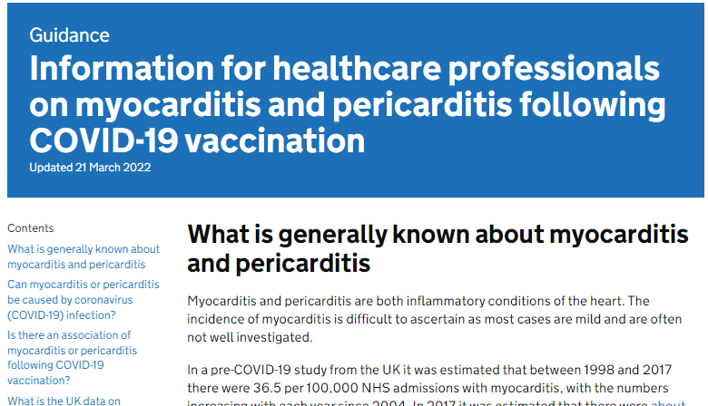
Myocarditis and pericarditis
cases of myocarditis and pericarditis have been reported rarely after COVID-19 vaccines
the reported rate appears to be highest in those under 25 years of age and in males, and after the second dose
onset is within a few days of vaccination and most cases are mild and have recovered without any sequelae
those who develop myocarditis or pericarditis following the first COVID-19 vaccination should be assessed by an appropriate clinician to determine whether it is likely to be vaccine related
subsequent doses should be deferred pending further investigation
Specific information for healthcare professionals is available on the gov.uk website
Notes:
Myocarditis is inflammation of the heart muscle.
Pericarditis is inflammation of the protective thin saclike membrane around the heart (pericardium).
https://www.gov.uk/government/publications/myocarditis-and-pericarditis-after-covid-19-vaccination/myocarditis-and-pericarditis-after-covid-19-vaccination-guidance-for-healthcare-professionals

Slide 39
Guillain-Barré syndrome (GBS)
GBS is a very rare and serious condition that affects the nerves- mainly in the feet, hands and limbs, causing numbness, weakness and pain. In severe cases, GBS can cause difficulty moving, walking, breathing and/or swallowing
very rare reports of GBS following COVID-19 vaccination have been received, however, no causal mechanism with COVID-19 vaccination has been proven, and cases of GBS following vaccination may occur by chance
in those who are diagnosed with GBS after the first dose of vaccine, the balance of risk benefit is in favour of completing a full COVID-19 vaccination schedule. Individuals who have a history of GBS should be vaccinated as appropriate for their age and underlying risk status
as there is no evidence to suggest that having had a prior diagnosis of GBS predisposes an individual to further episodes, in those who are diagnosed with GBS after the first dose of either of the mRNA vaccines, further vaccination can proceed as normal, once recovered

Slide 40
Capillary leak syndrome
a small number of cases of capillary leak syndrome have been reported after AstraZeneca (Vaxzevria®) and Moderna (Spikevax®) vaccination, some of whom had a prior history of this condition
capillary leak syndrome causes fluid and proteins to leak out of tiny blood vessels (capillaries) into surrounding tissues. This may lead to very low blood pressure, low blood albumin levels and thickened blood due to a decrease in plasma volume. Initial symptoms may include tiredness, nausea, abdominal pain, extreme thirst and sudden increase in body weight. Complications can include general swelling, compartment syndrome, kidney failure and stroke
individuals with a prior history of this condition should be carefully counselled about the risks and benefits of vaccination and advice from a specialist should be sought

Slide 41
Immune thrombocytopenia (ITP)
Immune thrombocytopenia (ITP) is a condition where the immune system does not function correctly and attacks and destroys platelets in the blood. Platelets help the blood to clot so this can lead to bruising and bleeding
there is now emerging evidence of a small risk of ITP or ITP relapse following COVID-19 vaccination
to date, this has been reported extremely rarely and the MHRA Yellow Card summary states that this is usually short-lived and of minor severity
previous ITP is not a contraindication for vaccination but guidance produced by the UK ITP Forum Working Party advises discussing the potential for a fall in platelet count in patients with a history of ITP receiving any COVID-19 vaccine and recommends a platelet count check 2 to 5 days after vaccination
Notes:
British Society for Haematology https://b-s-h.org.uk/about-us/news/covid-19-updates/

Slide 42
Menstrual disorders / unexpected vaginal bleeding
the MHRA has continued to review reports of suspected side effects of menstrual disorders and unexpected vaginal bleeding following COVID-19 vaccination in the UK
these reports are also being reviewed by the independent experts of the Commission on Human Medicines (CHM) COVID-19 Vaccines Benefit Risk Expert Working Group and the Medicines for Women’s Health Expert Advisory Group
evidence from the most recent review suggested a possible association between the Pfizer BioNTech (Comirnaty®) and Moderna (Spikevax®) COVID-19 vaccines and heavy menstrual bleeding
events were mostly non-serious and temporary in nature
the rigorous evaluation completed to date does not support a link between COVID-19 vaccines and other changes to menstrual periods
no evidence to suggest that COVID-19 vaccines affect fertility or ability to have children
Notes:
Coronavirus vaccine - summary of Yellow Card reporting - GOV.UK (www.gov.uk)

Slide 43
Local reactions at the vaccination site
the MHRA have received reports of skin reactions occurring around the vaccination site and extensive swelling of the vaccinated limb
the majority of the reports received have been following the Moderna (Spikevax®) and Pfizer BioNTech (Comirnaty®) vaccines
the reactions are characterized by a rash, swelling and tenderness that can cover the whole upper arm and may be itchy and/or painful and warm to the touch
the reactions are usually self-limiting and resolve within a day or two, although in some patients it can take slightly longer to disappear
individuals who experience this reaction after their first dose may experience a similar reaction in a shorter timeframe following the second dose, however, none of the reports received by the MHRA have been serious and people should still receive subsequent doses when invited
those who experience delayed local reactions after their COVID-19 vaccination which do not resolve within a few days should seek medical advice

Slide 44
Bell’s Palsy
Bell’s Palsy (BP) is a temporary weakness or paralysis affecting one side of the face that develops gradually; most people recover from this condition within a few months
BP is known to be associated with a number of infectious diseases, including the SARS-CoV-2 virus
whilst reporting of BP following COVID-19 vaccination is rare, the latest available data shows that there may be an increased risk of BP following COVID-19 vaccination
to raise awareness of this potential adverse event amongst healthcare professionals and patients, facial paralysis has been included in the product information for Pfizer BioNTech (Comirnaty®) and Moderna (Spikevax®) COVID-19 vaccines

Slide 45
COVID-19 vaccination programme considerations
The overall aim of the COVID-19 vaccination programme is to protect those who are at most risk from serious illness or death.
In order to advise which groups of patients to vaccinate and in which order to prioritise vaccination of these groups, the JCVI consider all the available relevant information on:
vaccine efficacy and/or immunogenicity and the safety of administration in different age and risk groups
the effect of the vaccine on acquisition of infection and transmission
epidemiological, microbiological and clinical characteristics of COVID-19.
From this, they then make recommendations to the Department of Health (DoH) and planning to deliver vaccine and maximise uptake in these groups can begin.
Notes:
Full details on COVID-19 vaccination eligibility criteria, with detail on the at-risk conditions, are included in the Green Book COVID-19 chapter.

Slide 46
Resident in a care home
there is clear evidence that those living in residential care homes for older adults have been disproportionately affected by COVID-19
those living in care homes have a high risk of exposure to infection due to their close contact with staff (including bank staff) and other residents including those residents returning to the care home from hospital
the closed setting of the care home also increases the risk of outbreaks occurring as any asymptomatic residents and staff could be potential reservoirs for on-going transmission
given the increased risk of outbreaks, morbidity and mortality in these closed settings, older adults in care homes are considered to be at very high risk
JCVI have advised that this group should be the highest priority for vaccination
vaccination of residents and staff at the same time is considered to be a highly efficient strategy within a vaccination programme with the greatest potential impact
Notes:
https://www.gov.uk/government/statistics/vivaldi-1-coronavirus-covid-19-care-homes-study-report

Slide 47
Older adults
older adults are considered to be at very high risk if they develop COVID-19 infection
data from the UK shows that the risk of poorer outcomes from COVID-19 infection increases dramatically with age in both healthy adults and in adults with underlying health conditions
evidence strongly indicates that the single greatest risk of mortality from COVID-19 is increasing age and that the risk increases exponentially with age
the absolute risk of mortality is higher in those over 65 years than that seen in the majority of younger adults with an underlying health condition
Notes:
Those over the age of 65 years have by far the highest risk, and the risk increases steeply with age.

Slide 48
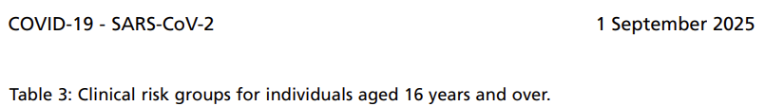
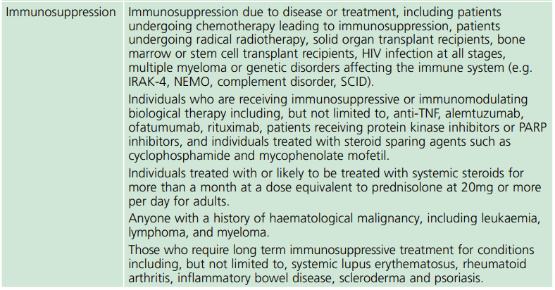
1. Individuals aged 6 months and over who are “immunosuppressed”
(as defined in sections of Tables 3 or 4 in the COVID-19 Chapter of Green book)
**Only the relevant “Immunosuppression” section has been included on this slide – for full list of clinical risk groups – see the COVID-19 Chapter of Green book**
Notes:
*1 Poorly controlled asthma is defined as: - ≥2 courses of oral corticosteroids in the preceding 24 months OR - on maintenance oral corticosteroids OR - ≥1 hospital admission for asthma in the preceding 24 months.
As well as age, other risk factors have been identified that place individuals at risk of serious disease or death from COVID-19. These include groups with certain underlying health conditions, as detailed in table 3 of the Green Book, chapter 14a.

Slide 49
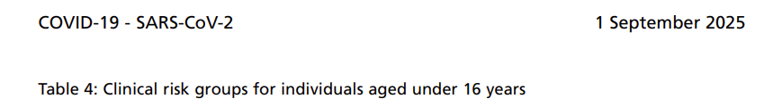
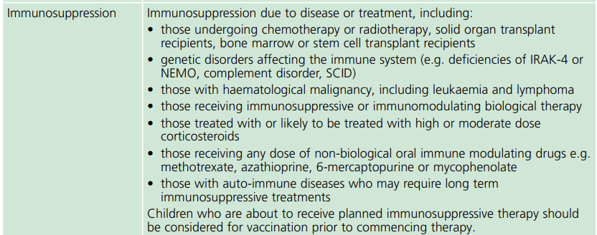
2. Individuals aged 6 months and over who are “immunosuppressed”
(as defined in sections of Tables 3 or 4 in the COVID-19 Chapter of Green book)
**Only the relevant “Immunosuppression” section has been included on this slide – for full list of clinical risk groups – see the COVID-19 Chapter of Green book**

Slide 50
Pregnancy
REMINDER: Following the latest JCVI advice on COVID-19 vaccination in 2025/2026, the COVID-19 vaccine is no longer offered to people who are pregnant. Only those who are immunosuppressed and pregnant i.e. specific population group.
studies following the use of the COVID-19 vaccines in pregnant women have shown the vaccines to be safe and highly effective in preventing serious complications
a large amount of observational data from women vaccinated during pregnancy in the USA has not shown an increase in adverse pregnancy outcomes
around 150,000 women in England, 25,000 in Scotland and 4,500 in Wales have received at least one dose of COVID- 19 vaccine whilst pregnant. Initial analysis of birth outcomes in women who had received at least one dose of the vaccine and gave birth between January to November 2021 in England showed a similar or higher rate of good birth outcomes than in unvaccinated women
there is now extensive post-marketing experience of the use of the Pfizer BioNTech and Moderna vaccines with no safety signals so far. These vaccines are therefore the preferred vaccines to offer to pregnant women (for those under 18 years, Pfizer BioNTech vaccine (Comirnaty®) is preferred)
Notes:
https://www.gov.uk/government/news/pregnant-women-urged-to-come-forward-for-covid-19-vaccination
https://assets.publishing.service.gov.uk/government/uploads/system/uploads/attachment_data/file/1036047/Vaccine_surveillance_report_-_week_47.pdf

Slide 51
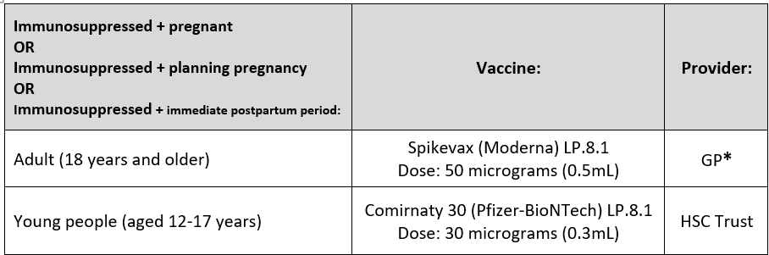
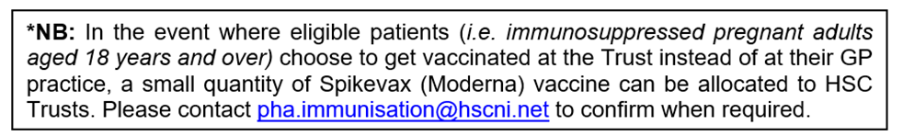
Specific Population Groups
Pregnancy is not an indication for COVID-19 vaccination during the Spring 2026 campaign.
However, those who are immunosuppressed (as defined in the Green Book), and are pregnant, planning pregnancy, or are in the immediate postpartum period should be offered the vaccine. They should receive a suitable product according to their age.
Immunosuppressed patients aged between 5 – 18 years and over are identified by their GP practice. Table 3 below outlines the provider and vaccine available according to patient age.
Notes:
https://www.gov.uk/government/news/pregnant-women-urged-to-come-forward-for-covid-19-vaccination
https://assets.publishing.service.gov.uk/government/uploads/system/uploads/attachment_data/file/1036047/Vaccine_surveillance_report_-_week_47.pdf

Slide 52
Specific Population Groups
The vaccines can be administered at any stage of pregnancy.
Studies following the use of COVID-19 vaccine in pregnant women have shown the vaccines to be safe and highly effective in preventing serious complications.
Vaccination against COVID-19 can take place at the same time as, or at any interval before or after, other vaccines offered in pregnancy (pertussis, influenza, RSV vaccines). The pertussis (whooping cough) and RSV vaccines should be given at the recommended gestation.
Routine questioning about last menstrual period and/or pregnancy testing is not required before offering COVID-19 vaccine.
Resources for pregnant and breastfeeding women are available from the Royal College of Obstetricians and Gynaecologists (RCOG) website.
Notes:
https://www.gov.uk/government/news/pregnant-women-urged-to-come-forward-for-covid-19-vaccination
https://assets.publishing.service.gov.uk/government/uploads/system/uploads/attachment_data/file/1036047/Vaccine_surveillance_report_-_week_47.pdf

Slide 53
Deprivation and ethnicity
there is clear evidence that certain Black, Asian and minority ethnic (BAME) groups have higher rates of infection, and higher rates of serious disease, morbidity and mortality from SARS-Cov-2 infection
there is no strong evidence that ethnicity by itself (or genetics) is the sole explanation for observed differences in rates of severe illness and deaths
certain health conditions are associated with increased risk of serious disease, and these health conditions are often overrepresented in certain BAME groups
societal factors, such as occupation, household size, deprivation, and access to healthcare can increase susceptibility to COVID-19 and worsen outcomes following infection
good vaccine coverage in BAME groups will be the most important factor within a vaccine programme in reducing inequalities for this group
Notes:
https://www.nature.com/articles/s41586-020-2521-4.pdf
The JCVI have advised that NHS England and Improvement, the Department of Health and Social Care, UKHSA and the devolved administrations work together to ensure that inequalities are identified and addressed in implementation. This could be through culturally competent and tailored communications and flexible models of delivery, aimed at ensuring everything possible is done to promote good uptake in Black, Asian and minority ethnic groups and in groups who may experience inequalities in access to, or engagement with, healthcare services. These tailored implementation measures should be applied across all priority groups during the vaccination programme.

Slide 54
5. COVID-19 vaccination programme
Spring 2026

Slide 55
Spring 2026: eligibility
The JCVI have recommended that a dose of COVID-19 vaccine should be offered to:
all adults aged 75 years and over
residents in a care home registered with RQIA
persons aged 6 months and over who are immunosuppressed (as defined in tables 3 and 4 of the COVID-19 chapter of the Green Book)
Notes:
For policy details, refer to the:
JCVI Advice:
JCVI statement on COVID-19 vaccination in 2025 and spring 2026 - GOV.UK
and DoH HSS CMO Policy Letter and PHA Operational Planning Letter.

Slide 56
Spring 2026
Covid-19 vaccines should ideally be offered around six months from any previous dose
however, operational flexibility can be used, for example, individuals in care homes or housebound patients may be offered the booster alongside other residents providing there was at least three months from the previous dose
based on the evidence that vaccine effectiveness can wane over time in adults, community pharmacies should prioritise the vaccination of care home residents from the beginning of the programme.
Notes:
COVID-19 Greenbook chapter 14a (publishing.service.gov.uk)

Slide 57
Primary COVID-19 vaccination
Only those who currently meet the eligibility criteria for a COVID-19 vaccination during the spring 2026 programme continue to be eligible for a primary vaccination
For the spring 2026 programme, the primary course consists of a single dose of COVID-19 vaccine. Further details regarding exceptions to this advice, are outlined in the COVID-19 Greenbook chapter 14a
Those in the eligible groups who have not yet come forward for primary vaccination may attend any vaccination provider to be vaccinated.
Notes:
JCVI Advice:
JCVI statement on COVID-19 vaccination in 2025 and spring 2026 - GOV.UK
DoH HSS CMO Policy Letter:
HSS(MD) 23 2025 - AUTUMN 2025 COVID-19 VACCINATION CAMPAIGN.pdf
PHA Operational Planning Letter:
Autumn-25-26-Flu-Covid-19-Programme-PHA-OPERATIONAL-LETTER-08092025.pdf

Slide 58
Reinforcing vaccination (1)
studies of boosting in the UK have shown that a third adult dose of AstraZeneca (Vaxzevria®), Novavax (Nuvaxovid®), Moderna (Spikevax®) and Pfizer BioNTech (Comirnaty®) vaccines successfully boosted individuals who had been primed with two doses of Pfizer BioNTech (Comirnaty®) or AstraZeneca (Vaxzevria®) vaccine around three months earlier
levels of IgG and neutralising antibody, including against Delta variant, were generally higher where an mRNA vaccine was used as either a heterologous or homologous boost
following the Omicron variant becoming the dominant global circulating strain in 2021, many vaccine manufacturers rapidly developed second generation vaccines that may have broader coverage against SARS-CoV-2 variants
overall, booster doses of the first bivalent variant mRNA vaccines (targeting BA.1), which were used in the autumn 2022 programme, showed superior immunogenicity against the matched strains and slightly improved immunogenicity against historic strains than the equivalent original vaccines
Notes:
Munro et al, 2021 Safety and immunogenicity of seven COVID-19 vaccines as a third dose (booster) following two doses of ChAdOx1-nCov19 (AZD1222) or BNT162b2: A blinded, randomised controlled trial (COV-BOOST). Lancet 2021 (in press).
COVID-19: the green book, chapter 14a - GOV.UK (www.gov.uk)

Slide 59
Reinforcing vaccination (2)
in the early summer of 2023, based on emerging evidence of superior immunogenicity against matched strains with good evidence of back-boosting against historic strains, regulators expressed a preference for moving from bivalent to monovalent variant vaccines
monovalent XBB mRNA vaccines produced by Pfizer BioNTech and Moderna were approved and available for use by October 2023
mRNA vaccines targeting the JN.1 subvariant were approved for use in July and September 2024
eligible individuals should be clearly advised that boosting is required to ensure timely protection, and therefore to accept whichever booster vaccine they are offered

Slide 60

COVID-19 vaccine: Spring 2026 (Adults)
Two brands of COVID-19 vaccine will be deployed during the Spring ‘26 programme for adults (aged 18 years and over)
Eligible Cohort | Vaccine Provider | Vaccine
75 years and over Immunosuppressed 18 years + | General Practitioners | Spikevax (Moderna) LP 8.1 Dose 0.5mL (50 micrograms)
 | HSC Trusts* | Nuvaxovid (Sanofi) JN.1 Dose 0.5 mL(5 micrograms)
75 years and over Immunosuppressed 18 years + Care home residents | Community Pharmacy
*NB: In the event where eligible patients in the specific population group, pregnant immunosuppressed adult (aged 18-years and over) chooses to be vaccinated at the Trust instead of at their GP practice, a small quantity of Spikevax (Moderna) can be allocated to HSC Trusts. Contact pha.immunisation@hscni.net to make arrangements. See slide 51 and 52 for further details.
Notes:
Vaccination of those in whom mRNA vaccines are unsuitable requires an individual clinical judgement, please check the Green Book, COVID-19 chapter for further information.

Slide 61
Severely immunosuppressed (1)
Some individuals who are immunosuppressed due to underlying health conditions or medical treatment may not mount a full immune response to COVID-19 vaccination.
The JCVI therefore advises that a small group of more severely immunosuppressed individuals should be offered additional doses of vaccination.
This includes individuals:
with primary or acquired immunodeficiency states at the time of vaccination due to certain conditions
on immunosuppressive or immunomodulating therapy at the time of vaccination
with chronic immune-mediated inflammatory disease who were receiving or had received immunosuppressive therapy prior to vaccination
who had received high-dose steroids (equivalent to >40mg prednisolone per day for more than a week) for any reason in the month before vaccination
Notes:
Definitions of severe immunosuppression and details of timings of additional doses are described in the COVID-19 chapter of the Green Book COVID-19 greenbook chapter 14a (publishing.service.gov.uk)
Individuals who receive bone marrow transplants, and many individuals who receive CAR-T therapy for certain conditions, may lose immunological memory from vaccination received prior to the treatment and the development of the underlying condition. After treatment and recovery, these individuals should be considered for a full course of revaccination for all vaccines used in the routine programme (see chapter 7). Specialist advice should be followed on which vaccines can be safely given and on the optimal timing for commencing revaccination.

Slide 62
Severely immunosuppressed (2)
unvaccinated individuals who become or have recently become severely immunosuppressed should be considered for primary and reinforcing vaccination, regardless of the time of year. Clinical judgement should be used to decide on the best timing to commence vaccination
in contrast to other eligible risk groups, those who are eligible for vaccination due to severe immunosuppression who miss vaccination during the campaign period, may be considered for a booster at a later date based on individual clinical judgement, balancing their immediate level of risk against the advantages of waiting till the next seasonal campaign
in general, vaccines administered during periods of minimum immunosuppression are more likely to generate better immune responses. Therefore, any planned additional doses should ideally be given with special attention paid to current or planned immunosuppressive therapies
Notes:
Any decision to defer immunosuppressive therapy or to delay possible benefit from vaccination until after immunosuppressive therapy should only be taken after due consideration of the risks of exacerbating their underlying condition, as well as the risks from COVID-19.

Slide 63
Long term COVID-19 vaccination programme
the UK COVID-19 pandemic vaccine programme was initiated in December 2020 with the primary objective to prevent severe disease, hospitalisations, and deaths
now that the vast majority of the UK adult population have been vaccinated and seroprevalence studies indicate that most of the adult and childhood population have been naturally infected, the UK COVID-19 vaccination programme has started to transition towards a longer-term more sustainable programme
JCVI have advised that emergency surge vaccination responses may be required should a novel variant of concern emerge with clinically significant biological differences compared to previous variants

Slide 64


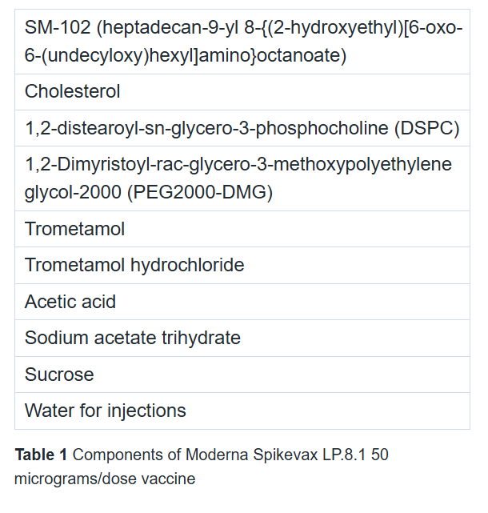
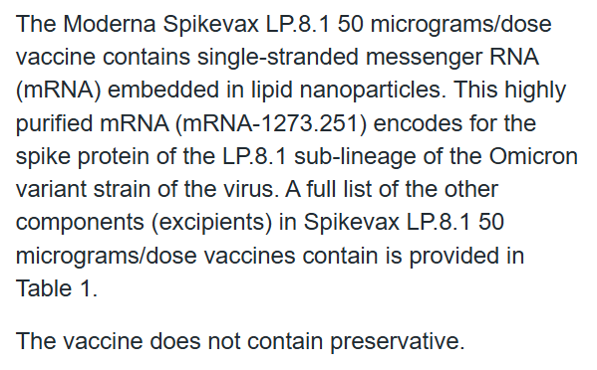
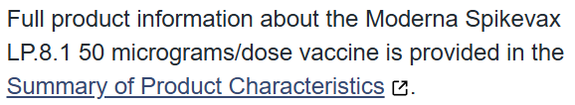
6. Vaccine specific information

Slide 65

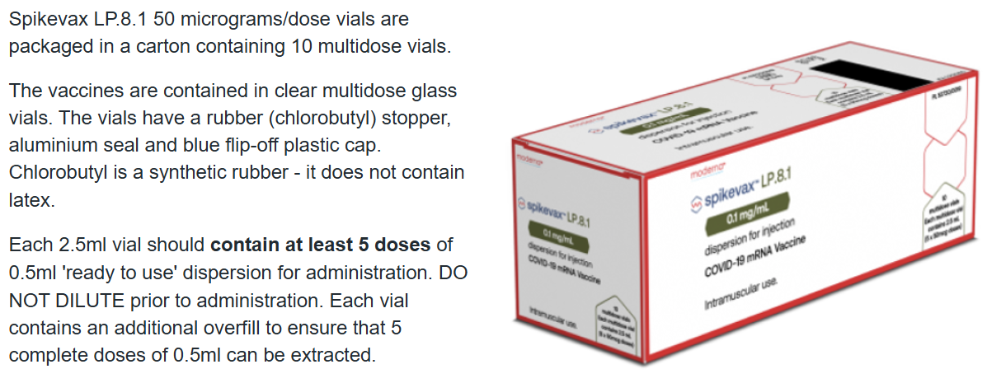
6. Vaccine specific information

Slide 66

6. Vaccine specific information
Whilst the Spikevax LP.8.1 50 micrograms/dose vaccines can be stored frozen for 9 months at temperatures between -50°C and -15°C, they will be delivered to vaccination sites in a thawed state.
Refrigerated vaccine must be transferred immediately to a vaccine fridge on arrival and stored within a carefully monitored temperature range of +2°C and +8°C.
Once thawed, the vaccine must not be re-frozen and should be stored refrigerated at +2°C to +8°C, protected from light, for a maximum of 30 days if not used (if it has not been opened and the bung has not been punctured by a needle). Within this period, up to 36 hours (maximum of 30 hours by road and up to 6 hours by air) may be used for transportation at +2°C to +8°C.
After the vaccine has been removed from the freezer to +2°C to +8°C storage, the vaccine will have been re-labelled with an updated expiry date on the outer carton. The original expiry date should have been crossed out. The label should state the time it was removed from the freezer into storage at +2°C to +8°C and the date and time by which it must be discarded 30 days later if it has not been used.
The unopened vaccine may be stored at +8°C to +25°C for up to 24 hours after removal from refrigerated conditions.

Slide 67
6. Vaccine specific information
Punctured multidose vial
Chemical and physical in-use stability has been demonstrated for 6 hours at +2°C to +25°C after initial puncture (within the allowed use period of 30 days at +2°C to +8°C and 24 hours at +8°C to +25°C).
Each multidose vial should be clearly labelled with the date and time of expiry (which will be 6 hours from when it was first punctured).
Because of the risk of microbial contamination, once the vial is punctured the product should be used as soon as possible and within 6 hours (stored at +2°C to +25°C).
Check the puncture time on the vial before each dose is drawn up and discard any unused vaccine after this time period.

Slide 68


6. Vaccine specific information
Preparation
Spikevax LP.8.1 50 micrograms/dose vaccines are ready to use preparations once thawed.
Swirl the vial gently after thawing and before each withdrawal. Do not shake the vaccine vial.
The vaccine should be white to off-white in colour.
If there is discolouration or other particulate matter present, the vaccine should not be administered.
Clean the top of the vial with a single-use alcohol swab and allow to air dry fully.
Unwrap one of the 1ml combined needle and syringes (CNS) procured for use with the vaccine (a 23G or 25G x 25mm needle and 1ml syringe will be routinely supplied; longer length (38mm) 23G or 25G needles will be available for morbidly obese individuals to ensure the vaccine is injected into muscle and can be ordered when ordering vaccine if required).

Slide 69
6. Vaccine specific information
Dose
The amount to be given for each dose of Spikevax LP.8.1 50 micrograms/dose vaccine is 0.5mL
Drawing up a dose
The dose-sparing needles and syringes being provided with the vaccine should be used in order to extract the correct number of full doses from the vial. If standard syringes and needles are used, there may not be sufficient volume to extract a complete final dose from a single vial. Care should be taken to ensure a full dose will be administered to the patient from the same vial. If the amount of vaccine remaining in the vial cannot provide a full dose, discard the vial and any excess volume. Do not pool excess vaccine from multiple vials.
Insert the needle vertically into the centre ring of the vaccine vial stopper.
Do not twist or rotate the needle once inserted as this may cause a particle to be cored out of the stopper (see Good practice tips).
Withdraw the correct dose for the brand of COVID-19 vaccine that you are using; take particular care to ensure the correct dose is drawn up as a partial dose may not provide protection.
Any air bubbles should be removed before removing the needle from the vial in order to avoid losing any of the vaccine dose.
The same needle and syringe should be used to draw up and administer the dose of vaccine to prevent under dosing.
The needle should only be changed between the vial and the patient if it is contaminated or damaged.

Slide 70
6. Vaccine specific information
Good practice tips
After removing the needle and syringe from the packaging, loosen the plunger by pulling it back and then depress it to ensure it moves easily before use. Ensure the plunger is fully depressed before withdrawing a vaccine dose.
To minimise the risk of particles breaking off from the rubber stopper and entering the vial, it is recommended that when drawing up the vaccine, you should:
insert the needle vertically (at a 90° angle) through the centre ring in the vaccine vial stopper. If the needle is not inserted vertically into the centre ring, it can result in the needle scraping rubber off the inner wall of the small channel of the stopper
do not twist or rotate the needle once inserted. If the needle is rotated or twisted during the piercing of the stopper, a particle may be cored out of the stopper
preferably pierce the stopper at a different site each time
Before giving the vaccine, recheck that the correct dose has been withdrawn and that there are no visible particles in the vaccine solution in the syringe. If there are visible particles, discard the vaccine and restart the drawing up process with a new needle and syringe.

Slide 71


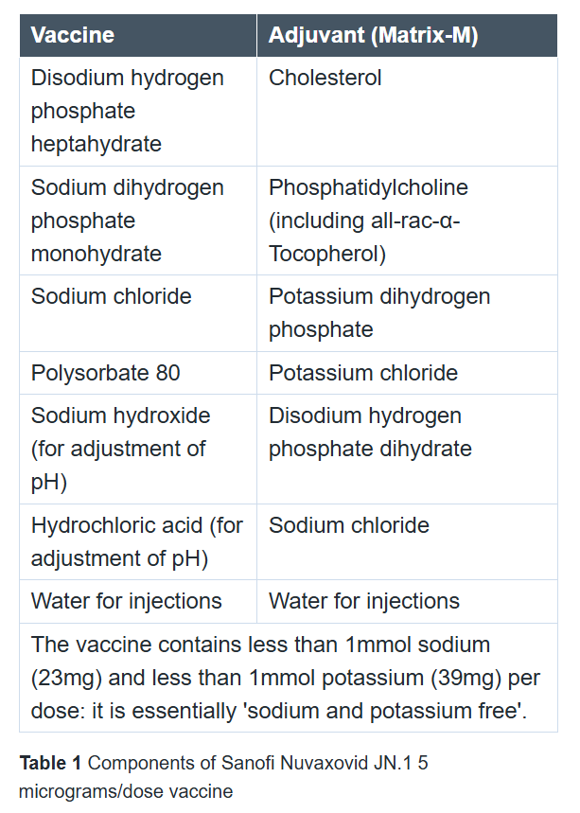
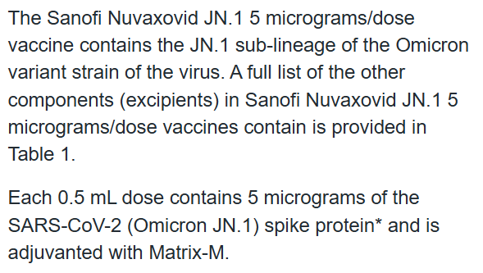
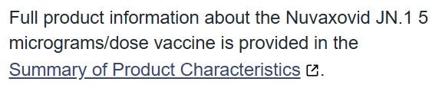
6. Vaccine specific information

Slide 72

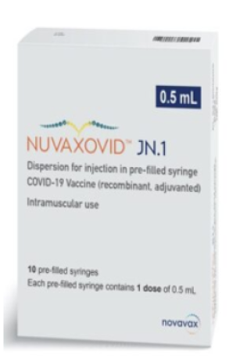
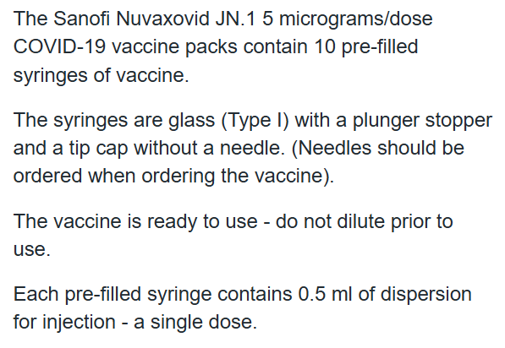
6. Vaccine specific information

Slide 73

6. Vaccine specific information
The vaccine is supplied refrigerated within a temperature range of +2°C and +8°C.
It can be stored for 9 months at this temperature range, protected from light.
It must be transferred immediately to a vaccine fridge upon delivery and stored (within the outer carton to protect it from light) within a carefully monitored temperature range of +2°C and +8°C.
The vaccine syringe should (only) be removed from the carton in the refrigerator immediately before use.
Stability data if the storage conditions are not met has not been provided.

Slide 74

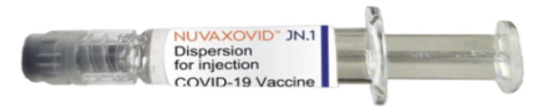
6. Vaccine specific information
Preparation
Do not shake the pre-filled syringe.
Each pre-filled syringe contains a colourless to slightly yellow, clear to mildly opalescent dispersion free from visible particles.
Visually inspect the contents of the pre-filled syringe for visible particulate matter and/or discolouration prior to administration. Do not administer the vaccine if either are present.
Do not use the pre-filled syringe if the tip cap has been removed or is missing.
Do not use the pre-filled syringe if it leaks or there are any visible cracks.
Use a sterile needle of the appropriate size for intramuscular injection.
Handling carefully to ensure the sterility of the needle and the contents of the syringe, remove the tip cap by slowly turning the cap counterclockwise and attach a needle appropriate for intramuscular injection, by twisting the needle in a clockwise direction until it fits securely on the syringe.
Uncap the needle when ready for administration.
Dose
The amount to be given for each dose of Nuvaxovid JN.1 5 micrograms/dose COVID-19 vaccine is 0.5mL. This is the entire volume contained within one pre-filled syringe. Administer the entire dose intramuscularly, preferably in the deltoid muscle of the upper arm.

Slide 75
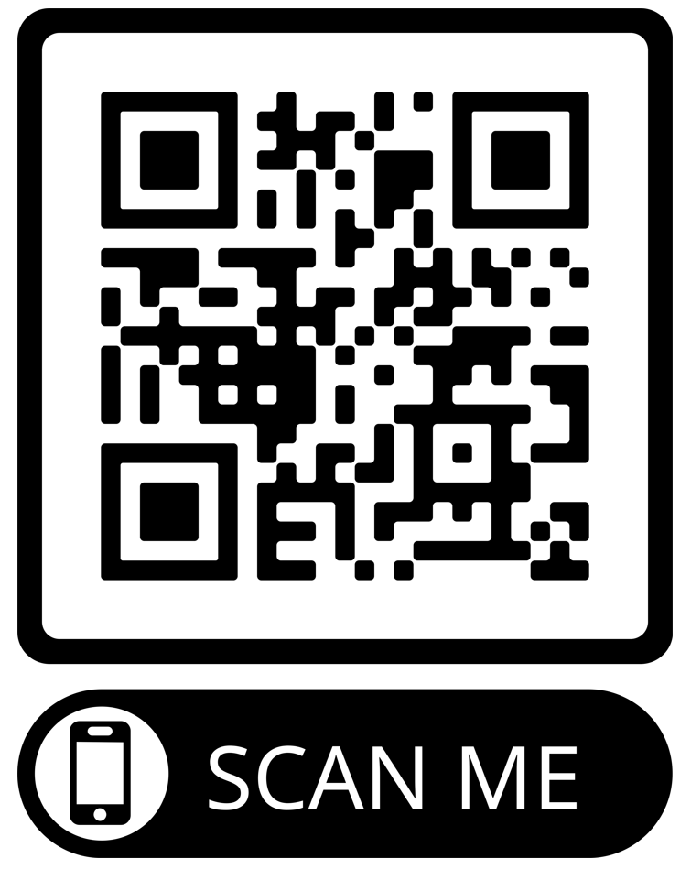

Reporting Adverse Reactions
Suspected adverse reactions or suspected side effects should be reported to the MHRA through the online Yellow Card COVID-19 | Making medicines and medical devices safer (mhra.gov.uk) or the Yellow Card app
The COVID-19 vaccines carry a black triangle symbol (▼) (as do all vaccines during the earlier stages of their introduction). This is to encourage reporting of all.
Anyone (patients and health care workers) can make a Yellow Card report, even if they are uncertain as to whether a vaccine caused the condition suspected adverse reactions
The QR code can be used for quick and easy access to the Yellow Card COVID-19 reporting site

Slide 76
Further information
UK vaccine policy can be found in the online publication commonly referred to as the
"Green Book" . This can be found on the Immunisation page of the GOV.UK website
Green Book recommendations are based upon JCVI’s expert opinion and should
always be followed, even when they differ from those made by the vaccine
manufacturer.
UKHSA COVID-19 vaccination: information for healthcare practitioners - GOV.UK (www.gov.uk)
This document provides additional information, answers to frequently asked questions
and actions to take in the event of inadvertent errors.
It is important to read this document before you start vaccinating and also to refer to the
online version regularly as it will be updated as more information becomes available
and to address any issues or frequently arising questions as COVID-19 vaccines are
delivered more widely.
Notes:
COVID-19 vaccination: information for healthcare practitioners - GOV.UK (www.gov.uk)

Slide 77
Further information (continued)
E learning resources: NHSE elfh Hub (e-lfh.org.uk)
Professional information | HSC Public Health Agency (hscni.net)
DoH CMO policy letter spring 2026:HSS MD 07 2026 - END OF COVID-19 2025 26 CAMPAIGN AND DETAILS OF SPRING 2026 VACCINATION CAMPAIGN.pdf
COVID-19: vaccinator competency assessment tool - GOV.UK (www.gov.uk)
COVID-19 vaccination programme - GOV.UK (www.gov.uk)
Notes:
JCVI Advice:
JCVI statement on COVID-19 vaccination in 2025 and spring 2026 - GOV.UK
DoH HSS CMO Policy Letter:
HSS(MD) 23 2025 - AUTUMN 2025 COVID-19 VACCINATION CAMPAIGN.pdf
PHA Operational Planning Letter:
Autumn-25-26-Flu-Covid-19-Programme-PHA-OPERATIONAL-LETTER-08092025.pdf

