Slide 1
COVID-19 Vaccination programme for
Young People and Children
Northern Ireland
Acknowledgments to UKHSA for use of their training resources
These slides are provisional – subject to revision
Notes:
Acknowledgments to the UK Health Security Agency (UKHSA)

Slide 2
Content
Learning objectives, key messages and introduction
COVID-19 symptoms and complications
COVID-19 in children
COVID-19 vaccines
COVID-19 vaccination programme for children
Consent for vaccination and addressing concerns
Vaccine specific information
Supporting children and further information
Notes:
Advice:
JCVI statement on COVID-19 vaccination in 2025 and spring 2026 - GOV.UK
DoH HSS CMO Policy Letter:
HSS(MD) 23 2025 - AUTUMN 2025 COVID-19 VACCINATION CAMPAIGN.pdf
PHA Operational Planning Letter:
Autumn-25-26-Flu-Covid-19-Programme-PHA-OPERATIONAL-LETTER-08092025.pdf

Slide 3
1. Learning objectives
By the end of this session, you should be able to:
explain what COVID-19 is and be aware of common symptoms / symptom progression
understand the COVID-19 vaccination programme for children and young people (6 month – 17 year olds)
understand how to communicate key facts in response to questions from children and their parents, and direct them to additional sources of information
describe the key principles of how to correctly store, prepare and administer COVID-19 vaccines which have been authorised for use in Northern Ireland (NI) children’s vaccination programmes

Slide 4
Pre-requisites to administering COVID-19 vaccine
Before administering COVID-19 vaccine, it is recommended you:
have undertaken training in the management of anaphylaxis and Basic Life Support as specified by policy for your local area and are familiar with Resuscitation Council UK (RCUK) guidance on Management of Anaphylaxis in the Vaccination Setting
have undertaken any additional statutory and mandatory training as required by your employer
have received COVID-19 vaccine training through attending a taught session and/or the eLearning for Healthcare COVID-19 vaccine e-learning programme Immunisation - elearning for healthcare (e-lfh.org.uk)
have received practical training in COVID-19 vaccine preparation and administration
have completed the COVID-19 vaccinator competency assessment tool
have an understanding of the legal mechanisms by which immunisers can supply and administer COVID-19 vaccine
have an appropriate legal framework to supply and administer COVID-19 vaccine in place e.g. patient specific prescription, Patient Specific Direction (PSD) or Patient Group Direction (PGD) and be able to recognise the differences between these and understand which staff can use each of these
be able to describe the process of consent and how this applies when giving vaccines
accessed and familiarised yourself with the following key documents: Green Book COVID-19 chapter and the PHA Healthcare professional factsheet COVID-19 immunisation programme
Notes:
COVID-19: vaccinator competency assessment tool - GOV.UK (www.gov.uk)

Slide 5
Key messages
vaccination to prevent COVID-19 has been a key measure to protect those who are at highest risk from serious illness and death
scientists across the world have worked to develop vaccines which have then been rigorously tested for safety and efficacy
it continues to be crucial that the COVID-19 vaccine is safely and effectively delivered to as many of those eligible as possible
those with a role in delivering the COVID-19 vaccine programme need to be knowledgeable, confident and competent in order to promote confidence in the vaccination programme and deliver the vaccine safely

Slide 6
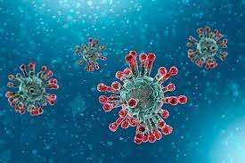
COVID-19 (SARS-CoV-2): the disease
COVID-19 is the disease that is caused by infection with the SARS-CoV-2 virus which belongs to the Coronavirus family
      - SARS-CoV-2 stands for Severe Acute Respiratory Syndrome (SARS) and CoV for coronavirus
      - COVID-19 stands for Coronavirus Disease and 19 is from the year 2019 when it was first seen
SARS-CoV-2 virus is the most recently discovered coronavirus and has now affected many countries globally
because of the global spread and the substantial number of people affected, the World Health Organisation (WHO) declared COVID-19 as a pandemic on 11/03/2020 (Pan (all) demos (people))
Notes:
COVID-19: the green book, chapter 14a - GOV.UK (www.gov.uk)

Slide 7
Viral infection
viruses are much smaller than bacteria and consist of a small amount of either DNA or RNA surrounded by a protein coat called a capsid
viruses cannot replicate themselves, but need to seek out the replication mechanism contained within a host cell
examples of vaccine preventable viral diseases include measles, mumps, rubella, influenza, hepatitis A and B
Influenza viruses, which are RNA viruses, are constantly mutating into slightly different forms, which is why we need to produce and give different flu vaccines every year
SARs-CoV-2 is an RNA virus
Notes:
NHSE elfh Hub (e-lfh.org.uk)

Slide 8
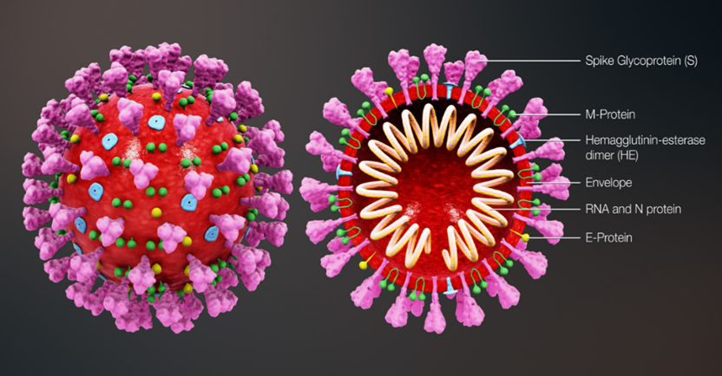
Coronavirus structure
the key parts of the coronavirus are the RNA and the spike proteins
the RNA is surrounded by an envelope which has different roles in the life cycle of the virus. These may include the assembly of new virus and helping new virus to leave the infected cell
the spike proteins (S) are anchored into the viral envelope and form a crown like appearance, like the solar corona, hence the name coronavirus. The spike proteins attach to the target cell and allow the virus to enter it
the RNA is inside the envelope and acts as a template
so that once it is inside the host cell, the coronavirus
can replicate itself and be released into the body
the Spike protein and the RNA have been used to
develop and make different vaccines to protect
against SARs-CoV-2
Notes:
Diagram of coronavirus virion structure showing spikes that form a "crown" like the solar corona, hence the name
https://commons.wikimedia.org/wiki/File:3D_medical_animation_coronavirus_structure.jpg

Slide 9
COVID-19: variants
all viruses change over time
mutations are changes to the genetic structure (RNA) of the virus and the means by which it adapts to survive
most mutations have little effect on the properties of the virus or its impact, however, some mutations have the potential to
    increase how easily the virus spreads
    cause more severe disease
    escape immunity (the immune response is in some way less effective)
    be less susceptible to the effects of the available vaccines, treatments or other public health and social measures
the original (sometimes termed wildtype or ancestral) SARS-CoV-2 virus has mutated, producing new variants, for example the Alpha, Delta, and Omicron variants
within a variant there may also be sub-variants, for instance, Omicron BA.1, BA.4, BA.5, XBB 1.5 and BA.2.86
Notes:
Overall, Omicron and subvariants of Omicron, have been shown to cause less severe disease than the previous strains, albeit on a background of a population with immunity due to vaccination and previous infection.
Between January and July 2023, successive strains of the Omicron sub-lineage denoted XBB have emerged and have not been associated with any major increases in incidence. A novel strain, denoted BA.2.86 was first detected in August 2023 with a very divergent genome from the predominant XBB strains.
Information on new variants under investigation is available at: SARS-CoV-2 variants of public health interest - GOV.UK (www.gov.uk)

Slide 10
Transmission of COVID-19 infection
For transmission to occur, the SARs-CoV-2 virus needs to be transported to a susceptible person. To do this, it needs to have:
a portal of exit (from the place where it is living and replicating)
a mode of transmission (such as coughing or sneezing) and
a portal of entry (to the susceptible host).
COVID-19 spreads primarily from person to person through small droplets and aerosols from the nose or mouth which are expelled when a person with COVID-19 coughs, sneezes, or speaks.
Droplets can also survive on objects and surfaces such as tables, doorknobs and handrails. However, fomites appear to play a minor role in transmission.
People can catch COVID-19 if they breathe in droplets or aerosols from a person infected with the virus, or by touching contaminated objects or surfaces, then touching their eyes, nose or mouth.
Secondary attack rates within households are high.
Notes:
Viral RNA can persist in respiratory samples for 7-12 days after symptom onset, and viral loads are highest soon after symptom onset.
COVID-19: the green book, chapter 14a - GOV.UK (www.gov.uk)

Slide 11
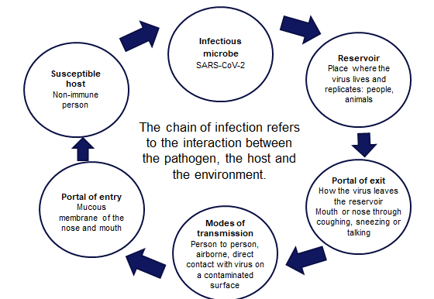
COVID-19: Chain of infection

Slide 12
2. COVID-19: symptoms and complications

Slide 13
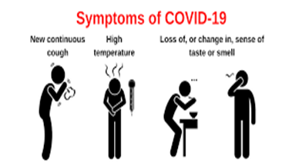
COVID-19: symptoms
The incubation period is 5 to 6 days but can vary between 1 and 14 days.
The symptoms of COVID-19 and other respiratory infections are very similar, they include:
new or continuous cough
high temperature, fever or chills
loss or change to sense of smell or taste
fatigue, lethargy and unexplained tiredness
shortness of breath
headache
sore throat
stuffy or runny nose
aching muscles
diarrhoea and vomiting
loss of appetite
Notes:
Symptoms of respiratory infections including COVID-19 | nidirect

Slide 14
COVID-19: symptom progression & complications
symptoms may begin gradually and are usually mild
the majority of people have asymptomatic to moderate disease and recover without needing hospital treatment
in severe cases, COVID-19 can lead to pneumonia, acute respiratory distress syndrome, multiple organ failure and death
older people and those with underlying medical problems such as high blood pressure, heart and lung problems, diabetes and cancer have an increased risk of severe disease
the risk of dying with COVID-19 is highest in the elderly, notably those aged 75 years and over
Notes:
Complications from COVID-19 can be severe and fatal, complications include:
venous thromboembolism
heart, liver and kidney problems
neurological issues
coagulation (blood clotting) failure
respiratory failure
multiple organ failure
septic shock.
COVID-19: the green book, chapter 14a - GOV.UK (www.gov.uk)
NHSE elfh Hub (e-lfh.org.uk)

Slide 15
3. COVID-19 in children

Slide 16
COVID-19:
Symptoms in children and young people
in general children appear to exhibit asymptomatic or mild disease
although cough and fever are the main symptoms in children, symptoms may be non-specific and atypical, affecting other organ systems, for example, gastrointestinal symptoms have been reported
the majority of children recover completely after acute SARS-CoV-2 infection and any persistent symptoms improve with time
initial evidence suggested that children had a lower susceptibility to SARS-CoV-2 infection, and they were unlikely to be key drivers of transmission at a population level. However, following the emergence and rapid spread of the Omicron variant and subvariants since November 2021, studies now show nearly all children in the UK have antibodies against SARS-CoV-2; mostly due to natural infection in the youngest age groups
Notes:
In one study, 11% of children and adolescents presented with fatigue, headache, myalgia, sore throat, lymphadenopathy and a low platelet count.
COVID-19 greenbook chapter 14a (publishing.service.gov.uk)

Slide 17
COVID-19 Complications: children and young people (1)
severe COVID-19 requiring hospitalisation is rare in children and deaths even more so, with an infection fatality ratio of less than 1 in 100,000 infections in 0-19 year-olds
a rare but severe multisystem inflammatory syndrome (MIS-C) occurring 2 to 4 weeks after the onset of COVID-19 has been identified in children and adolescents
known as ‘Paediatric multisystem inflammatory syndrome temporally associated with SARS-CoV-2 infection’ (PIMS-TS), this severe presentation encompasses a wide range of features, including fever, gastrointestinal symptoms, rash, myocardial injury and shock
PIMS-TS shares features with Kawasaki disease and toxic shock syndrome and can present in both the acute and convalescent phases of COVID-19 infection
Notes:
Bertran M, Amin-Chowdhury Z, Davies HG et al, 2022. COVID-19 deaths in children and young people in England, March 2020 to December 2021: An active prospective national surveillance study.
COVID-19 Greenbook chapter 14a (publishing.service.gov.uk)

Slide 18
COVID-19 Complications: children and young people (2)
PIMS-TS risk in the UK has declined as the virus has mutated from the original SARS-CoV-2 strain, and as natural and vaccine-induced immunity has increased against the virus in children
other complications from COVID-19 in children and young people include fever, cardiac symptoms (myocarditis, heart failure) and GI symptoms (abdominal pain, diarrhoea, vomiting)
serious long-term complications after recovering from acute SARS-CoV-2 infection are rare in children
Notes:
Cohen JM, Carter MJ, Ronny Cheung C, et al, 2022. Lower Risk of Multisystem Inflammatory Syndrome in Children (MIS-C) with the Delta and Omicron variants of SARS-CoV-2.
Shingleton J, Williams H, Oligbu G, et al, 2022. The changing epidemiology of PIMS-TS across COVID-19 waves: prospective national surveillance, January 2021 to July 2022, England.

Slide 19
Long COVID
for some individuals, COVID-19 can cause symptoms that last weeks or months after the infection has gone. This is sometimes called post-COVID-19 syndrome or ‘long COVID’
although many people feel better in a few days or weeks and most will make a full recovery within 12 weeks, for some people, symptoms can last longer
long COVID or Post-Acute Sequelae of SARS-CoV-2 (PASC) infection, are an area of ongoing study in the UK
reported symptoms are varied, involving most organ systems and affecting both physical and mental health
a review conducted by the UK Health Security Agency (UKHSA) found that having COVID-19 vaccine reduces the chances of having Long COVID
Notes:
Up to one in three people who have had COVID-19 report long COVID symptoms | NIHR
UKHSA review shows vaccinated less likely to have long COVID than unvaccinated - GOV.UK (www.gov.uk)

Slide 20
4. COVID-19 vaccines

Slide 21
COVID-19: vaccines for children and young people
COVID-19 vaccines currently authorised for use in the Northern Ireland children’s COVID-19 vaccination programme Spring 2026 include:
Pfizer-BioNTech Comirnaty® 30 LP.8.1 30 micrograms/dose
Licensed for vaccination of adolescents from the age of 12 years
But strictly for use in those aged 12-17 years old only
*Should an mRNA vaccine be deemed not clinically suitable, then Nuvaxovid JN.1 can be given*
Pfizer-BioNTech Comirnaty® 10 LP.8.1 10 micrograms/dose
Licensed for children from 5 to 11 years of age
Pfizer-BioNTech Comirnaty® 3 LP.8.1 3 micrograms/dose
Licensed for children from 6 months to 4 years of age.

Slide 22
COVID-19: mRNA vaccines (BioNTech-Pfizer)
the Pfizer-BioNTech COVID-19 (Comirnaty) vaccines are messenger ribonucleic acid (mRNA) vaccines
they contain the genetic sequence (mRNA) for the spike protein which is found on the surface of the SARS-CoV-2 virus, wrapped in a lipid envelope (referred to as a nanoparticle) to enable it to be transported into the cells in the body
when injected, the mRNA is taken up by the host’s cells which translate the genetic information and produce the spike proteins
these are then displayed on the surface of the cell. This stimulates the immune system to produce antibodies and activate T-cells which prepare the immune system to respond to any future exposure to the SARS-CoV-2 virus by binding to and disabling any virus encountered
as there is no whole or live virus involved, the vaccine cannot cause disease. The mRNA naturally degrades after a few days

Slide 23
Variant vaccines
following the recognition of the Omicron variant becoming the dominant global circulating strain during 2021, many vaccine manufacturers rapidly developed second generation vaccines that may have broader coverage against SARS-CoV-2 variants
so far, the emergence of new variants has been too rapid to enable incorporation of a new strain in time to pre-empt an increase in disease. In late 2022, incidence was largely driven by infection with Omicron BA.4 and BA.5
variant vaccines which use a well established format, such as mRNA vaccines, have been licensed on the basis of immunobridging - i.e. by showing non-inferiority of the neutralising antibody response to the ancestral strain, with potentially higher neutralising antibody response to the variant strain
in the early summer of 2023, based on emerging evidence of superior immunogenicity against matched strains with good evidence of back-boosting against historic strains, regulators expressed a preference for moving from bivalent to monovalent variant vaccines. Monovalent XBB mRNA vaccines produced by Pfizer BioNTech and Moderna were approved and available for use by October 2023
mRNA vaccines targeting the JN.1 subvariant were approved for use in July and September 2024. The approved vaccine subvariants for Spring 2026 is LP.8.1.

Slide 24
Interval between COVID-19 vaccines and COVID-19 infection
there are no safety concerns from vaccinating individuals with a past history of COVID-19 infection, or with detectable COVID-19 antibody
vaccination of individuals who may be infected or asymptomatic or incubating COVID-19 infection is unlikely to have a detrimental effect on the illness
there is no need to defer immunisation in individuals after recovery from a recent episode with compatible symptoms who were not tested for COVID-19
having prolonged COVID-19 symptoms is not a contraindication to receiving COVID-19 vaccine but if the patient is seriously debilitated, still under active investigation, or has evidence of recent deterioration, deferral of vaccination may be considered to avoid incorrect attribution of any change in the person’s underlying condition to the vaccine

Slide 25
Co-administration of COVID-19 and other vaccines (1)
initially data on co-administration of COVID-19 with other vaccines was limited, in the absence of such data first principles would suggest that interference between inactivated vaccines with different antigenic content is likely to be limited
there is no evidence of any safety concerns, although it may make the attribution of any adverse events more difficult
as COVID-19 vaccines are considered inactivated, where individuals in an eligible cohort present having recently received one or more other inactivated or a live vaccine, COVID-19 vaccination should still be given. The same applies for other live and inactivated vaccines where COVID-19 vaccination has been received first or where a individual presents requiring two or more vaccines
live vaccines which replicate in the mucosa, such as live attenuated influenza vaccine (LAIV) are unlikely to be seriously affected by co-administration with COVID-19 vaccination

Slide 26
Co-administration of COVID-19 and other vaccines (2)
it is generally better for vaccination to proceed to avoid any further delay in protection and to avoid the risk of the patient not returning for a later appointment
where co-administration does occur, patients should be informed about the likely timing of potential adverse events relating to each vaccine
if the vaccines are not given together, they can be administered at any interval, although separating the vaccines by a day or two will avoid confusion over systemic side effects

Slide 27
Contraindications to COVID-19 vaccines
the COVID-19 BioNTech-Pfizer (Comirnaty) vaccines should not be given to people who have had a confirmed anaphylactic reaction to the vaccine or any components of the vaccine. Expert advice should be sought where either contraindication is present
polyethylene glycol (PEG) is an allergen commonly found in medicines and also in household goods and cosmetics. Known allergy to PEG is extremely rare but may contraindicate receipt of Pfizer BioNTech (Comirnaty) vaccines. Expert advice should be obtained and if a decision is made to administer an mRNA vaccine, then this should only be done in hospital under medical supervision
there is now evidence that many individuals with initial apparent allergic reaction to an mRNA vaccine can tolerate a second dose of the same vaccine. Where there were no objective signs of anaphylaxis and symptoms rapidly resolved (with no more than 1 dose of IM adrenaline), a further dose of the same vaccine can be given*. If the reaction might have been anaphylaxis, obtain expert advice
Notes:
*if a decision is made to administer the same vaccine, then this should be done under medical supervision in the hospital setting.
Anaphylaxis can be a rare risk of most vaccines and it is important that health professionals are vigilant in watching for the early signs and initiate prompt treatment, as occurred in these cases. The vast majority of people will not be at risk of anaphylaxis after being administered the Pfizer BioNTech vaccines.

Slide 28
Precautions to COVID-19 vaccines (1)
it is recommended recipients of the COVID-19 BioNTech-Pfizer (Comirnaty) vaccines should be kept for observation and monitored for a minimum of 15 minutes. In recognition of the need to accelerate delivery of the COVID-19 vaccination programme in response to the emergence of the Omicron variant, the UK Chief Medical Officers recommended a permanent suspension of this requirement (doh-hss-md-21-2022.pdf (health-ni.gov.uk)
the exceptions to this 15 minute suspension are:
individuals with a strong history of dangerous or unexplained allergic reactions (e.g. anaphylaxis)
the Commission on Human Medicines is also content to support the permanent lifting of the 15 minute observation requirement for individuals without a history of allergy
facilities for management of anaphylaxis should be available at all vaccination sites
Notes:
Following COVID-19 vaccine administration, individuals should be observed for any immediate reactions whilst they are receiving any verbal post vaccination information and exiting the centre.
Suspension of the 15-minute wait for vaccination with mRNA vaccine for COVID-19: UK CMOs' opinion - GOV.UK (www.gov.uk)

Slide 29
Precautions to COVID-19 vaccines (2)
individuals with a localised urticarial (itchy) skin reaction (without systemic symptoms) to the first dose of a COVID-19 vaccine should receive the second dose of vaccine with prolonged observation (30 minutes) in a setting with full resuscitation facilities (e.g. a hospital)
individuals with non-allergic reactions (vasovagal (fainting) episodes, non-urticarial skin reaction or non-specific symptoms) can receive the second dose of vaccine in any vaccination setting

Slide 30
Side effects of COVID-19 vaccination
vaccines can cause side effects (these can be also referred to as adverse reactions). Side effects happen because vaccines work by triggering an immune system response. Most side effects are mild and only last a few days
very common side effects include: having a painful, heavy feeling and tenderness in the arm where you had the injection; feeling tired; a headache; general aches, chills, or flu like symptoms
mild fever can last for two to three days after the vaccination but a high temperature is unusual
children and young people may also have flu like symptoms with episodes of shivering and shaking for up to 2 days (oral paracetamol can be administered following vaccination, follow the dose advice in the packaging)
an uncommon side effect is swollen glands in the armpit or neck on the same side as the arm where you had the vaccine. This can last for around 10 days, but if it lasts longer seek medical advice

Slide 31
Local reactions at the vaccination site
the MHRA have received reports of skin reactions occurring around the vaccination site and extensive swelling of the vaccinated limb
the majority of the reports received have been following the Moderna (Spikevax®) and Pfizer BioNTech (Comirnaty®) vaccines
the reactions are characterized by a rash, swelling and tenderness that can cover the whole upper arm and may be itchy and/or painful and warm to the touch
the reactions are usually self-limiting and resolve within a day or two, although in some patients it can take slightly longer to disappear
individuals who experience this reaction after their first dose may experience a similar reaction in a shorter timeframe following the second dose, however, none of the reports received by the MHRA have been serious and people should still receive their second dose when invited
those who experience delayed local reactions after their COVID-19 vaccination which do not resolve within a few days should seek medical advice

Slide 32
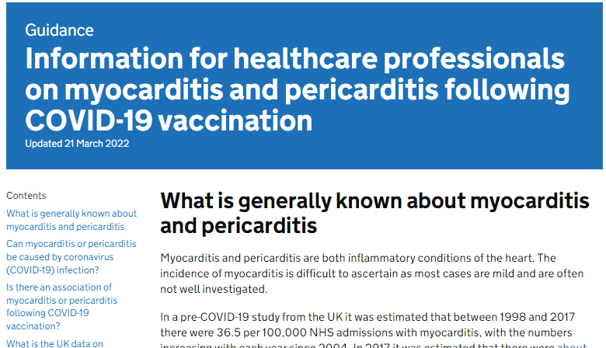
Myocarditis and pericarditis
cases of myocarditis and pericarditis have been reported rarely after the Pfizer BioNTech (Comirnaty®) vaccines
the reported rate appears to be highest in those under 25 years of age and in males, and after the second dose
onset is within a few days of vaccination and most cases are mild and have recovered without any sequelae
those who develop myocarditis or pericarditis following COVID-19 vaccination should be assessed by an appropriate clinician to determine whether it is likely to be vaccine related
subsequent doses should be deferred pending further investigation
Specific information for healthcare professionals is available on the gov.uk website
Notes:
Myocarditis is inflammation of the heart muscle.
Pericarditis is inflammation of the protective thin saclike membrane around the heart (pericardium).
https://www.gov.uk/government/publications/myocarditis-and-pericarditis-after-covid-19-vaccination/myocarditis-and-pericarditis-after-covid-19-vaccination-guidance-for-healthcare-professionals

Slide 33
Guillain-Barré syndrome (GBS)
GBS is a very rare and serious condition that affects the nerves- mainly in the feet, hands and limbs, causing numbness, weakness and pain. In severe cases, GBS can cause difficulty moving, walking, breathing and/or swallowing
very rare reports of GBS following COVID-19 vaccination have been received, however, no causal mechanism with COVID-19 vaccination has been proven, and cases of GBS following vaccination may occur by chance
in those who are diagnosed with GBS after the first dose of vaccine, the balance of risk benefit is in favour of completing a full COVID-19 vaccination schedule. Individuals who have a history of GBS should be vaccinated as appropriate for their age and underlying risk status
as there is no evidence to suggest that having had a prior diagnosis of GBS predisposes an individual to further episodes, in those who are diagnosed with GBS after the first dose of either of the mRNA vaccines, further vaccination can proceed as normal, once recovered

Slide 34
Bell’s Palsy
Bell’s Palsy (BP) is a temporary weakness or paralysis affecting one side of the face that develops gradually; most people recover from this condition within a few months
BP is known to be associated with a number of infectious diseases, including the SARS-CoV-2 virus
whilst reporting of BP following COVID-19 vaccination is rare, the latest available data shows that there may be an increased risk of BP following COVID-19 vaccination
to raise awareness of this potential adverse event amongst healthcare professionals and patients, facial paralysis has been included in the product information for the Pfizer BioNTech COVID-19 vaccines

Slide 35
Immune thrombocytopenia (ITP)
Immune thrombocytopenia (ITP) is a condition where the immune system does not function correctly and attacks and destroys platelets in the blood. Platelets help the blood to clot so this can lead to bruising and bleeding
there is now emerging evidence of a small risk of ITP or ITP relapse following COVID-19 vaccination
to date, this has been reported extremely rarely and the MHRA Yellow Card summary states that this is usually short-lived and of minor severity
previous ITP is not a contraindication for vaccination but guidance produced by the UK ITP Forum Working Party advises discussing the potential for a fall in platelet count in patients with a history of ITP receiving any COVID-19 vaccine and recommends a platelet count check 2 to 5 days after vaccination
Notes:
British Society for Haematology https://b-s-h.org.uk/about-us/news/covid-19-updates/

Slide 36
Menstrual disorders and unexpected vaginal bleeding
the MHRA has continued to review reports of suspected side effects of menstrual disorders and unexpected vaginal bleeding following vaccination against COVID-19 in the UK
these reports are also being reviewed by the independent experts of the Commission on Human Medicines COVID-19 Vaccines Benefit Risk Expert Working Group and the Medicines for Women’s Health Expert Advisory Group
evidence from the most recent review suggested a possible association between the Pfizer BioNTech (Comirnaty®) COVID-19 vaccines and heavy menstrual bleeding
events were mostly non-serious and temporary in nature
the rigorous evaluation completed to date does not support a link between COVID-19 vaccines and other changes to menstrual periods
there is no evidence to suggest that COVID-19 vaccines will affect fertility or the ability to have children
Notes:
Coronavirus vaccine - summary of Yellow Card reporting - GOV.UK (www.gov.uk)

Slide 37
COVID-19 BioNTech-Pfizer vaccines
the vaccine contains mRNA (nucleoside modified, embedded in lipid nanoparticles) encoded to the specific target variant e.g. KP.2, LP.8.1
the vaccine does not contain preservative
the vaccine does not contain latex, milk, lactose, gluten, egg, maize/corn or peanuts
no animal products are used in the manufacture of this vaccine, and does not contain any animal products
Full product information about each BioNTech-Pfizer Comirnaty vaccine can be found in the Summary of Product Characteristics (SmPC) for each vaccine product on the Electronic Medicines Compendium (EMC) website.

Slide 38
Storage and use:
COVID-19 Pfizer BioNTech Comirnaty vaccines
the mRNA Pfizer BioNTech (Comirnaty) vaccine has very specific storage, reconstitution and 'use within' requirements
all those involved in the delivery of the COVID-19 vaccination programme must be aware of the recommended storage requirements, refer to the vaccine product information.
If the vaccine is stored incorrectly:
the vaccines should be labelled and quarantined, the vaccines should not be used until further notice
breaches in the cold-chain should be reported in line with local arrangements, make alternative arrangements for immunisation clinics until resolved
further advice regarding use should be sought from the local Trust’s Pharmacy Department or the regional Medicines Information Service
Vaccine losses outside of secondary care should be reported to the PHA Duty Room (0300 555 0119) for further risk assessment, including whether patients need revaccination following a cold chain breach.
**Do not dispose of any vaccine stock until appropriate advice has been sought**
The vaccine must not be given if you are not confident that it has been stored or reconstituted as recommended by the manufacturer or as advised by a vaccine expert
Notes:
Guidance on vaccine handling and storage in GP practices | HSC Public Health Agency

Slide 39
5. COVID-19 vaccination programme:
Children and young people
Spring 2026

Slide 40
Spring 2026 eligibility
The JCVI have recommended that the COVID-19 vaccine should be offered to the following children and young people:
aged 6 months to 17 years who are immunosuppressed, as defined in tables 3 and 4 of the COVID-19 chapter of the Green Book
Notes:
JCVI Advice:
JCVI statement on COVID-19 vaccination in spring 2024 and considerations on future COVID-19 vaccination, 4 December 2023 - GOV.UK (www.gov.uk)
JCVI statement on COVID-19 vaccination in 2025 and spring 2026 - GOV.UK
DoH HSS CMO Policy Letter:
HSS(MD) 23 2025 - AUTUMN 2025 COVID-19 VACCINATION CAMPAIGN.pdf
PHA Operational Planning Letter:
Autumn-25-26-Flu-Covid-19-Programme-PHA-OPERATIONAL-LETTER-08092025.pdf

Slide 41
Primary COVID-19 vaccination
Only those who currently meet the eligibility criteria for a COVID-19 vaccination during the Spring 2026 programme continue to be eligible for a primary vaccination.
For the Spring 2026 Programme, the primary course consists of a single dose of COVID-19 vaccine. Further details regarding exceptions to this advice, are outlined in the COVID-19 Greenbook chapter 14a.
Those in the eligible groups who have not yet come forward for primary vaccination may attend any vaccination provider to be vaccinated.
Notes:
JCVI Advice:
JCVI statement on COVID-19 vaccination in spring 2024 and considerations on future COVID-19 vaccination, 4 December 2023 - GOV.UK (www.gov.uk)
JCVI statement on COVID-19 vaccination in 2025 and spring 2026 - GOV.UK
DoH HSS CMO Policy Letter:
HSS(MD) 23 2025 - AUTUMN 2025 COVID-19 VACCINATION CAMPAIGN.pdf
PHA Operational Planning Letter:
Autumn-25-26-Flu-Covid-19-Programme-PHA-OPERATIONAL-LETTER-08092025.pdf.gov.uk)

Slide 42
Children (6 months – 4 years old)
On 3 May 2023, the JCVI recommended that children aged 6 months to 4 years in a clinical risk group should be offered two primary paediatric doses of the Pfizer BioNTech Comirnaty 3 micrograms/dose vaccine with an interval of eight weeks between each dose.
Details of risk groups for 6 month – 4 year olds is provided in the Green Book COVID-19 chapter 14a
From autumn 2023, JCVI advises that children aged 6 months to 4 years should continue to receive two primary doses of vaccine. Children who remain eligible should receive doses of vaccine during a seasonal campaign, at a minimum interval of three months from their previous dose.
Notes:
COVID-19 vaccination of children aged 6 months to 4 years: JCVI advice, 9 December 2022 (updated 26 April 2023) - GOV.UK (www.gov.uk)

Slide 43
Severely immunosuppressed children and young people
  some children who are immunosuppressed due to underlying health conditions or medical treatment may not mount a full immune response to COVID-19 vaccination
  the JCVI therefore recommends that children and young people aged 6 months to 17 years who are severely immunosuppressed may be considered for additional doses at an interval of three months from the previous dose
  definitions of severe immunosuppression and details of timings of additional doses are described in the COVID-19 chapter of the Green Book COVID-19 Greenbook chapter 14a (publishing.service.gov.uk)
  in contrast to other eligible risk groups, those who are eligible for vaccination due to severe immunosuppression who miss vaccination during the campaign period, may be considered for a booster at a later date based on individual clinical judgement, balancing their immediate level of risk against the advantages of waiting till the next seasonal campaign

Slide 44
6. Consent for vaccination and addressing concerns

Slide 45
Consent for vaccination
at 16 years of age, a young person is presumed in law to have the capacity to consent, so young people aged 16 or 17 years should consent to their own medical treatment and a parent cannot override that consent
children under 16 can consent for themselves if they have the capacity and maturity to understand what they are consenting to and fully understand what is involved in the proposed procedure (this is referred to as ‘Gillick competence’)
although they can give their own consent, it is advised that ideally, the parents of those under 16 are involved in the consent process
however, if a Gillick-competent child consents to vaccination, a parent cannot override that consent and if a Gillick-competent child refuses vaccination, that refusal should be accepted

Slide 46
Gillick competence
For a young person under the age of 16 to be Gillick competent, they should have:
the ability to understand that they have a choice and that choices have consequences
the ability to understand any information given and arrive at a decision
a willingness to make a choice (including the choice that a parent or guardian should make the decision)
an understanding of the nature and purpose of vaccination
an understanding of any risks and side effects of vaccination and any risks of not being vaccinated
freedom from any undue pressure.

Slide 47
Addressing concerns and providing information to those being vaccinated
the COVID-19 vaccines are new vaccines. Patient information leaflets will be provided in advance but many individuals will want additional verbal reassurance or answers
it is important to read the information being made available to vaccinees so the information you give is consistent with this and so you know what information they have already had
it is also important to know where to direct individuals to for further information
if people’s questions and concerns are answered accurately and appropriately, they are more likely to accept vaccination
Notes:
As the COVID-19 vaccines are new vaccines, it is likely that people will have a lot of questions. Although they will be provided with patient information leaflets in advance of their immunisation appointment, many may not have read this or will want additional verbal reassurance or answers from you.
See Resources section for additional sources of information about the COVID-19 vaccine programme.

Slide 48
Addressing concerns: general principles
give the individual/parent/carer time to ask questions
find out the basis for their concerns
explore the nature and sources of information they have already gathered
check the individuals/parents/carers personal experience
provide them with other sources of information such as valid and reliable websites
check their understanding of the information that you provide
ask them if there are any more concerns
if they decline to be vaccinated, suggest talking again in a couple of days/weeks if appropriate
recommend immunisation

Slide 49
7. Vaccine-specific information

Slide 50
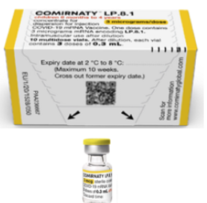
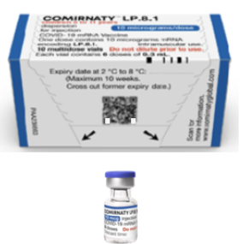
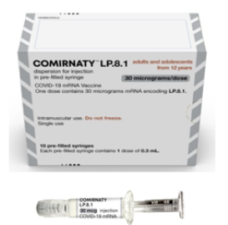
Age-specific vaccine recommendations
Infants aged 6 months - 4 years:
Pfizer-BioNTech Comirnaty 3 LP.8.1
Dose: 3 micrograms/dose
3 dose vial
Children aged 5 - 11 years:
Pfizer-BioNTech Comirnaty 10 LP.8.1
Dose: 10 micrograms/dose
Single dose vial
Children and Adolescents aged 12-17:
Pfizer-BioNTech Comirnaty 30 LP.8.1
Dose: 30 micrograms/dose
Single dose prefilled syringe

Slide 51
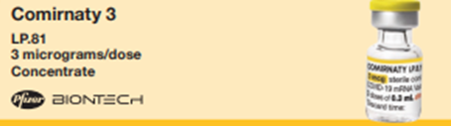
Children aged between 6 mths – 4 yrs
Pfizer BioNTech Comirnaty 3
LP.8.1
3 micrograms/dose (infant formulation)
a single dose is 0.3mL
Group | Recommendation (dose)
Children aged 6 months to 4 years who are who are immunosuppressed, as defined in tables 3 and 4 of the COVID-19 chapter of the Green Book | Primary: offer two doses of Comirnaty LP.8.1 3 micrograms/dose vaccine with an interval of 3 months between doses Booster: offer a single dose of Comirnaty LP.8.1 3 micrograms/dose vaccine at least 3 months from a previous COVID-19 vaccine dose

Slide 52
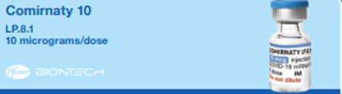
Children aged between 5 – 11 years
Pfizer BioNTech Comirnaty 10
LP.8.1
10 micrograms/dose (paediatric formulation)
a single dose is 0.3 mL
Group | Recommendation (dose)
Children aged 5 to 11 who are who are immunosuppressed, as defined in tables 3 and 4 of the COVID-19 chapter of the Green Book | Offer a single dose of Comirnaty LP.8.1 10 micrograms/dose vaccine
Notes:
Healthy children aged between 5 – 17 years will no longer be eligible to receive COVID-19 vaccination after the end of the Spring 2023 programme.
The paediatric formulation of the Pfizer BioNTech monovalent vaccine Comirnaty® LP.8.110mcg/dose became available from August 2024.

Slide 53
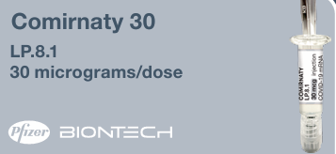
Children / young people aged 12–17 years
Pfizer BioNTech Comirnaty 30
LP.8.1
30 micrograms/dose (12 – 17 years old ONLY)
a single dose is 0.3 mL
Group | Recommendation (dose)
Children and young people aged 12 to 17 who are who are immunosuppressed, as defined in tables 3 and 4 of the COVID-19 chapter of the Green Book | Offer a single dose of Comirnaty LP.8.1 30 micrograms/dose vaccine
Notes:
Healthy children aged between 5 – 17 years will no longer be eligible to receive COVID-19 vaccination after the end of the Spring 2023 programme (30/06/2023).

Slide 54

COVID-19 vaccine:
Pfizer-BioNTech Comirnaty 3 LP.8.1
3 micrograms/dose
(paediatric formulation
6 months to 4 years)
**DILUTION REQUIRED**

Slide 55

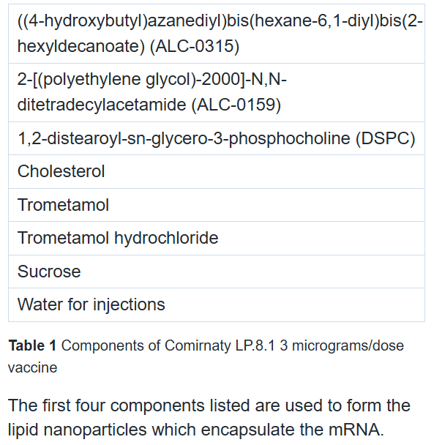
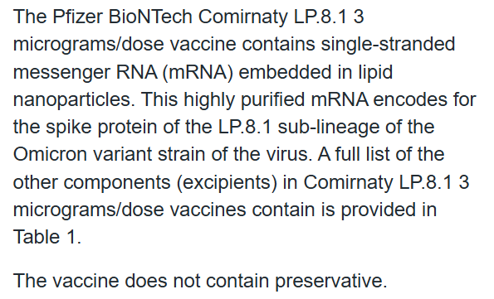
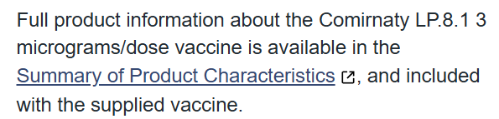
Notes:
*The mRNA encoding LP.8.1 is a single-stranded, 5'-capped messenger RNA (mRNA) produced using a cell-free in vitro transcription from the corresponding DNA templates, encoding the viral spike (S) protein of SARS-CoV-2 (Omicron LP.8.1).
Comirnaty LP.8.1 3 micrograms/dose concentrate for dispersion for injection, 3-dose vial - Summary of Product Characteristics (SmPC) - (emc) | 101152

Slide 56

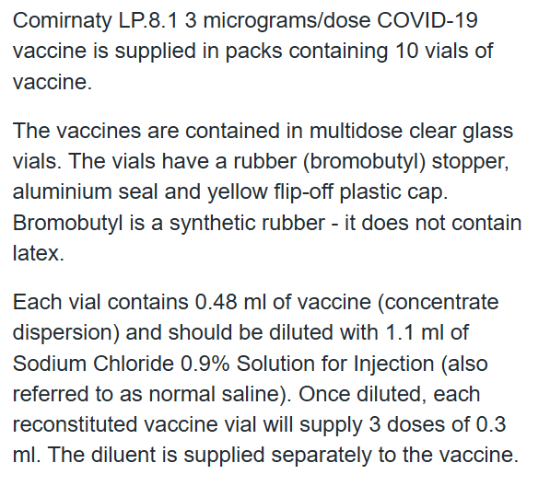
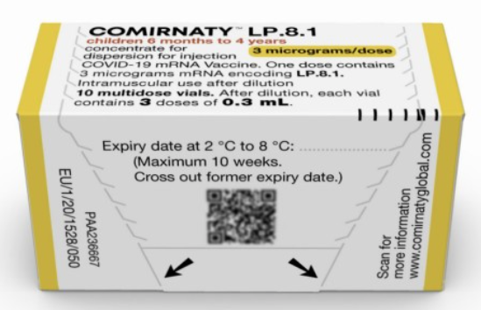
Notes:
*The mRNA encoding LP.8.1 is a single-stranded, 5'-capped messenger RNA (mRNA) produced using a cell-free in vitro transcription from the corresponding DNA templates, encoding the viral spike (S) protein of SARS-CoV-2 (Omicron LP.8.1).
Comirnaty LP.8.1 3 micrograms/dose concentrate for dispersion for injection, 3-dose vial - Summary of Product Characteristics (SmPC) - (emc) | 101152

Slide 57

Whilst the Comirnaty LP.8.1 3 micrograms/dose vaccines can be stored frozen for 18 months at temperatures between -90°C and -60°C, they will be delivered to vaccination sites in a thawed state.
Refrigerated vaccine must be transferred immediately to a vaccine fridge on arrival and stored within a carefully monitored temperature range of +2°C and +8°C.
Once thawed, the vaccine should not be re-frozen.
When removed from the freezer, thawed, unopened, undiluted Comirnaty LP.8.1 3 micrograms/dose vaccines have a maximum shelf life of up to 10 weeks at temperatures of +2°C to +8°C within the 18 month shelf life.
When the vaccines are received at +2°C to +8°C the expiry date on the outer carton should have been updated to reflect the refrigerated expiry date (10 weeks after removal from the freezer) and the original expiry date should have been crossed out.
Prior to use, unopened Comirnaty 3 micrograms/dose vaccines may be stored at +8°C to +30°C for up to 12 hours after removal from refrigerated conditions.
Vaccines should be stored in their original package to protect them from light. The vials can be handled in room light conditions but exposure to room light should be minimised and exposure to direct sunlight and ultraviolet light should be avoided.
Notes:
*The mRNA encoding LP.8.1 is a single-stranded, 5'-capped messenger RNA (mRNA) produced using a cell-free in vitro transcription from the corresponding DNA templates, encoding the viral spike (S) protein of SARS-CoV-2 (Omicron LP.8.1).
Comirnaty LP.8.1 3 micrograms/dose concentrate for dispersion for injection, 3-dose vial - Summary of Product Characteristics (SmPC) - (emc) | 101152

Slide 58
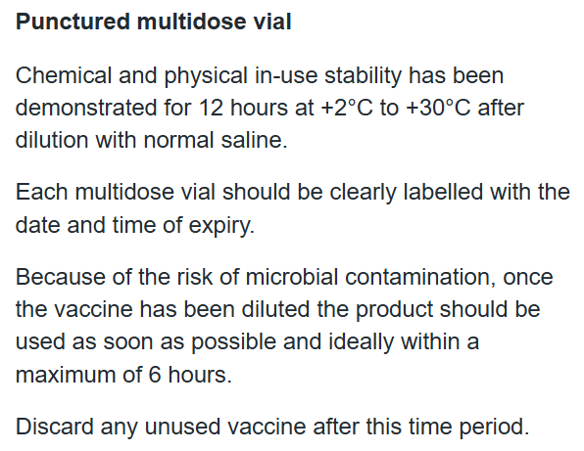
Notes:
*The mRNA encoding LP.8.1 is a single-stranded, 5'-capped messenger RNA (mRNA) produced using a cell-free in vitro transcription from the corresponding DNA templates, encoding the viral spike (S) protein of SARS-CoV-2 (Omicron LP.8.1).
Comirnaty LP.8.1 3 micrograms/dose concentrate for dispersion for injection, 3-dose vial - Summary of Product Characteristics (SmPC) - (emc) | 101152

Slide 59

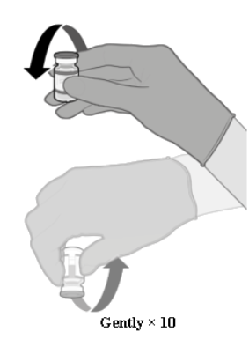
Prior to dilution, the thawed vaccine may contain white to off-white opaque amorphous (of no particular defined shape) particles. If there is discolouration or other particulate matter present, the vaccine should not be administered.
Gently invert the vial 10 times prior to dilution. One inversion means turning the vial upside down and back again (Figure 1). Do not shake the vial.
Invert the ampoule containing the Sodium Chloride 0.9% Solution for Injection diluent and withdraw 1.1 ml slowly to avoid formation of bubbles.
Discard the diluent ampoule and any remaining diluent in it. Do not use any other type of diluent.
Add diluent to the vaccine vial. You may feel some pressure in the vial as you add the diluent. Equalise the vial pressure by withdrawing 1.1 ml of air into the empty diluent syringe before removing the needle from the vial.
Remove the needle from the vial.
Dispose of dilution needle and syringe into a yellow sharps bin.
Gently invert the diluted solution 10 times. One inversion means turning the vial upside down and back again. Do not shake the vial.
The diluted vaccine should be a clear to slightly opalescent dispersion with no particulates visible. Do not use the diluted vaccine if particulates or discolouration are present.
Figure 1 How to correctly invert the vial. Image taken from the previous version of the Summary of Product Characteristics for Comirnaty 3 micrograms/dose vaccine (and as included in prior versions of this session)
Notes:
*The mRNA encoding LP.8.1 is a single-stranded, 5'-capped messenger RNA (mRNA) produced using a cell-free in vitro transcription from the corresponding DNA templates, encoding the viral spike (S) protein of SARS-CoV-2 (Omicron LP.8.1).
Comirnaty LP.8.1 3 micrograms/dose concentrate for dispersion for injection, 3-dose vial - Summary of Product Characteristics (SmPC) - (emc) | 101152

Slide 60

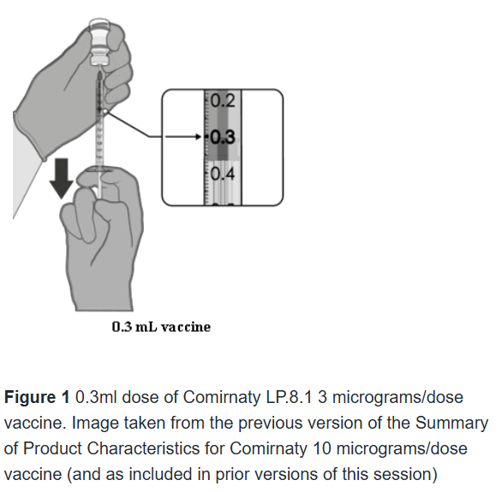
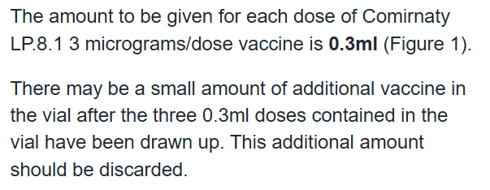
Notes:
*The mRNA encoding LP.8.1 is a single-stranded, 5'-capped messenger RNA (mRNA) produced using a cell-free in vitro transcription from the corresponding DNA templates, encoding the viral spike (S) protein of SARS-CoV-2 (Omicron LP.8.1).
Comirnaty LP.8.1 3 micrograms/dose concentrate for dispersion for injection, 3-dose vial - Summary of Product Characteristics (SmPC) - (emc) | 101152

Slide 61

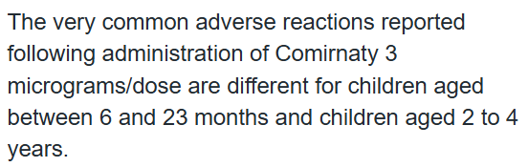
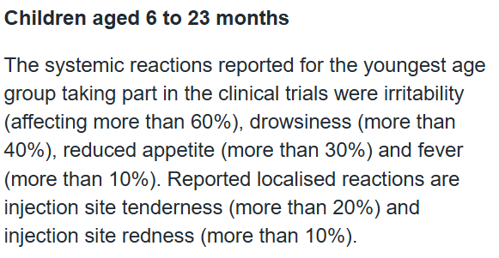

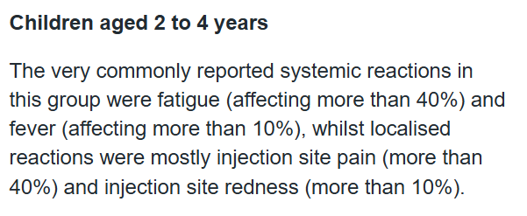
Notes:
*The mRNA encoding LP.8.1 is a single-stranded, 5'-capped messenger RNA (mRNA) produced using a cell-free in vitro transcription from the corresponding DNA templates, encoding the viral spike (S) protein of SARS-CoV-2 (Omicron LP.8.1).
Comirnaty LP.8.1 3 micrograms/dose concentrate for dispersion for injection, 3-dose vial - Summary of Product Characteristics (SmPC) - (emc) | 101152

Slide 62
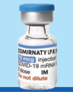
COVID-19 vaccine:
Pfizer-BioNTech Comirnaty 10 LP.8.1
10 micrograms/dose
(paediatric formulation
5 to 11 years)
**Ready-to-use (no dilution)**
Notes:
Comirnaty LP.8.1 10 micrograms/dose dispersion for injection, single dose vial - Summary of Product Characteristics (SmPC) - (emc) | 101151

Slide 63

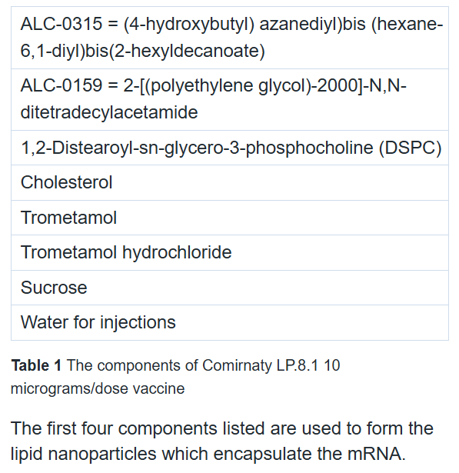
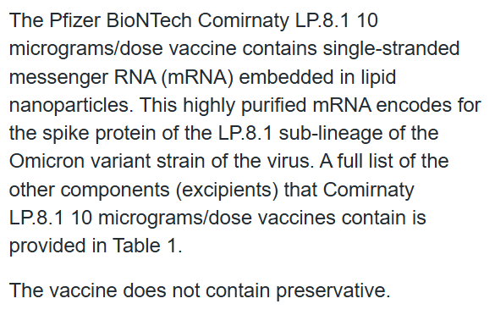
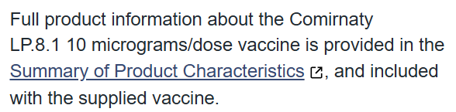
Notes:
*The mRNA encoding LP.8.1 is a single-stranded, 5'-capped messenger RNA (mRNA) produced using a cell-free in vitro transcription from the corresponding DNA templates, encoding the viral spike (S) protein of SARS-CoV-2 (Omicron LP.8.1)
Comirnaty LP.8.1 10 micrograms/dose dispersion for injection, single dose vial - Summary of Product Characteristics (SmPC) - (emc) | 101151

Slide 64

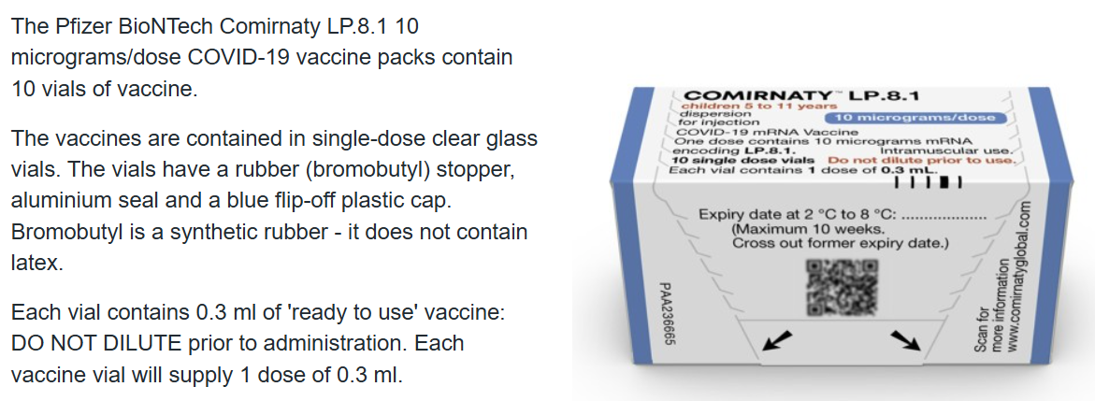
Notes:
*The mRNA encoding LP.8.1 is a single-stranded, 5'-capped messenger RNA (mRNA) produced using a cell-free in vitro transcription from the corresponding DNA templates, encoding the viral spike (S) protein of SARS-CoV-2 (Omicron LP.8.1)
Comirnaty LP.8.1 10 micrograms/dose dispersion for injection, single dose vial - Summary of Product Characteristics (SmPC) - (emc) | 101151

Slide 65

Whilst the Comirnaty LP.8.1 10 micrograms/dose COVID-19 vaccines can be stored frozen for 18 months at temperatures between -90°C and -60°C, they will be delivered to vaccination sites in a thawed state.
Refrigerated vaccine must be transferred immediately to a vaccine fridge on arrival and stored in a carefully monitored temperature range of +2°C and +8°C.
When removed from the freezer, thawed, unopened, Comirnaty LP.8.1 10 micrograms/dose vaccines have a maximum shelf life of up to 10 weeks at +2°C to +8°C within the 18 month shelf life.
When the vaccines are received at +2°C to +8°C the expiry date on the outer carton should have been updated to reflect the refrigerated expiry date (10 weeks after removal from the freezer) and the original expiry date should have been crossed out.
Prior to use, unopened Comirnaty LP.8.1 10 micrograms/dose vaccines can be stored for up to 12 hours at temperatures between +8°C and +30°C.
Vaccines should be stored in their original package to protect them from light. The vials can be handled in room light conditions but exposure to room light should be minimised and exposure to direct sunlight and ultraviolet light should be avoided.
Notes:
*The mRNA encoding LP.8.1 is a single-stranded, 5'-capped messenger RNA (mRNA) produced using a cell-free in vitro transcription from the corresponding DNA templates, encoding the viral spike (S) protein of SARS-CoV-2 (Omicron LP.8.1)
Comirnaty LP.8.1 10 micrograms/dose dispersion for injection, single dose vial - Summary of Product Characteristics (SmPC) - (emc) | 101151

Slide 66

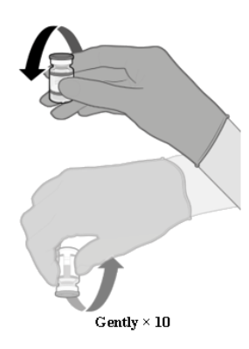
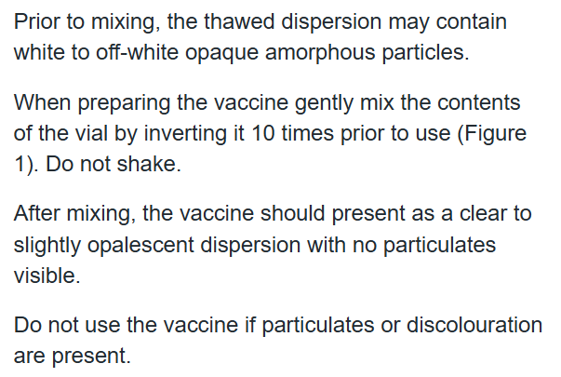
Figure 1 How to correctly invert the vial. Image taken from the previous version of the Summary of Product Characteristics for Comirnaty 10 micrograms/dose vaccine (and as included in prior versions of this session)
Notes:
*The mRNA encoding LP.8.1 is a single-stranded, 5'-capped messenger RNA (mRNA) produced using a cell-free in vitro transcription from the corresponding DNA templates, encoding the viral spike (S) protein of SARS-CoV-2 (Omicron LP.8.1)
Comirnaty LP.8.1 10 micrograms/dose dispersion for injection, single dose vial - Summary of Product Characteristics (SmPC) - (emc) | 101151

Slide 67

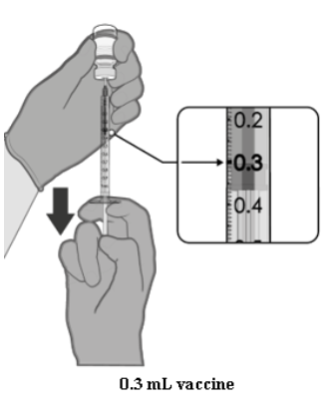
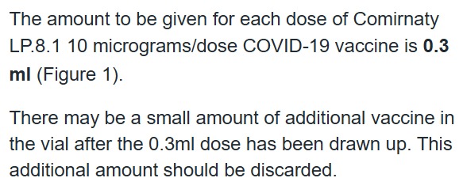
Figure 1 0.3ml dose of vaccine. Image taken from the previous version of the Summary of Product Characteristics for Comirnaty 10 micrograms/dose vaccine (and as included in prior versions of this session)
Notes:
*The mRNA encoding LP.8.1 is a single-stranded, 5'-capped messenger RNA (mRNA) produced using a cell-free in vitro transcription from the corresponding DNA templates, encoding the viral spike (S) protein of SARS-CoV-2 (Omicron LP.8.1)
Comirnaty LP.8.1 10 micrograms/dose dispersion for injection, single dose vial - Summary of Product Characteristics (SmPC) - (emc) | 101151

Slide 68

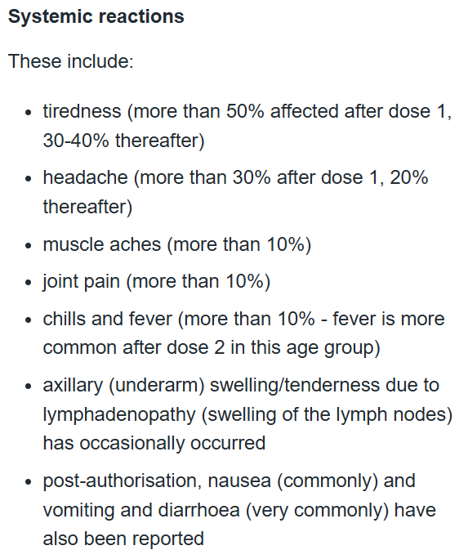
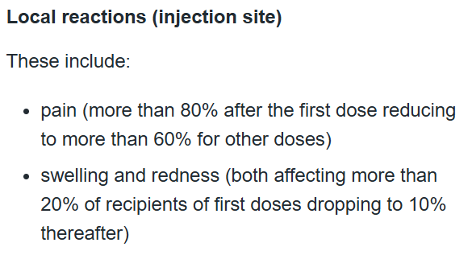

Notes:
*The mRNA encoding LP.8.1 is a single-stranded, 5'-capped messenger RNA (mRNA) produced using a cell-free in vitro transcription from the corresponding DNA templates, encoding the viral spike (S) protein of SARS-CoV-2 (Omicron LP.8.1)
Comirnaty LP.8.1 10 micrograms/dose dispersion for injection, single dose vial - Summary of Product Characteristics (SmPC) - (emc) | 101151

Slide 69

COVID-19 vaccine:
Pfizer-BioNTech Comirnaty 30 KP.2
30 micrograms/dose
(12 to 17 year olds)
**Ready-to-use (no dilution)**
NEW FORMULATION: Pre-filled Syringe
Notes:
Comirnaty KP.2 30 micrograms/dose dispersion for injection - Summary of Product Characteristics (SmPC) - (emc) | 100163

Slide 70

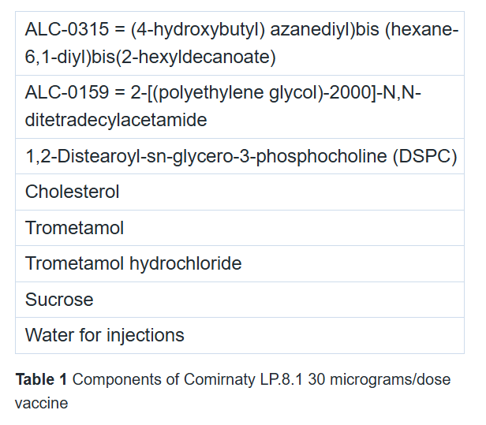
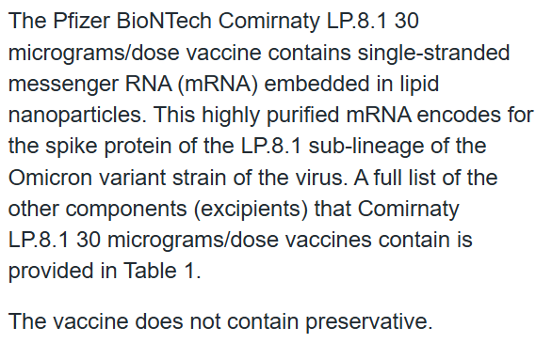
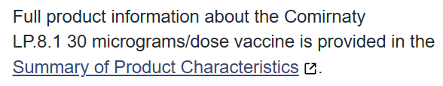
Notes:
Comirnaty KP.2 30 micrograms/dose dispersion for injection - Summary of Product Characteristics (SmPC) - (emc) | 100163
*Cemivameran is a single-stranded, 5'-capped messenger RNA (mRNA) produced using a cell-free in vitro transcription from the corresponding DNA templates, encoding the viral spike (S) protein of SARS-CoV-2 (Omicron KP.2).

Slide 71

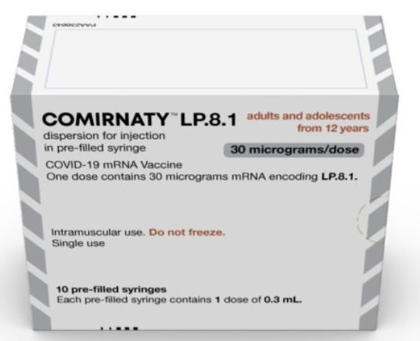
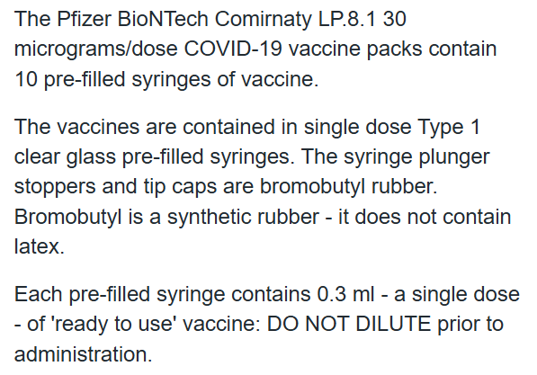
Notes:
Comirnaty KP.2 30 micrograms/dose dispersion for injection - Summary of Product Characteristics (SmPC) - (emc) | 100163
*Cemivameran is a single-stranded, 5'-capped messenger RNA (mRNA) produced using a cell-free in vitro transcription from the corresponding DNA templates, encoding the viral spike (S) protein of SARS-CoV-2 (Omicron KP.2).

Slide 72

Comirnaty LP.8.1 30 micrograms/dose COVID-19 vaccines are refrigerated (not frozen). They will be delivered to vaccination sites at temperatures between +2°C and +8°C
Refrigerated vaccine must be transferred immediately to a vaccine fridge on arrival and stored in a carefully monitored temperature range of +2°C and +8°C.
Comirnaty LP.8.1 30 micrograms/dose vaccines have a maximum shelf life of up to 12 months at +2°C to +8°C.
Prior to use, Comirnaty LP.8.1 30 micrograms/dose vaccines can be stored for up to 12 hours at temperatures between +8°C and +30°C.
Vaccines should be stored in their original package to protect them from light. During storage, exposure to room light should be minimised and exposure to direct sunlight and ultraviolet light should be avoided.
Notes:
Comirnaty KP.2 30 micrograms/dose dispersion for injection - Summary of Product Characteristics (SmPC) - (emc) | 100163
*Cemivameran is a single-stranded, 5'-capped messenger RNA (mRNA) produced using a cell-free in vitro transcription from the corresponding DNA templates, encoding the viral spike (S) protein of SARS-CoV-2 (Omicron KP.2).

Slide 73

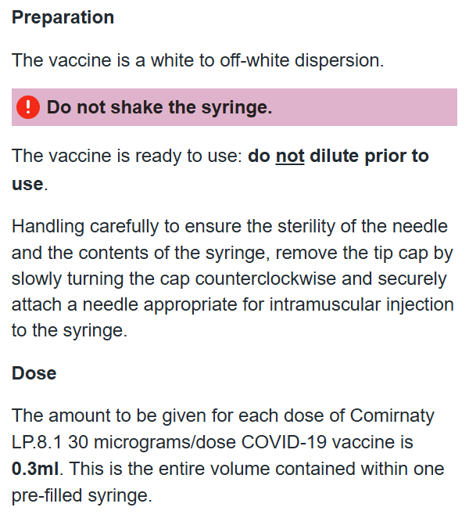
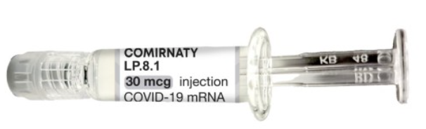
Notes:
Comirnaty KP.2 30 micrograms/dose dispersion for injection - Summary of Product Characteristics (SmPC) - (emc) | 100163
*Cemivameran is a single-stranded, 5'-capped messenger RNA (mRNA) produced using a cell-free in vitro transcription from the corresponding DNA templates, encoding the viral spike (S) protein of SARS-CoV-2 (Omicron KP.2).

Slide 74
The following reactions were reported by the vaccine clinical trial participants
Local reactions
Over 80% reported pain at the injection site. Redness and swelling was also commonly reported
Systemic reactions
The most frequently reported systemic reactions (reactions affecting the whole body) were
tiredness (> 60%) headache (> 50%)
muscle aches (> 30%) chills (> 30%)
joint pain (> 20%) raised temperature (pyrexia)(> 10%)
these symptoms were usually mild or moderate in intensity and resolved within a few days after vaccination
medicines such as paracetamol can be given for pain or fever if required
inform vaccinees these symptoms normally last less than a week but if their symptoms get worse or they are concerned, they should speak to their GP
all boosters led to short term local and systemic reactions, similar to those seen after the primary course, including local pain, fatigue, headache and muscle pain
Notes:
Note: Swollen axilla or neck glands on the same side as the vaccination site can occur as an uncommon reaction, this can last for up to 10 days. If the vaccine recipient is due to attend for a mammogram, they should be advised to inform clinicians regarding date of vaccine administration.

Slide 75
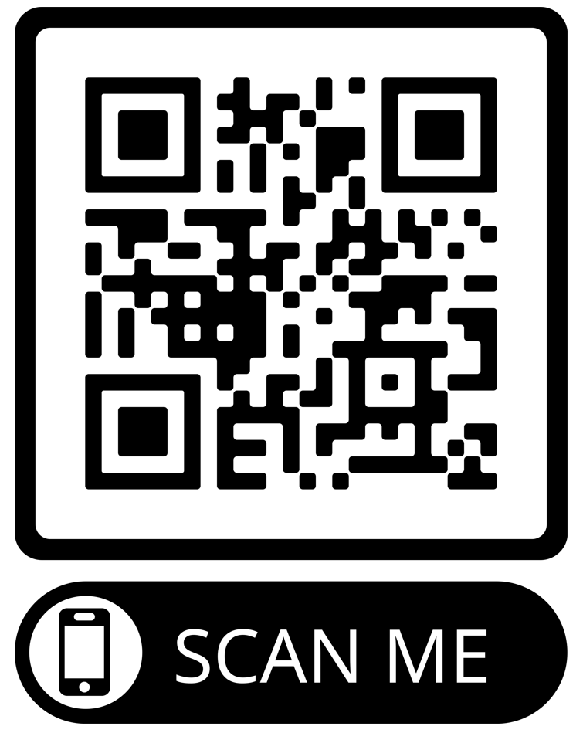

Reporting adverse reactions
Suspected adverse reactions or suspected side effects should be reported to the MHRA through the online Yellow Card COVID-19 | Making medicines and medical devices safer (mhra.gov.uk) or the Yellow Card app.
Anyone (patients and health care workers) can make a Yellow Card report, even if they are uncertain as to whether a vaccine caused the condition.
The COVID-19 vaccines carry a black triangle symbol (▼) (as do all vaccines during the earlier stages of their introduction). This is to encourage reporting of all suspected adverse reactions.
The QR code can be used for quick and easy access to the Yellow Card reporting site

Slide 76
8. Supporting children and further information

Slide 77
Supporting children and young people during vaccination (1)
Getting vaccinated can be daunting for some people, particularly children and young people - they may be anxious, scared or needle phobic.
Top tips for supporting children and young people during vaccination can be found in the linked document: PowerPoint Presentation (england.nhs.uk)
Notes:
https://www.england.nhs.uk/south/wp-content/uploads/sites/6/2021/09/covid-19-top-tips-for-supporting-children-and-young-people-during-vaccination-v1-090821.pdf

Slide 78
Supporting children and young people during vaccination (2)
The e-lfh hub from Health Education England also has a range of useful resources designed to support the delivery of COVID-19 vaccinations to children and young people.
These include modules on paediatric procedural anxiety and distraction techniques.
Notes:
https://portal.e-lfh.org.uk/

Slide 79
Further information (1)
UK vaccine policy can be found in the online publication commonly referred to as the
"Green Book" . This can be found on the Immunisation page of the GOV.UK website
Green Book recommendations are based upon JCVI’s expert opinion and should
always be followed, even when they differ from those made by the vaccine
manufacturer.
UKHSA COVID-19 vaccination: information for healthcare practitioners - GOV.UK (www.gov.uk)
This document provides additional information, answers to frequently asked questions
and actions to take in the event of inadvertent errors.
It is important to read this document before you start vaccinating and also to refer to the
online version regularly as it will be updated as more information becomes available
and to address any issues or frequently arising questions as COVID-19 vaccines are
delivered more widely.
Northern Ireland policy letter 2024: doh-hss-md-11-2024.pdf (health-ni.gov.uk)

Slide 80
Further information (2)
Professional information resources:
Northern Ireland COVID-19 Vaccination Programme | HSC Public Health Agency (hscni.net)
Professional information | HSC Public Health Agency (hscni.net)
Immunisation e learning platform: https://www.elfh.org.uk/programmes/immunisation/
UKHSA COVID-19 vaccination resources: COVID-19 vaccination programme - GOV.UK (www.gov.uk)
Oxford Knowledge Project: COVID-19 vaccines
MHRA guidance on coronavirus (COVID-19)
Notes:
Advice:
JCVI statement on COVID-19 vaccination in 2025 and spring 2026 - GOV.UK
DoH HSS CMO Policy Letter:
HSS MD 07 2026 - END OF COVID-19 2025 26 CAMPAIGN AND DETAILS OF SPRING 2026 VACCINATION CAMPAIGN.pdf
PHA Operational Planning Letter:
Autumn-25-26-Flu-Covid-19-Programme-PHA-OPERATIONAL-LETTER-08092025.pdf

