Slide 1
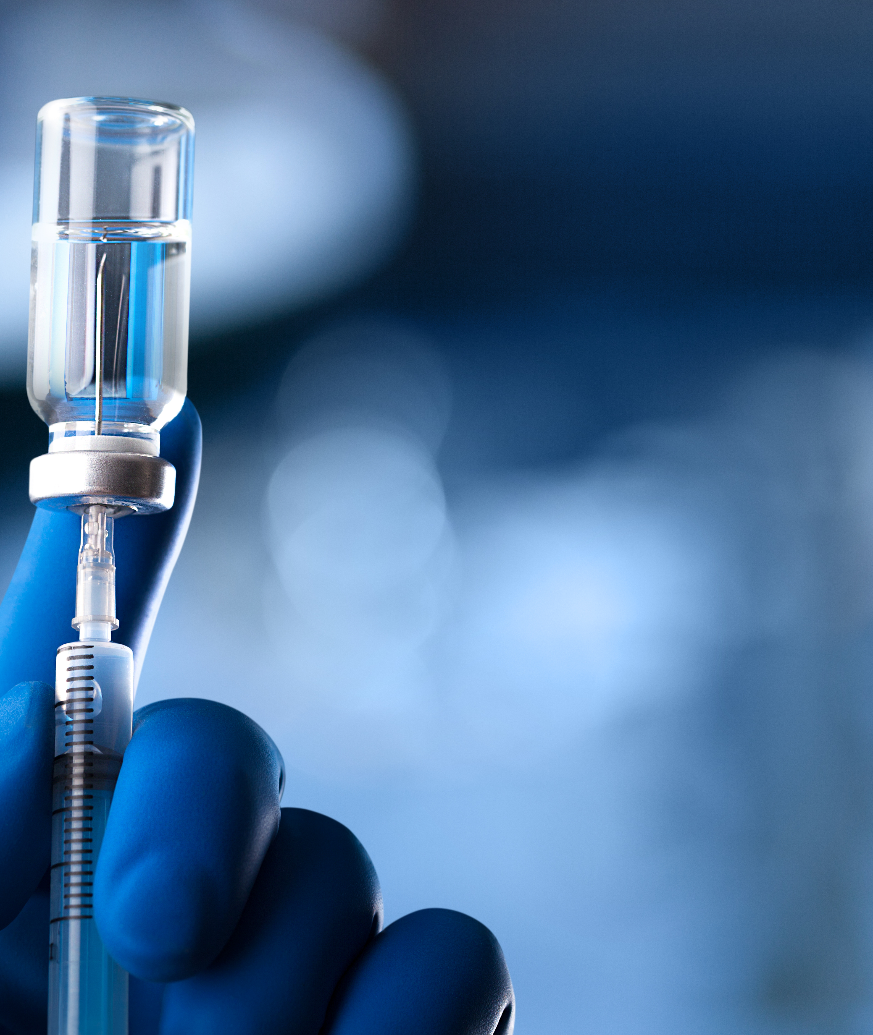

Pneumococcal Vaccines: Protecting Those Most at Risk
Acknowledgements to UKHSA for use of their data slides
Immunisation Team
Notes:
Acknowledgments to:
United Kingdom Health Security Agency (UKHSA)
PHA and other colleagues, Vaccine Preventable Surveillance team
Colleagues across Northern Ireland involved in regional Immunisation programmes
Regional Child Health Staff (CHS)

Slide 2
Learning outcomes
Describe pneumococcal disease and epidemiology in Northern Ireland (NI)
Be familiar with available pneumococcal vaccines
Understand the indications for immunisation, the current vaccine schedules, special considerations and contraindications

Slide 3
Streptococcus pneumoniae
Pneumococcal disease is the term used to describe infections caused by the bacterium Streptococcus pneumoniae (also known as pneumococcus or S. pneumoniae)
S. pneumoniae is an encapsulated Gram-positive bacteria
S. pneumoniae causes invasive and non-invasive pneumococcal disease. Strains without a capsule rarely cause disease
100 different serotypes (lack of cross-reactivity)
Carriage is common (in the nose and throat)
Transmission is via aerosols, droplets or direct contact with respiratory secretions of someone carrying the organism
Incubation period for pneumococcal disease is not clearly defined but may be as short as 1 – 3 days
Notes:
The capsule is the important determinant of the virulence of the bacteria - S. pneumoniae is an encapsulated Gram-positive coccus.
These bacteria are the most common cause of pneumonia.
There are over 100 different types of serotypes and development of immunity to one serotype has little ability to protect against another strain.
Prior to the routine conjugate vaccination programme (PCV), around 69% of invasive pneumococcal infections were caused by the ten (14, 9V, 1, 8, 23F, 4, 3, 6B, 19F, 7F) most prevalent serotypes.
Strains without a capsule rarely if ever cause disease.
The organism is found in the throat of about 40% of pre-school children and about 10% of adults - some serotypes of the pneumococcus may be carried in the nasopharynx without symptoms, with disease occurring in a small proportion of infected individuals.
Not all strains cause carriage in the same way.
Transmission is by aerosol, droplets or direct contact with respiratory secretions of someone carrying the organism. Transmission usually requires either frequent or prolonged close contact.

Slide 4
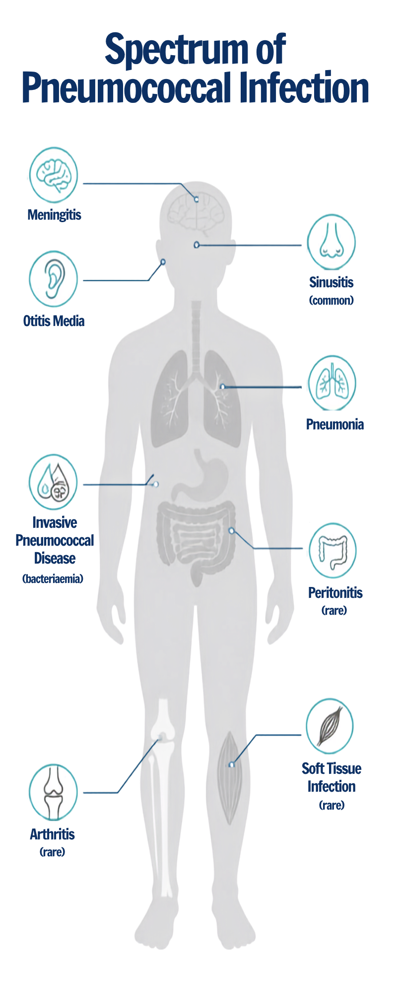
Notes:
Pneumococcus bacteria spreads locally into the sinuses or middle ear cavity, causing sinusitis or otitis media. It may also affect the lungs to cause pneumonia or systemic (invasive) infections including bacteraemic pneumonia, septicaemia and meningitis.
In the UK around 40,000 people a year are hospitalised with pneumococcal pneumonia.
Even with antibiotics, pneumonia still causes death in up to 20% of cases. Worldwide, it is the leading cause of death in children.
Pneumococcal meningitis is fatal in around 15% of children, and a further 25% will have severe, lasting complications; including loss of hearing, loss of sight, learning and speech disabilities, or seizures.
Invasive pneumococcal disease particularly affects very young babies, elderly people and those with weakened immune systems.
Recurrent infections may occur in association with skull defects, cerebrospinal fluid (CSF) leaks, cochlear implants or fractures of the skull.
Reference: Pneumococcal disease | Vaccine Knowledge Project

Slide 5
Epidemiology
Invasive pneumococcal disease (IPD) is a major cause of morbidity and mortality.
As with other respiratory infections, there is a seasonal variation in pneumococcal disease, with peak levels in the winter months
IPD particularly affects the very young, the elderly, and those with impaired immunity and other underlying medical conditions.
Recurrent infections may occur in association with skull defects, cerebrospinal fluid (CSF) leaks, cochlear implants or fractures of the skull.
Other risk groups include the those with an absent or non-functioning spleen, those with immunosuppression and certain underlying medical conditions (please find further information regarding risk groups in Table 2 Pneumococcal the green book chapter (publishing.service.gov.uk)
Notes:
In the UK, around 40,000 people a year are hospitalised with pneumococcal pneumonia. Even with the use of antibiotics, pneumonia still causes death in up to 20% of cases. Worldwide, pneumonia is the leading cause of death in children.
According to the WHO, pneumonia killed over 740,000 children in 2019, and accounts for 14% of all deaths of children under 5 years old.
Pneumonia can be caused by a number of different bacteria, viruses and fungi. However, it is estimated that at least two thirds of all cases of bacterial pneumonia are caused by Streptococcus pneumoniae bacteria.
IPD affects young, elderly and those with an absent / non-functioning spleen and other causes of impaired immunity.
Recurrent infections may occur in association with skull defects, cerebrospinal fluid (CSF) leaks, cochlear implants or fractures of the skull.
Green book chapter 25 - Pneumococcal (publishing.service.gov.uk)

Slide 6
Clinical risk group (Children aged 2 years and over, and adults) | Examples (decision based on clinical judgement)
Asplenia or dysfunction of the spleen | This also includes conditions such as homozygous sickle cell disease, hereditary spherocytosis, thalassemia major and coeliac disease with evidence of splenic dysfunction.
Chronic respiratory disease (chronic respiratory disease refers to chronic lower respiratory tract disease) | This includes chronic obstructive pulmonary disease (COPD), including chronic bronchitis and emphysema; and such conditions as bronchiectasis, cystic fibrosis, interstitial lung fibrosis, pneumoconiosis and bronchopulmonary dysplasia (BPD). Individuals in whom respiratory function may be compromised due to neurological or neuromuscular disease (such as cerebral palsy). Asthma is not an indication, unless so severe as to require continuous or frequently repeated use of systemic steroids (as defined in Immunosuppression below).
Chronic heart disease | This includes those requiring regular medication and/or follow-up for ischaemic heart disease, congenital heart disease, hypertension with cardiac complications, and chronic heart failure.
Chronic kidney disease | Nephrotic syndrome, chronic kidney disease at stages 4 and 5 and those on kidney dialysis or with kidney transplantation.
Chronic liver disease | This includes cirrhosis, biliary atresia and chronic hepatitis.
Diabetes | Diabetes mellitus requiring insulin or anti-diabetic medication. This does not include diabetes that is only diet controlled.
Immunosuppression | Due to disease or treatment, including patients undergoing chemotherapy leading to immunosuppression, bone marrow transplant, asplenia or splenic dysfunction, complement disorder, HIV infection at all stages, multiple myeloma or genetic disorders affecting the immune system (such as IRAK-4, NEMO). Individuals on or likely to be on systemic steroids for more than a month at a dose equivalent to prednisolone at 20mg or more per day (any age), or for children under 20kg, a dose of 1mg or more per kg per day.
Individuals with cochlear implants | It is important that immunisation does not delay the cochlear implantation.
Individuals with cerebrospinal fluid leaks | This includes leakage of cerebrospinal fluid such as following trauma or major skull surgery (does not include CSF shunts).
Occupational risk | Please see page 10 of Pneumococcal Chapter of Green book
People experiencing Homelessness | Rough sleepers and those using homeless hostels or night-shelters
Table 2 - Clinical risk groups who should receive pneumococcal immunisation (Green book)
Notes:
Children and adults in at-risk groups (as outlined in Table 25.2 in the Green Book) may require additional protection against pneumococcal disease. The vaccine(s) and schedule used will depend on the age at presentation, their routine vaccination status and the nature of the underlying condition The Green book of immunisation: chapter 25 - pneumoccocal (publishing.service.gov.uk).
There is an association between exposure to metal fumes and pneumonia, particularly lobar pneumonia, and between welding and invasive pneumococcal disease. PPV23 or PCV20 (single dose for those who have not received PPV23 or PCV20 previously) should be considered for those at risk of frequent or continuous occupational exposure to metal fumes (such as welders) taking into account the exposure control measures in place.
Vaccination may reduce the risk of pneumococcal disease but should not replace the need for measures to prevent or reduce exposure.

Slide 7
Patients age when presenting or first diagnosed with a clinical risk condition | At clinical risk (excluding those with asplenia, splenic dysfunction, complement disorder or severe immunocompromise¹) |  | Asplenia, splenic dysfunction, complement disorder or severe Immunocompromise¹
 | PCV13 | Dose(s) from 2 years of age | PCV20 | Dose(s) from 2 years of age
Infants from birth to one year of age | Routine PCV13 at 16 weeks and one year (on or after first birthday). | *PPV23 or PCV20 at 2 years, at least 4 weeks after last PCV dose | Two PCV20 doses at least 4 weeks apart (commencing with their first visit at 8 weeks of age, or as soon as possible thereafter). Infants diagnosed after 16 weeks who have already received PCV13 should receive two doses of PCV20 with an interval of at least 4 weeks between any doses. Replace routine PCV13 booster dose with a booster dose of PCV20 at one year (on or after the first birthday). | *PPV23 or PCV20 at 2 years, at least 4 weeks after last PCV dose.
One year to two years of age | Routine PCV13 booster at one year (on or after first birthday, irrespective of whether PCV was received under one year of age). | *PPV23 or PCV20 at 2 years, at least 4 weeks after last PCV dose. | Give PCV20 booster at one year (on or after the first birthday). If routine PCV13 booster at one year (on or after the first birthday) already given, then give PCV20 at least 4 weeks later. | *PPV23 or PCV20 at 2 years, at least 4 weeks after last PCV dose
Two years onwards² | No further PCV13 required irrespective of previous PCV vaccination history (if PCV was not received under 2 years of age, it does not need to be given prior to giving the PPV23 or PCV20 dose). | *One PPV23 or one PCV20. | Asplenia, splenic dysfunction or complement disorder: No further PCV13 required irrespective of previous PCV vaccination history. Severely immunocompromised: No further PCV13 Instead give one dose of PCV20 (irrespective of previous PCV vaccination history). | *PPV23 or PCV20 at least 4 weeks after any previous PCV dose.
Table 3 – Summary of vaccine doses for individuals in a clinical risk group (Green book)
*PCV20 became available to order for adults from 65 years of age and the at-risk programme in early 2026. Locally held stocks of PPV23 should be used up first.
Notes:
1. Examples of severe immunocompromise include bone marrow transplant patients, patients with acute and chronic leukaemia, multiple myeloma or genetic disorders affecting the immune system (such as IRAK-4, NEMO). Note that bone marrow transplant recipients under 2 years of age require 2 doses of PCV20 given at least 4 weeks apart, followed by a further dose of PCV20 at 2 years of age (and at least 4 weeks after their previous PCV20 dose), while those aged 2 years and over require 2 doses of PCV20 given at least 4 weeks apart.
2. For individuals with asplenia, splenic dysfunction (including sickle cell disease) or chronic kidney disease, re-immunisation with PCV20 is recommended every 5 years.
Green Book on immunisation Pneumococcal chapter

Slide 8
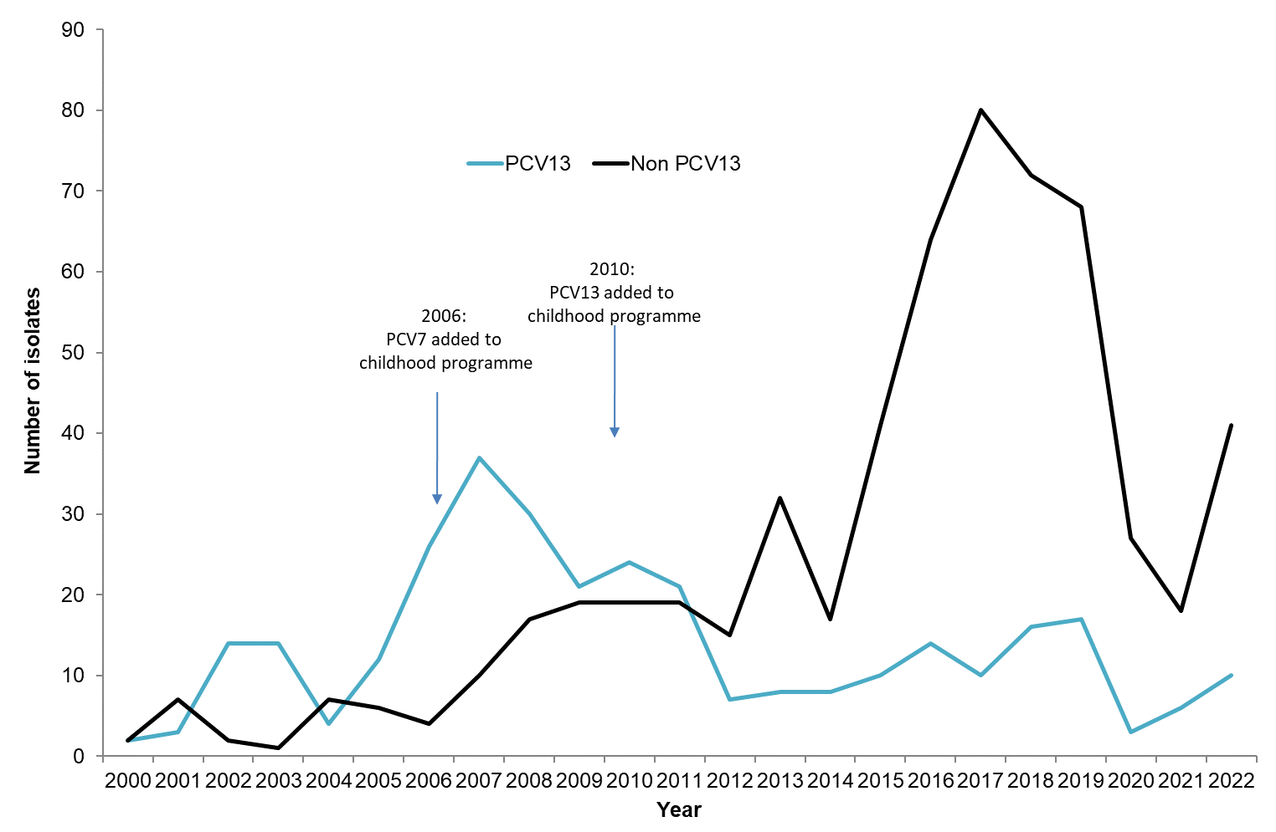
Laboratory confirmed cases of IPD by PCV/non-PCV serogroup, 2000-2022, Northern Ireland
Source: NILIS
2020 data is much lower compared to previous years , this maybe due the COVID-19 pandemic and related lockdown

Slide 9
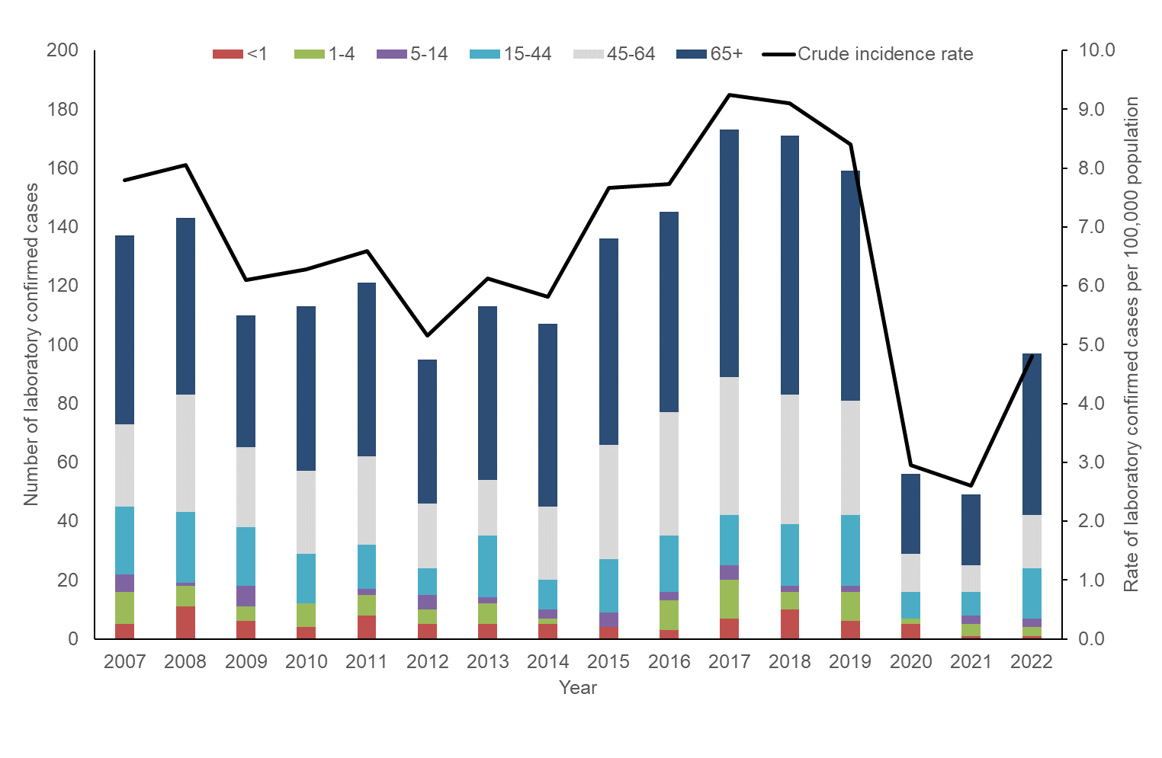
Laboratory confirmed cases of Invasive Streptococcus Pneumoniae by age group, 2007-2022, Northern Ireland
Source: NILIS

Slide 10
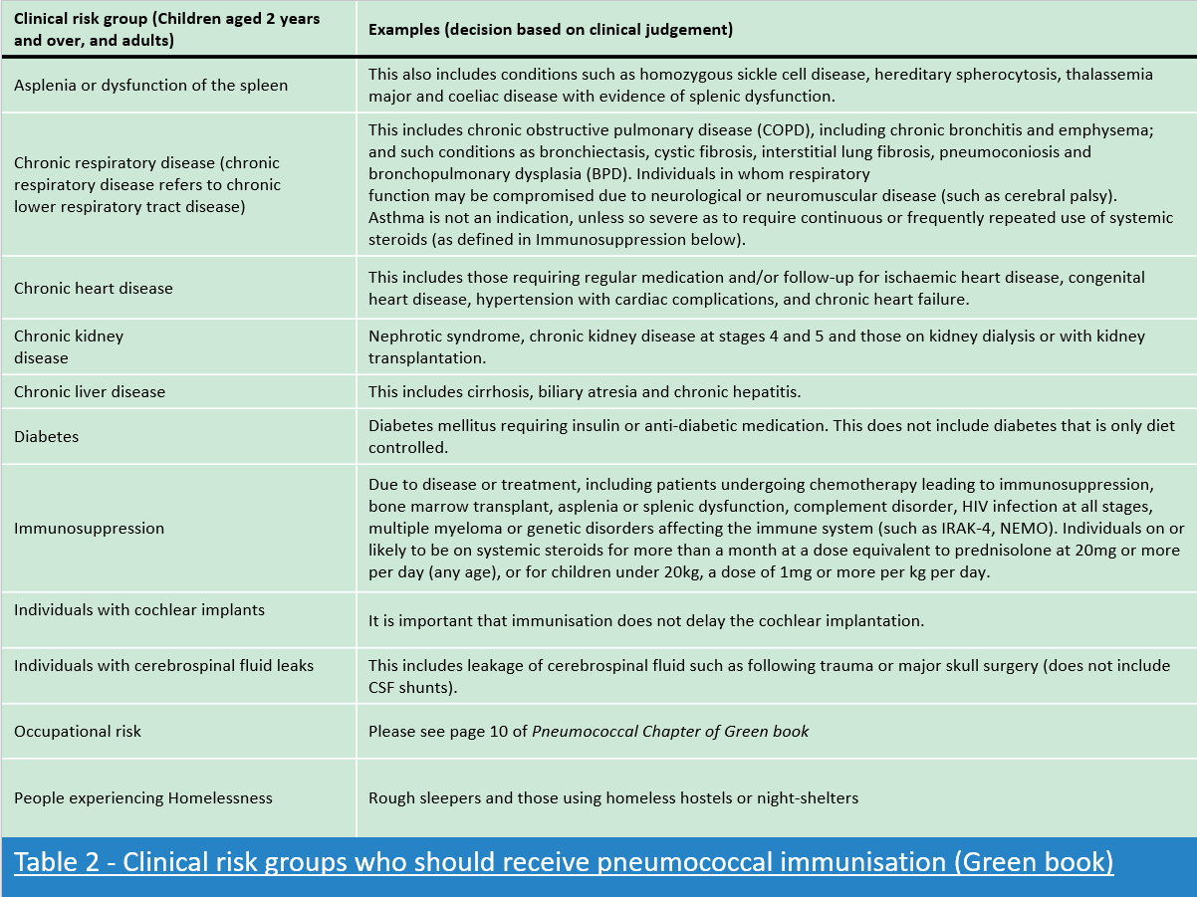
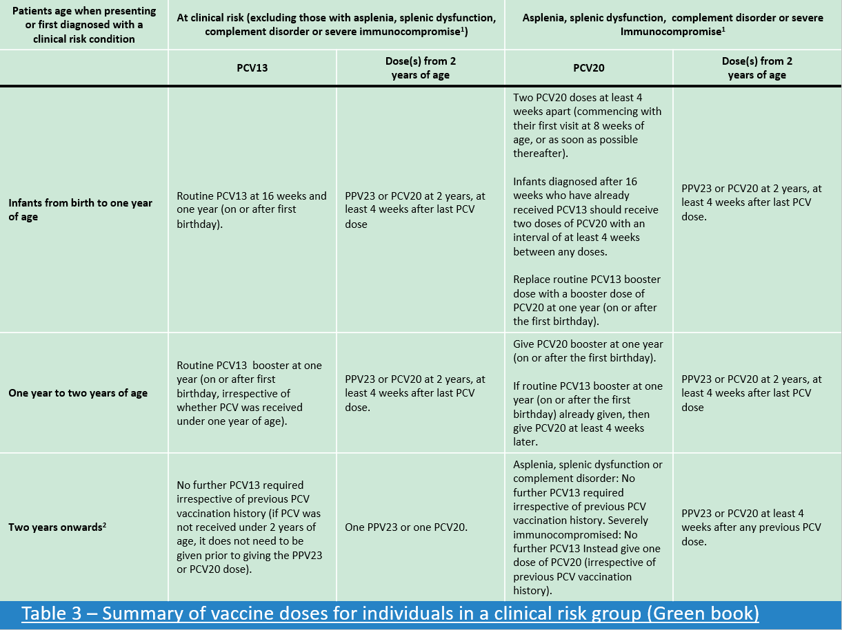
Eligibility
Pneumococcal Immunisation Programme
Routine Programmes
Infants (under two years of age)
Adults (aged 65 years)
2. At Risk Programme
(Children aged 2 years and over, and adults)
See slide 6 – Table 2 of Green book
for clinical risk groups
See slide 7 – Table 3 of Green book
for vaccine dosing
Age due | Diseases protected against | Vaccine given and trade name
Sixteen weeks old | Diphtheria, tetanus, pertussis, polio, Hib and hepatitis B | DTaP/IPV/Hib/HepB | Infanrix hexa or Vaxelis
 | Pneumococcal (13 serotypes) | PCV | Prevenar 13
One year old (on or after the child’s first birthday) | Pneumococcal MenB Measles, mumps, rubella, varicella | PCV MenB MMRV | Prevenar 13 Bexsero ProQuad or Priorix Tetra
65 years old | Pneumococcal (23 or 20 serotypes) | Pneumococcal polysaccharide vaccine (PPV23) or Pneumococcal conjugate vaccine (PCV20) once PPV23 stock exhausted | Pneumovax 23 Prevenar 20
UKHSA Guidance
Green Book – Pneumococcal Chapter
Notes:
1. UKHSA Guidance
2. Green Book – Pneumococcal Chapter
The list of conditions in Table 2 of the Green Book Pneumococcal chapter is not exhaustive and, following assessment, on a case-by-case basis, doctors may use their clinical judgement to advise vaccination of individuals with an equivalent risk.
Requests from secondary care to primary care for any vaccination not covered by the national programme should include a clear rationale and specific details of the vaccines and schedule they would like to their patient to receive. A prescription or PSD will be required. If the rationale or other details are unclear, the primary care clinician being asked to write the prescription or PSD should ask secondary care for this information because they are taking on the legal and professional responsibility for prescribing and administration of a prescription only medicine (POM). The national vaccine stock cannot be used for indications not covered by the Green Book.

Slide 11
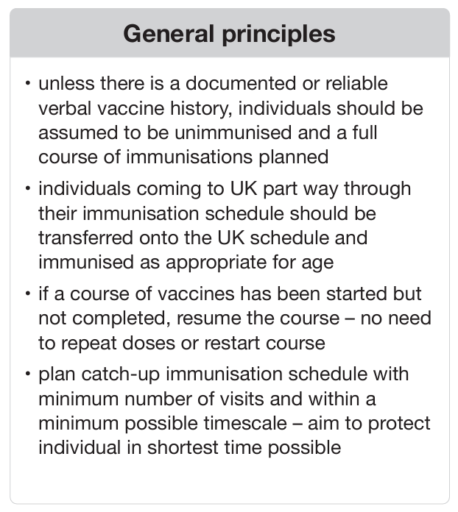
Pneumococcal Immunisation Programme:
Uncertain or Incomplete immunisation status
Infants from eight weeks of age up to first birthday | Children from first up to second birthday
Children require 1 dose of PCV13 in first year of life Children who are aged 16 weeks or over when starting their primary schedule can be given their single infant priming dose of PCV13 with their first set of primary immunisations. If a child has received PCV10 vaccine abroad, they should be offered 1 dose of PCV13 (at least 4 weeks after PCV10 was given and once they are 16 weeks of age). A dose of PCV13, PCV14, PCV15 or PCV20 given abroad from 12 weeks of age counts as a valid dose Children in certain risk groups require 2 doses of PCV20 instead of PCV13. See Green Book Pneumococcal chapter Table 3 | All children require a dose of PCV over the age of 1 year. If a child has received PCV10 vaccine abroad, they should be offered 1 dose of PCV13 (at least 4 weeks after PCV10 was given). PCV14, PCV15 or PCV20 given abroad over 1 year of age counts as a valid dose Children in certain risk groups require a dose of PCV20 instead of PCV13. See Green Book Pneumococcal chapter Table 3
Full UKHSA Algorithm for: Vaccination of people with uncertain or incomplete immunisation - GOV.UK
Notes:
Individuals with unknown or incomplete vaccination histories:
An unimmunised or partially immunised child aged between one and under two years of age should have a single dose of PCV13.
Unimmunised children who present late for vaccination before the age of one year should receive a single priming dose of PCV13, followed by a PCV13 booster at one year of age (on or after their first birthday) ideally allowing a minimum 4 week interval between the priming and booster dose to ensure appropriate boosting of the immune response. If the first PCV dose is given late (within 4 weeks of the first birthday) then a minimum interval of 4 weeks should be observed before the booster dose. However, if in the opinion of the healthcare professional, allowing an interval may lead to further delays in administration of the booster dose, then dose two can be administered after the child’s first birthday, at any interval after the first dose to bring the child up to date with the UK schedule as soon as possible.
For a child in a clinical risk group, if their PCV dose in the routine programme is given very late (for example at 23 months), then a minimum interval of 4 weeks should be observed before giving a booster dose of PPV23 or PCV20 (when available).
Routine immunisation with PCV is not offered after the 2nd birthday unless child is at increased risk of pneumococcal disease
Full UKHSA Algorithm for: Vaccination of people with uncertain or incomplete immunisation - GOV.UK

Slide 12
Pneumococcal vaccines
Two types of pneumococcal vaccine:
1. Pneumococcal Conjugate Vaccine (PCV)
2. Pneumococcal Polysaccharide Vaccine (PPV)
PCV13 (Prevenar 13),
PCV15(Vaxneuvance)
PCV20 (Prevenar 20):
The number in the name corresponds to the number of serotypes covered by the vaccine
Conjugated vaccine (antigens are cross-linked to a protein antigen) to improve antibody response in children from 2 months of age
Direct protection and indirect (herd) protection achieved through the prevention of pneumococcal carriage in the vaccinated child’s nasopharynx.
PCV15 (Vaxneuvance) is currently not included in the UK national immunisation programme.
PPV (Pneumovax 23):
PPV23 contains purified capsular polysaccharide from 23 common capsular types of pneumococcus
Antibodies to capsular polysaccharides produced by the third week following immunisation
Antibody response to PPV in children < 2 years is poor
**PPV23 is discontinued but may continue to be used where local stocks remain. Following depletion or expiry of existing PPV23 stock, PCV20 may be used**
Notes:
The PCV used in the UK gives protection against 13 types of pneumococcal bacteria that all cause pneumococcal disease.
PPV 23 contains purified capsular polysaccharide from each of 23 common capsular types of pneumococcus.
The vaccines do not contain any live bacteria and cannot cause pneumococcal disease.

Slide 13
Changes to UK national immunisation programme:
PPV23 and PCV20
Please note:
Current (from late 2025)
Following a procurement exercise carried out by UKHSA, PCV20 is in use for adults 65 years and over and the at-risk programme
PPV23 is discontinued but may continue to be used where local stocks remain. Following depletion or expiry of existing PPV23 stock, PCV20 may be used

Slide 14
Objectives of pneumococcal childhood programme
To protect all of those for whom infection is likely to be more common/serious:
Infants as part of routine childhood immunisation schedule
Children in clinical risk groups
Notes:
It is estimated that in the first 11 years of the pneumococcal vaccine (PCV) programme (2006-07 to 2016-17), the vaccine prevented nearly 40,000 cases of invasive pneumococcal disease, and about 2000 deaths (Vaccine knowledge project).
PCV (Pneumococcal Conjugate Vaccine) | Vaccine Knowledge Project (ox.ac.uk)

Slide 15
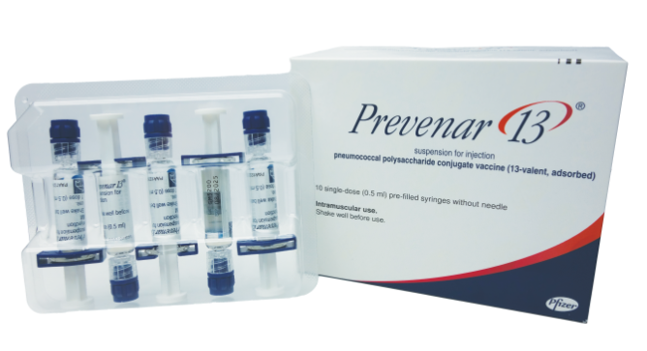
Universal Childhood Programme
Pneumococcal Conjugate Vaccine (PCV13)
Prevenar 13®
Notes:
The brand name of the PCV used in the UK is Prevenar 13.

Slide 16
Pneumococcal Conjugate Vaccine (PCV13)
Vaccine Type | Pneumococcal Conjugate Vaccine (PCV13) inactivated vaccine
Brand Name | Prevenar 13® (Pfizer)
Pneumococcal Serotypes | Contains polysaccharide from 13 common capsular types 1, 3, 4, 5, 6A, 6B, 7F, 9V, 14, 18C, 19A, 19F, 23F. These are conjugated to protein (CRM197)
Administration | The vaccine should be given by intramuscular injection. The preferred sites are the anterolateral aspect of the thigh (vastus lateralis muscle) in infants (1 year and under) or the deltoid muscle of the upper arm in children and adults.
Rationale | Reduces carriage and therefore induces herd immunity
SmPC (Summary of Product Characteristics) | https://www.medicines.org.uk/emc/product/453/smpc
Notes:
Prevenar 13 suspension for injection - Summary of Product Characteristics (SmPC) - (emc) (medicines.org.uk)
Green book Chapter 4 covers guidance on administering vaccines Green-Book-Chapter-4.pdf

Slide 17
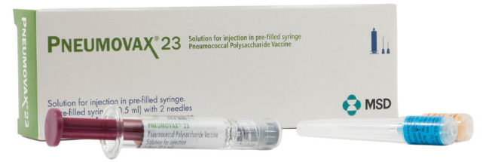
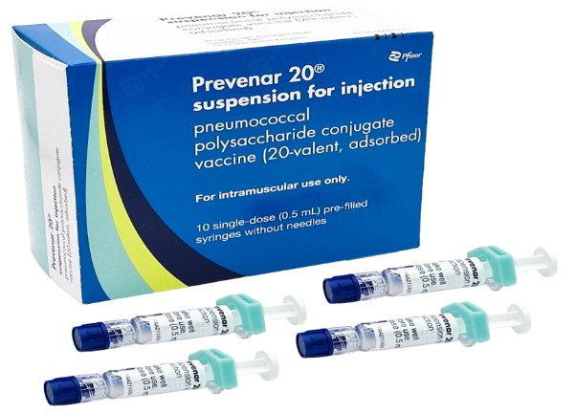
AT RISK AND 65+ ADULT PROGRAMME
Vaccine Type | Vaccine Brand Name | Vaccine Packaging
Pneumococcal Polysaccharide Vaccine (PPV23) | Pneumovax 23
Pneumococcal Conjugate Vaccine (PCV20) | Prevenar 20
**PPV23 is discontinued but may continue to be used where local stocks remain. Following depletion or expiry of existing PPV23 stock, PCV20 may be used**

Slide 18
Objectives of pneumococcal adult programme
To protect all of those for whom infection is likely to be more common/serious:
At-risk groups (refer to table 2 and 3 in green book or slide 6 and 7
Routinely for all adults aged 65 years and older.
Notes:
PPV23 - adults aged 65 years and over, and clinical risk groups aged 2 years or over.

Slide 19
Pneumococcal Polysaccharide Vaccine (PPV23)
Vaccine Type | Pneumococcal Polysaccharide Vaccine (PPV23) inactivated vaccine
Brand Name | Pneumovax 23® (MSD)
Pneumococcal Serotypes | Contains purified capsular polysaccharide from each of 23 capsular types of pneumococcus (PPV23) 1, 2, 3, 4, 5, 6B, 7F, 8, 9N, 9V,10A, 11A, 12F, 14, 15B, 17F, 18C, 19F, 19A, 20, 22F, 23F, 33F
Administration | Intramuscular injection. Preferred site is the deltoid muscle of the upper arm. Subcutaneous if patient has a bleeding disorder.
SmPC (Summary of Product Characteristics) | https://www.medicines.org.uk/emc/product/9692/smpc
**PPV23 is discontinued but may continue to be used where local stocks remain. Following depletion or expiry of existing PPV23 stock, PCV20 may be used**
Notes:
The 23 types included in the vaccine account for about 96% of pneumococcal isolates that cause serious infections. The length of protection is not known and may vary between capsular types.
For individuals with a bleeding disorder, vaccines normally given by an IM route should be given by deep subcutaneous injection to reduce the risk of bleeding Green-Book-Chapter-4.pdf (publishing.service.gov.uk)
Pneumovax 23 solution for injection in pre-filled syringe - Summary of Product Characteristics (SmPC) - (emc) (medicines.org.uk)

Slide 20
Pneumococcal Conjugate Vaccine (PCV20)
Vaccine Type | Pneumococcal Conjugated Vaccine (PCV20) inactivated vaccine
Brand Name | Prevenar 20® (MSD)
Pneumococcal Serotypes | Serotypes covered: 1, 3, 4, 5, 6A, 6B, 7F, 8, 9V, 10A, 11A, 12F, 14, 15B, 18C, 19A, 19F, 22F, 23F, 33F
Administration | Intramuscular injection. Preferred site is the deltoid muscle of the upper arm. Subcutaneous if patient has a bleeding disorder.
SmPC (Summary of Product Characteristics) | https://www.medicines.org.uk/emc/product/13461/smpc
Notes:
The 23 types included in the vaccine account for about 96% of pneumococcal isolates that cause serious infections. The length of protection is not known and may vary between capsular types.
For individuals with a bleeding disorder, vaccines normally given by an IM route should be given by deep subcutaneous injection to reduce the risk of bleeding Green-Book-Chapter-4.pdf (publishing.service.gov.uk)
Pneumovax 23 solution for injection in pre-filled syringe - Summary of Product Characteristics (SmPC) - (emc) (medicines.org.uk)

Slide 21
PPV23 and PCV20 dose and schedule
A single dose is 0.5mL.
Recommended for:
All adults 65+ years
Individuals aged 2 years or over in clinical risk groups.
Individuals experiencing homelessness who are rough sleepers and those using hostels for the homeless or night shelters, or in other accommodation on an emergency / ‘crash bed’ basis only
Antibody levels are likely to rapidly decline in individuals with no spleen, splenic dysfunction or chronic renal disease. Therefore, revaccination recommended every 5 years.
**PPV23 is discontinued but may continue to be used where local stocks remain. Following depletion or expiry of existing PPV23 stock, PCV20 may be used**
Notes:
Children and adults in clinical risk groups will require additional pneumococcal vaccination depending on their age at presentation (diagnosis), vaccination status and underlying condition – see Green Book for further information Immunisation of individuals with underlying medical conditions: the green book, chapter 7 - GOV.UK (www.gov.uk)

Slide 22
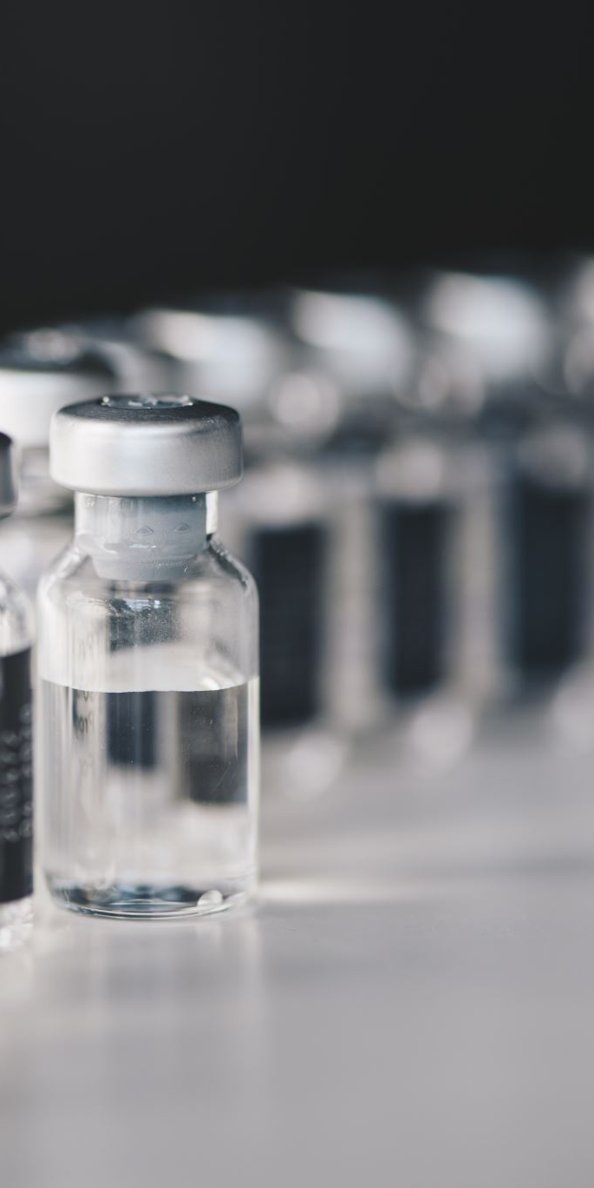
Contraindications
There are very few individuals who cannot receive pneumococcal vaccines.
Pneumococcal vaccines should not be administered to those who have had:
A confirmed anaphylaxis to a previous dose of a pneumococcal vaccine
OR
A confirmed anaphylactic reaction to any component or residue from the manufacturing process.
Minor illnesses without fever or systemic upset are not valid reasons to postpone immunisation.
Notes:
If an individual is acutely unwell, immunisation should be postponed until they have fully recovered. This is to avoid confusing the differential diagnosis of any acute illness by wrongly attributing any signs or symptoms to the adverse effects of the vaccine.
Pneumococcal vaccines can be given to pregnant women when the need for protection is required without delay. There is no evidence of risk from vaccinating pregnant women or those who are breastfeeding with inactivated viral or bacterial vaccines or toxoids.

Slide 23

Side effects (adverse reactions)
Common side effects of PCV and PPV:
Redness
Tenderness and/or swelling at injection site
Irritability
Slightly raised temperature
Loss of appetite
Drowsiness/increased sleep.
Notes:
Common (affecting up to 1 in 10 people at each dose): redness, tenderness and/or swelling at the injection site, slightly raised temperature, irritability, loss of appetite, drowsiness, problems with sleeping.
Many of these symptoms can be relieved by rest and paracetamol (if required).
As with any vaccine, medicine or food, there is a very small chance of a severe allergic reaction (anaphylaxis).

Slide 24

Reporting suspected adverse reactions
Suspected adverse reactions or suspected side effects should be reported to the Medicines and Healthcare Products Regulatory Agency (MHRA) Yellow Card | Making medicines and medical devices safer (mhra.gov.uk) or the Yellow Card app.
Anyone (patients and health care workers) can make a Yellow Card report, even if they are uncertain as to whether a vaccine caused the condition.
Notes:
As with all other vaccines serious adverse reaction after vaccination should be reported using the online yellow card system.

Slide 25
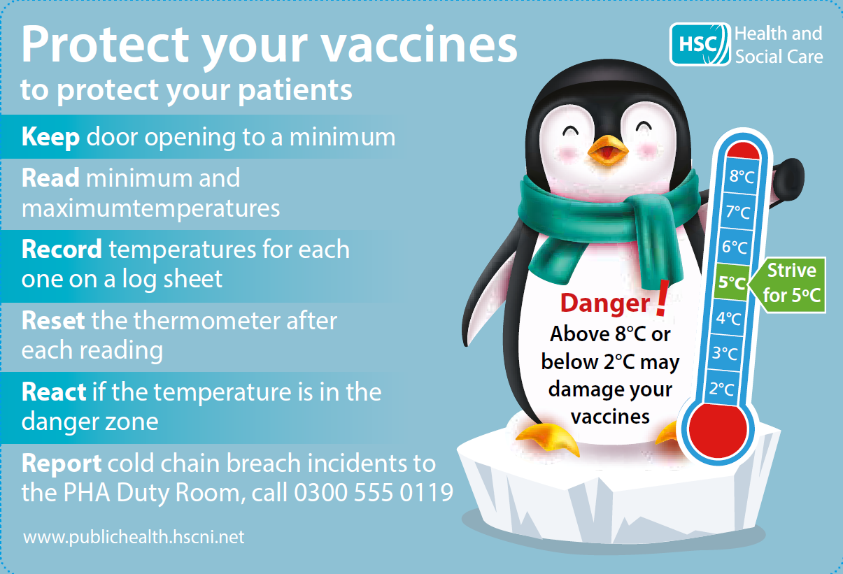
Cold Chain
Vaccines should be stored between 2°C to 8°C
Appropriate action must be taken if there has been a significant breach in cold-chain.
A significant CCB is less than 2°C or more than 8°C for more than 20 minutes
Notes:
Significant Cold Chain Breach – is defined as when vaccines have been subjected to temperatures above 8 degrees C or below 2 degrees C for more than 20 minutes.
Quarantine the CCB’d vaccines - label or mark and notify all members of your team that the vaccines must not be used or disposed of until advised by Medicines Management.
Contact local/regional Medicines Management or your local Trust Pharmacy department for advice. Be prepared to share the relevant information e.g. vaccine details (batch/expiry), number of doses, storage condition data (temperature and times) and any other details.
Report incident to PHA Duty Room again be prepared with the CCB information.
If MI advice is delayed and vaccines are required for an urgent clinic, please contact the PHA immunisation team via email to discuss whether additional vaccine can be released.
Please be prepared to contact patients to reschedule clinics.
After receiving MI advice on the fate of the CCB’d vaccines - please complete and return the Unusable Vaccines Form to PHA Duty Room
If cold chain breached vaccines were used, PHA Duty Room will assist with a risk assessment of whether revaccination will be required.
Consider contacting your SPPG practice support manager for additional support, advice and shared learning.

Slide 26
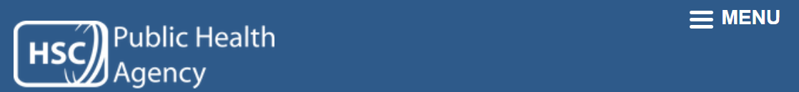


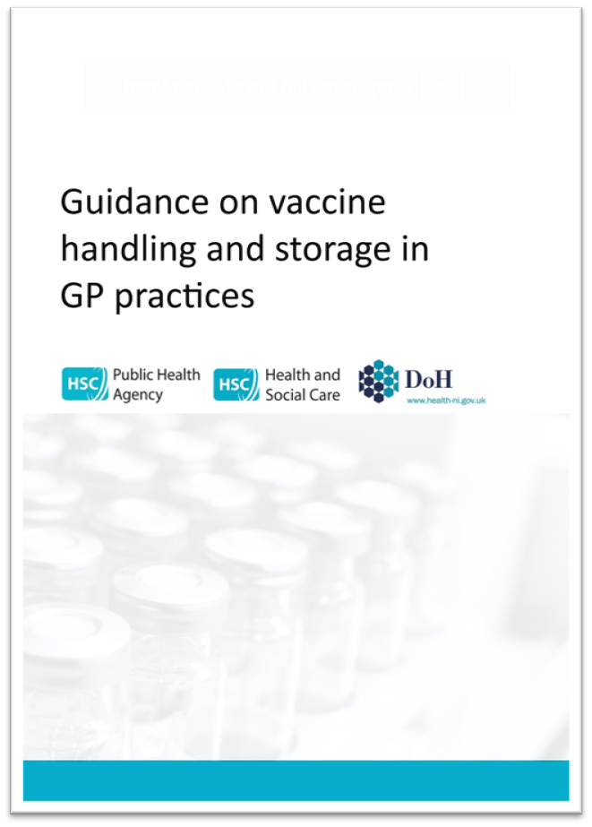
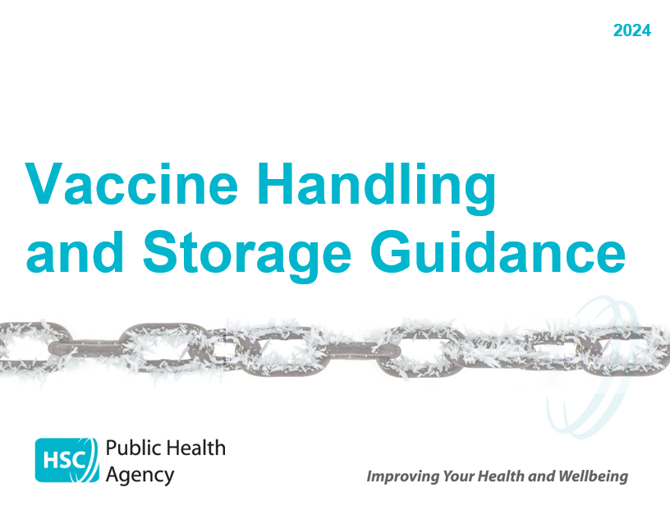

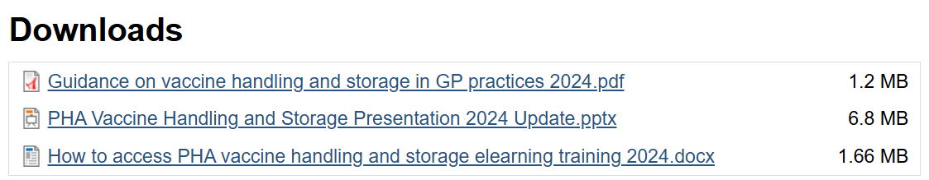
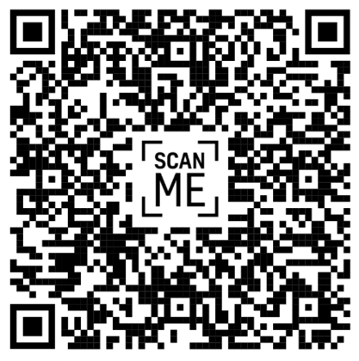
Vaccine Handling & Storage Resources
Information for managing Cold Chain Breaches included
Notes:
You may scan the QR code

Slide 27
Expansion to existing pneumococcal vaccination programme
Key points about the expansion of the pneumococcal vaccination programme:
• Eligible people experiencing homelessness (PEH) are defined as individuals experiencing homelessness who are rough sleepers and those using hostels for the homeless or night shelters, or in other accommodation on an emergency / ‘crash bed’ basis only;
• From October 2026, pneumococcal vaccination should be offered to PEH through existing Trust inclusion services; GPs are asked to facilitate vaccination of people experiencing homelessness, as defined above, on request. GPs can claim the normal Item of Service (IoS) fee for these patients.
• PEH aged 16 years and over will be eligible while retaining a degree of flexibility in practice to accommodate younger individuals experiencing homelessness (as defined above) when / as appropriate;
• PCV20 (Prevenar 20® vaccine) can be co-administered with seasonal influenza vaccine and all other vaccines for which individuals in this cohort may be eligible. Administration of any vaccination presents an opportunity to review an individual’s vaccination history and offer any outstanding vaccinations for which they are eligible; see: Vaccination of individuals with uncertain or incomplete immunisation

Slide 28

CMO Letter for PEH Expansion
HSS MD 35 2026 pneumococcal Vaccination for PEH

Slide 29
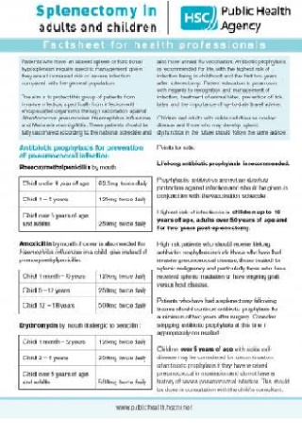
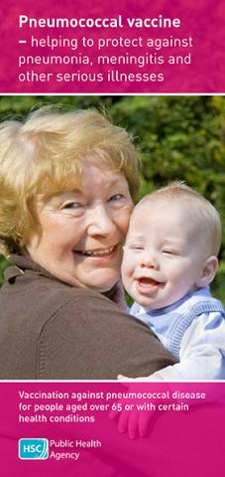
Further resources
Pneumococcal: the green book chapter
Immunisation – e learning for healthcare (e-lfh.org.uk)
Immunisation/vaccine preventable diseases | HSC Public Health Agency (hscni.net)
Publications

