Slide 1

Childhood Influenza (flu) Immunisation
Programme for Northern Ireland
PHA would like to acknowledge the UK Health Security Agency (UKHSA) for sharing their training resources for adaption and use in Northern Ireland
Notes:
This training resource has been designed to deliver core information for healthcare practitioners involved in delivering the childhood flu immunisation programme for the 2024/25 flu season. This resource does not cover all the actual administration techniques involved in vaccination. If staff are required to administer vaccinations they should refer to their line manager for additional training that may be required.

Slide 2
Key messages
the childhood influenza (flu) programme reduces the impact of seasonal influenza on children and reduces transmission of influenza within the community
by reducing transmission of influenza, the programme should also avert many cases of severe influenza and influenza-related deaths in older adults and individuals in clinical risk groups

Slide 3
Learning outcomes
The purpose of this training resource is to:
develop the knowledge base of healthcare practitioners regarding the 2026/27 flu vaccination programme for children
support healthcare practitioners involved in discussing flu vaccination for children with parents and carers by providing evidence based information
promote high uptake of flu vaccine in children through increasing the knowledge of those involved in delivering the vaccination programme
provide information on the administration of the live attenuated intranasal influenza vaccine (LAIV)

Slide 4

Influenza
Influenza (or flu):
is a viral infection affecting the respiratory tract
is highly infectious and spreads rapidly in closed communities
can be spread by people with mild / no symptoms
usually occurs in an 8-10 week period during the winter
Notes:
Influenza virus causes an acute viral infection of the respiratory tract commonly referred to as flu.
Flu is highly infectious and spreads rapidly in closed communities, such as schools. It is possible to have been infected with flu and to have mild symptoms, or remain asymptomatic.
Serological studies in healthcare professionals have shown that approximately 30-50% of influenza infections can be asymptomatic. Asymptomatic people can still transmit flu to other people.
Most cases of flu occur during an 8-10 week period during the winter months but sometimes the flu season can start earlier. It is important that those at higher risk are vaccinated by the end of December to prevent infection.
Green book chapter 19 Influenza (publishing.service.gov.uk)
4

Slide 5
Influenza virus: types
There are three main types of influenza virus
Type
A viruses | cause the majority of seasonal flu cases always the cause of pandemics animal reservoir – birds, wildfowl, also carried by mammals
B viruses | associated with low-level sporadic disease burden of disease mostly in children predominantly found in humans
C viruses | minor respiratory illness only
Notes:
There are three types of influenza virus that can cause disease in humans: A, B & C. Influenza A & B are responsible for most clinical illness.
Influenza A causes the majority of seasonal influenza cases and outbreaks, and it is the usual cause of epidemics/pandemics. The virus is found in many different animal species and may spread between them. Birds, particularly wildfowl, are the main animal reservoir for influenza A.
The burden of Influenza B disease is mostly in children when the severity of illness can be similar to that associated with influenza A.
A fourth type of influenza virus (D virus), primarily affects cattle and is not known to infect or cause illness in humans.

Slide 6

Influenza A virus
Genetic material (RNA) in the centre
Two surface antigens
Two surfce antigens:
Haemagglutinin (H)
Neuraminidase (N)
There are 18 different types of H and 11 different types of N
e.g. H3N2 or H1N1
Notes:
This slide shows a schematic model of an influenza A virus. Influenza A is an RNA virus and there are two antigens on the surface of the virus as illustrated.
The role of the Hemagglutinin (H) antigen is to bind to the cells of the host. There are currently 18 known different types of H surface antigen.
The role of the Neuraminidase (N) antigen is to release the virus from the host cell surface. There are currently 11 known different types of N surface antigen.
The different types of H and N antigens are identified by numbers that when combined provide the name of the influenza A virus e.g. H3N2 / H1N1.
NHSE elfh Hub (e-lfh.org.uk)

Slide 7
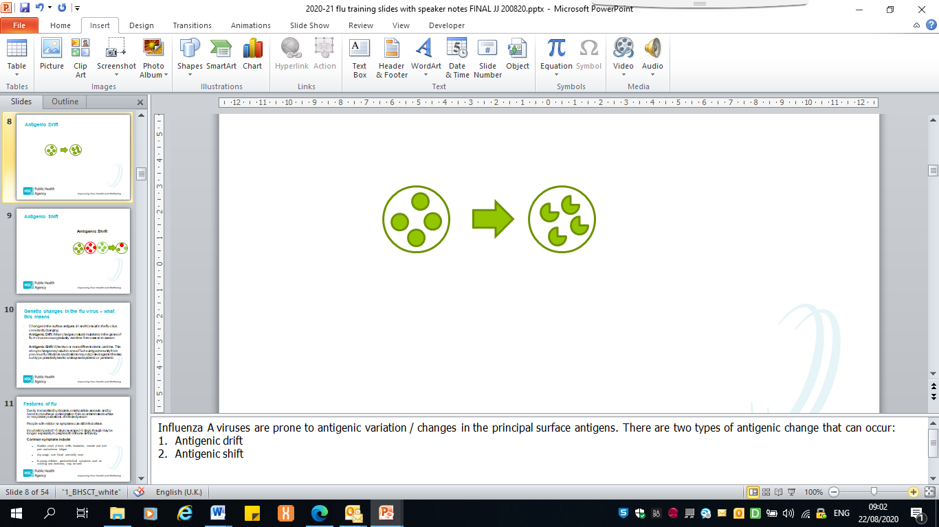
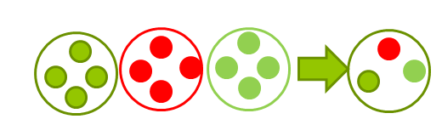
Influenza virus: Genetic changes and what this means
Changes in surface antigens result in the virus constantly changing (mutating).
Antigenic drift: minor changes (natural mutations) in the genes of influenza A viruses that occur gradually over time from season to season..
Antigenic shift: when two or more different strains combine. This abrupt change may result in a new influenza A subtype. Immunity from previous flu infections/vaccinations may not protect against the new subtype, potentially leading to widespread epidemics or pandemics.
The World Health Organisation (WHO) monitors epidemiology throughout the world and advises on the strains of influenza A and B predicted to be circulating in the forthcoming winter. These strains are included in the flu vaccines developed each year.
Notes:
Influenza A viruses are prone to antigenic variation / changes in the principal surface antigens.
Minor changes described as antigenic drift occur progressively from season to season. This means that the circulating strain will differ every year and is the reason why the flu vaccine is given every year, as the content may change.
Influenza A virus can also change abruptly when 2 or more different strains of influenza A combine, resulting in antigenic shift and a new subtype of influenza A, to which little / no immunity exists within the general population. This potentially leads to a widespread epidemic / pandemic.
WHO convenes a group that reviews the global influenza situation (once each year for the northern hemisphere and once for the southern hemisphere) and recommends which influenza strains should go in the seasonal vaccine to be produced by manufacturers for the following season six to eight months later. This recommendation is based on information about the circulating viruses and epidemiological data from around the world at that time.

Slide 8
Influenza: Characteristics
  Easily transmitted by droplets, small-particle aerosols and by hand to mouth/eye contamination from a contaminated surface or respiratory secretions of an infected person.
  People with mild or no symptoms can still infect others.
  Incubation period 1-5 days (average 2-3 days), although may be longer especially in people with immune deficiency (immunosuppression).
  Common symptoms include:
    sudden onset of fever, chills, headache, muscle and joint pain and extreme fatigue
    dry cough, sore throat and stuffy nose
    in young children, gastrointestinal symptoms such as vomiting and diarrhoea, may be seen.
Notes:
Serological studies in healthcare professionals have shown that approximately 30 to 50% of influenza infections can be asymptomatic; but the proportion of influenza infections that are asymptomatic may vary depending on the characteristics of the influenza strain.
In healthy individuals, flu is usually unpleasant but self-limiting with recovery within 2-7 days.
Cases of influenza in the UK tend to occur during an 8 to 10 week period during the winter, however the timing, extent and severity of this ‘seasonal’ influenza can all vary.
Green book chapter 19 Influenza (publishing.service.gov.uk)

Slide 9
Influenza: Complications
Common:
  bronchitis
  otitis media (children), sinusitis
  secondary bacterial pneumonia
Less common:
  meningitis, encephalitis, meningoencephalitis
  primary influenza pneumonia
Risk of complications is higher in:
      children under six months
      older people
      those with underlying health conditions such as respiratory disease, cardiac disease, long-term neurological conditions or immunosuppression
      pregnant women (influenza during pregnancy is also associated with perinatal mortality, prematurity, small for gestational age (SGA) and low birth weight)
Notes:
Primary influenza pneumonia is a rare complication that may occur at any age and carries a high case fatality rate, it was seen more frequently during the 2009 pandemic and the following influenza season.
In children, the risk of serious illness from influenza is higher among children under six months of age, and those with underlying health conditions.
Green Book Chapter 19 Influenza (publishing.service.gov.uk)

Slide 10
Flu epidemiology

Slide 11
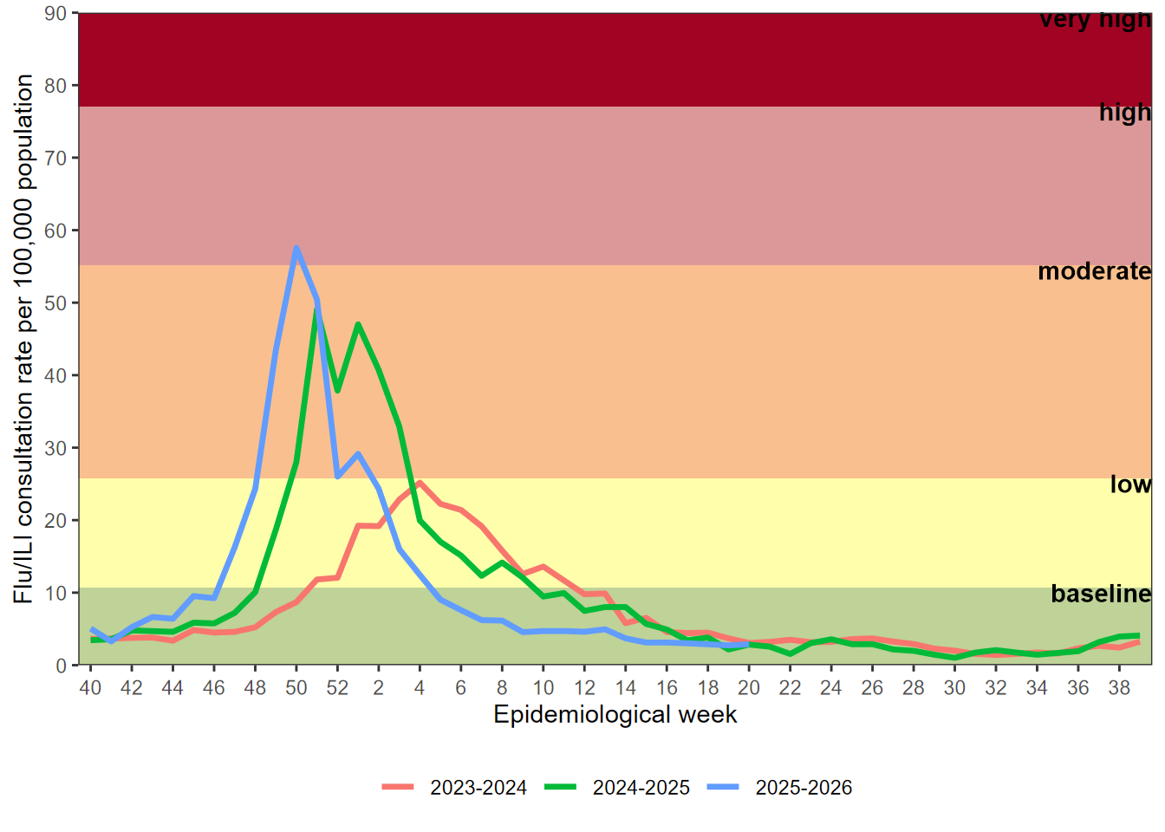
GP influenza/flu-like illness (FLI) consultation rates
Annual all age GP influenza-like illness rates for 2023/24 to 2025/26 and past seasons Respiratory Annual Surveillance Report, Northern Ireland 2025-2026 | HSC Public Health Agency
Notes:
This graph shows the rate of influenza/influenza-like illness episodes in Northern Ireland per 100,000 consultations in primary care for the 2020/21 to 2023/24 flu seasons. The data show that although flu viruses circulate each winter season, the degree of activity varies substantially.
Weekly GP consultations in Northern Ireland in the 2022/23 and 2023/24 seasons were higher than observed in the 2021 to 2022 and 2020 to 2021 seasons, but lower than seen in the 2017 to 2018 season.
Influenza activity in England is monitored by the UK Health Security Agency (UKHSA) Surveillance of influenza and other seasonal respiratory viruses in the UK, winter 2022 to 2023 - GOV.UK (www.gov.uk)

Slide 12
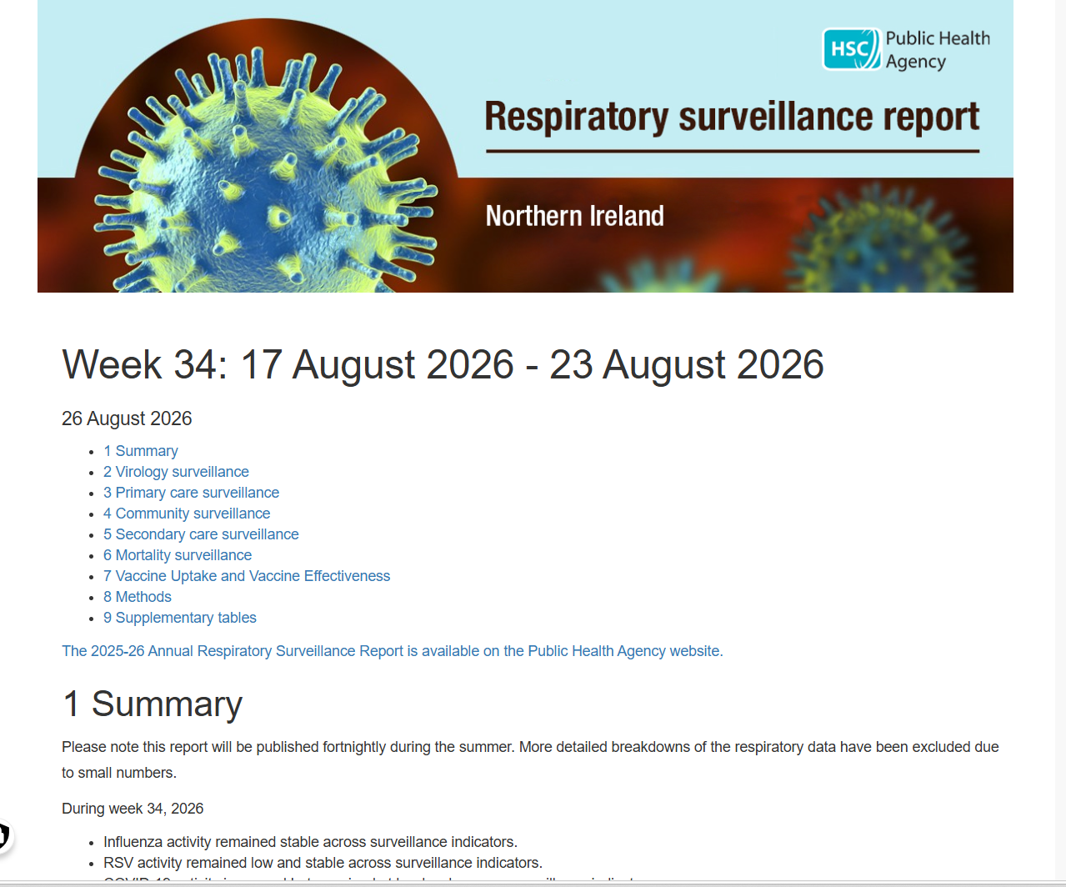
Influenza Weekly Surveillance Bulletin,
Northern Ireland
Public Health Agency weekly Flu Surveillance Bulletin
Notes:
The PHA Health Protection Flu team monitors flu activity throughout the year. This includes information on primary care consultations, laboratory testing and positivity, strain types, indicators of severity including hospitalisations, intensive care admissions, respiratory deaths and excess all-cause mortality.
During the flu season (1st October to end of March) the flu bulletin is available every 2 weeks, and then weekly and can be accessed by PHA website.

Slide 13
History of the national flu vaccination programme
Late 1960s: influenza immunisation recommended in the UK to directly protect those in clinical risk groups at higher risk of influenza associated morbidity and mortality
2000: extended to include all people aged 65 years or over
2010: pregnancy added as a clinical risk group
2014: morbid obesity added as a clinical risk group
2013: all pre-school children from 2 years and primary school children
2020: school aged children in Year 8
2021: extension to 50-64 year olds*, school age children up to Year 12 and household contacts of immunocompromised individuals
2024: flu vaccine programme offer to clinical risk groups, all aged 65 years and over, and all children aged 2 up to school age Year 12
Notes:
* unlike the previous few years, the flu vaccine will not be available during the 2024/25 programme to everyone aged 50-64 years of age; only those aged 50 – 64 who are in a clinical at risk group doh-hss-md-23-2023.pdf (health-ni.gov.uk)
The flu vaccination programme was introduced into NI in the late 1960s and was recommended for those in clinical risk groups that have a higher risk of associated morbidity and mortality. In 2000 the programme was extended to include everyone > 65 years of age. In 2010 pregnancy was added as a clinical risk category for routine flu immunisation. In 2013 the programme was extended to include pre-school children from 2 years and older and all primary school children
In 2020/21, the programme was extended to include Year 8 school children and household contacts of anyone who had received a shielding letter during the COVID-19 pandemic.
In 2021/22, the vaccination programme was further extended to additional cohorts, such as all healthy 50 to 64 year olds, year 9 -12 school children and household contacts of immunocompromised individuals.
In 2023/24, the extension to 50 – 64 year olds was removed.

Slide 14
Rationale for vaccinating children against flu
Extension of the seasonal flu vaccination programme to children aims to considerably lower the public health impact of flu by:
providing direct protection thus preventing a large number of cases of influenza in children
providing indirect protection by lowering influenza transmission from children:
      to other children
      to adults
      to those in clinical risk groups of any age.
Reducing influenza transmission in the community should avert many cases of severe influenza and influenza-related deaths in older adults and people with clinical risk factors.
Studies have shown that administration of flu vaccine to children has reduced GP consultations for influenza-like illness, swab positivity in primary care, laboratory confirmed hospitalisations and percentage of respiratory emergency department attendances.
Notes:
In July 2012, the JCVI recommended extending the annual flu programme to include healthy children aged 2 to 17 in order both to lower the potentially serious impact of flu in vaccinated children and also to have a more profound effect on flu transmission. Children are the main source of transmission in the population, and extending the flu programme to include healthy children should therefore reduce the spread of infection from children to other children, to adults and to those in clinical risk groups of any age.
Reducing flu transmission in the community should avert many cases of severe flu and flu-related deaths in older adults and people with clinical risk factors.
In Northern Ireland the programme was started in pre-school children > 2 years and all primary school children. From 2020/21, the programme has been extended to include Year 8 children in Northern Ireland.
From 2021/2022, the programme has been further extended to included Year 9-12 secondary children.
Since the programme was introduced to pre-school and primary school children in Northern Ireland the levels of GP consultation rates has been lower compared to other parts of the UK and ROI where there was a more limited vaccination programme for healthy children.

Slide 15
Childhood flu vaccination programme 2026/27

Slide 16
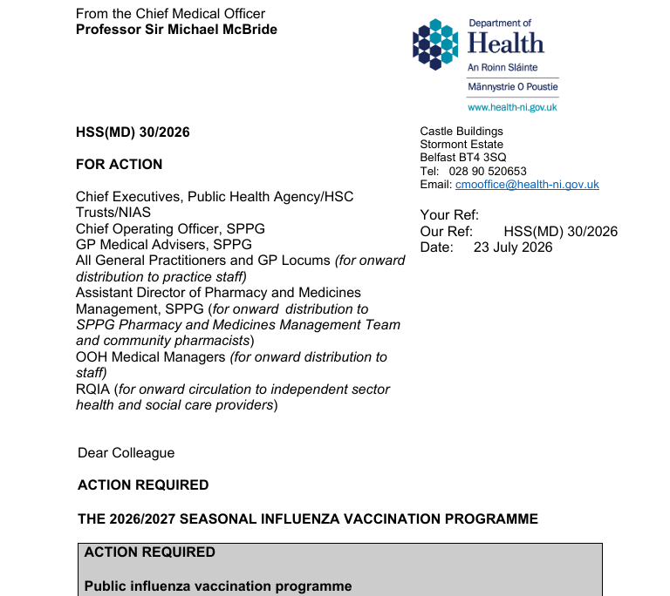
Flu Vaccination Programme: Policy outlined in annual CMO letter 2026/27
  Link to CMO letter published
HSS(MD) 30 2026 - THE 2026 2027 SEASONAL INFLUENZA VACCINATION PROGRAMME.pdf
Notes:
Every year the Department of Health publishes the annual CMO season flu letter. This letter provides information on the policy for the seasonal flu programme in NI. Eligible groups, types of vaccine and other relevant information is included within the letter.

Slide 17
Flu Vaccination Programme: Eligibility
Childhood criteria for 2026/27
those aged 6 months to 17 years in clinical risk groups (as defined by the influenza chapter in ‘Immunisation against infectious disease’ (the ‘Green Book’)
all preschool children aged 2 to 4 years on 1 September 2026
all primary and secondary school children (up to year 12)
those aged 6 months to 17 years who are household contacts of immunocompromised individuals*
16 – 17 year olds who are health and social care workers (HSCWs) and are directly involved in the care of patients or clients
16 – 17 year olds who are in receipt of a carer’s allowance, or those who are the main carer of an elderly or disabled person whose welfare may be at risk if the carer falls ill
Notes:
*consideration should also be given to vaccinating household contacts or carers of immunocompromised individuals, i.e. individuals who expect to share living accommodation on most days over the winter and for whom close contact is unavoidable. Child contacts of very severely immunocompromised individuals should be given inactivated vaccine rather than the live intranasal vaccine (LAIV) that would normally be recommended for children aged 2 to 17 years.
https://www.health-ni.gov.uk/sites/default/files/2025-07/HSS MD 26 2025 - SEASONAL INFLUENZA VACCINATION PROGRAMME 2025 2026.pdf
It is important that preterm infants who have risk factors have their immunisations at the appropriate chronological age. Influenza immunisation should be considered after the child has reached 6 months of age.
Those children who have never received influenza vaccine before and are aged between 2 to 9 years and are in a clinical risk group should be offered a second dose at least 4 weeks later.
Green Book Chapter 19 Influenza (publishing.service.gov.uk)

Slide 18
Flu vaccine: Effectiveness
Vaccine effectiveness (VE) varies from one season to the next.
The UK has a well-established system to monitor flu vaccine effectiveness each season, using data from primary care schemes in England, Scotland, Wales and Northern Ireland.
A recent NI study demonstrated that overall vaccine effectiveness against lab-confirmed influenza was 46% (CI 39.7%-5(60.8%; 95% CI: 48.3% to 70.5%).
Vaccine effectiveness is higher in children aged 2–17 years (60.8%) than in adults aged 18–64 years (40.5%) and ≥ 65 years (42.3%).
Vaccination reduced the odds of hospitalisation due to influenza A(H1) by 44.3% and A(H3) by 49.9%.
While VE is lower in the elderly, immunisation reduces incidence of severe disease, hospital admission and mortality.
Read the full study here: Effectiveness of Influenza Vaccines and Duration of Protection Against Hospitalisation During the 2024/25 Season in Northern Ireland, UK - Bucholc - 2026 - Influenza and Other Respiratory Viruses - Wiley Online Library
Notes:
Influenza activity is monitored in the UK through a variety of schemes based in primary and secondary care. One important indicator is based on reports of new consultations for influenza-like illness from GP practices, combined with virologic surveillance.
All authorised influenza vaccines need to meet safety, efficacy and quality standards set by the Commission on Human Medicines.
Mismatches between the components in the vaccine and circulating viruses do occur from time to time and explains much of the variation in estimates of vaccine effectiveness. When antigenic drift occurs, vaccination is still recommended as some degree of protection may be conferred against the drifted strain and the vaccine should still offer protection against the other strains in the vaccine.
After immunisation, protective immune responses may be achieved within 14 days.
NHSE elfh Hub (e-lfh.org.uk)
Influenza: the green book, chapter 19 - GOV.UK (www.gov.uk)
International evidence continues to accumulate on the effectiveness of the newer vaccines (ECDC 2020). JCVI keeps its advice on seasonal influenza vaccines under regular review Surveillance of influenza and other seasonal respiratory viruses in the UK - GOV.UK (www.gov.uk)
It is important to remember that flu vaccination remains the best way to protect people from flu. It not only protects people who have received the vaccine, but also those around them.

Slide 19
Flu Vaccination Programme:
2026/27 childhood programme
the list of eligible groups is not exhaustive
clinical judgement should be applied to take account the risk of exacerbating any underlying disease with influenza, as well as the risk of serious illness from influenza itself
those involved in delivering flu vaccine programmes should be familiar with the updated chapter of The Green Book and the HSS CMO seasonal flu letter link .
Notes:
The list of clinical risk groups is not exhaustive and the healthcare practitioner should apply clinical judgement to take into account the risk of influenza exacerbating any underlying disease that a patient may have, as well as the risk of serious illness from flu itself. Flu vaccine should be offered in such cases even if the individual is not in one of the specified clinical risk groups.
Details are included in the Department of Health (NI) HSS CMO letter https://www.health-ni.gov.uk/sites/default/files/2025-07/HSS MD 26 2025 - SEASONAL INFLUENZA VACCINATION PROGRAMME 2025 2026.pdf and Chapter 19 of The Green Book https://www.gov.uk/government/publications/influenza-the-green-book-chapter-19

Slide 20
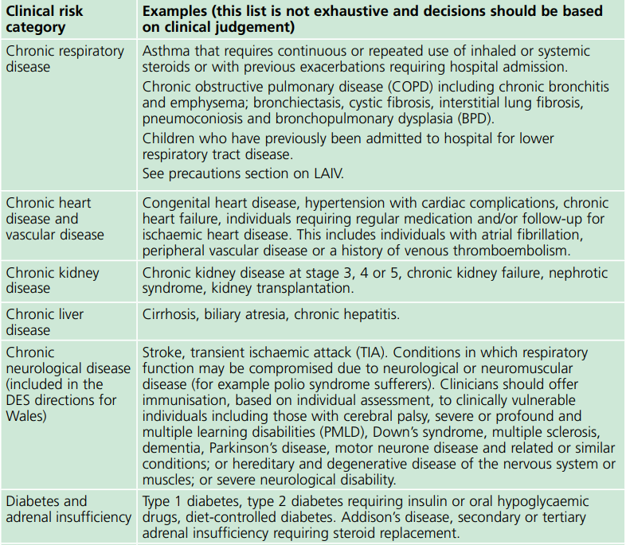
Clinical risk groups
The national flu immunisation programme 2017/18
Notes:
Increasing uptake of flu vaccine is important in clinical risk groups because of the increased risk of death and serious illness if people who are in these groups develop flu. In particular uptake rates in people with chronic liver and neurological disease need to be improved. Some of the highest mortality groups are associated with patients with liver and chronic neurological disease.
Green Book Chapter 19 Influenza (publishing.service.gov.uk)

Slide 21
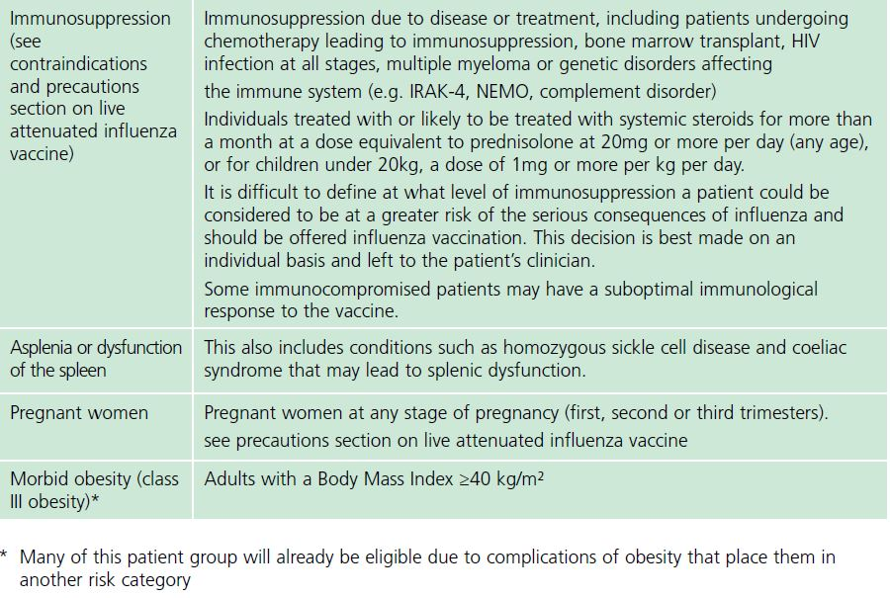
Clinical risk groups (continued)
Notes:
The flu chapter of The Green Book has been updated and those involved in delivering flu vaccine programmes should be familiar with the updated chapter and the HSS CMO letter https://www.health-ni.gov.uk/sites/default/files/2025-07/HSS MD 26 2025 - SEASONAL INFLUENZA VACCINATION PROGRAMME 2025 2026.pdf

Slide 22
Flu Vaccination Programme
Children’s programme uptake rates 2025/26
uptake in 2025/26 for 2-4 year olds was 29.7% compared to 30.0 in 2024/25
59.4% of primary school children were vaccinated against flu during 2025/26 compared to 64.9% in 2024/25
55% of children and young people in years 8 to 12 in secondary schools were vaccinated in 2025/26 compared to 58.5% in the previous year
Notes:
The Public Health Agency Surveillance team have reported flu vaccination uptake for 2023/24 from data extracted from the Vaccine Management System (VMS): Influenza Weekly Surveillance Bulletin, Northern Ireland, 2023/24 | HSC Public Health Agency (hscni.net).
The HSS (MD) 24/2025 letter doh-hss-md-17-2024.pdf (health-ni.gov.uk) sets out the flu uptake for 2023/24.
The HSS(MD) 2025/26 letter:
https://www.health-ni.gov.uk/sites/default/files/2025-07/HSS MD 26 2025 - SEASONAL INFLUENZA VACCINATION PROGRAMME 2025 2026.pdf

Slide 23
Flu Vaccination Programme
2026/27 targets for uptake rates
vaccine uptake varies widely between the individual eligible groups and by age category for those with underlying clinical risk factors
the aim of the influenza programme for 2026/27 is to demonstrate a 100% offer and to exceed the uptake levels achieved amongst each cohort during the 2025/26 programme.
general practices and school providers should ensure all eligible children are offered the opportunity to be vaccinated by an active call mechanism, supplemented with opportunistic offers where pragmatic
the goals outlined by the Department of Health for 2026/27 are to increase uptake rates across all eligible groups, particularly those in at-risk groups, pre-school and secondary school children
Notes:
The Department of Health urge providers to repeat this commitment and resolve in 2024/25, with the goal of increasing uptake rates across all eligible cohorts, particularly pre-school and secondary school children, those in at-risk groups, pregnant women, and frontline HSCWs, where uptake has been disappointing during 2023/24.
The annual flu immunisation programme is a critical element of the system-wide approach for delivering robust and resilient health and care services during the winter.
The HSS(MD) 2025/26 letter:
https://www.health-ni.gov.uk/sites/default/files/2025-07/HSS MD 26 2025 - SEASONAL INFLUENZA VACCINATION PROGRAMME 2025 2026.pdf

Slide 24
Flu vaccines: Types
Two main types of flu vaccine available:
  inactivated – administered by injection (IIVc)
  live attenuated – administered by nasal application (LAIV)
None of the flu vaccines can cause clinical influenza in those that are eligible for the vaccine*
The inactivated and live attenuated flu vaccines supplied for the children’s programme are trivalent vaccines – containing two subtypes of Influenza A and one B virus type.
the inactivated vaccine is recommended for children under the age of 2, and those who cannot receive live attenuated vaccine due to contraindications, or parental preference
Notes:
*the live attenuated influenza vaccine (LAIV), contains live viruses that have been attenuated (weakened) and adapted to cold so that they can only replicate at the lower temperatures found in the nasal passage. These live viruses cannot replicate efficiently elsewhere in the body but may cause mild coryzal symptoms. LAIV should not be given to children or adolescents who are clinically severely immunocompromised due to conditions or immunosuppressive therapy. It is also contraindicated in children and adolescents receiving salicylate therapy (other than for topical treatment of localised conditions).
Inactivated flu vaccines given by intramuscular injection have been used in the UK for many years. The live intranasal influenza vaccine (LAIV) was introduced into the UK schedule in 2013.
Inactivated flu vaccines for 2025/2026 are trivalent formulations, containing two subtypes of influenza A and one B virus. This is a change from last year, where the previous recommended vaccine type was quadrivalent which contained the B/Yamagata lineage which has now been excluded following WHO and JCVI advice.
The live attenuated intranasal vaccine LAIV is also a trivalent preparation.
The inactivated vaccine (IIVc) is available to order for children aged 2 years and over who are contraindicated to receive the LAIV.

Slide 25
Vaccine composition:
Northern Hemisphere 2026/27*
The WHO recommends that trivalent vaccines for use in the 2026-2027 northern hemisphere influenza season contain the following:
Egg-based vaccines
an A/Missouri/11/2025 (H1N1) pdm09-like virus;
an A/Darwin/1454/2025 (H3N2)-like virus; and
a B/Tokyo/EIS13-175/2025 (B/Victoria lineage)-like virus
Cell culture-, recombinant protein- or nucleic acid-based vaccines
an A/Missouri/11/2025 (H1N1)pdm09-like virus;
an A/Darwin/1415/2025 (H3N2)-like virus; and
a B/Pennsylvania/14/2025 (B/Victoria lineage)-like virus
The previous recommendation for the B/Yamagata lineage component of the quadrivalent influenza vaccines are no longer included as per WHO and JCVI:
a B/Phuket/3073/2013 (B/Yamagata lineage)-like virus.
Notes:
*The World Health Organization (WHO) convenes a group that reviews the global influenza situation (once each year for the northern hemisphere and once for the southern hemisphere) and recommends which influenza strains should go in the seasonal flu vaccines to be produced by manufacturers for the following season six to eight months later. This recommendation is based on information about the circulating viruses and epidemiological data from around the world at that time.
https://www.who.int/news/item/27-02-2026-recommendations-for-influenza-vaccine-composition-for-the-2026-2027-northern-hemisphere-season

Slide 26
Changes to the LAIV for the 2026/2027 flu vaccination programme
when LAIV was first introduced into the annual flu vaccination programme for children in 2013, the vaccine was a trivalent vaccine which contained two type A and one type B influenza virus strains
in 2014, in order to extend protection against flu for children, who are more frequently infected with the B strains than adults, both B strains were included in the LAIV: the quadrivalent LAIV was then offered for the next 10 flu seasons
the quadrivalent LAIV used in Northern Ireland was Fluenz Tetra®
For the 2026/27 flu vaccination programme, the LAIV will be a trivalent vaccine again, and is commercially known as Fluenz®
this follows a recommendation from the WHO in 2023 that the B/Yamagata lineage antigen should be excluded from future influenza vaccines as there have been no confirmed naturally occurring B/Yamagata lineage virus detections after March 2020

Slide 27
Changes to the LAIV for the 2025/2026 flu vaccination programme (continued)
the Joint Committee for Vaccination and Immunisation (JCVI) felt that continuing to vaccinate children with a live vaccine which contained B/Yamagata increased the potential theoretical risk of reassortment (a process by which influenza viruses exchange genetic material with each other which can affect the transmissibility and pathogenicity of the virus and lead to new variants) and the return of circulating B/Yamagata strains
therefore, the JCVI recommended LAIV return to a trivalent formulation
the company who manufacture the only LAIV used in the UK have reformulated their vaccine
the trivalent vaccine will offer the same level of protection against the two A and one B flu virus strains in it as the quadrivalent vaccine and the inactivated flu vaccines are likely to become trivalent vaccines in future flu seasons
Notes:
Green Book Chapter 19 Influenza (publishing.service.gov.uk)

Slide 28
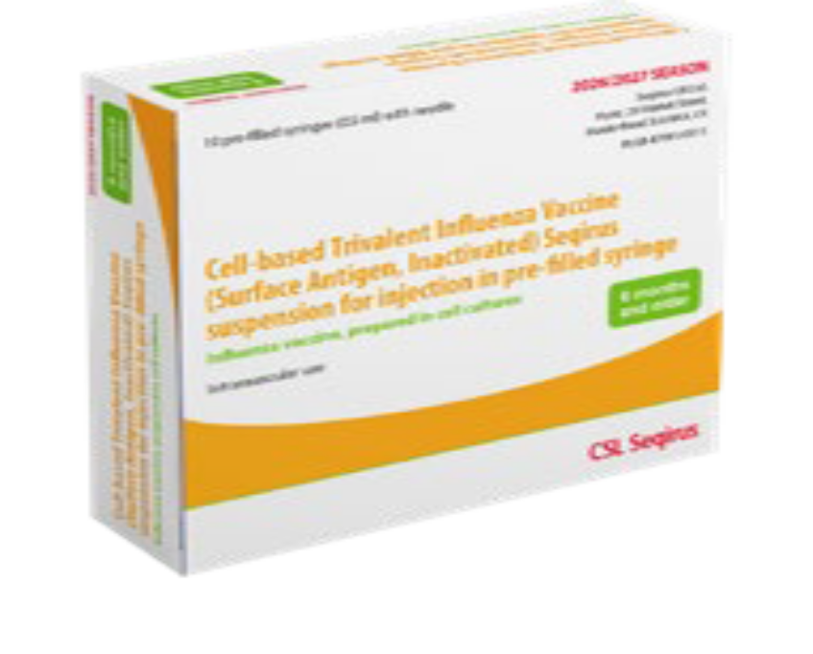
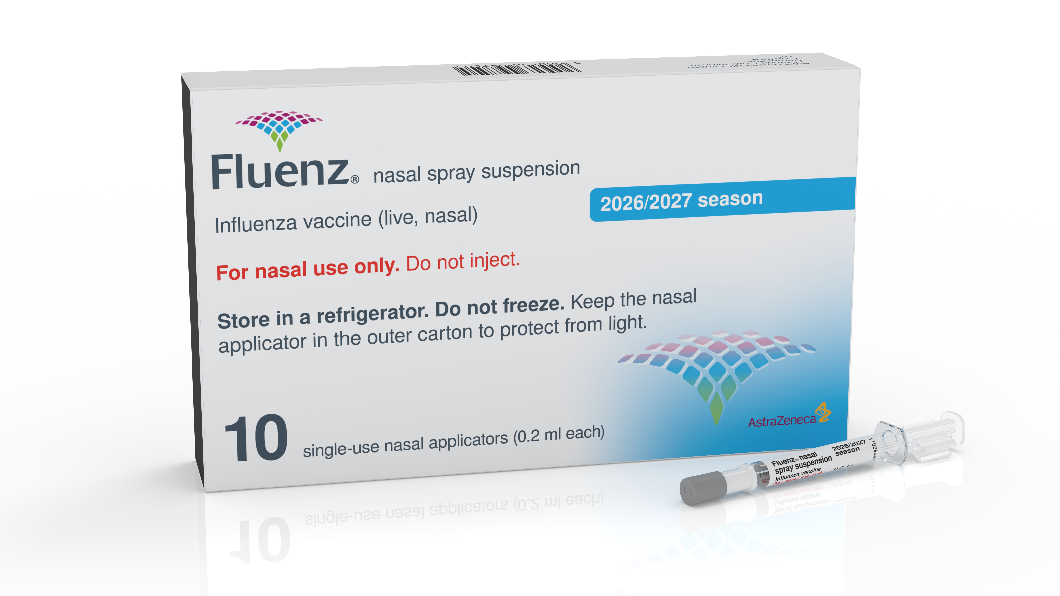
Flu vaccines
Children - Seasonal Flu 2026/27
IIVc
LAIV- Fluenz®
“Live-attenuated”
“cell-based”
Notes:
LAIV = Live Attenuated Influenza Vaccine (commercial brand = Fluenz®)
IIVc = Cell-based, Inactivated Influenza Vaccine (no commercial brand)
Both vaccine formulations are trivalent.

Slide 29
Vaccines procured in Northern Ireland for eligible children in 2026/27
Live attenuated intranasal vaccine (LAIV - Fluenz ®)
children aged 2 - 17 years in school nursing or general practice
Cell-based Inactivated influenza vaccine (IIVc)
children >2 years if LAIV contraindicated in general practice or school nursing
children aged 6 months – 2 years in general practice
Notes:
Green Book Chapter 19 Influenza:
The JCVI have advised that children aged 2 to less than 18 years of age should be offered the live attenuated influenza vaccine (LAIV), unless it is medically contraindicated or otherwise unsuitable.
Some special educational needs (SEN) schools cater for individuals up to 25 years of age. Any young person over 17 years of age in a clinical risk group and in a SEN school can be vaccinated with their peers, using LAIV or IIVc as appropriate.
In those aged 2 to less than 18 years, for whom LAIV is not suitable, JCVI advises the use of IIVc as the preferred choice.
In children aged 6 months to 2 years eligible for influenza vaccination, IIVc is the preferred choice.
There are 2 types of flu vaccine available:
The live attenuated influenza vaccine is administered intranasally and the only vaccine available for use is Fluenz® – this is for children between the age of 2 and 17 years old (up to 18th birthday).
Inactivated flu vaccine is administered by injection - a cell-based trivalent inactivated vaccine IIVc - this is for use in children between the age of 6 months – 2 years and those aged 2 to 17 years old who are unable to receive LAIV.

Slide 30
1. Live attenuated influenza vaccine
LAIV - Fluenz®
Recommended for children from age 2 years to < 18 years
Remains the vaccine of choice for at risk children aged 2 to <18 years – except where contraindicated
Notes:
Fluenz® is a live attenuated intranasal influenza vaccine, formulated as a trivalent vaccine for 2025/2026.
SmPC link: Fluenz nasal spray suspension Influenza vaccine (live, nasal) - Summary of Product Characteristics (SmPC) - (emc) | 15790
As well as being the vaccine of choice for healthy preschool children (from age 2 upwards) and children p1-7 and Years 8-12 (the programme delivered by the school nursing team), Fluenz® is also the vaccine of choice for at-risk children age 2 -17 years inclusive.
LAIV:
has been shown to be more effective in children compared with inactivated influenza vaccines
may offer some protection against strains not contained in the vaccine in addition to those that are, and has potential to offer better protection against virus strains that have undergone antigenic drift
since this vaccine is comprised of weakened whole live virus, it also replicates natural infection which induces better immune memory (thereby offering better longer-term protection to children than from the inactivated vaccines)
LAIV has a good safety profile in children aged two years and older.
It is important to note that some Fluenz stocks may expire (15 week shelf life after released from manufacturer) before the end of December so expiry dates should be checked before use and an effort should be made to try and complete the programme by the end of December.

Slide 31

LAIV (Fluenz®)
  ready to use nasal spray (suspension)
  applicator contains 0.2ml (administered as 0.1ml per nostril)
  LAIV can be administered at the same time as, or at any interval between other vaccines, including live vaccines
  children should breathe normally – no need to actively inhale
  the vaccine is rapidly absorbed so no need to repeat the dose if child sneezes, blows their nose or their nose drips following administration
  one dose required unless:
    child is in a clinical risk group and is under 9 years old and has not previously received a flu vaccine
  if second dose required leave at least 4 weeks between doses
Notes:
Fluenz® is supplied as a single use prefilled nasal applicator.
It is a live attenuated nasal vaccine and must not be injected.
The nasal applicator is ready to use. No reconstitution or dilution is required.
The nasal suspension is colourless to pale yellow, clear to opalescent. Small white particles may be present.
Each applicator of Fluenz (LAIV) contains 0.2ml (0.1ml administered/ nostril).
One dose is required unless the child is in a clinical risk group and is < 9 years old and has not previously received a flu vaccine. If a second dose is required at least 4 weeks interval should be left between doses. If the child attends primary school they will be offered the first vaccine in school but there is no mop up and at-risk children should attend their GP for vaccination if they have missed the first dose and/or require a second dose of vaccine. If Fluenz is not available for use when a child attends for their second vaccine because stocks have expired, the second dose can be replaced with Seqirus quadrivalent inactivated vaccine (IIVc).

Slide 32
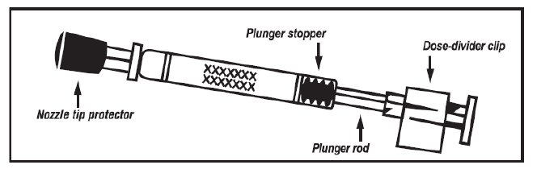
LAIV: applicator
Image taken from Fluenz Tetra® SPC

Slide 33
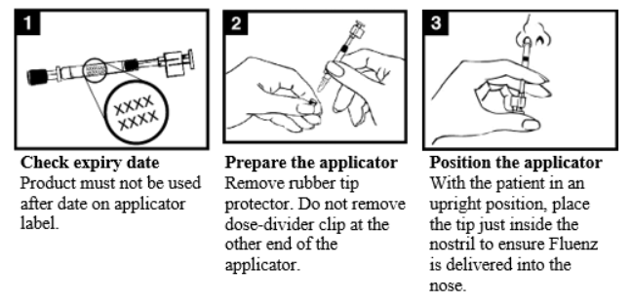
LAIV: Administration (1)
Images taken from Fluenz Tetra® SPC
Notes:
0.1ml per nostril
Check the expiry date - the vaccine must be used before the date on the applicator label.
Prepare the applicator - remove the rubber tip protector. Do not remove the dose divider clip at the other end of the applicator.
Position the applicator – with the patient in an upright position, place the tip just inside the nostril to ensure LAIV is delivered into the nose.

Slide 34
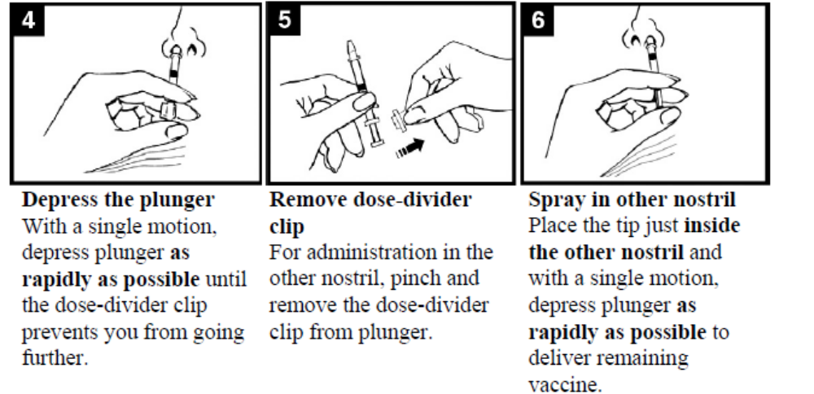
LAIV: Administration (2)
Images taken from Fluenz Tetra® SPC
Notes:
Depress the plunger – with a single motion, depress the plunger as rapidly as possible until the dose-divider clip prevents you from going further.
5. Remove the dose-divider clip (for administration in the other nostril) - pinch and remove the dose-divider clip from the plunger.
6. Spray in other nostril – place the tip just inside the other nostril and with a single motion, depress the plunger as rapidly as possible to deliver remaining vaccine.

Slide 35
2. Cell-based inactivated influenza vaccine
(IIVc)
First line for all children aged 6 months to 2 years who are eligible for the flu vaccine
Second line for children over 2 years with contraindication to Fluenz®
Single intramuscular (IM) injection
One dose schedule required unless: child is in a clinical risk group and under 9 years old and has not previously received a flu vaccine
  if second dose required leave at least 4 weeks between doses
IIVc
“cell-based”
Notes:
IIVc is licensed for adults and children from 6 months of age, formulated as a trivalent vaccine for 2025/2026.
SmPC link: Cell-based Trivalent Influenza Vaccine (Surface Antigen, Inactivated) Seqirus suspension for injection in pre-filled syringe - Summary of Product Characteristics (SmPC) - (emc) | 15818
One dose schedule unless:
child is in a clinical risk group and
< 9 years old and
has not previously received a flu vaccine
Children who have received 1 or more doses of flu vaccine in previous flu seasons should be considered as previously vaccinated and only require a single dose of vaccine.

Slide 36
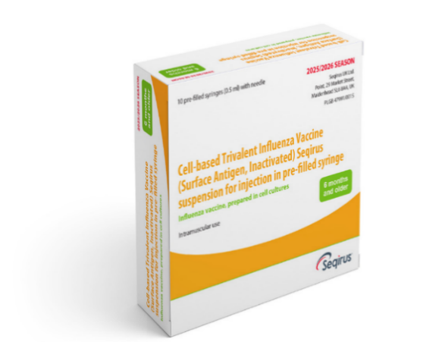
Cell-based inactivated influenza vaccine (IIVc)
IIVc was licensed in the UK in December 2018 for adults and children from 9 years of age. It now also licensed for children from 2 years of age
IIVc is a trivalent vaccine containing two subtypes of Influenza A (H3N2 and H1N1pdm00) and one B virus lineage.
IIVc has a similar safety profile to other flu vaccines (similar rate and type of adverse reactions reported). Millions of doses of cell-based vaccine have been administered with no serious safety concerns
the cell-based vaccine manufacturing process uses an animal cell line (Madin-Darby Canine Kidney or MDCK) to grow the influenza virus rather than the traditional egg based manufacturing methods
this manufacturing process eliminates the risk of egg-adaptation and may result in the vaccine containing virus that is a closer match to wild-type circulating flu viruses
IIVc is egg free
Notes:
IIVc was first licenced in the US in 2016 and was licensed in the UK in December 2018 for adults and children from 9 years of age.
It now also licensed for children from 6 months of age
Cell cultured vaccines such as IIVc should overcome some of the issues associated with egg-adaptation seen in vaccines which use virus grown in eggs (IIVe and IIVe) and which alters the antigenic profile of the A(H3N2) egg propagated vaccine virus compared with the wild type reference strain.
Green Book Chapter 19 Influenza (publishing.service.gov.uk)

Slide 37
Administration of flu vaccines given by injection
The inactivated influenza vaccines should normally be administered by intramuscular (IM) injection into the deltoid muscle in the upper arm (or anterolateral aspect of the thigh in infants).
IIVc is supplied in a single-dose prefilled syringe, containing a 0.5ml dose, and does not require reconstitution.
Patients taking anticoagulants / with bleeding disorder
individuals on stable anticoagulation therapy (including individuals on warfarin who are up-to-date with their scheduled INR testing and whose latest INR was below the upper threshold of their therapeutic range) can receive intramuscular (IM) vaccination
if in any doubt, consult with the clinician responsible for prescribing or monitoring the individual’s anticoagulant therapy.
Notes:
There is a lack of evidence that the subcutaneous route of vaccination is any safer than the intramuscular route in people taking anticoagulants. The subcutaneous route can itself be associated with an increase in localised reactions.
Individuals on stable anticoagulation therapy, including individuals on warfarin who are up-to-date with their scheduled International Normalised Ratio (INR) testing and whose latest INR was below the upper threshold of their therapeutic range, can receive intramuscular vaccination. A fine needle (23 or 25 gauge) should be used for the vaccination, followed by firm pressure applied to the site (without rubbing) for at least 2 minutes.
Immunisation procedures: the green book, chapter 4 - GOV.UK (www.gov.uk)

Slide 38
Storage of all flu vaccine
  Efficacy, safety and quality may be adversely affected if vaccines are not stored at the temperatures specified in the licence.
Must be stored in accordance with manufacturer’s instructions:
  store between +2⁰C and +8⁰C
  do not freeze
  store in original packaging
  protect from light.
Check expiry dates regularly:
  LAIV has an expiry date 15 weeks after manufacture – this is much shorter than inactivated flu vaccines
  it is important that the expiry date on the nasal spray applicator is checked before use.
Notes:
Vaccines should be stored in the original packaging at +2°C to +8°C and protected from light. All vaccines are sensitive to some extent to heat and cold. Heat speeds up the decline in potency of most vaccines, thus reducing their shelf life. Freezing may cause increased reactogenicity and loss of potency for some vaccines and can also cause hairline cracks in the container, leading to contamination of the contents.
LAIV may be left out of the refrigerator/removed from the cold chain for a maximum period of 12 hours at a temperature not above 25°C. If the vaccine has not been used after this 12-hour period, it should be disposed of.
Vaccines are expensive and it is important to minimise wastage through inappropriate storage. We have had a few cold-chain failures recently where practices did not place vaccines in the vaccine fridge on arrival to the practice, resulting in large vaccine losses and it is important to ensure that all staff responsible for handling / storing vaccines have received cold-chain training Guidance on vaccine handling and storage in GP practices | HSC Public Health Agency (hscni.net)
It is also important to check the expiry dates of flu vaccines and to rotate stock to prevent vaccine loss. LAIV has a shelf life of 15 weeks that starts at the point of release from the manufacturer. This is a shorter shelf life than other influenza vaccines and some of this time will have passed when the vaccine reaches the place where it is to be administered. It is important that the expiry date on the nasal spray applicator is checked before use. If the expiry date has passed, arrangements should be made to have the vaccine disposed of safely.

Slide 39
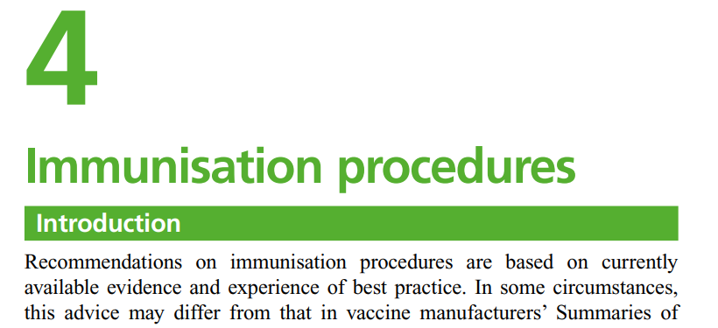
Co-administration of flu and other childhood vaccines
no interval required between inactivated flu vaccines and any other childhood vaccines
if two or more intramuscular vaccines are given at the same time, they should be given in separate sites (preferably a separate limb) and leave at least 2.5 cms between administration sites
LAIV can also be given at the same time as other live or inactivated vaccines
See Green-Book-Chapter-4.
Notes:
There is no interval required between inactivated and live flu vaccines and any other childhood vaccine. If it is necessary to administer the inactivated flu vaccine at the same time as other vaccines e.g. childhood vaccines / school leavers booster, the vaccines should be administered in separate limbs / leave at least 2.5 cms between vaccination sites.
LAIV triggers an immune response in the nasal mucosa. This is unlikely to interfere with the body’s response to other vaccines. Similarly, it’s unlikely that the response to LAIV will be affected by the immune response from intramuscular vaccines.

Slide 40
Contraindications live attenuated flu vaccine (LAIV)
The live attenuated flu vaccine (Fluenz®) should not be given to children or adolescents who are:
clinically severely immunodeficient due to conditions or immunosuppressive therapy, such as:
        acute and chronic leukaemias
        lymphoma
        HIV infection not suppressed by antiretroviral therapy
        cellular immune deficiencies
        high dose corticosteroids
receiving salicylate therapy*
known to be pregnant.
See subsequent slide for children with acute and severe asthma
Notes:
*because of the theoretical risk of Reye’s syndrome following administration of the LAIV to children on aspirin therapy or other salicylate-containing medicine, they should not be given LAIV and should instead be offered an inactivated flu vaccine.
LAIV is not contraindicated for use in children or adolescents:
living with HIV who are receiving antiretroviral therapy and attaining viral suppression
those who are receiving topical corticosteroids, inhaled corticosteroids or low-dose systemic corticosteroids
those receiving corticosteroids as replacement therapy, for example for adrenal insufficiency.
LAIV is contraindicated in children and adolescents receiving salicylate therapy (other than for topical treatment of localised conditions) because of the association of Reye’s syndrome with salicylates and wild-type influenza infection.
Chapter 6 of the Green Book on contraindications and special precautions gives further advice on the use of live vaccines in individuals who are immunosuppressed Contraindications and special considerations: the green book, chapter 6 - GOV.UK (www.gov.uk)
Safety data for the live attenuated flu vaccine when given in pregnancy is limited. Whilst there is no evidence of risk with live attenuated flu vaccine, inactivated flu vaccines are preferred for those who are pregnant. There is no need, however, to specifically test eligible girls for pregnancy or to advise avoidance of pregnancy in those who have been recently vaccinated.

Slide 41
Contraindications (inactivated flu vaccines)
There are very few individuals who cannot receive any flu vaccines.
None of the influenza vaccines should be given to those who have had:
confirmed anaphylactic reaction to a previous dose of the vaccine
confirmed anaphylactic reaction to any component of the vaccine (except ovalbumin - see precautions).
Note: Always refer to SmPC for individual products when deciding which vaccine to give
Notes:
The Summary of Product Characteristics (SmPCs) for individual products should always be referred to when deciding which vaccine to give, these can be accessed via the Electronic Medicines Compendium (EMC) website Home - electronic medicines compendium (emc)
There are very few individuals who cannot receive any flu vaccine.
For children aged 2 years up to their 18th birthday, where live flu vaccine cannot be given, the cell based quadrivalent inactivated vaccine could be given instead.
Confirmed anaphylaxis is rare (see Chapter 8 of the Green Book for further information). Other allergic conditions such as rashes may occur more commonly and are not contraindications to further immunisation. A careful history of the event will often distinguish between true anaphylaxis and other events that are either not due to the vaccine or are not life threatening. In the latter circumstance, it may be possible to continue the immunisation course. Specialist advice must be sought on the vaccines and the circumstances in which they could be given. The risk to the individual of not being immunised must be taken into account.
Green Book Chapter 19 Influenza (publishing.service.gov.uk)

Slide 42
Precautions to flu vaccines
Acutely unwell:
defer flu vaccine until recovered
Heavy nasal congestion:
  defer LAIV until resolved or, if the child is in a risk group, consider inactivated flu vaccine (IIVc) to provide protection without delay
  Cochlear implants:
  children with cochlear implants can be given LAIV safely, although ideally not in the week prior to implant surgery or for 2 weeks afterwards, or if there is evidence of on-going cerebrospinal fluid (CSF) leak
Use with antiviral agents against influenza:
LAIV should not be administered at the same time or within 48 hours of cessation of treatment with influenza antiviral agents
administration of influenza antiviral agents within two weeks of administration of LAIV may adversely affect the effectiveness of the vaccine
Notes:
Minor illnesses without fever of systemic upset are not valid reasons to postpone vaccination. If the individual is acutely unwell, immunisation may be postponed until they have recovered. This is to avoid confusing the differential diagnosis of acute illness by wrongly attributing any signs or symptoms to the adverse effects of the vaccine.
There is no data on the effectiveness of LAIV when given to children with a heavily blocked or runny nose attributable to infection or an allergy. However as heavy nasal congestion might impede delivery of the vaccine to the nasopharyngeal mucosa, deferral of administration until nasal congestion has resolved should be considered or an appropriate alternative influenza vaccine that is administered by injection should be considered.
There is a potential for influenza antiviral agents to lower the effectiveness of the live attenuated influenza vaccine. Administration of influenza antiviral agents within two weeks of administration of LAIV may adversely affect the effectiveness of the vaccine.
Green Book Chapter 19 Influenza (publishing.service.gov.uk)

Slide 43
Acute wheezing and severe asthma
The Joint Committee on Vaccination and Immunisation (JCVI) advise:
children with asthma on inhaled corticosteroids may safely be given LAIV irrespective of the dose prescribed
LAIV is not recommended for children and adolescents currently experiencing an acute exacerbation of symptoms including: - those who have had increased wheezing and/or - needed additional bronchodilator treatment in previous 72 hours
such children should be offered a suitable inactivated influenza vaccine (IIVc) to avoid a delay in protection
children who require regular oral steroids for maintenance of asthma control, or have previously required intensive care for asthma exacerbation should only be given LAIV on the advice of their specialist
as these children may be at higher risk from influenza infection, those who cannot receive LAIV should receive a suitable inactivated influenza vaccine
Notes:
There are limited safety data in children who require regular oral steroids for maintenance of asthma control, or have previously required intensive care for asthma exacerbation – such children should only be given LAIV on the advice of their specialist.
Children with significant asthma and aged under nine years who have not been previously vaccinated against influenza will require a second dose (of either LAIV or inactivated vaccine as appropriate).
Green book chapter 19 Influenza (publishing.service.gov.uk)

Slide 44
Egg allergy
children with an egg allergy that did not result in an intensive care admission can be safely vaccinated with LAIV in any setting (including primary care and schools)
children aged 2 years of age and over with a history of egg allergy that required admission to intensive care for a previous severe anaphylaxis to egg can now be offered IIVc in any setting (including primary care and schools)
Notes:
JCVI has advised that, except for those with severe anaphylaxis to egg which has previously required intensive care, children with an egg allergy can be safely vaccinated with Fluenz® (LAIV) in any setting (including primary care and schools).
Inactivated influenza vaccines that are egg-free or have a very low ovalbumin content (<0.12 micrograms/ml - equivalent to <0.06 micrograms for a 0.5 ml dose) may be used safely in individuals with egg allergy.
LAIV which previously had an upper ovalbumin limit of 1.2 micrograms/ml, has been shown to be safe for use in egg-allergic children.
The ovalbumin content of LAIV has been further reduced since 2016 (≤0.024 micrograms per 0.2ml dose).
Green Book Chapter 19 Influenza (publishing.service.gov.uk)

Slide 45
Porcine gelatine
LAIV contains a highly purified form of gelatine derived from pigs
gelatine is used in LAIV as a stabiliser - it protects the live viruses from the effects of temperature
gelatine is commonly used in a range of pharmaceutical products, including many capsules and some vaccines
there is no other live attenuated flu vaccine available that does not contain porcine gelatine. The manufacturer of LAIV (Fluenz®) tested 40 potential stabilisers – gelatine was chosen because without it, stability was significantly reduced
for eligible children whose parents refuse LAIV due to the porcine gelatine content, the injectable IIVc can be offered

Slide 46
LAIV and ‘viral shedding’
LAIV does not create an external mist of vaccine virus in the air when children are being vaccinated and others in the room should not be at risk of ‘catching’ the vaccine virus
administration of the intranasal vaccine delivers just 0.1ml of fluid straight into each nostril and almost all the fluid is immediately absorbed into the child’s nose
although vaccinated children are known to shed virus a few days after vaccination, the vaccine virus that is shed is less able to spread from person to person than natural flu infection
the amount of virus shed is normally below the levels needed to pass on infection to others and the virus does not survive for long outside of the body. This is in contrast to natural flu infection, which spreads easily during the flu season

Slide 47
Transmission risk from live vaccine
there is a theoretical potential for transmission of live attenuated virus to immunocompromised contacts - risk is for one to two weeks following vaccination with LAIV
extensive use of LAIV in the UK (over 25 million doses) – no reports of illness among immunocompromised patients inadvertently exposed to vaccinated children
however, where close contact with severely immunocompromised patients (e.g. bone marrow transplant patients requiring isolation) is likely/unavoidable (e.g. household members) consider an appropriate inactivated flu vaccine instead
no reports of transmission of vaccine virus in healthcare settings
as a precaution, however, very severely immunosuppressed healthcare workers should not administer LAIV
Notes:
There is a theoretical potential for transmission of live attenuated influenza virus in Fluenz® to immunocompromised contacts for one to two weeks following vaccination.
For children > 2 years of age who are close contacts with severely immunocompromised patients, offer IIVc as an alternative to LAIV.
In theory, healthcare workers may have low level exposure to LAIV viruses during administration of the vaccine and/or from recently vaccinated patients. The vaccine viruses are cold-adapted and attenuated and are unlikely to cause symptomatic influenza.
Green book chapter 19 Influenza (publishing.service.gov.uk)

Slide 48
Inadvertent administration of LAIV
if an immunocompromised individual receives LAIV the degree of immunosuppression should be assessed
if patient is severely immunocompromised, antiviral prophylaxis should be considered
otherwise they should be advised to seek medical advice if they develop flu-like symptoms in the four days following administration of the vaccine
if antivirals are used for prophylaxis or treatment, patient should also be offered inactivated flu vaccine in order to maximise their protection (this can be given straight away)

Slide 49
Adverse reactions
Commonly reported following inactivated flu vaccine:
pain, swelling or redness at the injection site, low grade fever, malaise, shivering, sweating, fatigue, headache, myalgia (muscle pain) and arthralgia (joint pain)
a small painless nodule (induration) may also form at the injection site
these symptoms usually disappear within one to two days without treatment.
Commonly reported following live attenuated flu vaccine:
nasal congestion/rhinorrhoea, reduced appetite, weakness and headache.
Rarely, after live or inactivated vaccine:
immediate reactions such as urticaria, angio-oedema, bronchospasm and anaphylaxis can occur.
Notes:
Rarely immediate reactions such as urticaria, angio-oedema, bronchospasm and anaphylaxis can occur following administration of the inactivated / live vaccine.
The following adverse events have been reported very rarely after influenza vaccination over the past 30 years but no causal association has been established: neuralgia, paraesthesia, convulsions and transient thrombocytopenia, vasculitis with transient renal involvement and neurological disorders such as encephalomyelitis.
Green book chapter 19 Influenza (publishing.service.gov.uk)

Slide 50
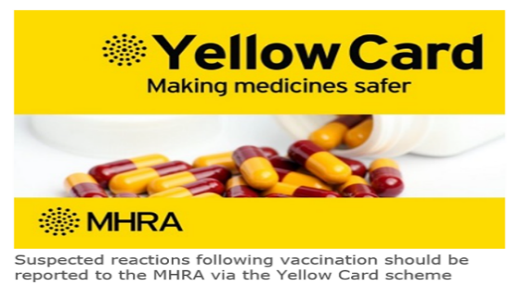

Reporting suspected adverse reactions
Suspected adverse reactions (or side effects) following flu vaccination should be reported to the Medicines and Healthcare Products Regulatory Agency (MHRA) Yellow Card | Making medicines and medical devices safer (mhra.gov.uk) or via the Yellow Card app.
Anyone (patients and health care workers) can make a Yellow Card report, even if they are uncertain as to whether a vaccine caused the condition.
The inactivated quadrivalent flu vaccines (IIVc and aIIV) carry a black triangle symbol (▼) (as do all vaccines during the earlier stages of their introduction). This is to encourage reporting of all suspected adverse reactions.
Notes:
As with all other vaccines serious adverse reaction after vaccination should be reported using the online yellow card system.
The QR code can be used for quick and easy access to the Yellow Card reporting site.

Slide 51
Programme delivery 2026/27

Slide 52
2026/27 childhood flu programme
The 2026/27 flu programme will launch from September 2026
Service providers can commence ordering vaccine stock from mid September 2026. It is advisable to order stock two weeks prior to any planned clinics
Practices can start clinics once they have received the vaccine
Leaflets can be downloaded from PHA web-site
PGDs available from early September
Notes:
The childhood vaccination programme will begin in September 2024, however, those administering the vaccine can and begin offering the vaccine as soon as they have received their first delivery of vaccine. General Practices should receive initial delivery of vaccines before the end of September and should check the Movianto website regularly for updates.
Leaflets should be arriving in General Practices by the last week in August and additional flu leaflets can also be downloaded from the PHA website http://www.publichealth.hscni.net/directorate-public-health/health-protection/immunisationvaccine-preventable-diseases.

Slide 53
When to vaccinate
vaccinate as soon as vaccine available to offer protection before influenza begins to circulate in the community
try to vaccinate by December 2026 before influenza circulation peaks
however, do continue to offer vaccination throughout the season (until 31st March 2027), especially if level of influenza activity is high
remember that immune response following flu vaccination takes about two weeks to develop fully
protection offered by the vaccine is thought to last for at least one influenza season
as antibody levels are likely to reduce in subsequent seasons, and there may be changes to the circulating strains from one season to next, annual revaccination is important
Notes:
Although influenza activity is not usually significant in the UK before the middle of November, the influenza season can start early and therefore the ideal time for immunisation in childhood is between September and early November. After immunisation, protective immune responses may be achieved within 14 days. Protection afforded by the vaccine is thought to last for at least one influenza season. However, as the level of protection provided in subsequent seasons is likely to reduce and there may be changes to the circulating strains from one season to the next, annual revaccination is important.
Protection from the vaccine lasts much longer in children, therefore the priority is to start vaccinating all children (including those in clinical risk groups) from early September, or as soon as vaccine becomes available, both to provide early protection to children and reduce transmission to the wider population.

Slide 54
Children’s vaccination programme
School based
School Health teams offer the flu vaccine to:
all children (including those in a clinical risk group) attending primary school, special school and years 8-12 of secondary school during the 2026/27 academic year i.e. those born between 2 July 2010 to 1 July 2022*
school teams should prioritise special schools for early vaccinations
Notes:
*some children in eligible school years might above have a date of birth outside of the date ranges stated (for instance if a child has been accelerated or held back a year), these children should be offered immunisation along with their class peers.
Children in a clinical risk group that attend a mainstream school should receive their vaccine through the normal school health team arrangements. However, if there is high parental anxiety about a child in one of the clinical risk groups with higher risk of disease and where the school vaccine visit is scheduled later in the season (i.e. after end of November) or if flu starts to circulate earlier than previous sessions, GPs (or their paediatrician if they attend the hospital during the early season) are asked to facilitate where possible earlier vaccination if requested.
Please see Chapter 19 of the Green Book, table 19.1, for relative risk rates of clinical risk groups in flu.

Slide 55
Children’s vaccination programme
General Practice based
GPs should actively call and offer flu vaccine to:
all pre-school children aged two years or more on the 1 September 2026 i.e. those born between 2 July 2022 and 1 September 2024
children who miss their offer of a vaccination in school
young people aged 16 and 17 who are in a clinical risk group and who are born before 2 July 2010
children in at-risk groups for whom LAIV is unsuitable
children aged 6 months to less than 2 years in a clinical risk group
Notes:
Children aged 6 months to less than 2 years - cell-grown quadrivalent influenza vaccine (IIVc)

Slide 56
Vaccine ordering
all injectable flu vaccines are purchased regionally for Northern Ireland
LAIV for children is purchased centrally by UKHSA for the UK
GP practices must order all flu vaccines via the Movianto online website
Trust Pharmacy should order through the normal pharmacy system for school nurses and HSCW programmes
providers are responsible for ordering sufficient flu vaccine and taking all steps to avoid over ordering and vaccine wastage
While there is no shortage of stock, PLEASE Don’t Over Order!
Movianto will deliver within 48 hours of an order being placed, and will deliver as often as needed. Allow up to five days during busier periods (for example, at the beginning of the programme)
only order what you need for the next week
  this avoids large losses if fridge breaks down (cold chain failure) and being left over at end of campaign
vaccine stock cannot be taken back once it has been delivered
Notes:
Please only order the amount of vaccines that you require and do not overstock flu vaccine. Overstocking can result in loss of a large number of vaccines in the event of a cold-chain failure. Movianto will deliver vaccines within your quota on the next working day. Vaccines can not be returned to Movianto once they have been delivered.
It is important to prevent avoidable vaccine losses.

Slide 57
Further resources
HSS(MD) 30 2026 - THE 2026 2027 SEASONAL INFLUENZA VACCINATION PROGRAMME.pdf
Flu healthcare worker’s factsheet
PHA flu page
The Green Book: Influenza Chapter
Flu Immunisation - elearning for healthcare (e-lfh.org.uk)
Flu patient information leaflets
Public Health Agency weekly Flu Surveillance Bulletin
Guidance on vaccine handling and storage in GP practices
Flu immunisation training recommendations - GOV.UK (www.gov.uk)
UKHSA_National_Minimum_Standards_for_immunisation_training_2025.pdf
Notes:
Finally the following resources are available and include:
The Green Book’s revised chapter on influenza vaccination, the HSS CMO letter, flu leaflets and posters and a factsheet on flu vaccination for healthcare workers. PHA have added all of the information on flu (including the flu bulletin) to a separate page on the web-site and this can be accessed via the following link:
https://www.publichealth.hscni.net/directorate-public-health/health-protection/influenza
Vaccine SmPC links to EMC:
LAIV Fluenz nasal spray suspension Influenza vaccine (live, nasal) - Summary of Product Characteristics (SmPC) - (emc) | 15790
IIVc Cell-based Trivalent Influenza Vaccine (Surface Antigen, Inactivated) Seqirus suspension for injection in pre-filled syringe - Summary of Product Characteristics (SmPC) - (emc) | 15818

